Slide 1
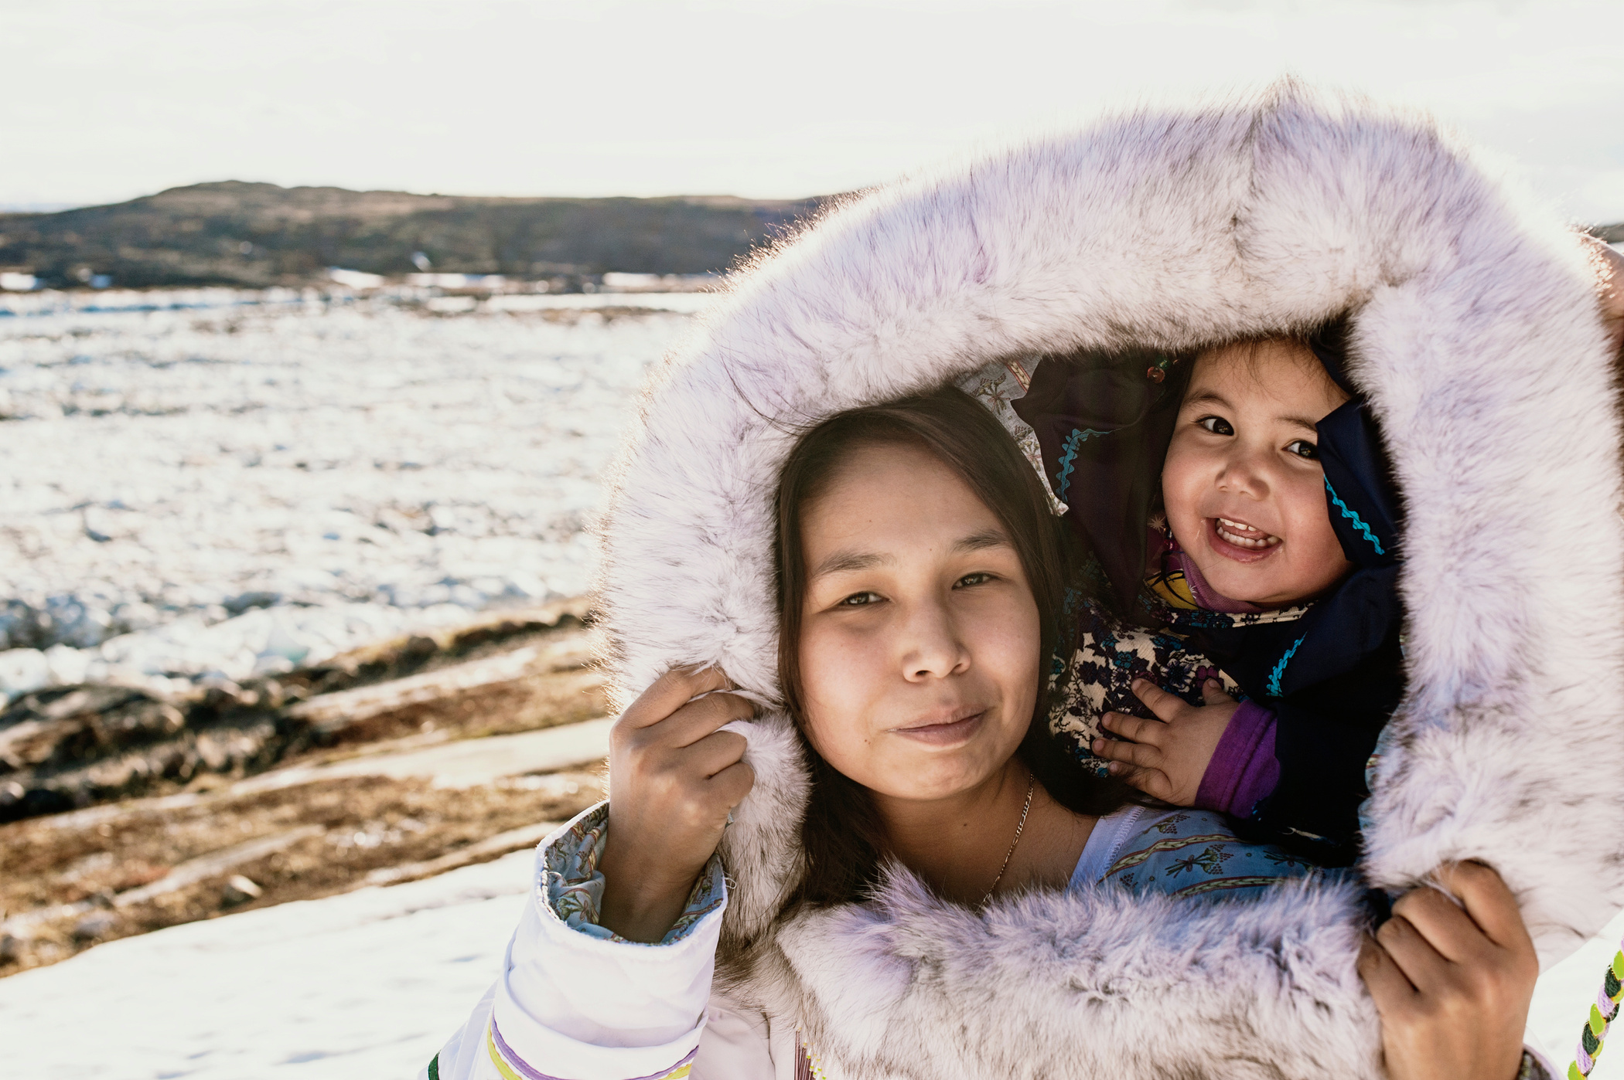

VWB ᓄᓇᕗᒻᒥ ᓯᖏᖅᑕᐅᓯᒪᔪᑦ ᖃᐅᔨᒪᔭᐅᓕᕐᓂᖏᑦ ᐊᒻᒪᓗ ᓯᖏᖅᑕᐅᑦᑕᐃᓕᒪᑎᑦᑎᓂᕐᒧᑦ ᐃᓕᓐᓂᐊᒐᒃᓴᐅᔪᑦ
ᐃᓕᓐᓂᐊᕈᑎᒃᓴᖅ 3:
ᓯᖏᖅᑕᐅᓯᒪᔪᑦ ᐊᒻᒪᓗ ᐃᓄᐃᑦ

Slide 2
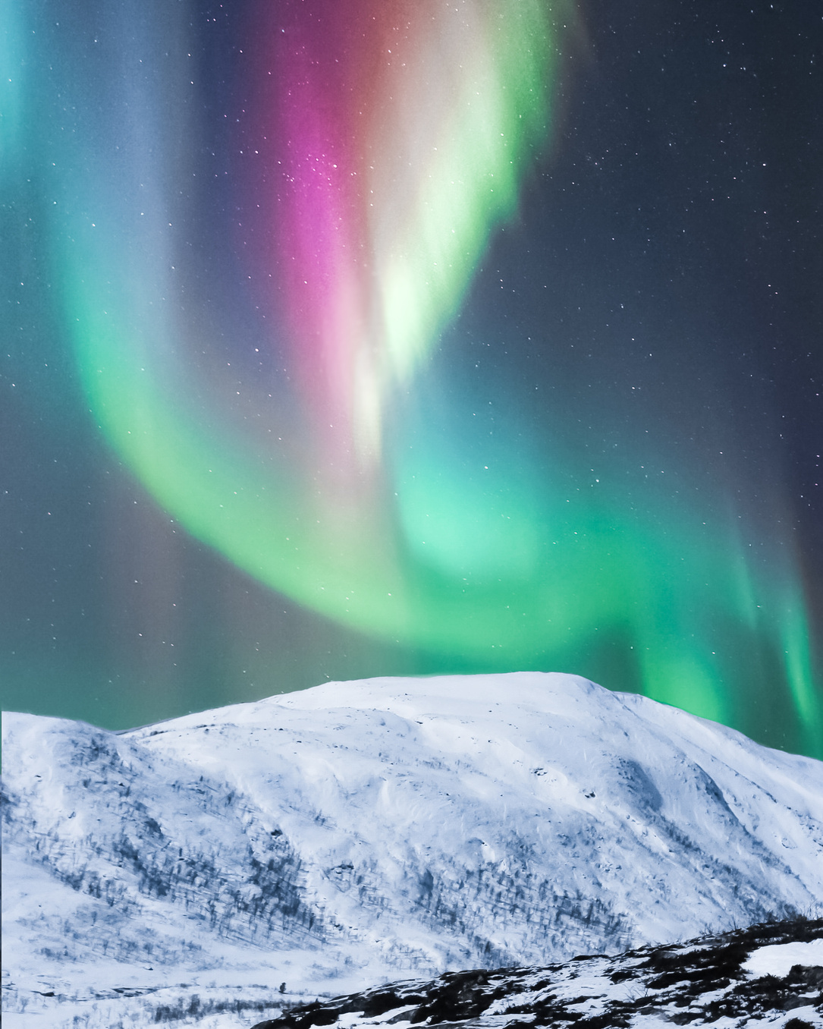
ᐃᓕᓐᓂᐊᖅᑕᐅᔪᒪᔪᑦ
ᐃᓱᓕᑉᐸᑦ ᑖᓐᓇ ᐃᓕᓐᓂᐊᕋᒃᓴᖅ, ᐃᒪᐃᓕᐅᕈᓐᓇᓕᕐᓂᐊᖅᑐᖓ:
ᓇᓗᓇᐃᔭᕐᓗᒋᑦ ᖃᓄᖅ ᐃᓄᒃ
ᓯᖏᖅᑕᐅᒍᓐᓇᕐᒪᖔᖅ ᐊᐃᑦᑑᑕᐅᓲᕐᒧᑦ ᐋᓐᓂᐊᕐᒧᑦ.
ᓇᓗᓇᐃᔭᕐᓗᒋᑦ ᖃᓄᐃᓕᐅᖅᑕᐅᔭᕆᐊᓖᑦ ᒪᓕᒋᐊᖃᓲᑦ ᐃᓄᒃ
ᑮᔭᒥᓂᐅᒍᓂ ᕿᓱᒃᑕᒥᓂᐅᒍᓂ
ᐆᒪᔪᕐᒧᑦ ᐅᕝᕙᓘᓐᓃᑦ ᐊᑦᑐᖅᓯᔪᒥᓂᐅᔪᖅ
ᐊᓯᐊᓂᒃ ᐆᒪᔪᕐᒥᒃ ᓯᖏᖅᑕᐅᓯᒪᓇᓱᒋᔭᐅᔪᒥᒃ.

Slide 3
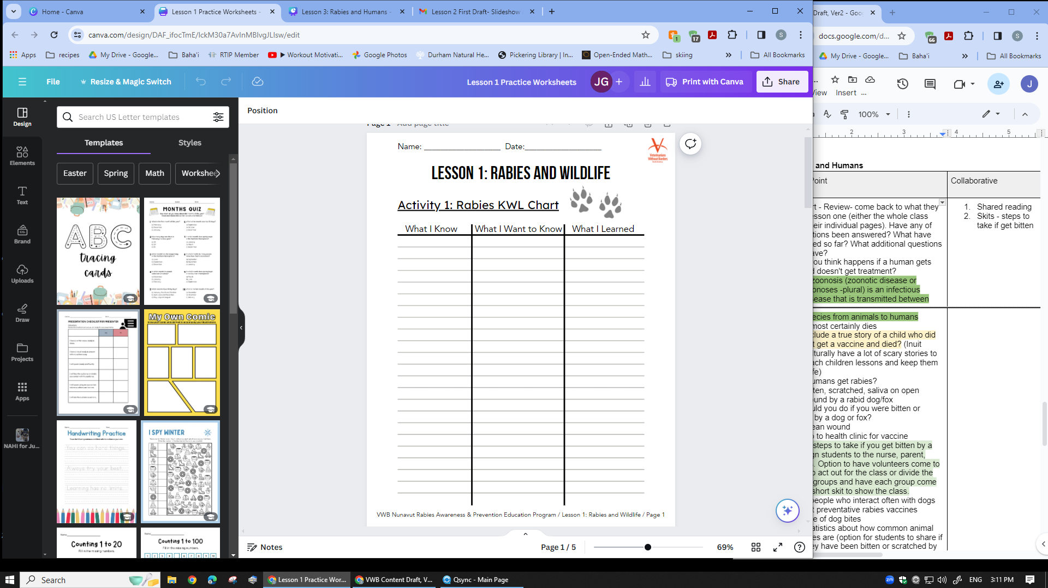

KWL ᑎᑎᖅᑐᖅᓯᒪᓂᖏᑦ ᕿᒥᕐᕈᓇᒃᑕᐅᔪᑦ
ᐊᐱᖅᑯᑎᑎᑦ ᓇᓕᐊᑐᐃᓐᓇᑦ ᑭᐅᔭᒥᓂᐅᕚᑦ?
ᖃᓄᖅ ᐃᓕᔅᓯᒪᓕᖅᐱᑦ ᒫᓐᓇᐅᔪᖅ?
ᓄᑖᕐᓂᒃ ᐊᐱᖅᑯᑎᒃᓴᖃᖅᐱᑦ ᐃᓚᔭᐅᔪᓐᓇᖅᑐᓂᒃ ᑎᑎᖅᑐᖅᓯᒪᔪᓄᑦ?

Slide 4

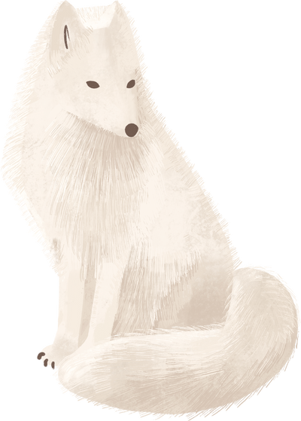
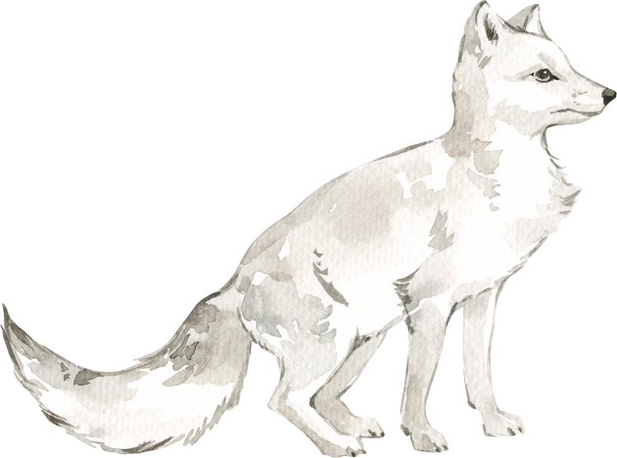

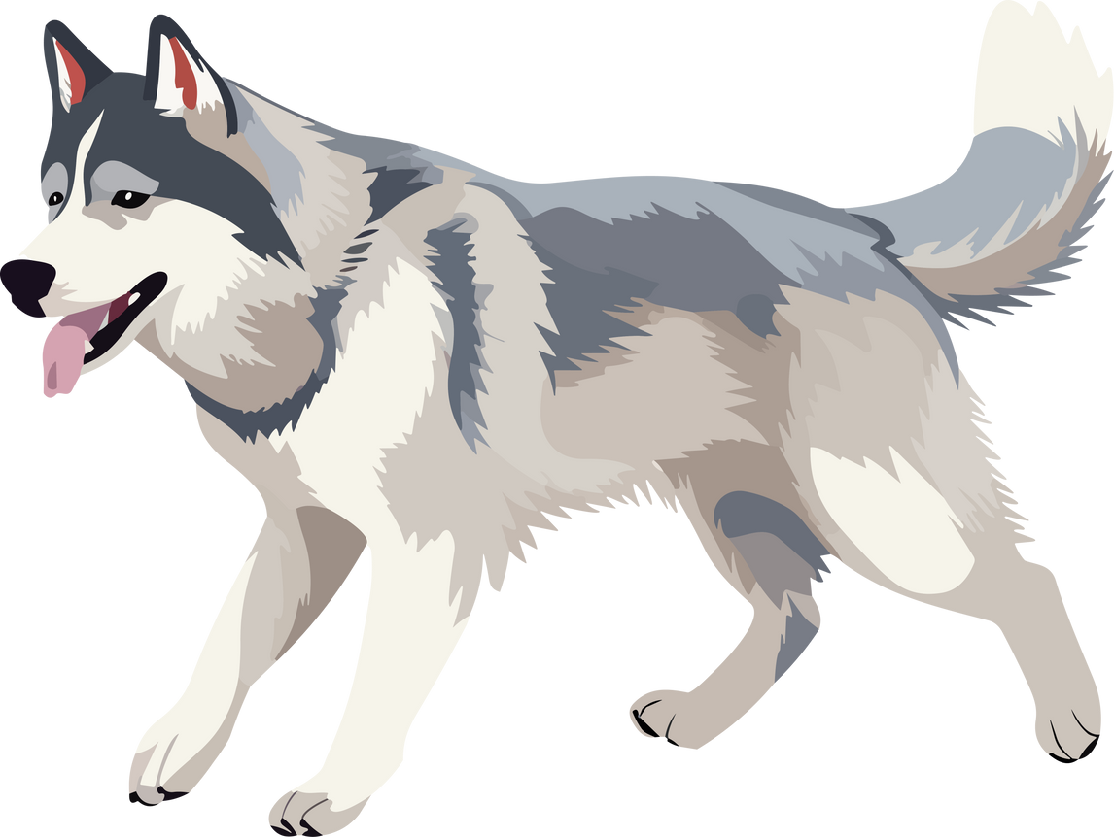
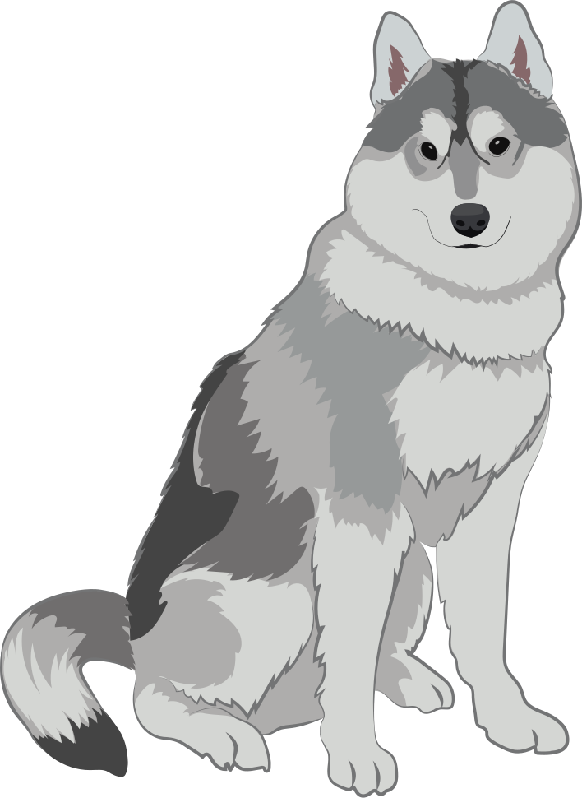
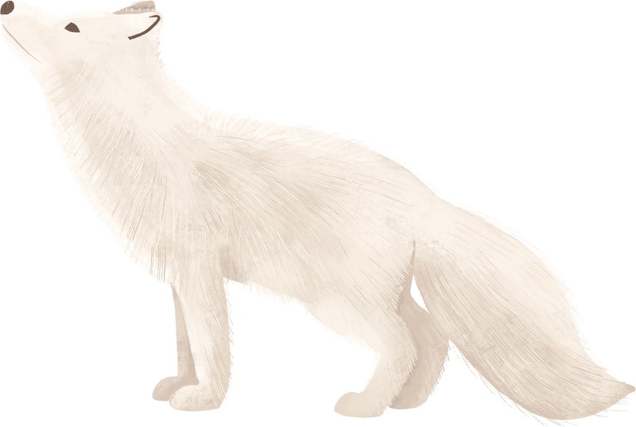

ᓯᖏᖅᑕᐅᓯᒪᓂᖅ ᕿᒥᕐᕈᒃᑲᓐᓂᒐᓛᓪᓗᒍ
ᖃᐅᔨᒪᒐᑦᑕ ᑎᕆᒐᓂᐊᑦ ᓯᖏᖅᑕᐅᓲᑦ
ᐊᓯᖏᖕᓂᒃ ᐊᐃᑦᑐᖅᑕᐅᓯᒪᔪᓂᑦ ᑎᕆᒐᓂᐊᕐᓃᖅᑐᒥᓂᐅᓚᐅᖅᑎᓪᓗᒋᑦ.
ᖃᐅᔨᒪᒋᕗᒍᑦ ᕿᒻᒦᑦ ᓯᖏᖅᑕᐅᓲᖑᓗᐊᖅᑐᑦ
ᐊᐃᑦᑐᖅᑕᐅᓯᒪᔪᓂᑦ ᑎᕆᒐᓂᐊᕐᓃᑦᑐᒥᓂᐅᓚᐅᖅᑎᓪᓗᒋᑦ ᐅᕝᕙᓘᓐᓃᑦ ᕿᒻᒥᓃᑦᑐᒥᓂᐅᓚᐅᖅᑎᓪᓗᒋᑦ.
ᑭᓯᐊᓂᓕ ᐃᓄᐃᑦ ᖃᓄᖅ?
ᐃᓄᐃᑦ ᐊᐃᑦᑐᖅᑕᐅᔪᓐᓇᕆᕚᑦ ᓯᖏᑕᐅᓗᑎᑦ?

Slide 5
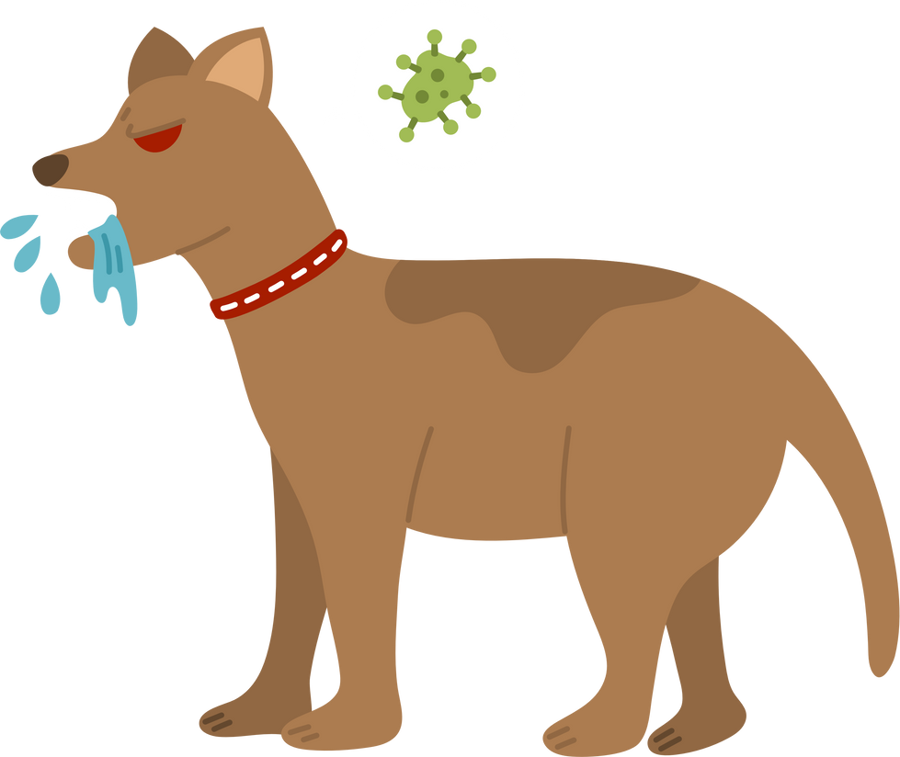
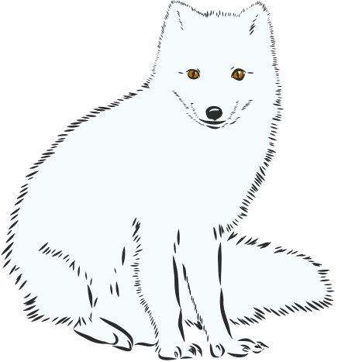

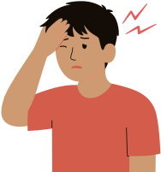
ᓯᖏᖅᑕᐅᓯᒪᔪᑦ ᐊᒻᒪᓗ ᐃᓄᐃᑦ
ᐄ’ ᐊᐃᑦᑐᖅᑕᐅᔪᓐᓇᖅᐳᑦ!
ᓯᖏᖅᓯᒍᑎᐅᓲᖅ ᐋᓐᓂᐊᖅ ᐆᒪᔪᕐᓂᑦ ᐃᓄᖕᓄᑦ ᐊᐃᑦᑑᑕᐅᓲᖑᕗᖅ. ᑕᒪᓐᓇ ᑐᑭᓕᒃ ᐋᓐᓂᐊᓕᕈᑕᐅᔪᓐᓇᖅᑐᖅ ᐊᐃᑦᑑᑕᐅᔪᓐᓇᖅᑐᖅ ᐆᒪᔪᕐᓂᑦ ᐃᓄᖕᓄᑦ.
ᐃᓄᐃᑦ ᐊᐃᑦᑐᖅᑕᐅᓲᑦ ᓯᖏᖅᑕᕈᑎᒧᑦ ᐋᓐᓂᐊᕐᒧᑦ ᐊᐃᑦᑐᖅᑕᐅᓯᒪᔪᒥᒃ ᐆᒪᔪᒧᕐᒧᑦ, ᕿᒻᒥᐅᓗᐊᓲᖑᓪᓗᑎᑦ. ᐃᓄᐃᑦ ᓯᖏᖅᑕᐅᔪᓐᓇᙱᓐᓂᖅᓴᐅᔪᑦ ᑎᕆᒐᓂᐊᕐᓂᑦ ᐅᕝᕙᓘᓐᓃᑦ ᐊᓯᖏᖕᓂᒃ ᐆᒪᔪᕐᓂᑦ.

Slide 6
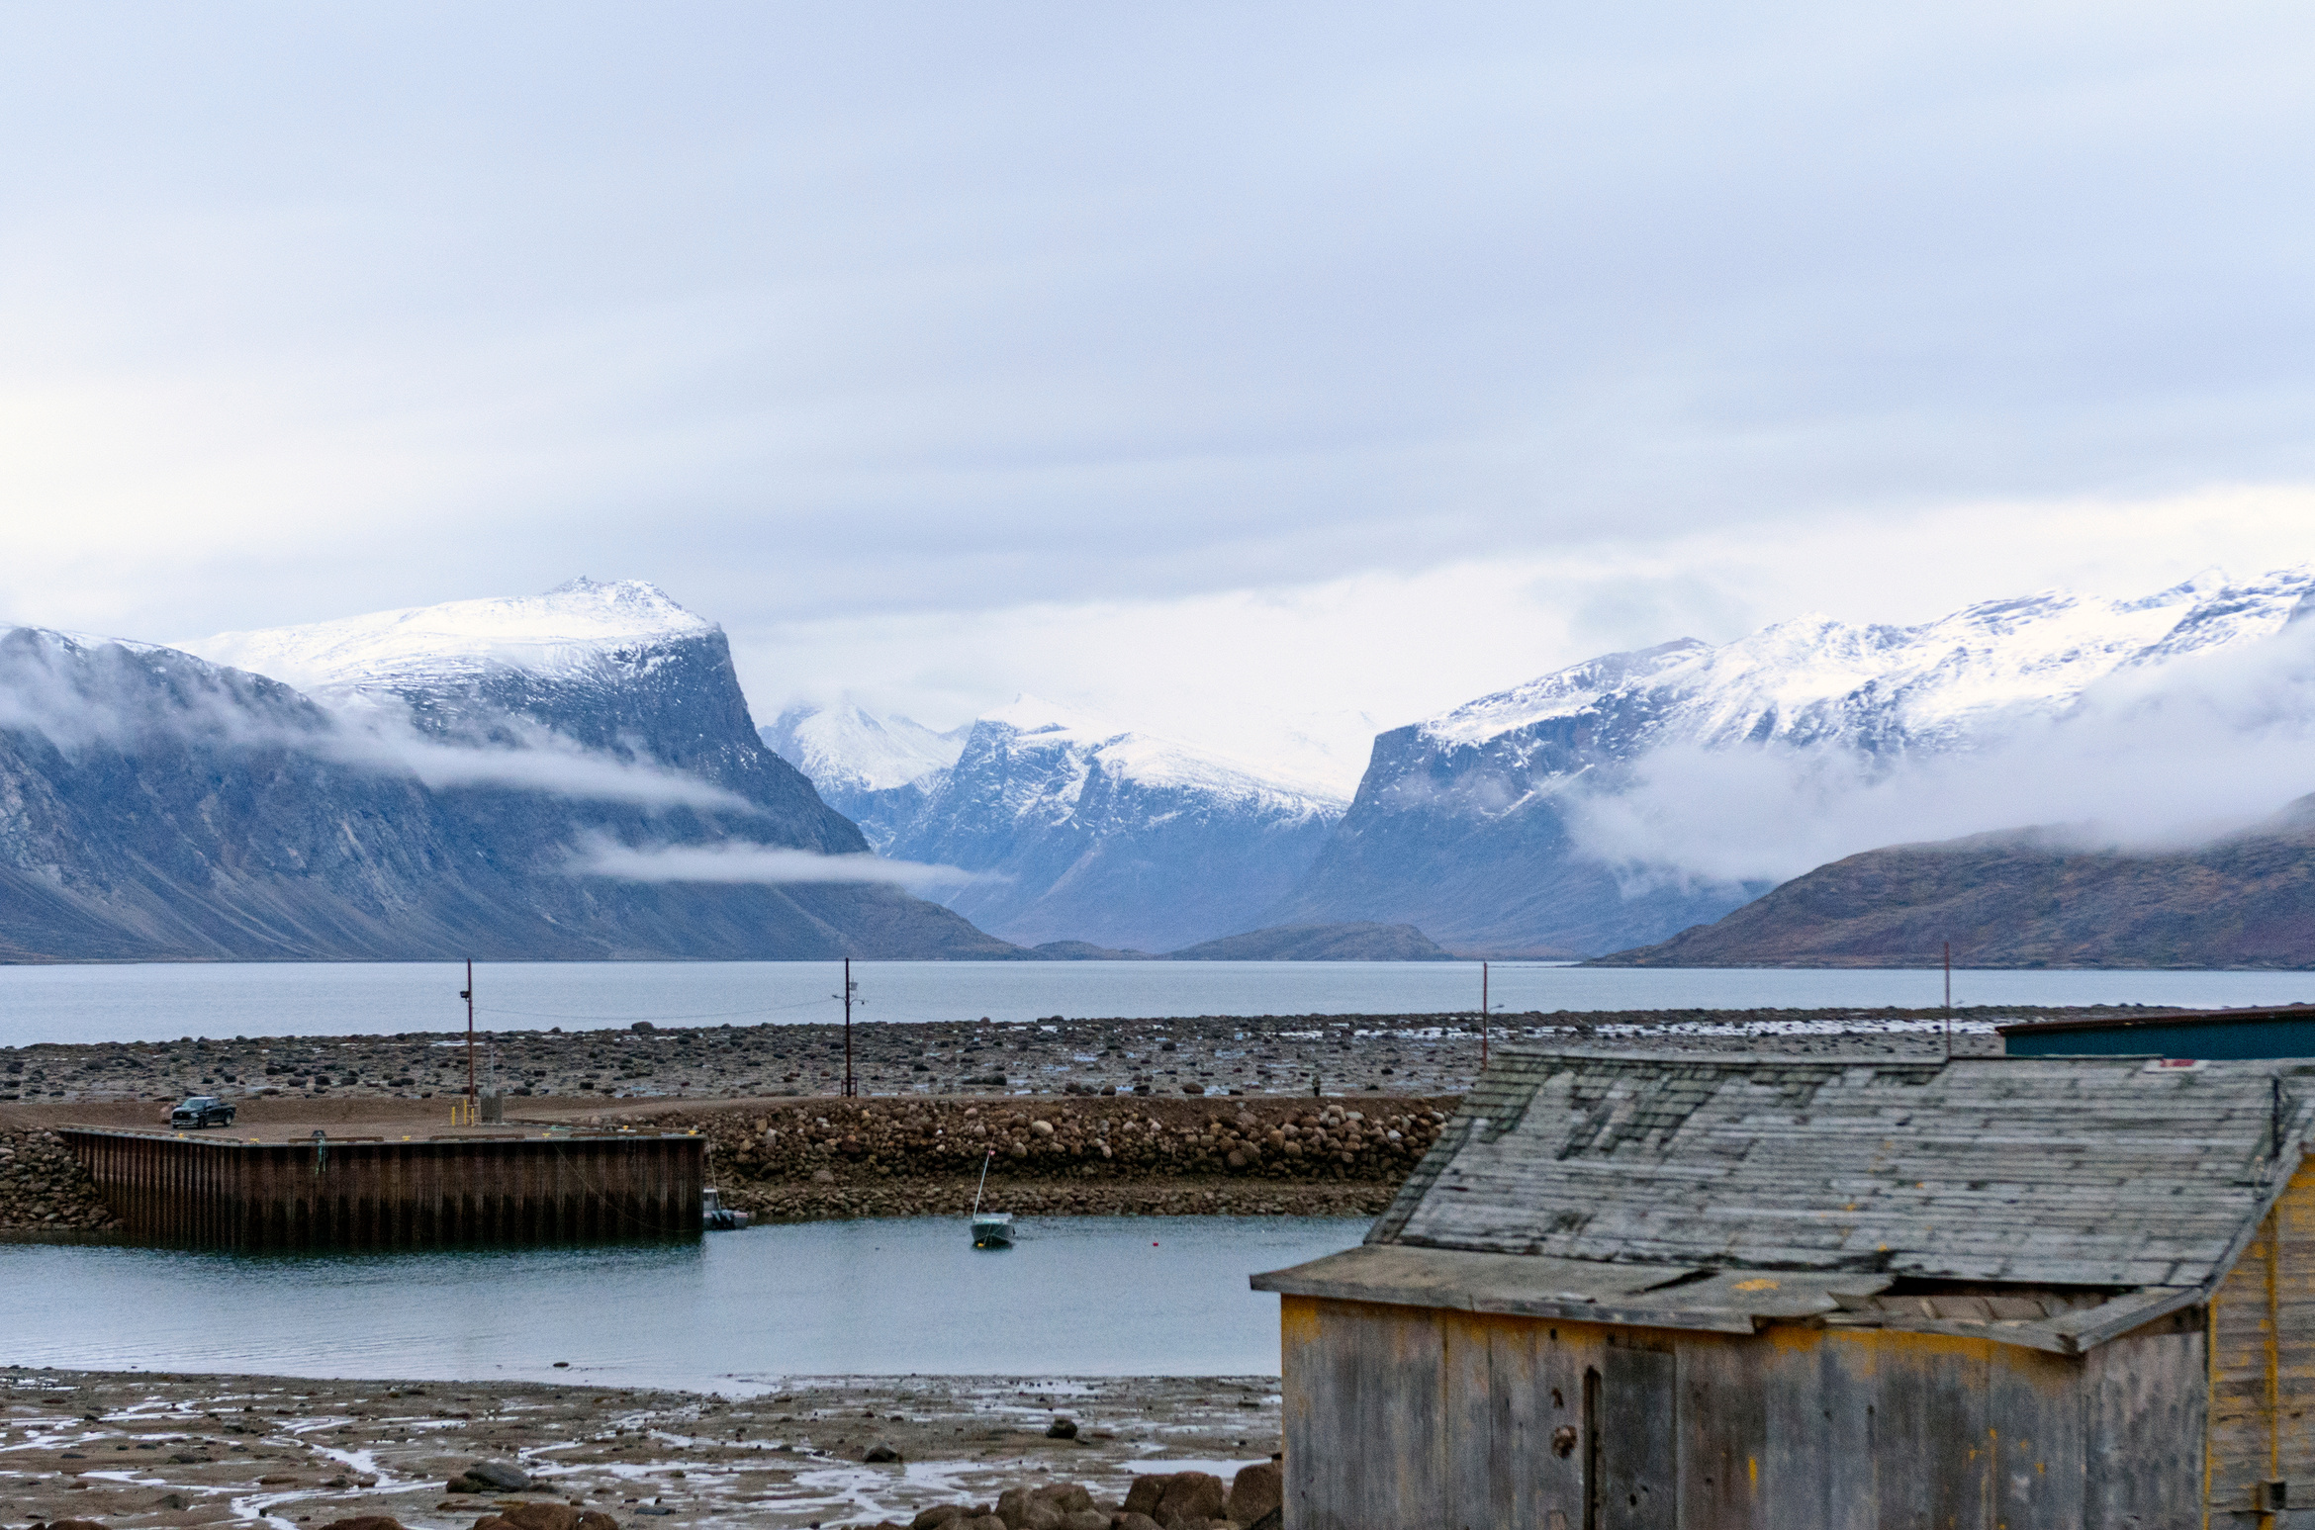
ᖃᓄᖅ ᐃᓱᒪᕕᑦ ᐃᓄᒃ ᐊᐃᑦᑐᖅᓯᒪᔭᐅᔭᕆᐊᖓᓂᒃ
ᓯᖏᖅᑕᐅᓯᒪᓗᓂ ᕿᒻᒥᒧᑦ ᐅᕝᕙᓘᓐᓃᑦ ᐊᓯᐊᓄᑦ ᐆᒪᔪᒧᑦ?

Slide 7
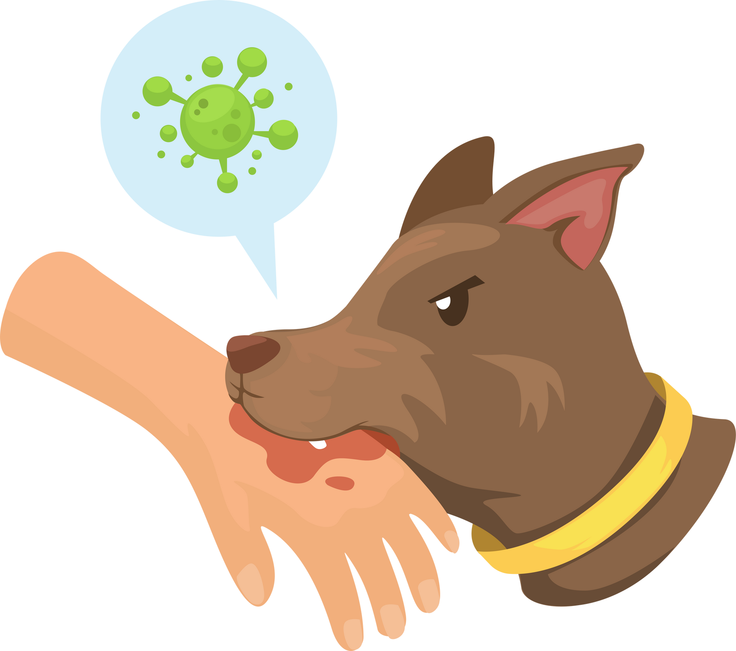
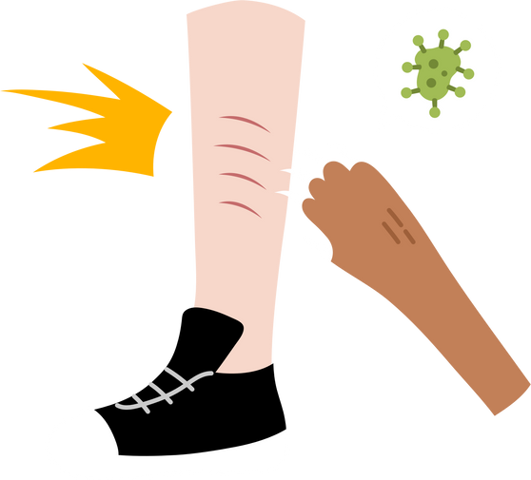




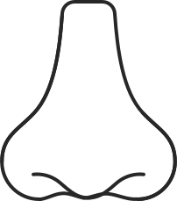
ᖃᓄᐃᖅ ᐃᓄᐃᑦ ᓯᖏᖅᑕᐅᓲᖑᒻᒪᖔᑖ ᐋᓐᓂᐊᓕᕐᓗᑎᑦ
ᐃᓄᐃᑦ ᐊᐃᑦᑐᖅᑕᐅᓗᐊᓲᑦ
ᐋᓐᓂᐊᓕᕈᑕᐅᓲᕐᒧᑦ ᓯᖏᖅᑕᒥᓂᐅᑎᓪᓗᒋᑦ ᑮᔭᐅᓪᓗᑎᑦ ᕿᓱᒃᑕᐅᓪᓗᑎᓪᓘᓐᓃᑦ
ᐊᐃᑦᑐᖅᑕᐅᓯᒪᔪᒧᑦ ᐆᒪᔪᕐᒧᑦ, ᓲᕐᓗᒃ ᕿᒻᒥᒧᑦ.
ᑕᐃᒪᐃᒍᓐᓇᕆᕗᑦ ᐃᓄᐃᑦ
ᐊᐃᑦᑐᖅᑕᐅᓯᒪᓗᑎᑦ ᓯᖏᖅᑕᐅᓗᑎᑦ ᓄᕙᖓ
ᐊᐃᑦᑐᖅᑕᐅᓯᒪᔪᑉ ᐆᒪᔪᑉ ᕿᓕᕐᓂᑯᒨᕈᓂ ᐅᕝᕙᓘᓐᓃᑦ
ᐃᓄᑉ ᐃᔨᖏᒃ, ᖃᓂᖓ ᐅᕝᕙᓘᓐᓃᑦ ᕿᖓᖓᓄᑦ.

Slide 8
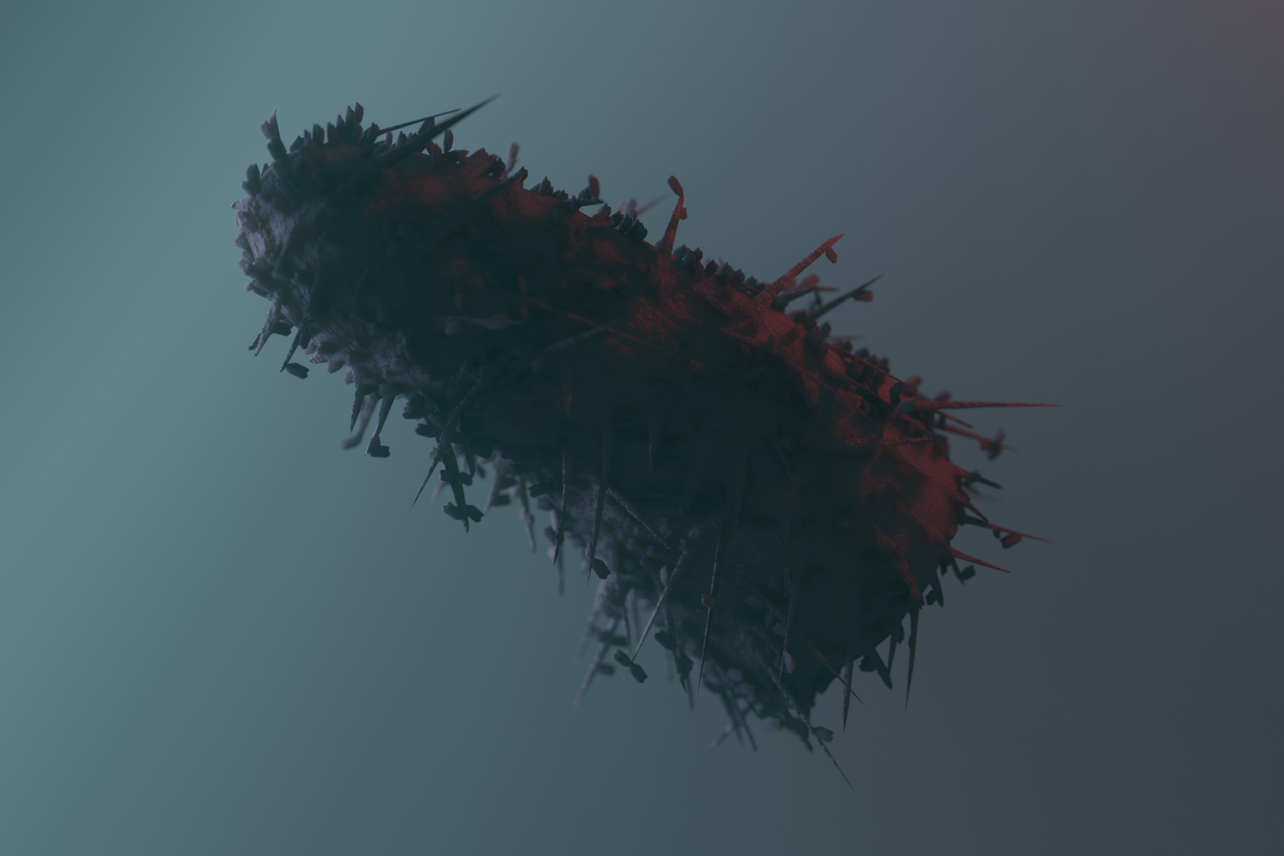
ᓯᖏᖅᑕᐅᓯᒪᔪᑦ ᐊᒻᒪᓗ ᐃᓄᐃᑦ ᓱᓕᔪᑦ
ᓯᖏᖅᓯᓯᒪᔭᐅᓂᖅ ᑐᖁᓐᓇᖅᑑᕗᖅ ᐋᓐᓂᐊᖅ ᑲᒪᒋᔭᐅᑦᑎᐊᓪᓚᕆᒋᐊᓕᒃ.
ᒪᓕᑦᑐᒍ ᓄᓇᕐᔪᐊᕐᒥ ᐋᓐᓂᐊᖃᕐᓇᙱᑦᑐᓕᕆᓂᕐᒧᑦ ᑲᑐᔾᔨᖃᑎᒌᖏᑦ, ᓯᖏᖅᑕᐅᓯᒪᔪᑦ 59,000 ᐃᓄᐃᑦ ᑐᖁᓲᑦ ᐊᕐᕌᒍᑕᒫᑦ ᓄᓇᕐᔪᐊᕐᒥ. ᐊᕝᕙᖏᑕ ᐅᖓᑕᐅᔨᓯᒪᔪᑦ ᓄᑕᖅᑲᐅᕗᑦ.
ᐃᓗᓕᖏᑦ ᒥᒃᓵᓄᑦ, ᐊᒥᓲᓂᖏᑦ ᓄᓇᕗᒻᒥ 2021−ᖑᑎᓪᓗᒍ ᑭᒡᓕᓯᓂᐊᖅᑕᐅᓯᒪᔪᑦ ᑲᓇᑕᒥ ᑭᒡᓕᓯᓂᐊᖅᑎᒻᒪᕆᒃᑯᓐᓄᑦ ᐃᒪᓐᓇᐅᑎᒋᓚᐅᖅᑐᑦ 36,858.

Slide 9
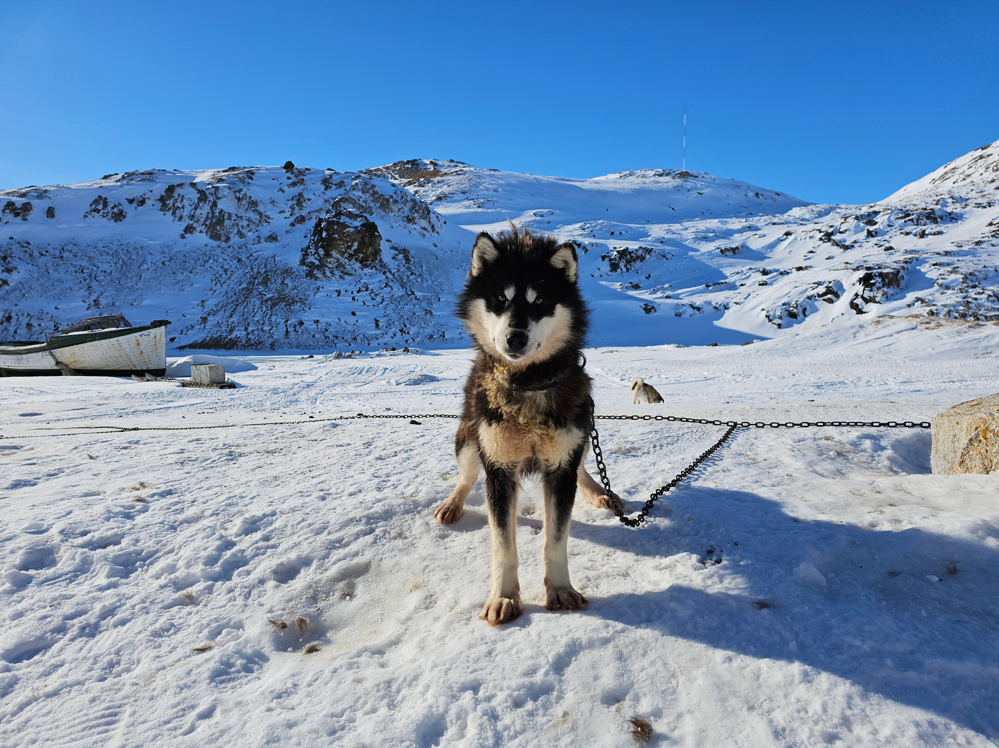
ᖃᓄᐃᓕᐅᕆᐊᖃᕋᓱᒋᕕᑦ ᐃᒪᐃᑕᐅᓐᓂᕈᕕᑦ ᑮᔭᐅᓗᑎᑦ, ᕿᓱᒃᑕᐅᓗᑎᑦ ᐆᒪᔪᕐᒧᑦ ᐅᕝᕙᓘᓐᓃᑦ ᐊᑦᑐᖅᓯᓐᓂᕈᕕᑦ ᐆᒪᔪᕐᒥᒃ ᐃᓕᖅᑯᓯᖅᓱᑦᑎᐊᙱᑦᑐᒧᑦ?

Slide 10

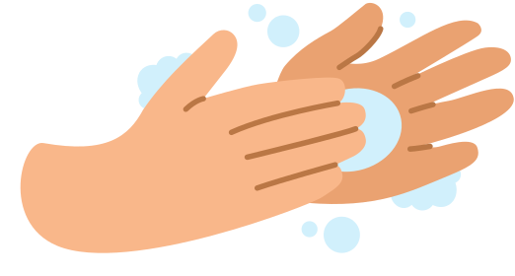


ᖃᓄᐃᓕᐅᕆᐊᖃᖅᑐᒃᓴᐅᒻᒪᖔᖅᐱᑦ
ᐃᒪᐃᓕᐅᕋᔭᖅᑐᑎᑦ ᑮᔭᐅᓐᓂᕈᕕᑦ ᐅᕝᕙᓘᓐᓃᑦ ᕿᓱᒃᑕᐅᓐᓂᕈᕕᑦ ᐆᒪᔪᕐᒧᑦ (ᓲᕐᓗᒃ ᕿᒻᒥᒧᑦ ᐅᕝᕙᓘᓐᓃᑦ ᑎᕆᒐᓂᐊᕐᒧᑦ)
ᐅᕝᕙᓘᓐᓃᑦ ᐆᒪᔪᕐᒥᒃ ᐊᑦᑐᖅᓯᓐᓂᕈᕕᑦ ᖃᐅᔨᒪᔭᐅᔪᒥᒃ ᐅᕝᕙᓘᓐᓃᑦ ᑲᖐᒋᔭᐅᔪᒥᒃ ᓯᖏᖅᑕᐅᓯᒪᔫᔭᕆᐊᖓᓂᒃ.
ᐅᖃᐅᔾᔨᓗᑎᑦ ᐃᓐᓇᕐᒥᒃ ᖃᓄᐃᑕᐅᓚᐅᕐᓂᕐᓂ.
ᑮᔭᐅᓐᓂᕈᕕᑦ ᕿᓱᒃᑕᐅᓐᓂᕈᕕᓪᓘᓐᓂᑦ, ᐅᐊᓴᑲᐅᑎᒋᓗᒍ ᑭᓕᕐᓂᖓ ᐅᐊᓴᐅᒻᒥᒃ ᐊᑐᕐᓗᑎᑦ ᑎᓴᐃᖓᔪᒥᓪᓗ ᐃᒥᕐᒧᑦ.
ᖁᐱᕐᕈᓂᑦ ᑐᖁᓴᐃᔾᔪᑎᖃᖅᑐᒧᑦ ᐅᐊᓴᕐᓗᒍ ᐃᒥᐊᓗᓕᒻᒧᑦ ᐅᕝᕙᓘᓐᓃᑦ ᐊᒥᐊᓕᒻᒧᑦ ᐅᐊᓴᐅᑎᓕᒻᒧᑦ.
ᐋᓐᓂᐊᕐᕕᓕᐊᑲᐅᑎᒋᓗᑎᑦ.

Slide 11

ᐋᓐᓂᐊᕐᕕᓕᐊᖅᑐᑦ
ᐃᒪᐃᒻᒪᑦ ᐱᒻᒪᕆᐅᓪᓗᓂ ᐋᓐᓂᐊᕐᕕᓕᐊᕐᓗᑎᑦ 24 ᐃᑲᕐᕋᑦ ᐃᓗᐊᓂ ᑮᔭᒥᓂᐅᒍᕕᑦ ᕿᓱᒃᑕᒥᓂᐅᒍᕕᓪᓘᓐᓃᑦ ᐆᒪᔪᕐᒧᑦ ᐅᕝᕙᓘᓐᓃᑦ ᐊᑦᑐᖅᓯᔪᒥᓂᐅᒍᕕᑦ ᐆᒪᔪᕐᒥᒃ ᓯᖏᖅᑕᐅᓯᒪᑐᐃᓐᓇᕆᐊᓕᒻᒧᑦ.
ᐋᓐᓂᐊᕐᕕᒻᒥ, ᐋᓐᓂᐊᓯᐅᖅᑎᐅᔪᖅ ᓘᒃᑖᕐᓘᓐᓃᑦ ᑲᒪᒐᔭᖅᑐᖅ ᕿᓕᕐᓂᑯᒥᓂᕐᓂᑦ ᐊᒻᒪᓗ ᐃᓱᒪᓕᐅᕐᓗᑎᑦ ᓯᖏᖅᑕᐅᑦᑕᐃᓕᒪᒍᑎᒥᒃ ᑲᐱᓯᓗᑎᑦ.

Slide 12



The Rabies Vaccine
ᓯᖏᖅᑕᒥᓂᐅᒍᕕᑦ ᐊᒻᒪᓗ
ᐃᒪᐃᑦᑕᐃᓕᒍᕕᑦ ᓯᖏᖅᑕᐅᔾᔭᐃᒃᑯᑎᒧᑦ ᑲᐱᔭᐅᓗᑎᑦ ᑭᖑᕙᙱᑦᑐᒃᑯᑦ…
... ᐃᒪᓐᓇᑎᒋᐸᓗᒃ 100%
ᑐᖁᒍᓐᓇᖅᐳᑎᑦ.
ᓯᖏᖅᑕᒥᓂᐅᒍᕕᑦ ᐊᒻᒪᓗ
ᐃᒪᐃᒃᑯᕕᑦ ᓯᖏᖅᑕᐅᔾᔭᐃᒃᑯᑎᒥᒃ ᑲᐱᔭᐅᓗᑎᑦ ᑭᖑᕙᙱᑦᑐᒃᑯᑦ…
... ᐃᒪᓐᓇᑎᒋᐸᓗᒃ 100%
ᓇᖅᑮᔪᓐᓇᑦᑎᐊᖅᐳᑎᑦ.
ᓯᖏᖅᑕᐅᑦᑕᐃᓕᒪᒍᑏᑦ ᑲᐴᑏᑦ ᑕᐃᒪᐃᑎᑦᑎᒍᓐᓇᕐᒪᑕ ᐱᐅᓕᑦᑎᓗᑎᑦ ᐃᓅᓯᕐᓂ.

Slide 13
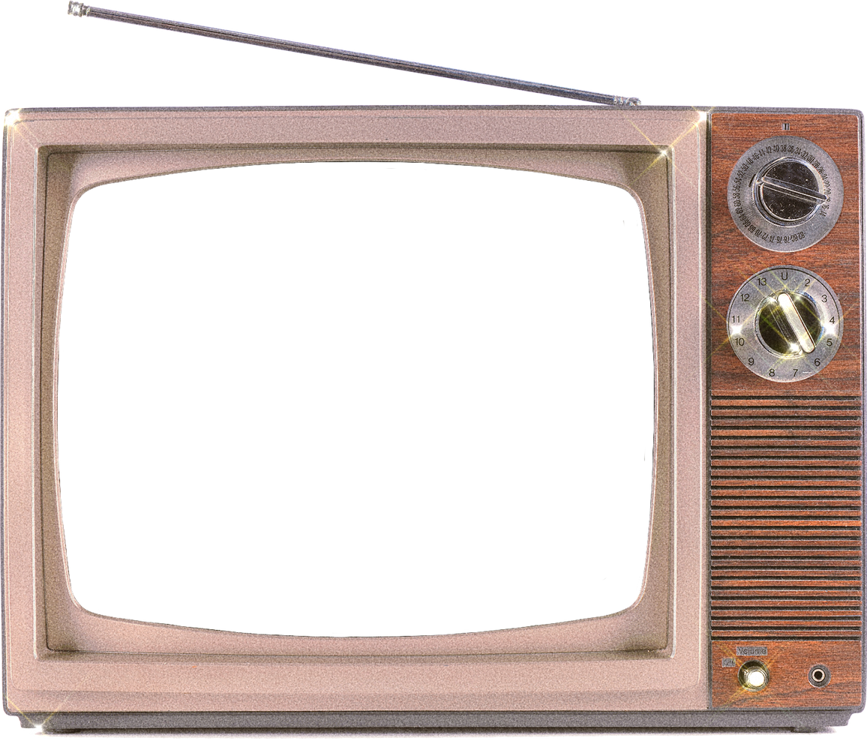
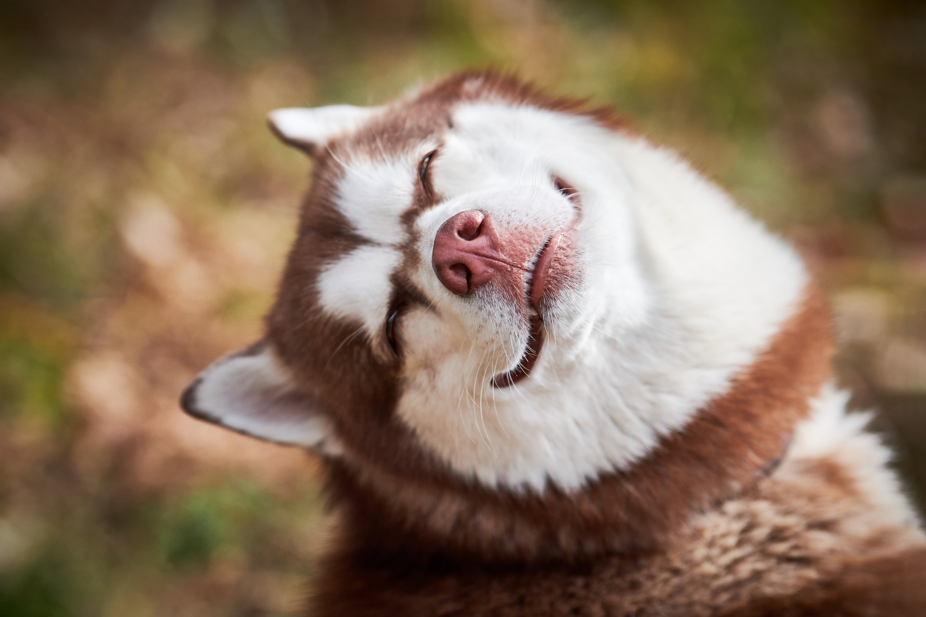
ᐆᑦᑐᕋᐅᔭᙳᐊᕐᓂᒃᑯᑦ ᑐᑭᓯᓇᖅᓯᑎᑦᑎᔪᑦ

Slide 14
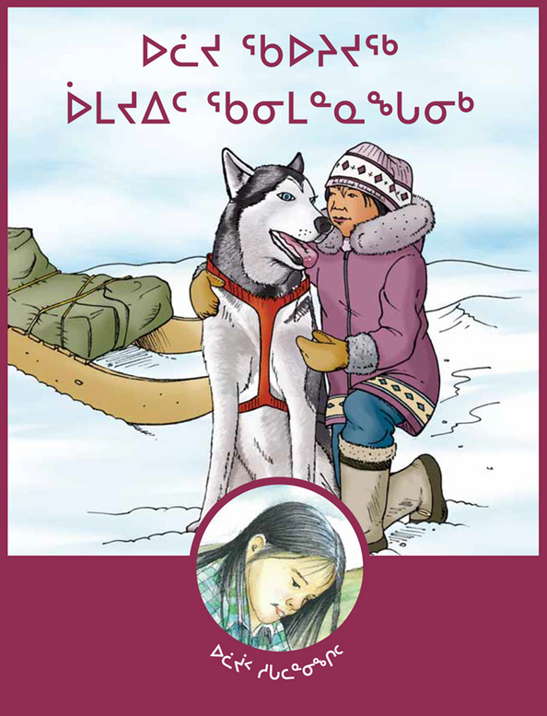
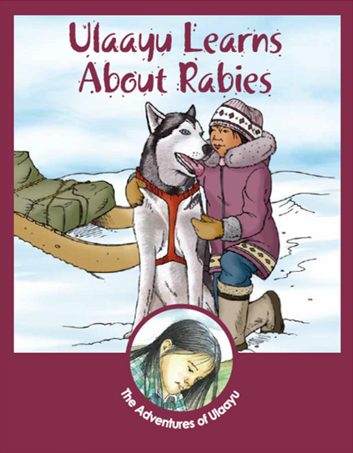
ulaayu learns about rabies
ᑕᖅᕿᐊᖅ ᐃᓕᓐᓂᐊᖅᑐᖅ ᓯᖏᖅᑕᐅᓯᒪᔪᑦ ᒥᒃᓵᓄᑦ ᑖᒃᑕ ᕼᐃᐅᒧᑦ ᓴᓇᔭᒥᓂᖅ
ᕕᑦᓂ ᐅᓂᒃᑳᖅᑐᐊᖅᑐᖅ ᐃᓄᒻᒥᒃ ᐊᕐᓇᒥᒃ
ᐃᓕᓐᓂᐊᖅᑐᒥᓂᐅᔪᖅ ᓯᖏᖅᑕᐅᓯᒪᔪᒥᒃ ᕿᒻᒥᖏᑦ ᑎᕆᒐᓂᐊᕐᒨᖅᑐᒥᓂᐅᓚᐅᖅᑎᓪᓗᒋᑦ ᓄᓇᑐᐃᓐᓇᕐᒦᑦᑐᑎᑦ.
ᐅᖃᓕᒫᕐᓗᒍ ᖃᐅᔨᒃᑲᓐᓂᖁᓪᓗᑎᑦ ᓯᖏᖅᑕᐅᓯᒪᓂᐅᑉ ᒥᒃᓵᓄᑦ, ᖃᓄᖅ ᐊᐃᑦᑑᑕᐅᓲᖑᒻᒪᖔᕐᒥᒃ, ᐊᒻᒪᓗ ᖃᓄᖅ ᐊᐃᑦᑐᖅᑕᐅᑦᑕᐃᓕᒪᒍᓐᓇᕐᒪᖔᑦ ᐃᓄᐃᑦ ᐊᒻᒪᓗ ᕿᒻᒦᑦ.
Notes:
https://www.gov.nt.ca/ecc/sites/ecc/files/resources/rabies_story_book_inu.pdf
https://www.gov.nt.ca/ecc/sites/ecc/files/resources/rabies_story_book_en.pdf

Slide 15
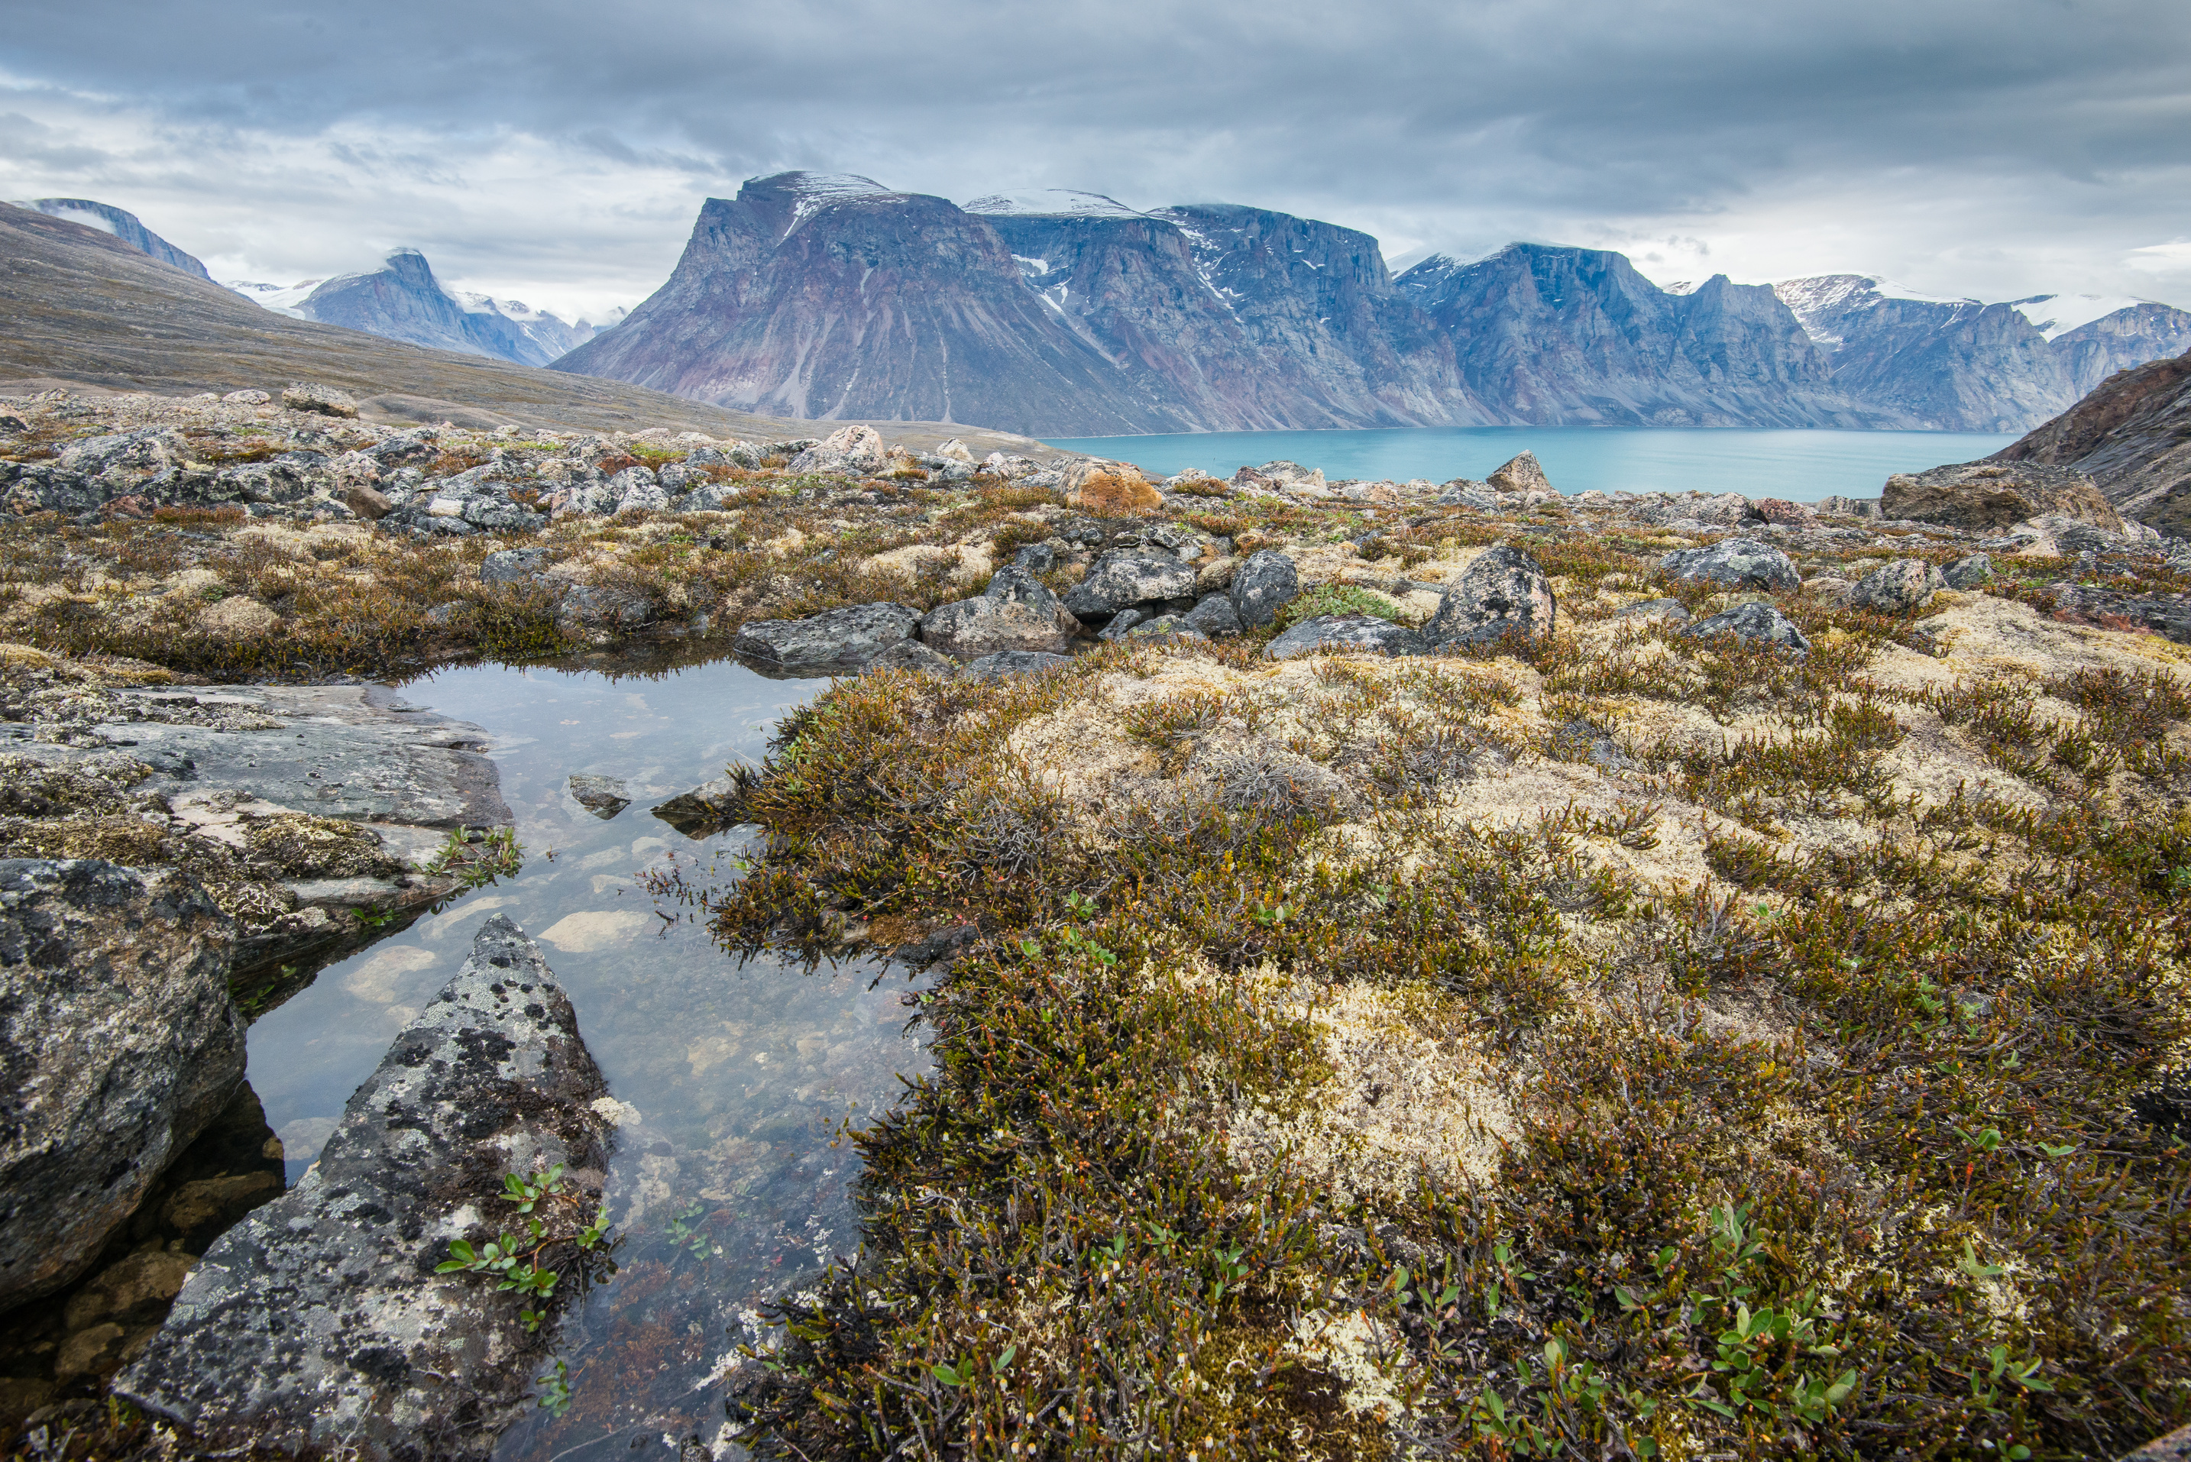
ᐆᑦᑐᕋᓚᐅᖅᑕ

