Slide 1
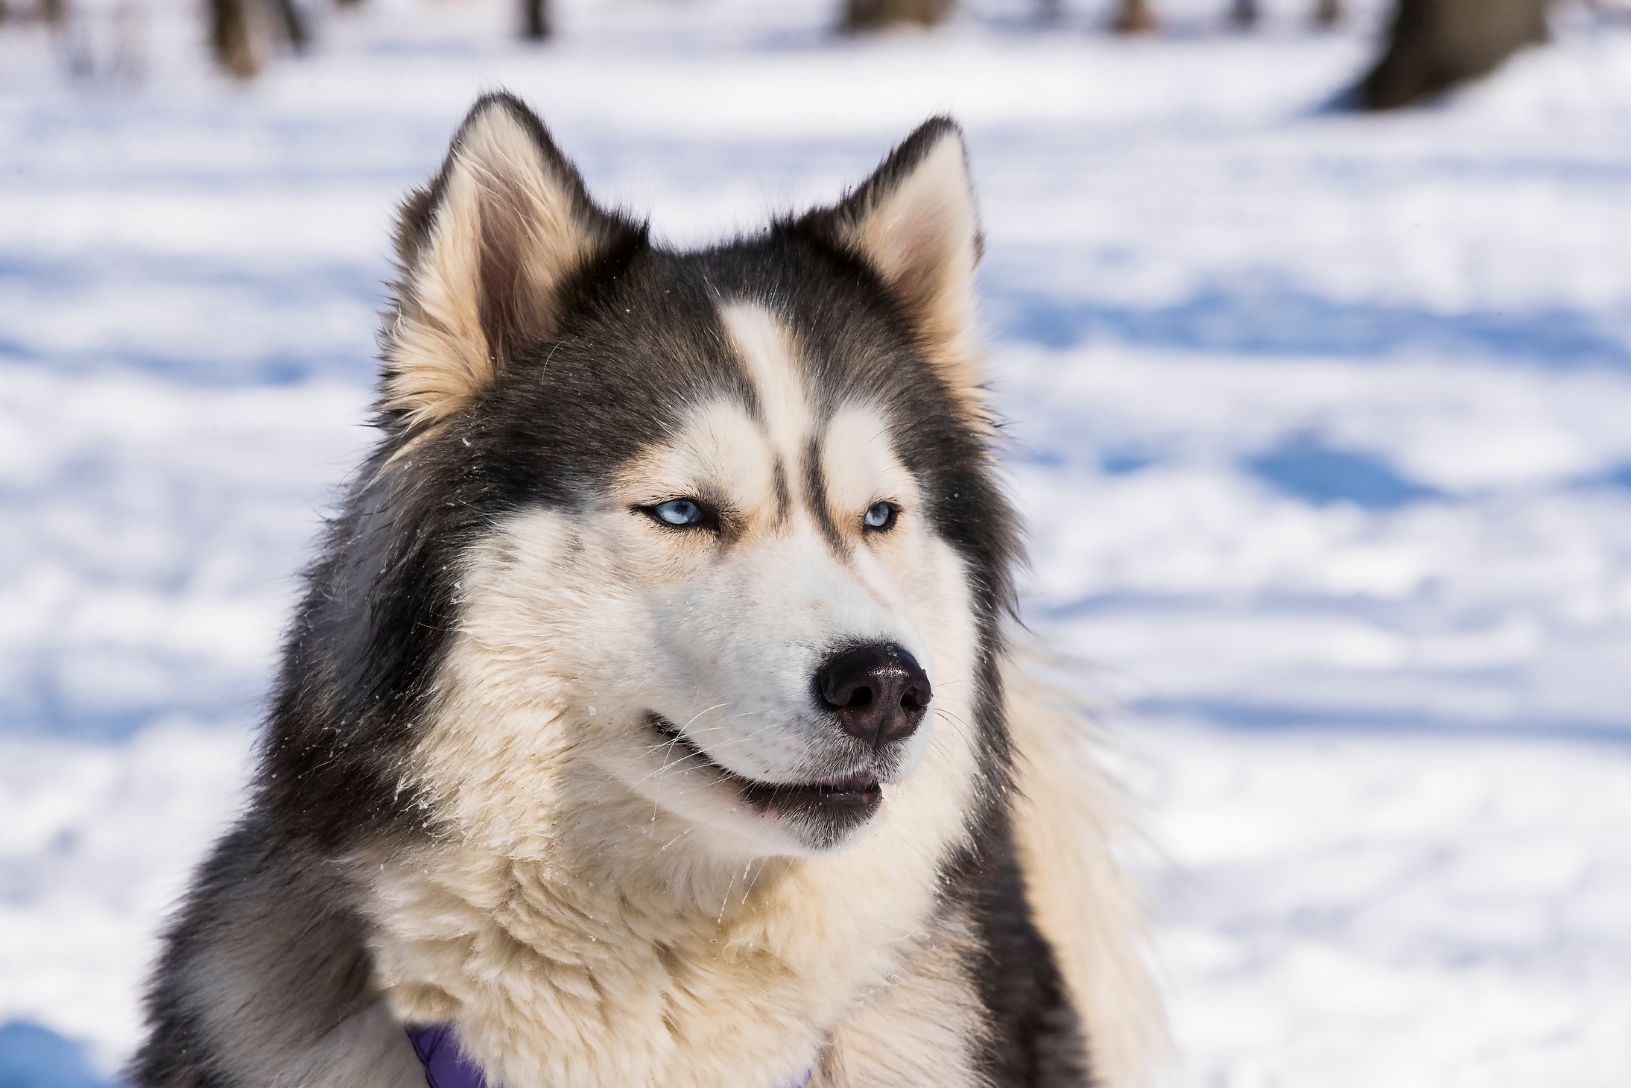

VWB ᓄᓇᕗᒻᒥ ᓯᖏᖅᑕᐅᓯᒪᔪᑦ ᖃᐅᔨᒪᔭᐅᓕᕐᓂᖏᑦ ᐊᒻᒪᓗ ᓯᖏᖅᑕᐅᑦᑕᐃᓕᒪᑎᑦᑎᓂᕐᒧᑦ ᐃᓕᓐᓂᐊᒐᒃᓴᐅᔪᑦ
ᐃᓕᓐᓂᐊᕈᑎ 2:
ᓯᖏᖅᑕᐅᓯᒪᔪᑦ ᐊᒻᒪᓗ ᕿᒻᒦᑦ

Slide 2
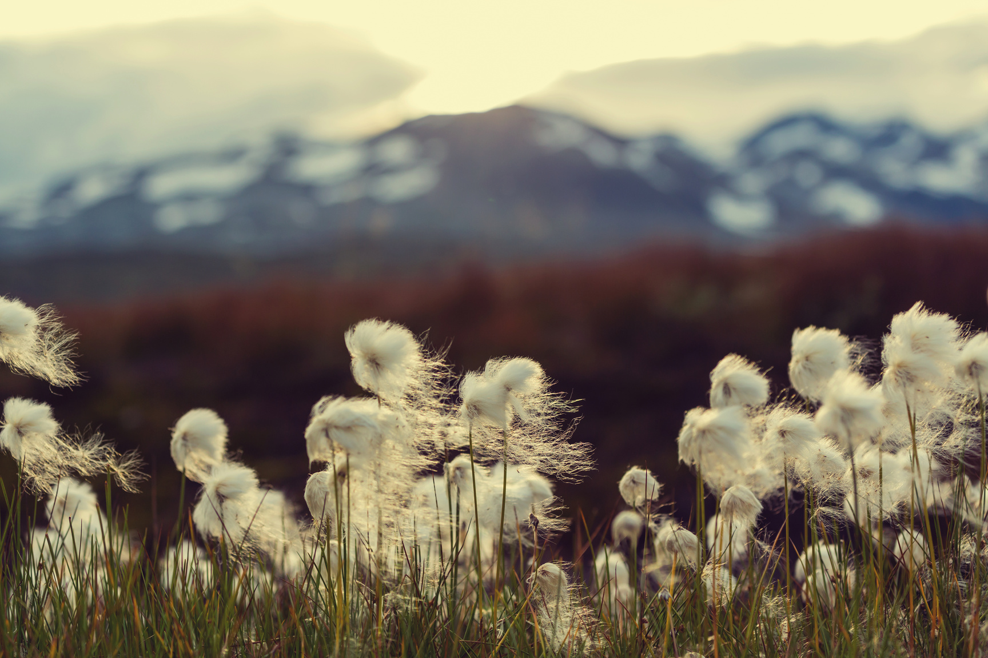
ᐃᓕᓐᓂᐊᖅᑕᐅᔪᒪᔪᑦ
ᐃᓱᓕᑉᐸᑦ ᑖᓐᓇ ᐃᓕᓐᓂᐊᕋᒃᓴᖅ, ᐃᒪᐃᓕᐅᕈᓐᓇᓕᕐᓂᐊᖅᑐᖓ:
ᓇᓗᓇᐃᔭᕐᓗᒋᑦ ᓯᖏᖅᑕᐅᓯᒪᔪᑦ ᖃᓄᐃᓲᖑᓂᖏᑦ ᕿᒻᒥᓂᑦ.
ᓇᓗᓇᐃᔭᐃᓗᑎᑦ ᖃᓄᖅ ᕿᒻᒦᑦ ᓯᖏᖅᑕᐅᑦᑕᐃᓕᒪᒍᓐᓇᕐᒪᖔᑕ.

Slide 3
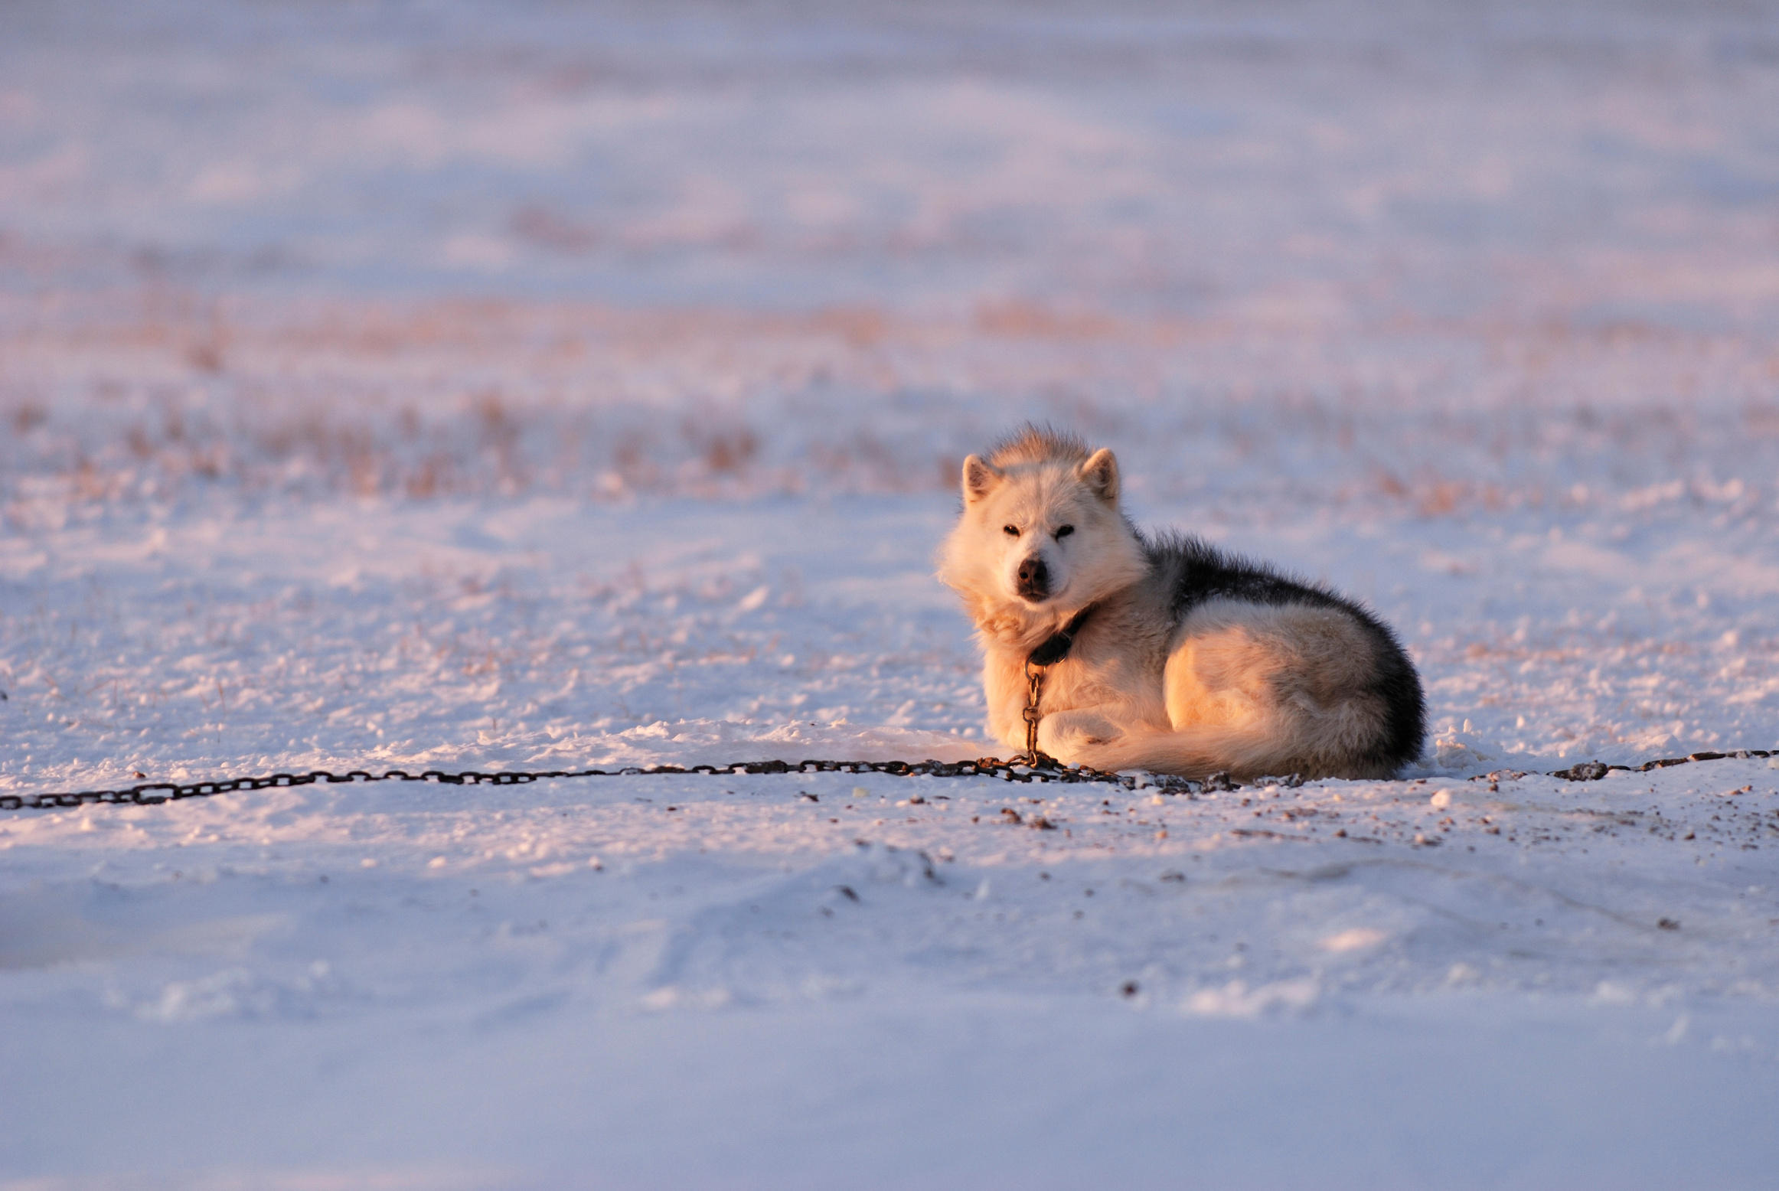
ᖃᓄᖅ ᐃᓱᒪᕕᑦ ᕿᒻᒦᑦ ᒥᒃᓵᓄᑦ?
ᐱᐅᙱᑦᑑᓪᓗᒋ, ᐱᐅᔫᓪᓗᒋᑦ ᐅᕝᕙᓘᓐᓃᑦ ᑕᒪᒃᑮᒃ?

Slide 4


ᓯᖏᖅᑕᐅᓯᒪᓂᖅ ᕿᒥᕐᕈᒃᑲᓐᓂᒐᓛᓪᓗᒍ
ᐃᖅᑲᐅᒪᒋᑦ…
ᓯᖏᖅᑕᐅᓯᒪᓂᖅ ᐃᒪᐃᑦᑑᕗᖅ ᑐᖁᓐᓇᖅᑐᖅ ᐋᓐᓂᐊᖅ ᐊᐃᑦᑑᑕᒥᓂᐅᓲᖑᓪᓗᓂ.
ᓯᖏᖅᑕᐅᓲᖅ ᐋᓐᓂᐊᖅ ᐆᒪᔪᕐᓂᑦ ᐊᒃᓱᒻᒪᕆᒃ ᐋᓐᓂᐊᓕᖅᑎᑦᑎᓲᖅ
ᐊᐃᑦᑐᖅᑕᐅᓯᒪᔪᑦ ᐆᒪᔪᐃᑦ ᓯᖏᖅᑕᐅᓯᒪᓪᓗᑎᑦ ᑐᖁᐃᓐᓇᐸᓗᓲᑦ

Slide 5
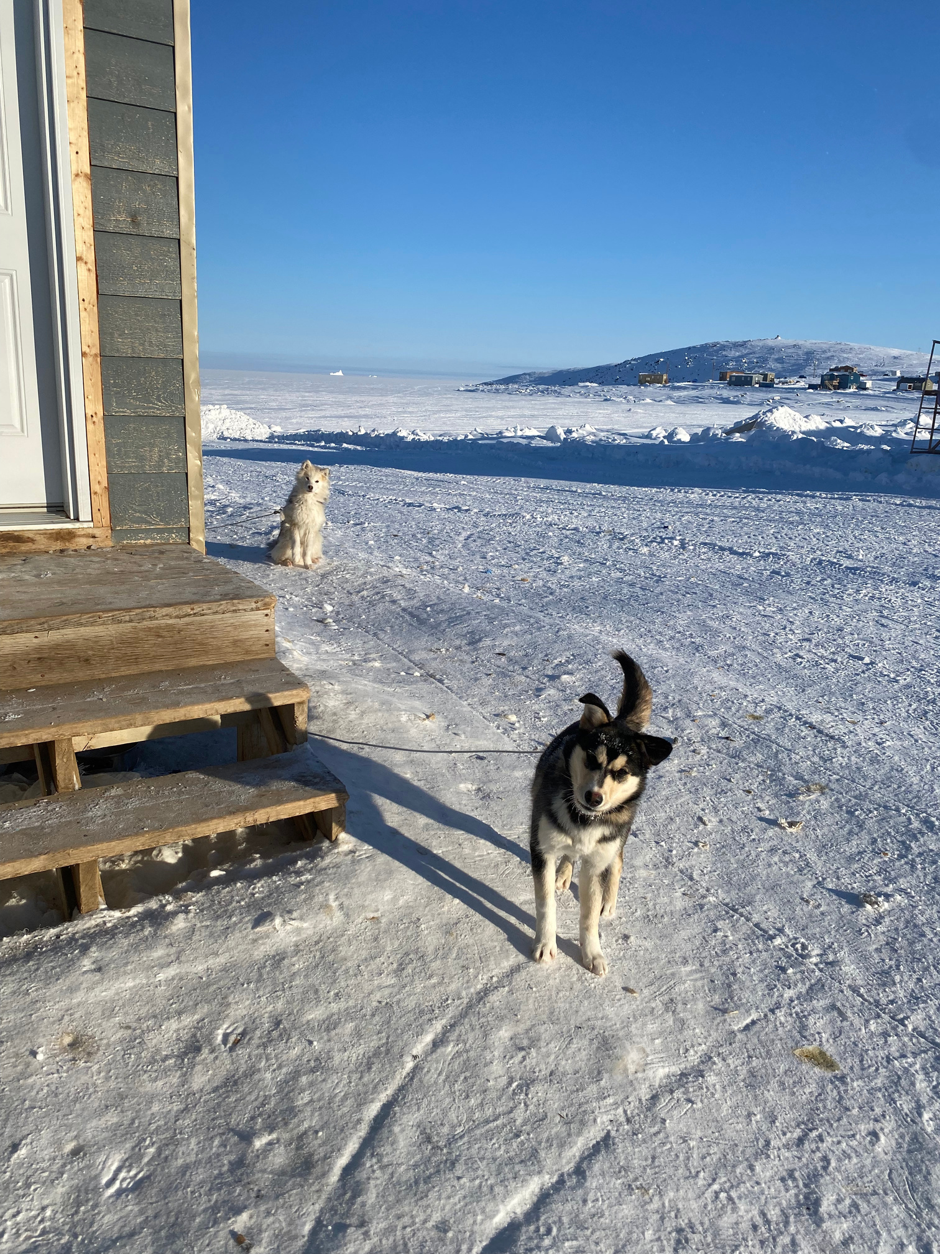
ᖃᓄᖅ ᐃᓱᒪᒋᔭᖃᖅᐱᑦ ᕿᒻᒦᑦ ᐊᐃᑦᑐᖅᑕᐅᓲᖑᒋᐊᖏᓐᓂᒃ ᓯᖏᖅᑕᐅᓪᓗᑎᑦ ᐋᓐᓂᐊᕐᒥᒃ?

Slide 6
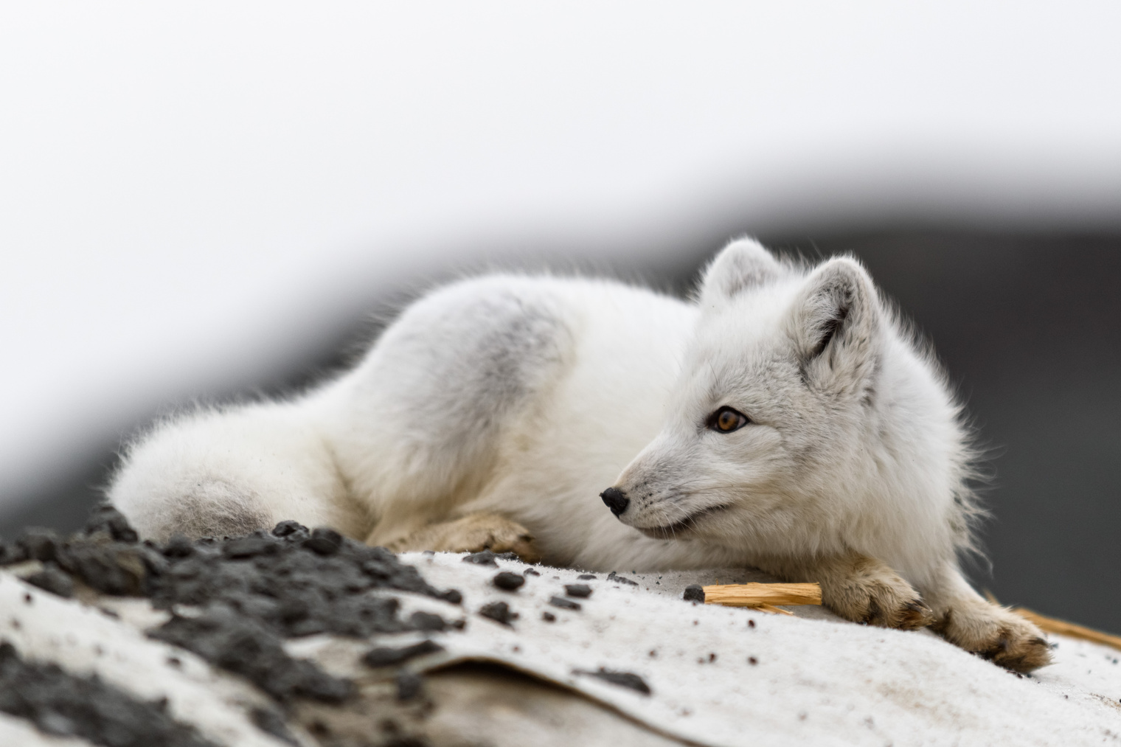

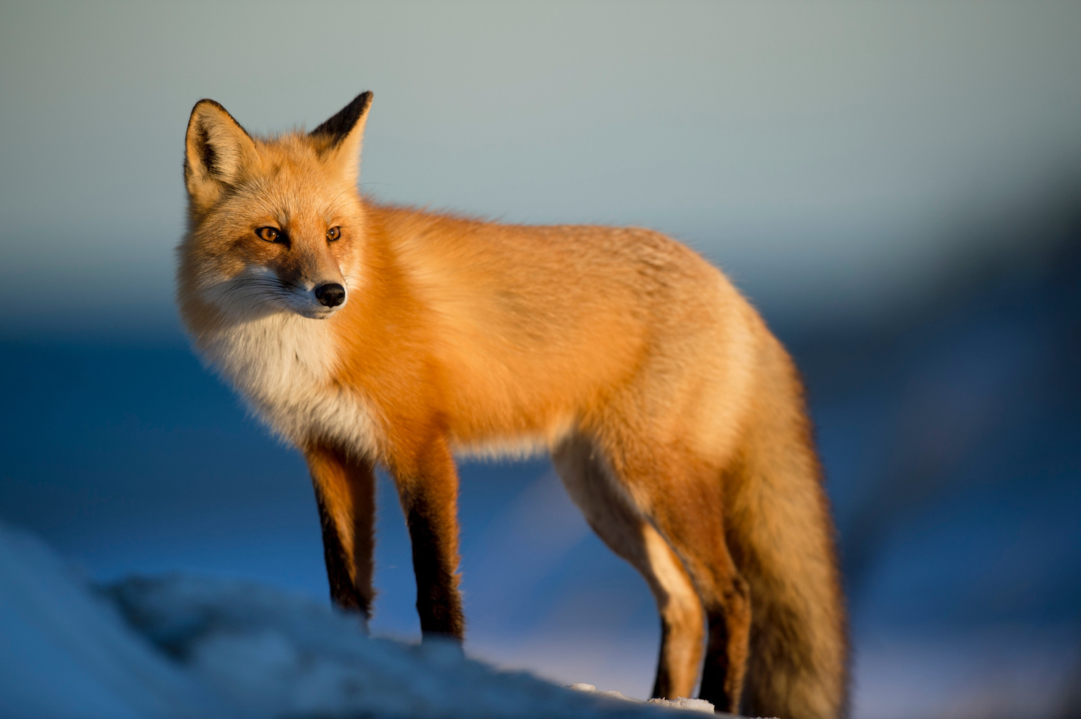
ᐊᐃᑦᑐᖅᑕᐅᓯᒪᔪᑦ ᕿᒻᒦᑦ
ᐱᑦᑎᐊᖅᐳᑎᑦ! ᕿᒻᒦᑦ ᓯᖏᖅᑕᐅᓗᐊᓲᑦ ᖃᓄᐃᓕᔭᒥᓂᐅᑎᓪᓗᒋᑦ ᑎᕆᒐᓂᐊᕐᔪᓂᑦ ᐅᕝᕙᓘᓐᓃᑦ ᐊᐃᐱᓚᒃᑕᓄᑦ ᑎᕆᒐᓂᐊᓄᑦ
ᐊᐃᑦᑐᖅᑕᐅᓯᒪᔪᑦ ᑎᕆᒐᓂᐊᑦ ᓄᓇᓕᒻᒨᓲᖑᕗᑦ ᐊᒻᒪᓗ ᐹᓕᖅᑐᑎᑦ ᕿᒻᒥᓂᑦ. ᐅᕆᐊᖏᑦ ᑮᓯᔪᒥᓂᐅᑎᓪᓗᒋᑦ ᐊᐃᑦᑐᖅᑕᐅᓲᑦ ᐋᓐᓂᐊᕐᒥᒃ ᑕᐃᑲᙵᑦ ᑎᕆᒐᓂᐊᕐᓂᑦ ᐊᐃᑦᑐᖅᑕᐅᓯᒪᔪᓂᑦ ᖃᓄᐃᙱᑦᑐᓄᑦ ᕿᒻᒥᓂᒃ ᐊᐃᑦᑐᐃᓪᓗᑎᑦ.
ᕿᒻᒦᑦ ᓯᖏᖅᑕᐅᓲᖑᒻᒥᔪᑦ ᐊᓯᖏᖕᓄᑦ ᕿᒻᒥᓄᑦ ᐊᐃᑦᑐᖅᑕᐅᓯᒪᔪᓄᑦ

Slide 7


ᖃᓄᖅ ᖃᐅᔨᒪᓲᖑᕕᑦ ᕿᒻᒥᖅ ᓯᖏᖅᑕᐅᓯᒪᒋᐊᖓᓂᒃ?
ᕿᒻᒦᑦ ᓯᖏᖅᑕᐅᓯᒪᔪᑦ ᐊᓯᔾᔨᓲᑦ ᐃᓕᖅᑯᓯᖏᑦ ᐊᔾᔨᐸᓗᑐᐃᓐᓇᑦᑎᐊᖏᑦ ᐃᓕᖅᑯᓯᕆᔭᐅᔪᑦ ᐊᓯᔾᔨᖃᑦᑕᕐᓂᖏᑦ ᐊᐃᑦᑐᖅᑕᐅᓯᒪᔪᑦ ᑎᕆᒐᓂᐊᑉ
ᐃᓱᒪᒃᓴᖅᓯᐅᖃᑎᒋᓗᒋᑦ ᐃᓕᓐᓂᐊᖅᑏᑦ ᓇᓗᓇᐃᒃᑯᑕᖏᑦ ᓯᖏᖅᑕᐅᓯᒪᔪᑦ ᕿᒻᒥᓂᑦ

Slide 8


ᓇᓗᓇᐃᒃᑯᑕᖏᑦ ᓯᖏᖅᑕᐅᓯᒪᔪᑦ ᕿᒻᒥᓂᑦ
ᐃᓄᓐᓄᑦ ᐃᖅᓯᓵᕆᓲᑦ, ᐆᒪᔪᕐᓄᑦ, ᐅᕝᕙᓘᓐᓃᑦ ᑭᓱᑐᐃᓐᓇᕐᓄᑦ
ᐊᑦᑐᖅᑕᐅᑎᓪᓗᒍ, ᓂᐱᒧᑦ, ᐅᕝᕙᓘᓐᓃᑦ ᖃᐅᒪᒧᑦ ᐱᓗᐊᖅᑐᖅ
ᓇᒻᒥᓂᖅ ᑎᒥᒥᓂᒃ ᑮᓯᖃᑦᑕᖅᑐᑦ
ᓄᕚᕿᓗᐊᕐᓂᖅᓴᐅᓲᑦ
ᓂᕆᒡᒐᖅᑐᑦ ᐃᒥᒡᒐᖅᑐᑦ
ᓂᐱᖃᙱᓐᓂᖅᓴᐅᔪᑦ ᐅᕝᕙᓘᓐᓃᑦ ᓄᒫᓱᓐᓂᖅᓴᐅᔪᑦ
ᑐᙵᓇᓗᐊᖅᑐᖅ
ᐱᓱᒡᒐᖅᑐᑦ ᓅᒍᓐᓇᙱᑦᑐᓪᓘᓐᓃᑦ (ᐃᓚᖓᒍᑦ ᐅᕝᕙᓘᓐᓃᑦ ᓅᒍᓐᓇᐃᓪᓕᑦᑎᐊᒻᒪᕆᒃᓯᒪᔪᑦ)
ᐊᔾᔨᒋᙱᑕᖓᓂᒃ ᓯᓗᓲᑦ

Slide 9

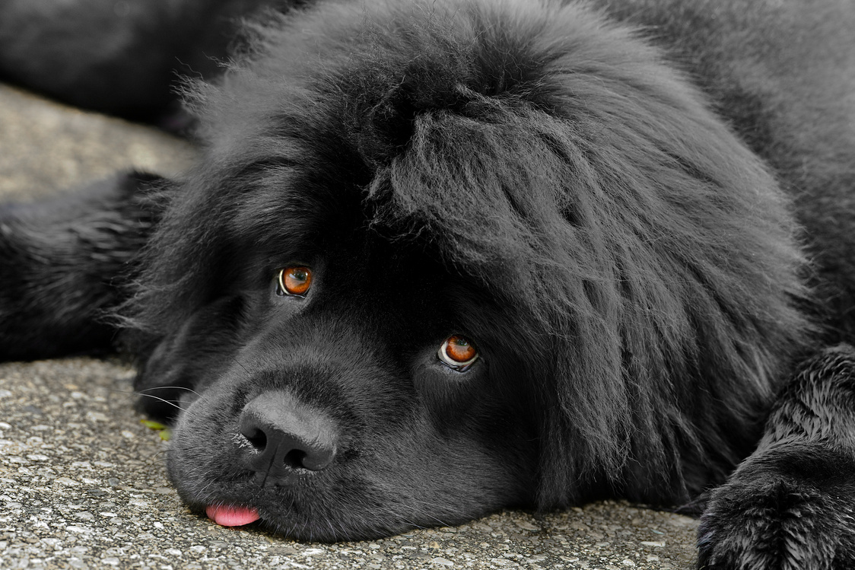
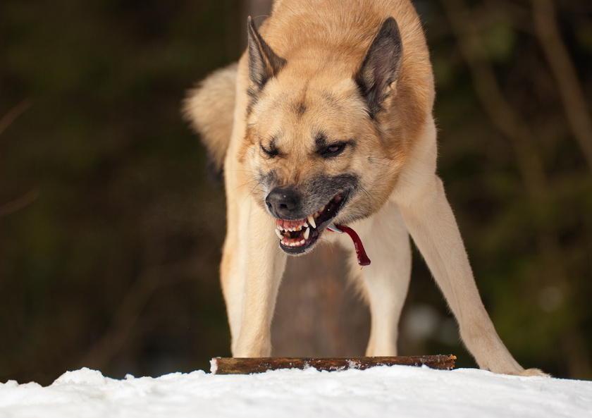
“ᓂᙵᐅᒪᔪᑦ” ᓯᖏᖅᑕᐅᓯᒪᓪᓗᑎᑦ ᐅᕝᕙᓘᓐᓃᑦ “ᖃᓄᐃᓗᐊᖅᑑᔮᙱᑦᑐᑦ” ᓯᖏᖅᑕᐅᓯᒪᔪᑦ
ᐃᓄᓐᓄᑦ ᐃᖅᓯᓵᕆᓲᑦ, ᐆᒪᔪᕐᓄᑦ, ᐅᕝᕙᓘᓐᓃᑦ ᑭᓱᑐᐃᓐᓇᕐᓄᑦ
ᓇᒻᒥᓂᖅ ᑎᒥᒥᓂᒃ ᑮᓯᖃᑦᑕᖅᑐᑦ
ᐊᔾᔨᒋᙱᑕᖓᓂᒃ ᓯᓗᓲᑦ
ᓄᕚᕿᓗᐊᕐᓂᖅᓴᐅᓲᑦ
ᐊᑦᑐᖅᑕᐅᑎᓪᓗᒍ, ᓂᐱᒧᑦ, ᐅᕝᕙᓘᓐᓃᑦ ᖃᐅᒪᒧᑦ ᐱᓗᐊᖅᑐᖅ
ᓂᐱᖃᙱᓐᓂᖅᓴᐅᔪᑦ ᐅᕝᕙᓘᓐᓃᑦ ᓄᒫᓱᓐᓂᖅᓴᐅᔪᑦ
ᓂᕆᒡᒐᖅᑐᑦ ᐃᒥᒡᒐᖅᑐᑦ
ᑐᙵᓇᓗᐊᖅᑐᖅ
ᐱᓱᒡᒐᖅᑐᑦ ᓅᒍᓐᓇᙱᑦᑐᓪᓘᓐᓃᑦ (ᐃᓚᖓᒍᑦ ᐅᕝᕙᓘᓐᓃᑦ ᓅᒍᓐᓇᐃᓪᓕᑦᑎᐊᒻᒪᕆᒃᓯᒪᔪᑦ)

Slide 10
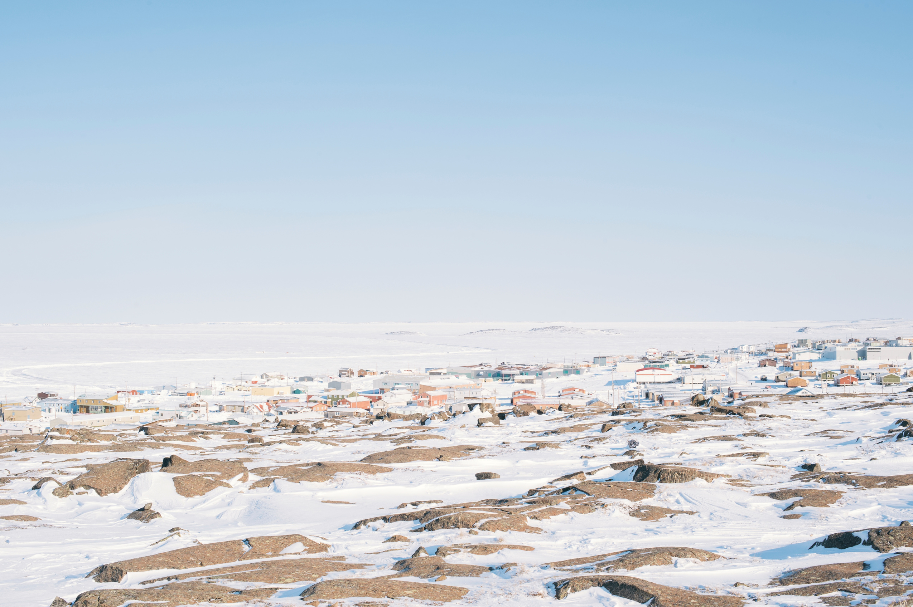
ᖃᓄᐃᓕᓲᖑᓱᕆᕕᒋᑦ ᕿᒻᒥᖅ ᑲᖐᒋᔭᐅᒍᓂ ᓯᖏᖅᑕᐅᓯᒪᒋᐊᖓᓂᒃ?

Slide 11
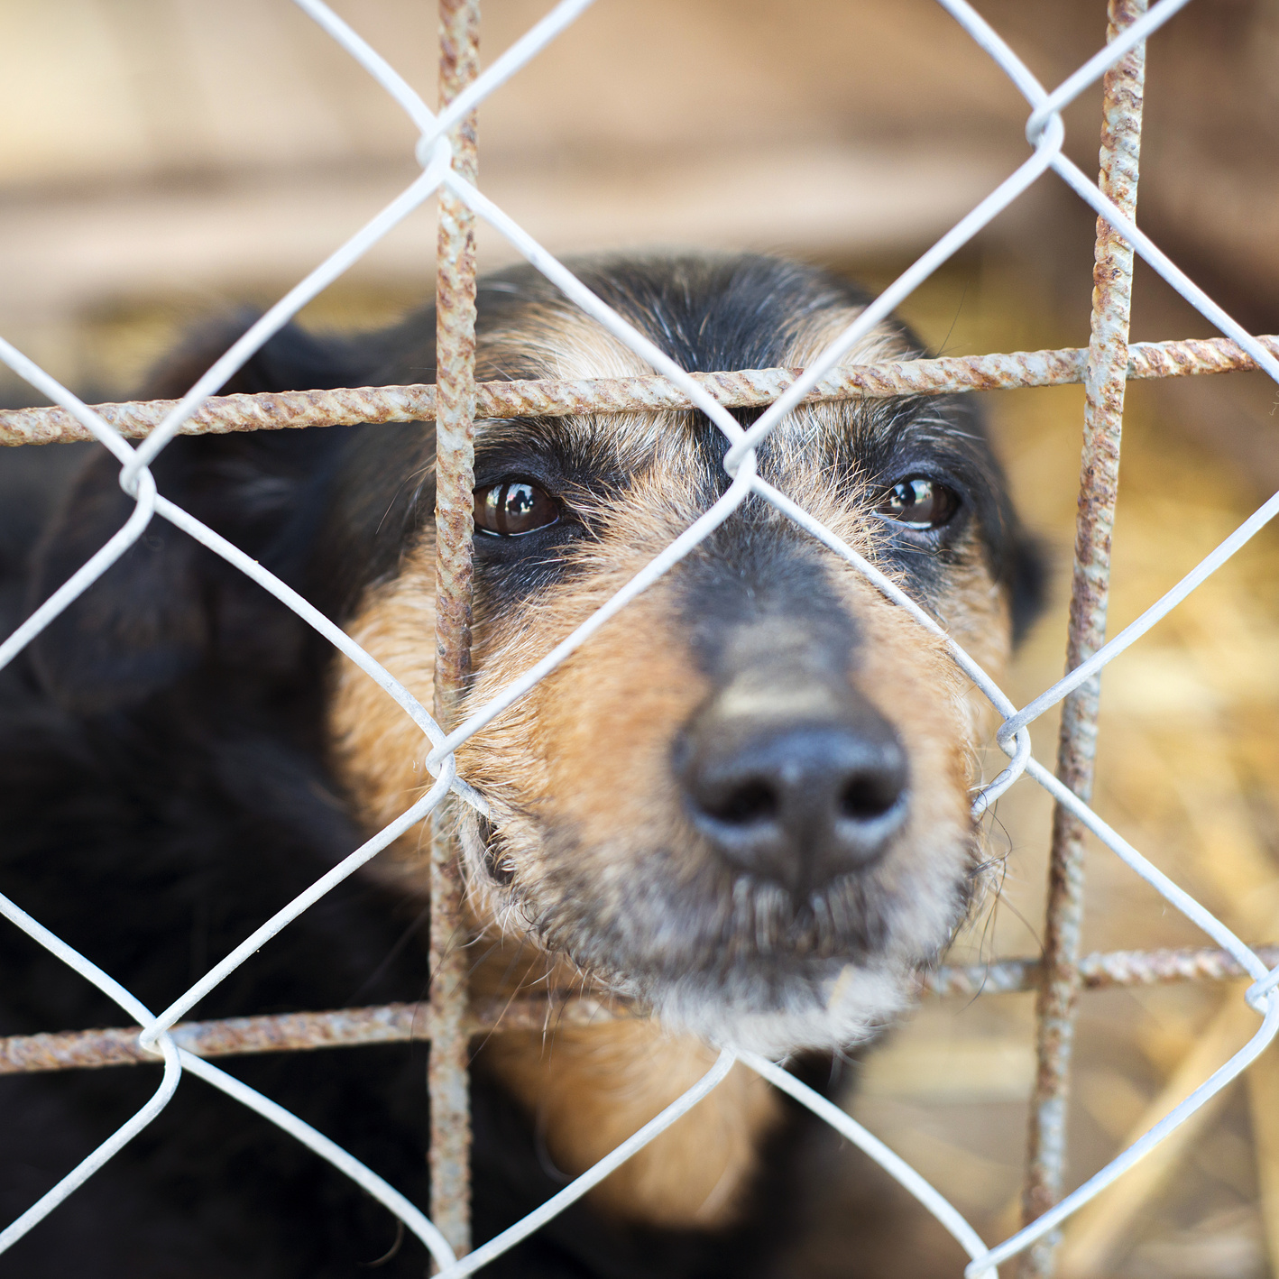
ᑲᖐᒋᔭᐅᔪᑦ ᓯᖏᖅᑕᐅᓯᒪᓱᕆᒋᐊᖏᖕᓂᒃ
ᕿᒻᒥᖅ ᑲᖐᒋᔭᐅᓐᓂᕈᓂ ᓯᖏᖅᑕᐅᓯᒪᔪᖅ, ᐃᓄᑑᑎᑕᐅᑲᐅᑎᒋᔭᕆᐊᓕᒃ ᐊᒻᒪᓗ ᐊᓯᖏᖕᓂᒃ ᕿᒻᒥᓃᑎᑕᐅᙱᓪᓗᓂ ᐃᓄᓐᓂᓗ.
ᐃᓄᑑᑎᒃᑯᕕᐅᒃ ᐊᐃᑦᑐᐃᒐᔭᙱᑦᑐᖅ ᐊᓯᖏᖕᓂᒃ ᕿᒻᒥᓂᑦ ᐃᓄᓐᓂᓪᓘᓐᓃᑦ ᐅᐊᑦᑎᔭᐅᑎᓪᓗᒍ ᓯᖏᖅᑕᐅᓯᒪᔪᕐᔫᔮᕆᐊᖓᓂᒃ ᐃᓛᓐᓂᒃᑯᑦ ᕿᒻᒥᖅ ᕿᑭᖅᑕᐅᑲᐅᑎᒋᒍᓐᓇᖅᑐᖅ.
ᕿᒻᒥᖅ ᓯᖏᖅᑕᐅᓯᒪᔪᕐᔫᔮᕈᓂ, ᑐᖁᒐᔭᖅᑐᖅ 7−ᓂᒃ ᑎᑭᓪᓗᒍ 10−ᓄᑦ ᐅᓪᓗᓄᑦ.

Slide 12
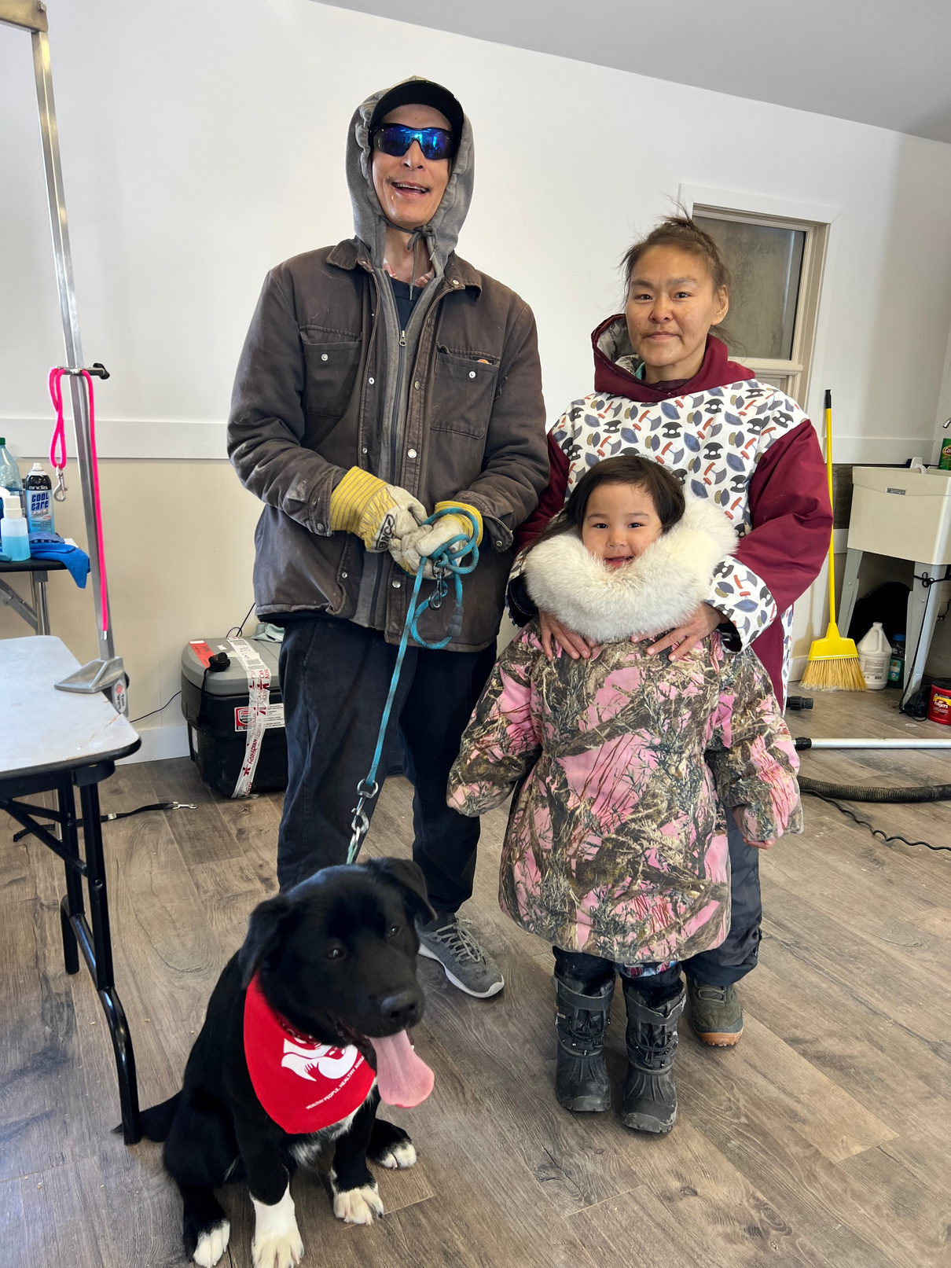
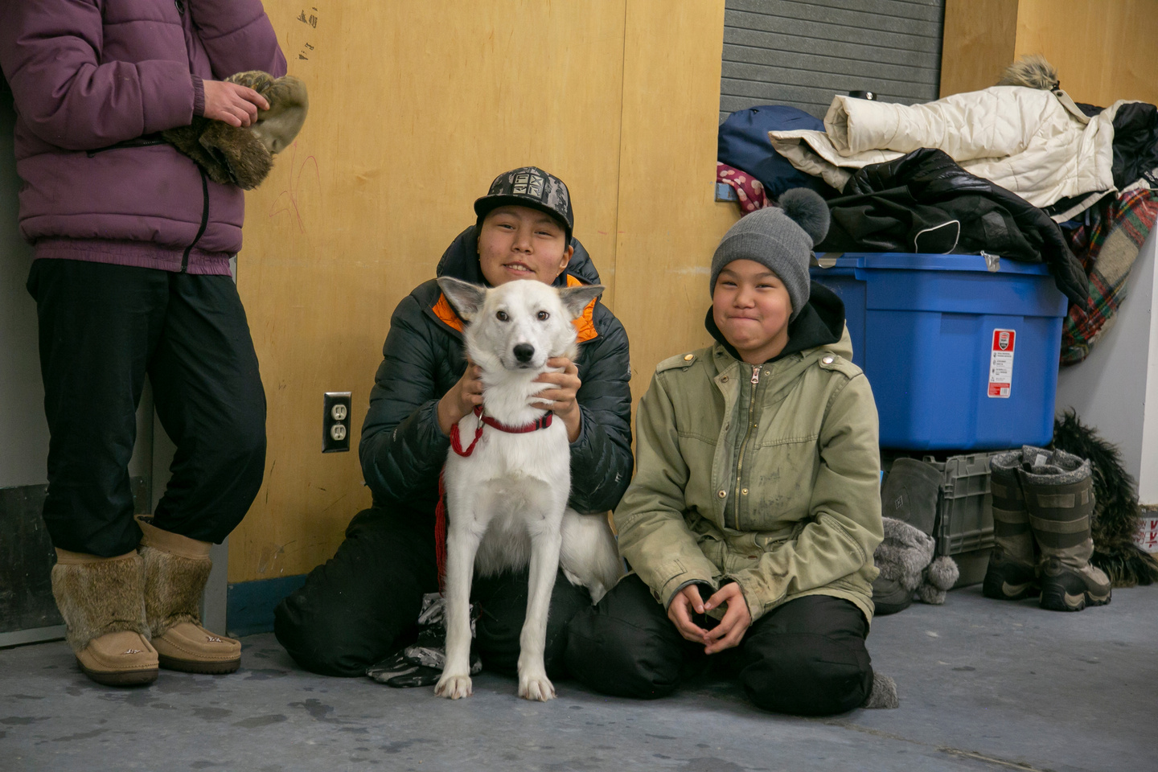
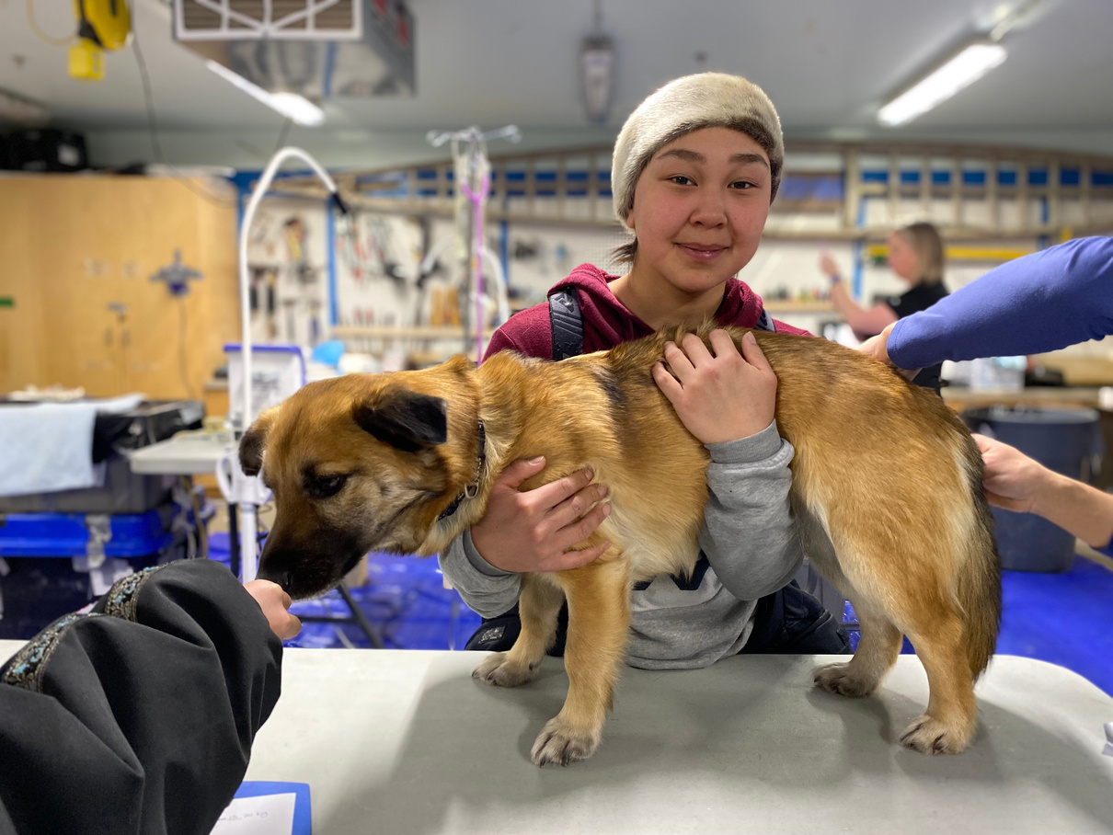
ᖃᓄᐃᓕᐅᕈᓐᓇᖅᐲᑦ ᐃᑲᔪᕋᔭᖅᑐᒥᒃ ᕿᒻᒦᑦ ᓯᖏᖅᑕᐅᑦᑕᐃᓕᖁᓪᓗᒍ?

Slide 13
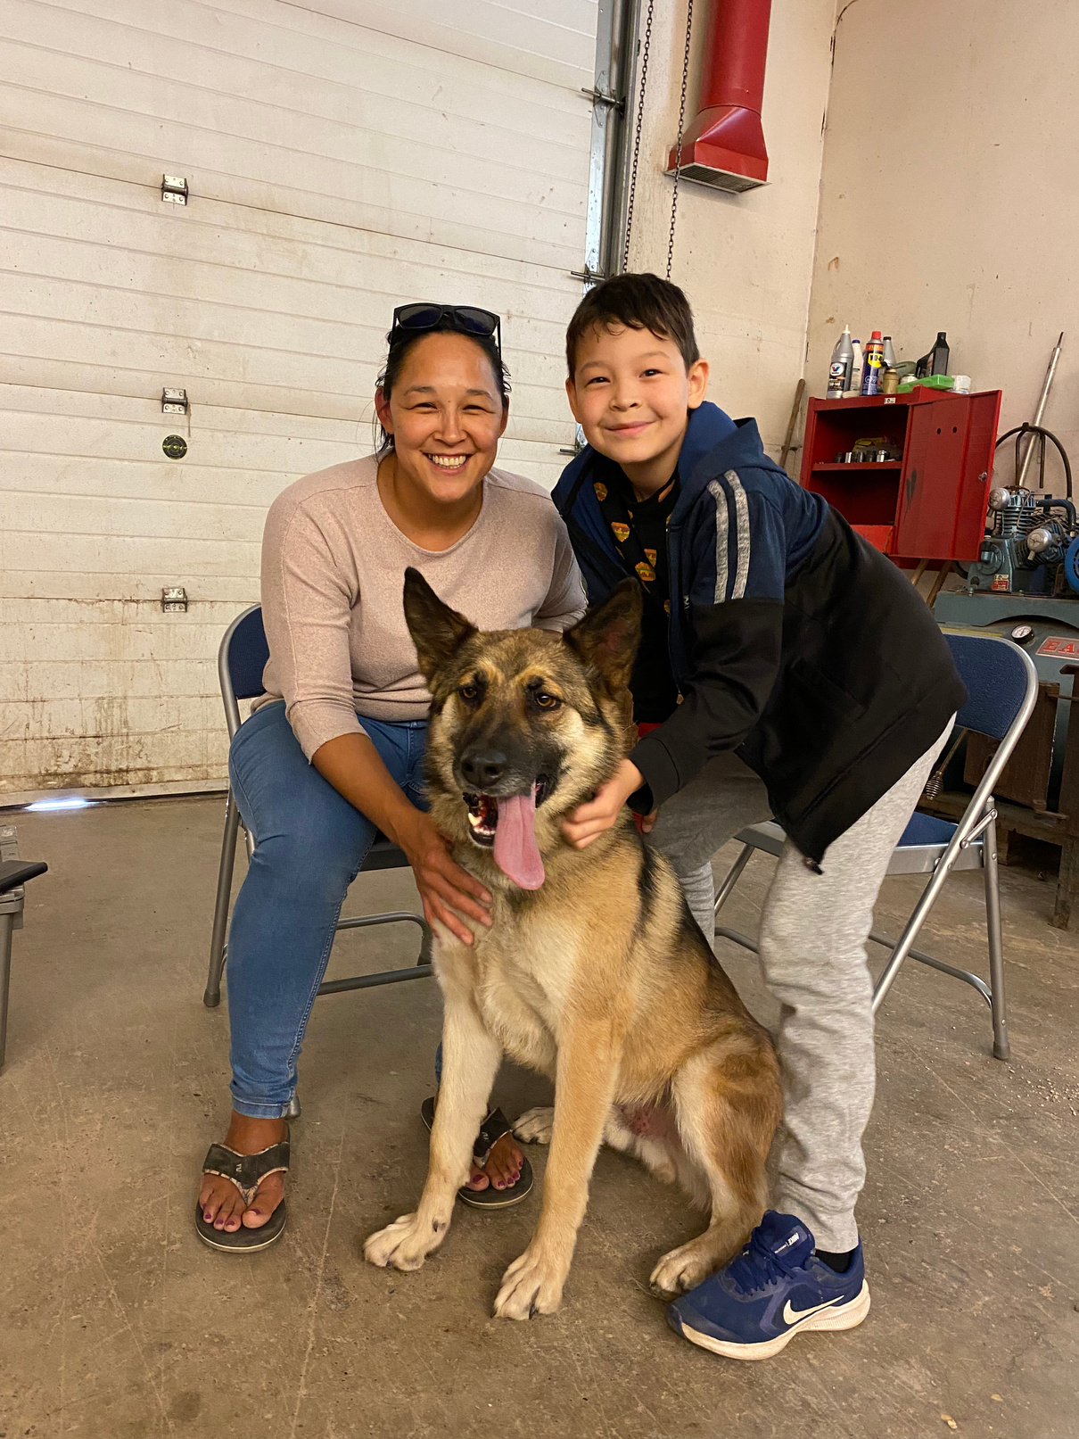
ᖃᓄᐃᓕᐅᕈᓐᓇᖅᑕᑎᑦ ᓯᖏᖅᑕᐅᑦᑕᐃᓕᒪᑎᑦᑎᓗᑎᑦ
ᖃᓄᐃᓕᐅᕈᓐᓇᖅᑕᑎᑦ ᐃᑲᔪᕋᔭᖅᑐᑦ ᕿᒻᒦᑦ ᓯᖏᖅᑕᐅᑦᑕᐃᓕᓗᓂ:
ᕿᒻᒦᑦ ᐊᕐᕌᒍᑕᒫᑦ ᓯᖏᖅᑕᐅᑦᑕᐃᓕᒪᒍᑎᒥᒃ ᑲᐱᔭᐅᒃᑲᖃᑦᑕᕐᓗᒍ
ᕿᒻᒦᑦ ᐊᓯᖏᖕᓂᑦ ᕿᒻᒥᓃᑦᑕᐃᓕᒪᑎᖃᑦᑕᕐᓗᒍ
ᕿᒻᒦᑦ ᐃᓗᐊᓃᑎᖃᑦᑕᕐᓗᒍ ᐅᕝᕙᓘᓐᓃᑦ ᐃᓯᖅᑎᖃᑦᑕᕐᓗᒍ ᑎᕆᒐᓂᐊᕐᒥᒃ ᑕᑯᔪᖃᕋᐃᒍᓂ ᓄᓇᓕᖕᓂ
ᕿᒻᒦᑦ ᐱᑐᒃᓯᒪᑎᖃᑦᑕᕐᓗᒍ ᐊᒻᒪᓗ ᓇᒧᕈᓘᔮᖅᑎᖃᑦᑕᙱᓪᓗᒍ ᓄᓇᓕᒻᒥ
ᖃᐅᔨᓴᕐᓗᒍ ᖁᒻᒦᑦ ᓯᖏᖅᑕᐅᓯᒪᔫᔮᙱᒃᑲᓗᐊᕐᒪᖔᕐᒥᒃ

Slide 14
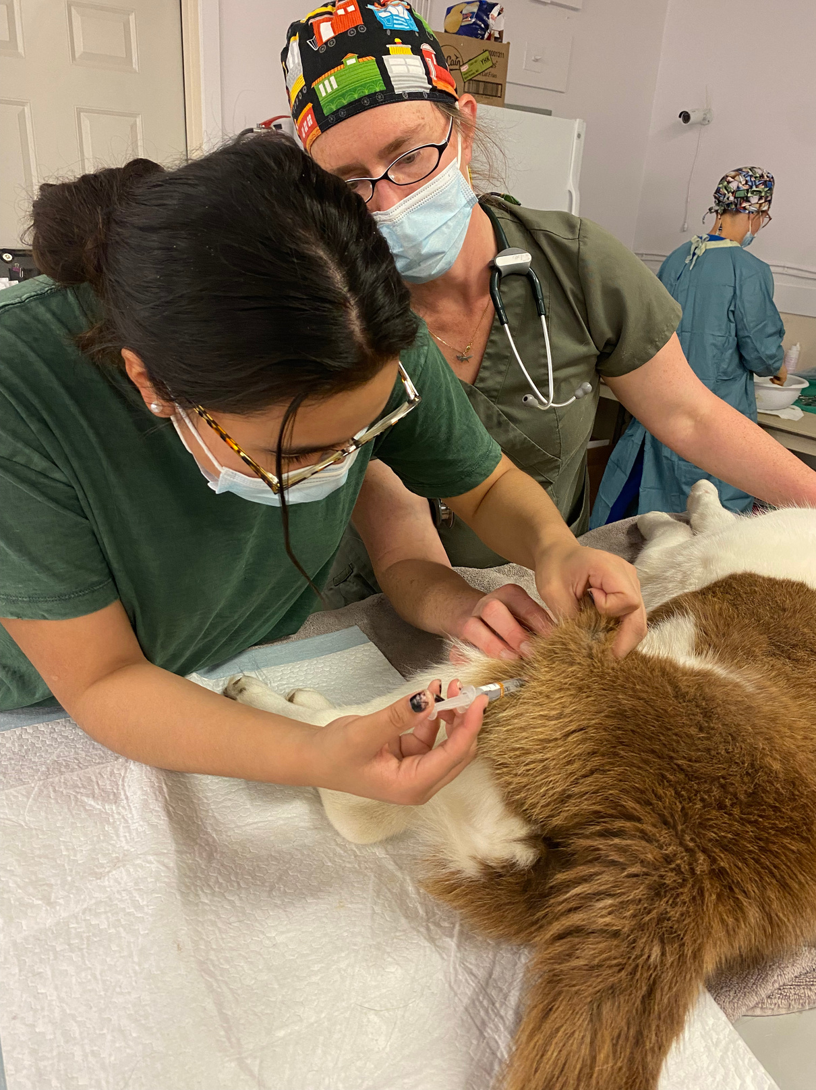

ᓯᖏᖅᑕᐅᑦᑕᐃᓕᒪᒍᑏᑦ ᑲᐴᑏᑦ
ᕿᒻᒦᑦ ᓯᖏᖅᑕᐅᑦᑕᐃᓕᒪᑎᓛᖑᒍᓐᓇᖅᑕᐃᑦ, ᓯᖏᖅᑕᐅᑦᑕᐃᓕᒪᒍᑎᒥᒃ ᑲᐱᔭᐅᒃᑲᖃᑦᑕᕐᓗᒍ
ᑐᒪᓐᓇ ᑐᑭᓕᒃ ᑮᔭᐅᒍᑎᑦ ᐊᐃᑦᑐᖅᑕᐅᓯᒪᔪᒧᑦ ᑎᕆᒐᓂᐊᕐᒧᑦ ᐅᕝᕙᓘᓐᓃᑦ ᕿᒻᒥᒧᑦ, ᐊᐅᖏᖕᓃᑦᑐᖅ ᑲᐴᑎᒦᙶᖅᑐᖅ ᐋᓐᓂᐊᖅᑕᐃᓕᒪᒍᑎᓕᒃ ᐊᐃᑦᑐᐃᑦᑕᐃᓕᒪᑎᑦᑎᒐᔭᖅᑐᖅ
ᕿᒻᒦᑦ ᑲᐱᔭᐅᖃᑦᑕᕆᐊᓖᑦ −ᐊᕐᕌᖑᑕᒫᖑᓲᖅ − ᐊᐃᑦᑐᖅᑕᐅᑦᑕᐃᓕᒪᖁᓪᓗᒋᑦ.

Slide 15
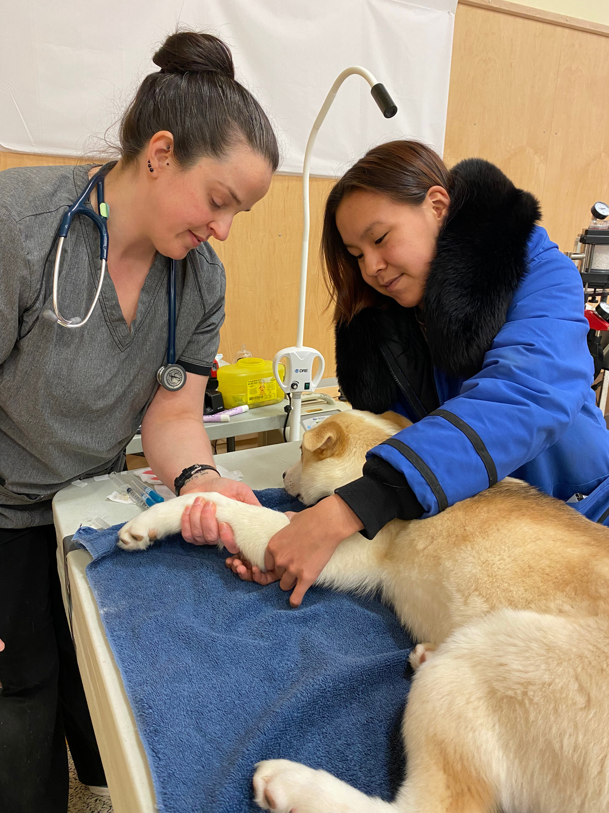

ᐆᒪᔪᕐᓄᑦ ᑕᑯᔭᐅᕝᕖᑦ
ᐆᒪᔪᕐᓄᑦ ᑕᑯᔭᐅᕝᕖᑦ ᑭᒡᓕᖃᙱᑦᑐᑦ ᑎᒥᖏᑦ ᐊᕐᕌᒍᑕᒫᑦ ᑕᑯᔭᐅᕝᕕᓂ ᒪᑐᐃᖓᑎᑦᑎᓲᑦ ᐃᓚᖏᓐᓂ ᓄᓇᕗᑦ ᓄᓇᓕᖏᓐᓂ. ᑕᐃᒃᑯᐊ ᐱᐅᕗᑦ ᕿᒻᒦᑦ ᑲᐱᔭᐅᑎᒋᐊᖅᑐᒃᑲᖃᑦᑕᕐᓗᒍ ᓯᖏᖅᑕᐅᑦᑕᐃᓕᒪᒍᙱᒥᒃ!
ᐱᑕᖃᙱᒃᑯᓂ, ᐊᐱᕆᓗᒍ ᓄᓇᓕᓐᓂ ᐋᓐᓂᐊᕐᕕᒃ ᐅᕝᕙᓘᓐᓂᑦ ᕿᒧᒃᓯᖅᑎ ᖃᐅᔨᒪᒍᑎᑦ ᐊᐱᕆᓗᒋᑦ ᑲᐱᔭᐅᒍᓐᓇᕐᒪᖔᖅ ᕿᒻᒦᑦ ᓇᒥ ᓄᓇᓕᖕᓂ.

Slide 16
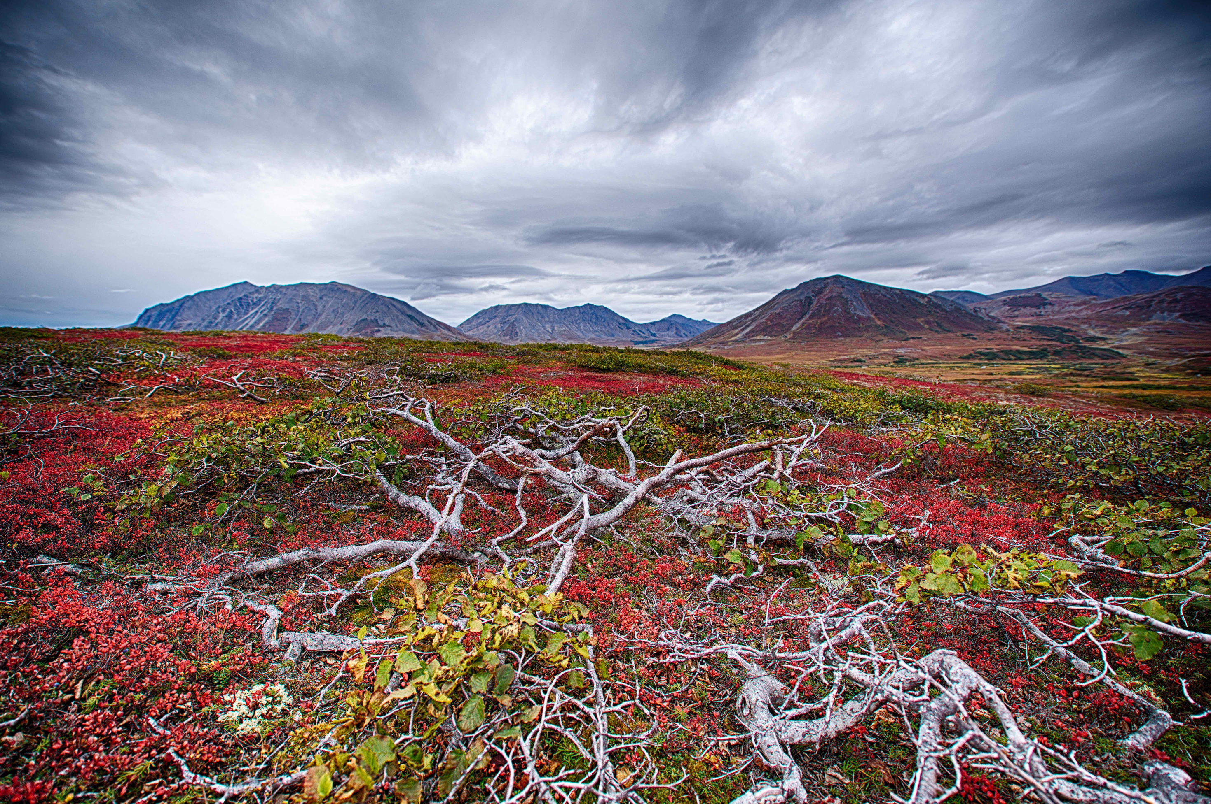
ᐆᑦᑐᕋᓚᐅᖅᑕ

