Slide 1
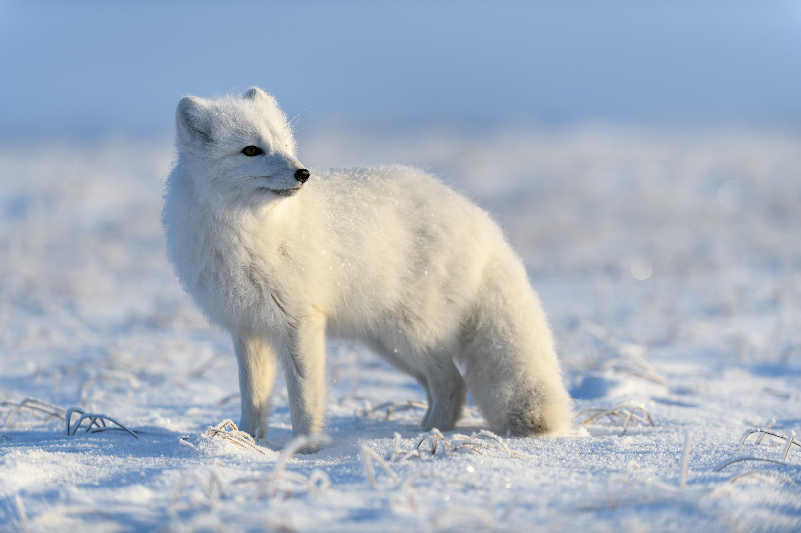

VWB ᓄᓇᕗᒻᒥ ᓯᖏᖅᑕᐅᓯᒪᔪᑦ ᖃᐅᔨᒪᔭᐅᓕᕐᓂᖏᑦ ᐊᒻᒪᓗ ᓯᖏᖅᑕᐅᑦᑕᐃᓕᒪᑎᑦᑎᓂᕐᒧᑦ ᐃᓕᓐᓂᐊᒐᒃᓴᐅᔪᑦ
ᐃᓕᓐᓂᐊᕈᑎᒃᓴᖅ 1:
ᓯᖏᖅᑕᐅᓯᒪᔪᑦ ᐊᒻᒪᓗ ᐆᒪᔪᑦ

Slide 2
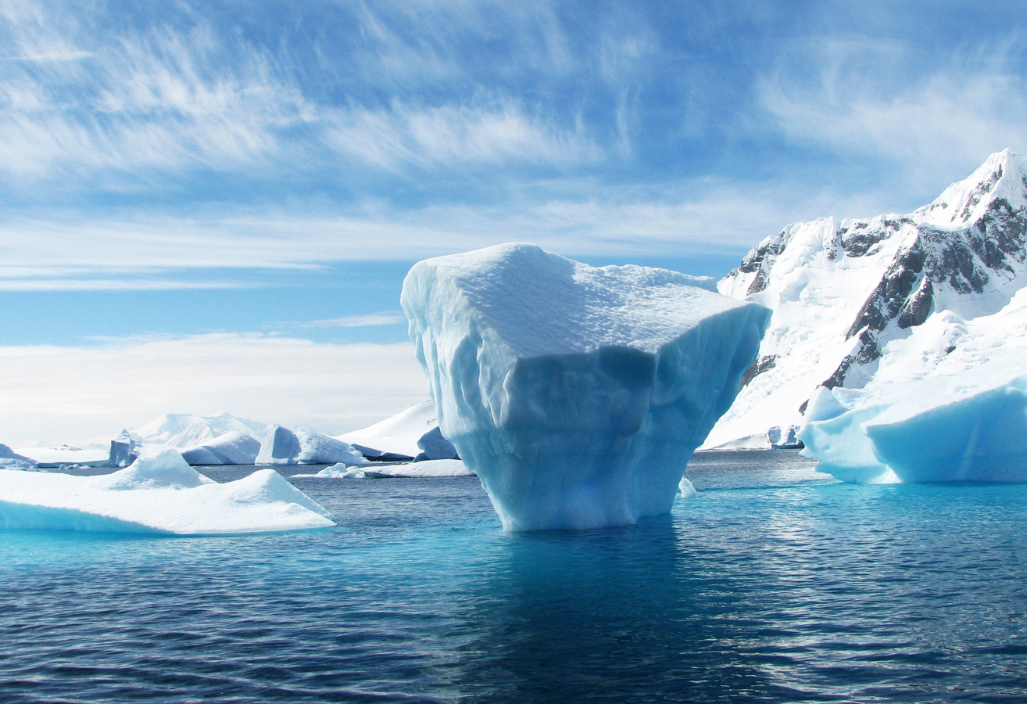
ᐃᓕᓐᓂᐊᖅᑕᐅᔪᒪᔪᑦ
ᐃᓱᓕᑉᐸᑦ ᑖᓐᓇ ᐃᓕᓐᓂᐊᕋᒃᓴᖅ, ᐃᒪᐃᓕᐅᕈᓐᓇᓕᕐᓂᐊᖅᑐᖓ:
ᓇᓗᓇᐃᔭᐃᓗᖓ ᑭᓲᒻᒪᖔᖅ ᓯᖏᖅᑕᐅᓯᒪᓂᖅ.
ᓇᓗᓇᐃᔭᕐᓗᒋᑦ ᓇᓗᓇᕈᓐᓃᕈᑎᖏᑦ ᐊᒻᒪᓗ ᖃᓄᐃᓕᐅᓲᖑᓂᖏᑦ ᓯᖏᖅᑕᐅᓯᒪᔪᑦ ᑎᕆᒐᓐᓂᐊᑦ
ᓇᓗᓇᐃᖅᓯᓗᖓ ᖃᓄᖅ ᐊᑦᑕᕐᓇᖅᑕᐃᓕᒪᒍᓐᓇᕐᒪᖔᕐᒪ ᐆᒪᔪᕐᓃᑦᑎᓪᓗᖓ

Slide 3
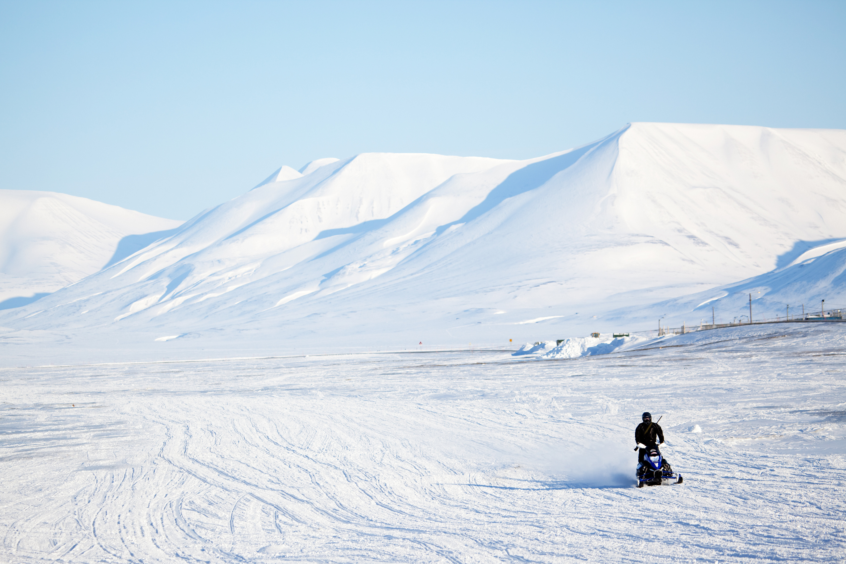
ᑭᓱᓂᑦ ᖃᐅᔨᒪᕕᑦ ᓯᖏᖅᑕᐅᓯᒪᔪᑦ ᒥᒃᓵᓄᑦ?
ᑭᓱᓂᑦ ᖃᐅᔨᒪᕕᑦ?
ᑭᓱᓂᑦ ᖃᐅᔨᒪᔪᒪᕕᑦ?

Slide 4


ᓯᖏᖅᑕᐅᓯᒪᔪᑦ
ᓯᖏᖅᑕᐅᓯᒪᓂᖅ ᐃᒪᐃᑦᑑᕗᖅ ᑐᖁᓐᓇᖅᑐᖅ ᐋᓐᓂᐊᖅ ᐊᐃᑦᑑᑕᒥᓂᐅᓲᖑᓪᓗᓂ.
ᐊᐃᑦᑑᑕᒥᓂᐅᓲᖅ ᖁᐱᕐᕈᕋᓛᑦ ᒥᑭᓗᐊᒧᑦ ᑕᑯᔪᓐᓇᙱᑕᑎᑦ.
  ᖃᓄᐃᑦᑐᓂᑦ ᐊᐃᑦᑑᑕᐅᓲᓂᑦ ᐊᓯᖏᖕᓂᒃ ᖃᐅᔨᒪᒋᕕᑦ?
  ᖃᓄᖅ ᑐᑭᖃᕐᒪᑦ ᑐᖁᔾᔪᑕᐅᓲᖑᒋᐊᖓᓂᒃ?

Slide 5

ᐆᒪᔪᐃᑦ ᓯᖏᖅᑕᐅᓯᒪᔪᑦ
ᓯᖏᖅᑕᐅᓲᖅ ᐋᓐᓂᐊᖅ ᐆᒪᔪᕐᓂᑦ ᐊᒃᓱᒻᒪᕆᒃ ᐋᓐᓂᐊᓕᖅᑎᑦᑎᓲᖅ
ᐳᕕᑦᑎᑦᑎᓕᓲᖅ ᖃᕋᓴᖏᓐᓂᒃ (ᖃᕋᓴᖏᑦ ᐳᓪᓕᖅᑐᑎᑦ ᐊᖏᓗᐊᓕᖅᑐᑎᑦ)
ᐊᐃᑦᑐᖅᑕᐅᓯᒪᔪᑦ ᐆᒪᔪᐃᑦ ᓯᖏᖅᑕᐅᓯᒪᓪᓗᑎᑦ ᑐᖁᐃᓐᓇᐸᓗᓲᑦ

Slide 6
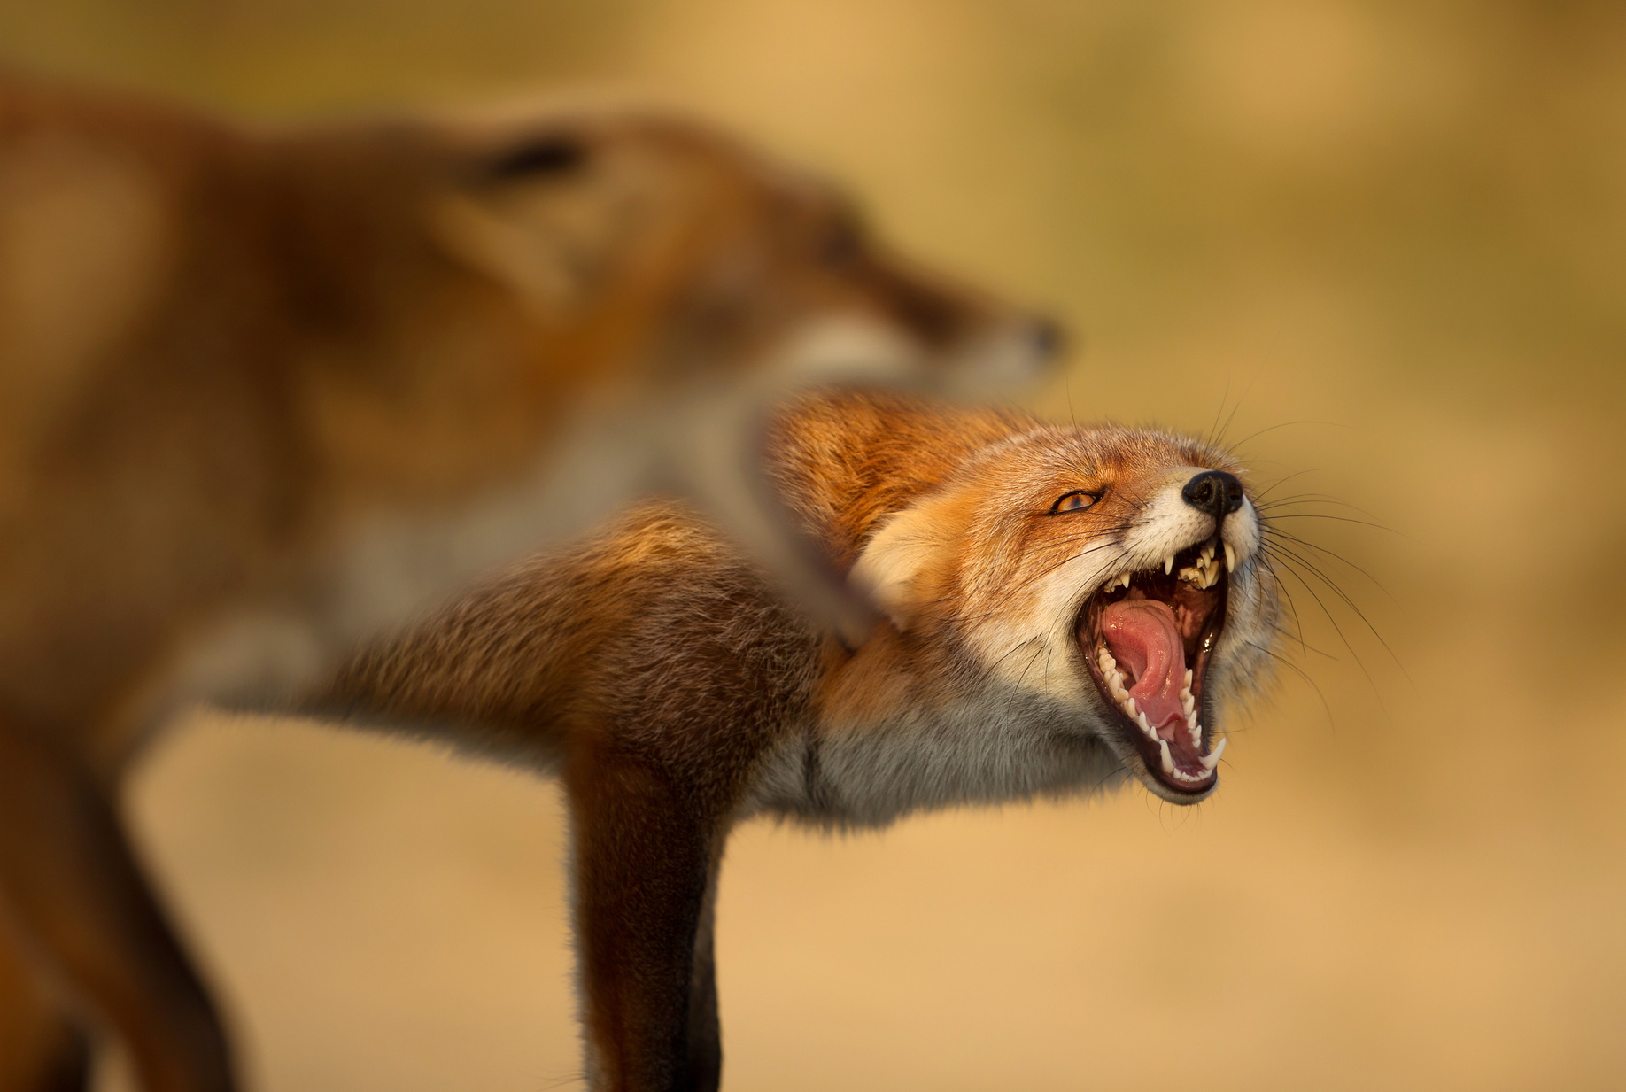
ᓯᖏᖅᓯᔪᖃᕈᓐᓇᖅᑐᖅ ᐊᐃᑦᑐᐃᓗᑎᑦ
ᐊᐃᑦᑑᑕᐅᓲᖅ ᐅᕆᐊᕐᒦᓲᖅ ᐊᐃᑦᑐᖅᑕᐅᓯᒪᔪᓂᑦ ᐆᒪᔪᕐᓂᑦ
ᓯᖏᖅᓯᒪᔪᑦ ᑮᓯᒐᐃᒻᒪᑕ ᐋᓐᓂᐊᙱᑦᑐᒥᒃ ᐆᒪᔪᕐᒥᒃ, ᐋᓐᓂᐊᙱᑦᑐᖅ ᐆᒪᔪᖅ ᓯᖏᖅᓯᒪᓕᕈᓐᓇ ᕐᒥᔪᖅ.
ᐊᐃᑦᑐᖅᑕᐅᓯᒪᔪᑦ ᐆᒪᔪᐃᑦ ᐊᐃᑦᑐᐃᓲᖅ ᐋᓐᓂᐊᕐᒥᒃ ᐊᓯᐊᓄᑦ ᑐᖁᓚᐅᙱᑦᑎᓪᓗᒋᑦ.

Slide 7
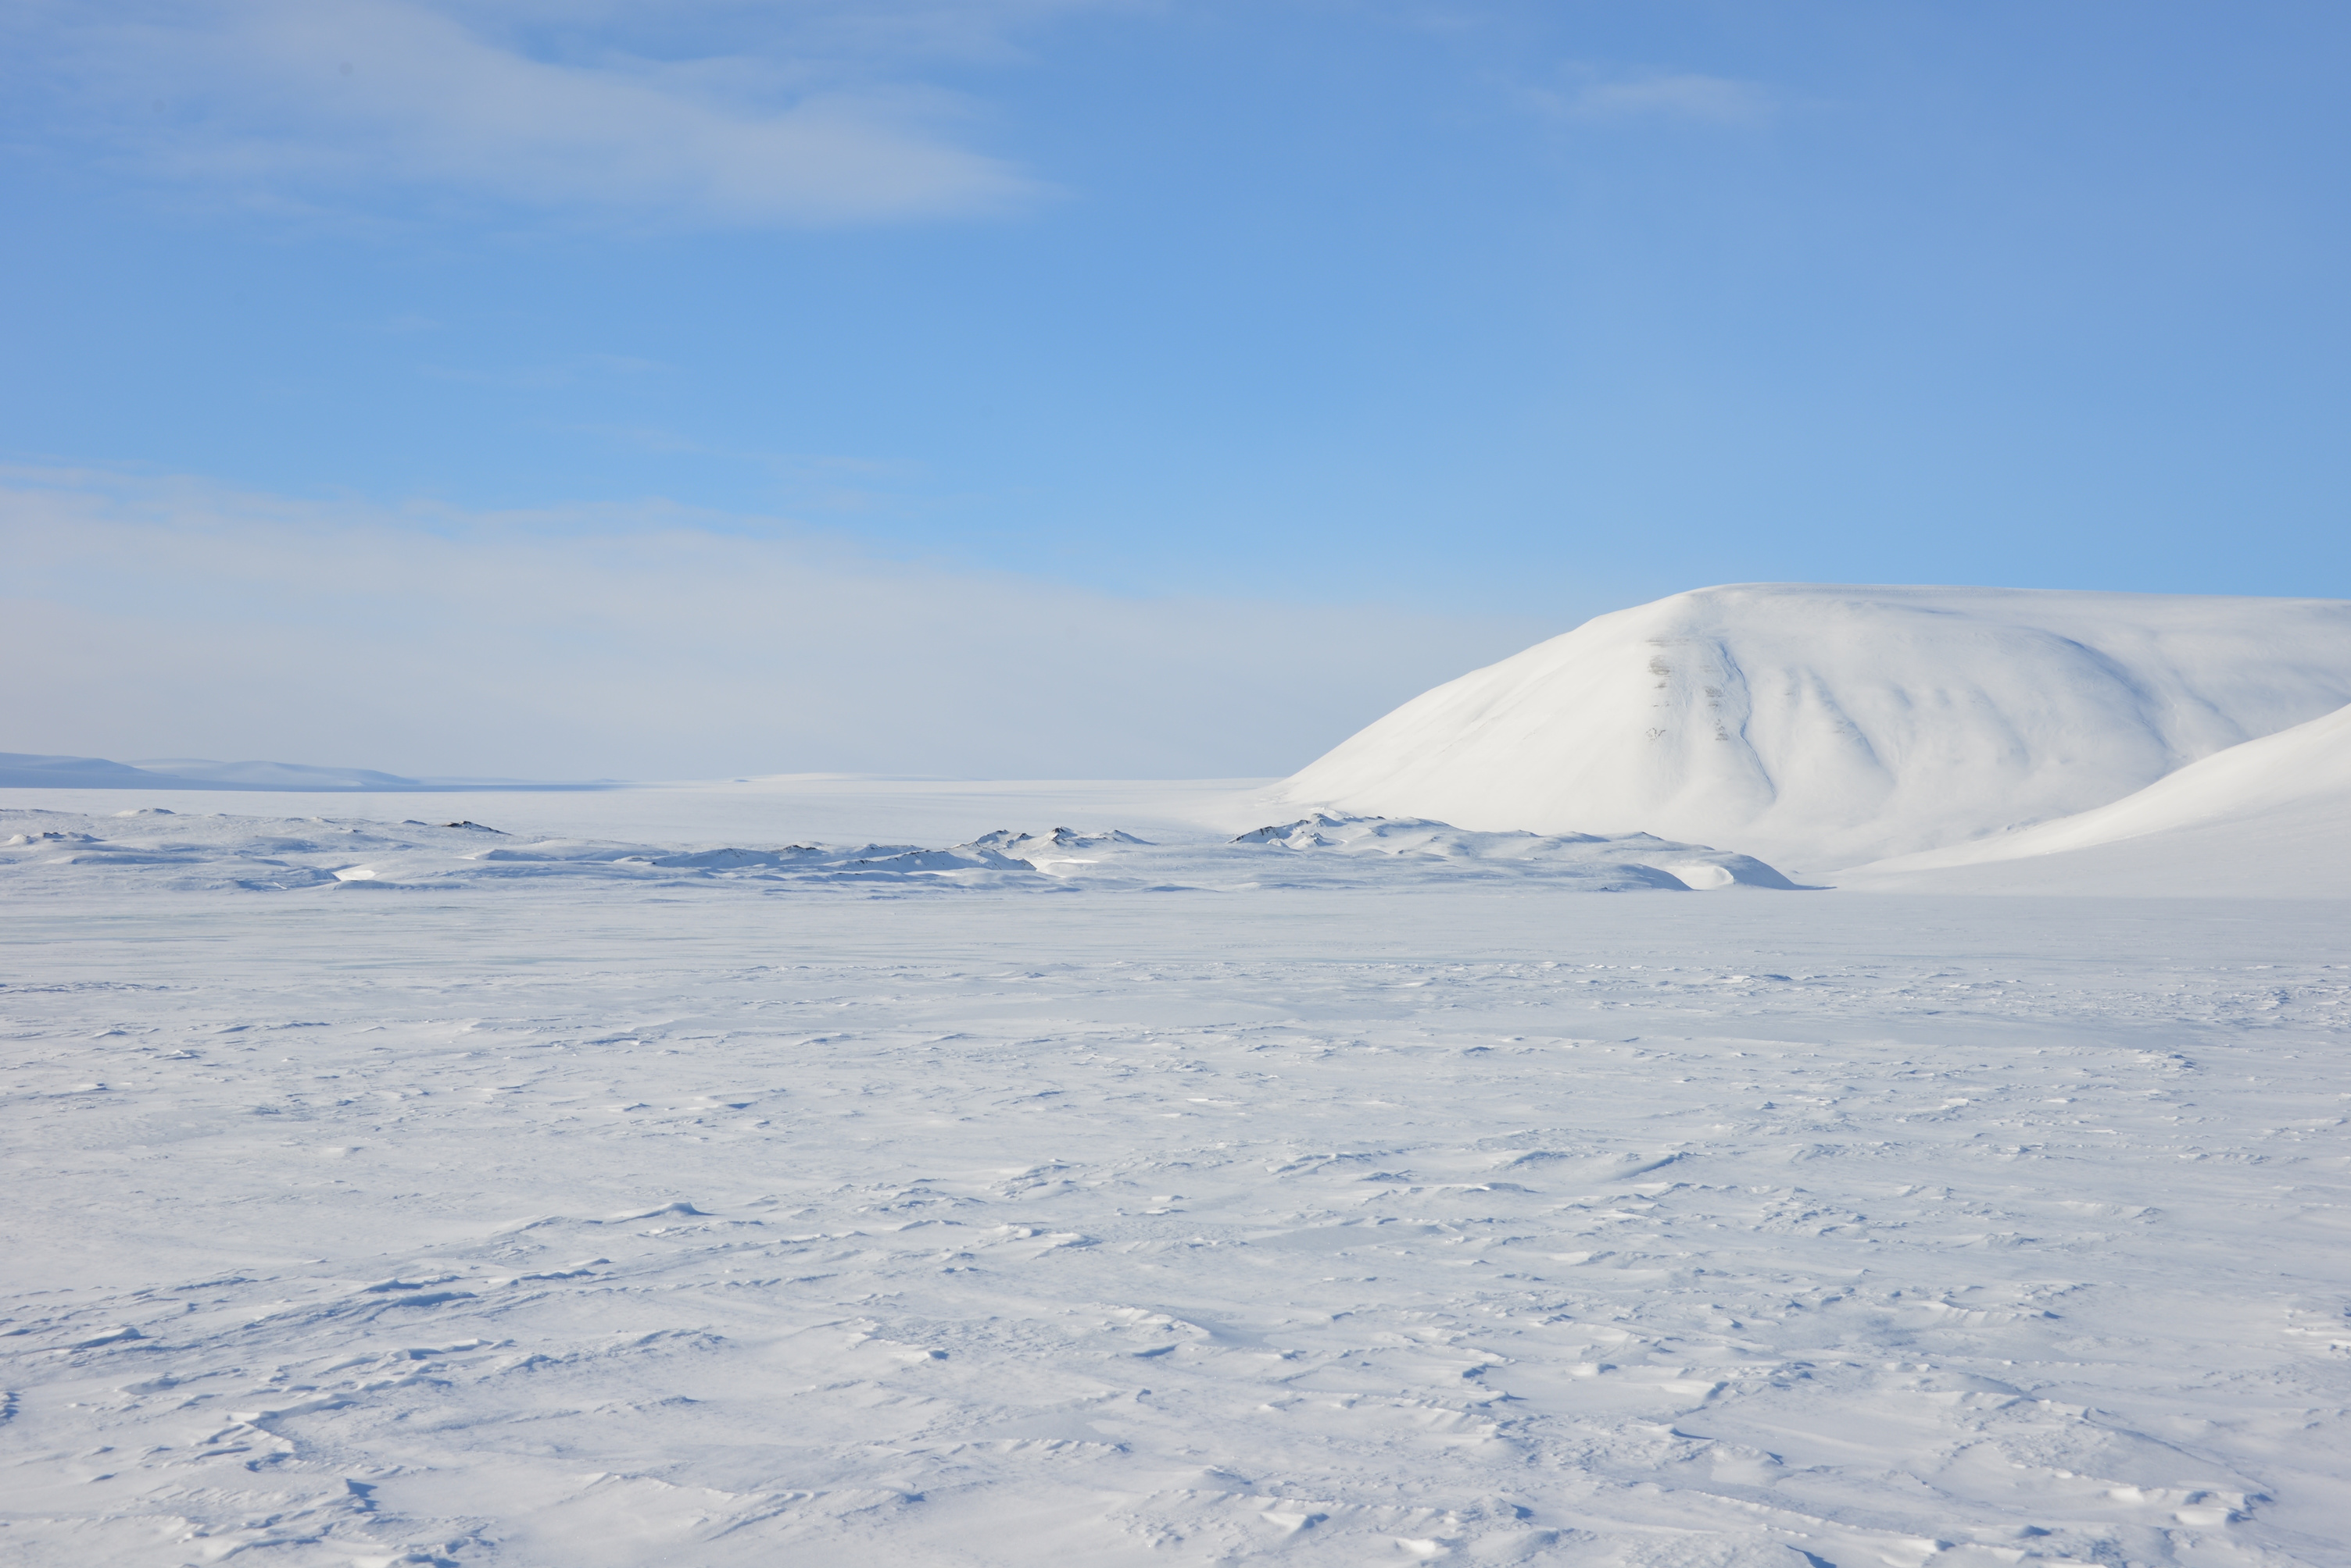
ᓇᓕᐊ ᐅᑭᐅᖅᑕᖅᑐᒥ ᐆᒪᔪᑦ ᓯᖏᖅᑕᐅᔪᓐᓇᓲᖑᕙ?
ᖃᓄᖅ ᐃᕝᕕᑦ ᐃᓱᒪᕕᑦ?

Slide 8
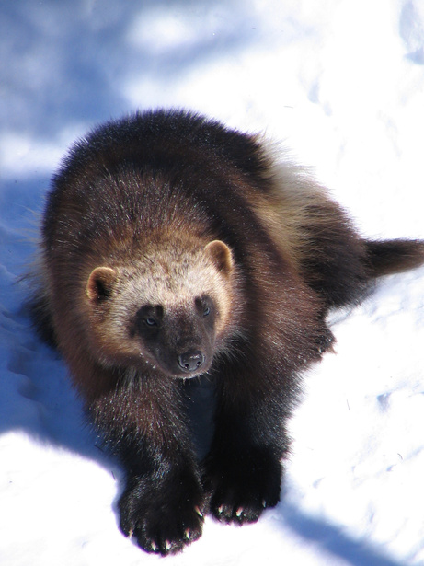
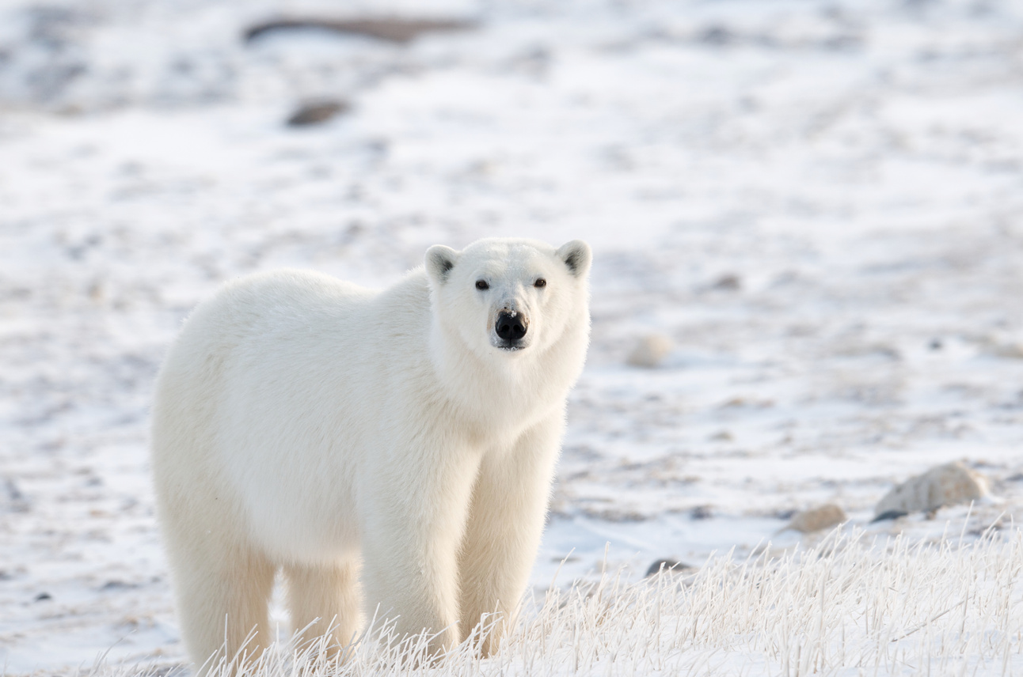
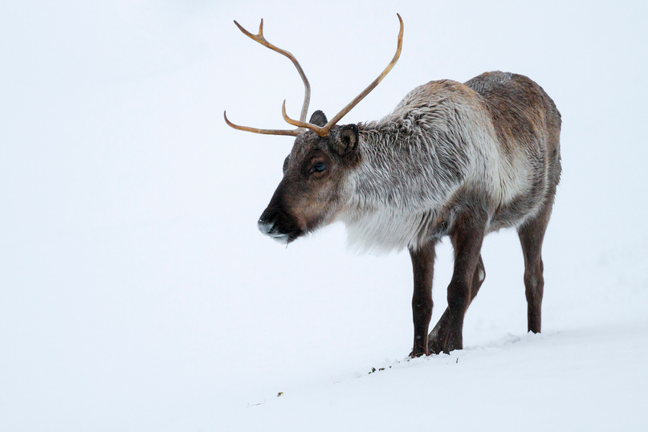
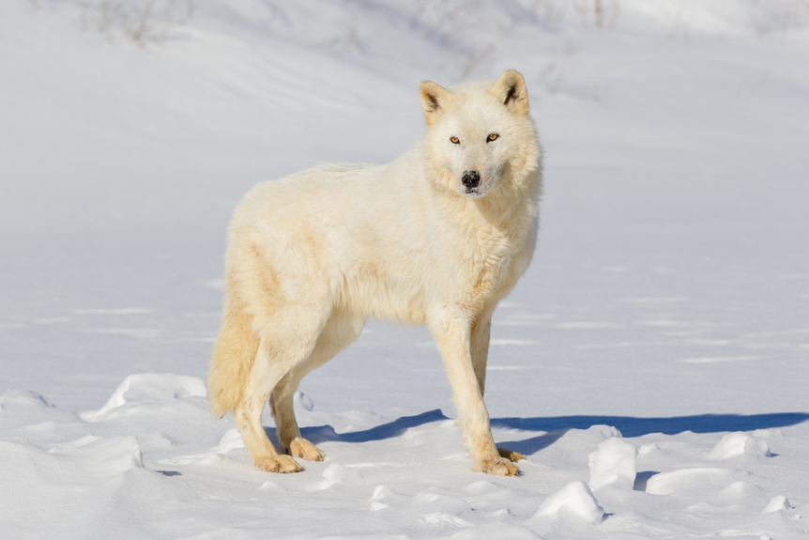
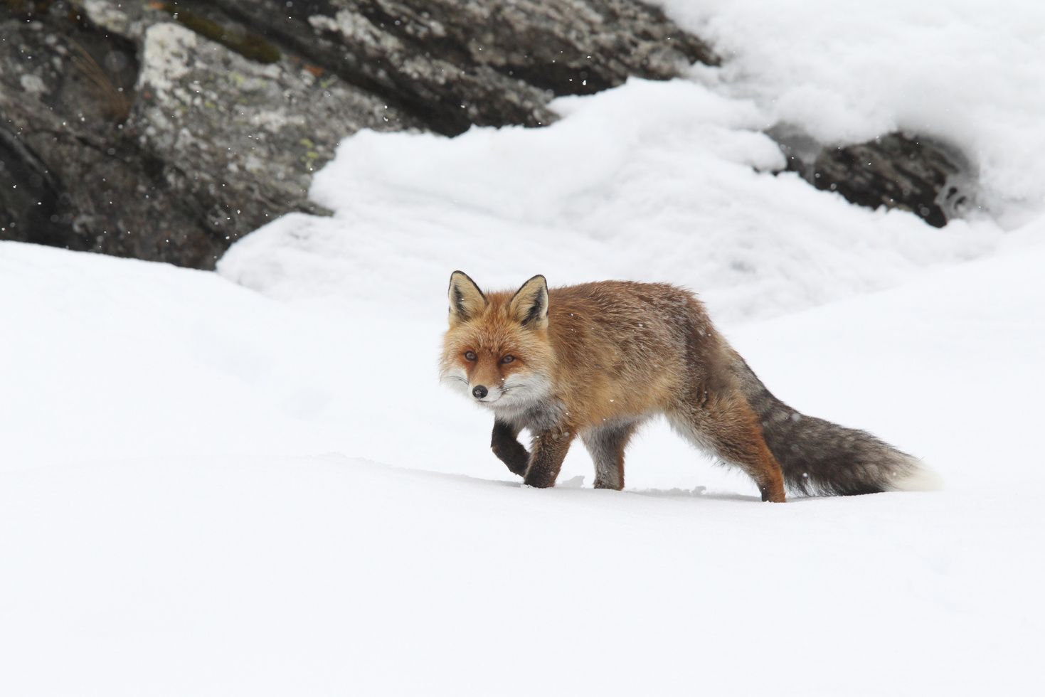
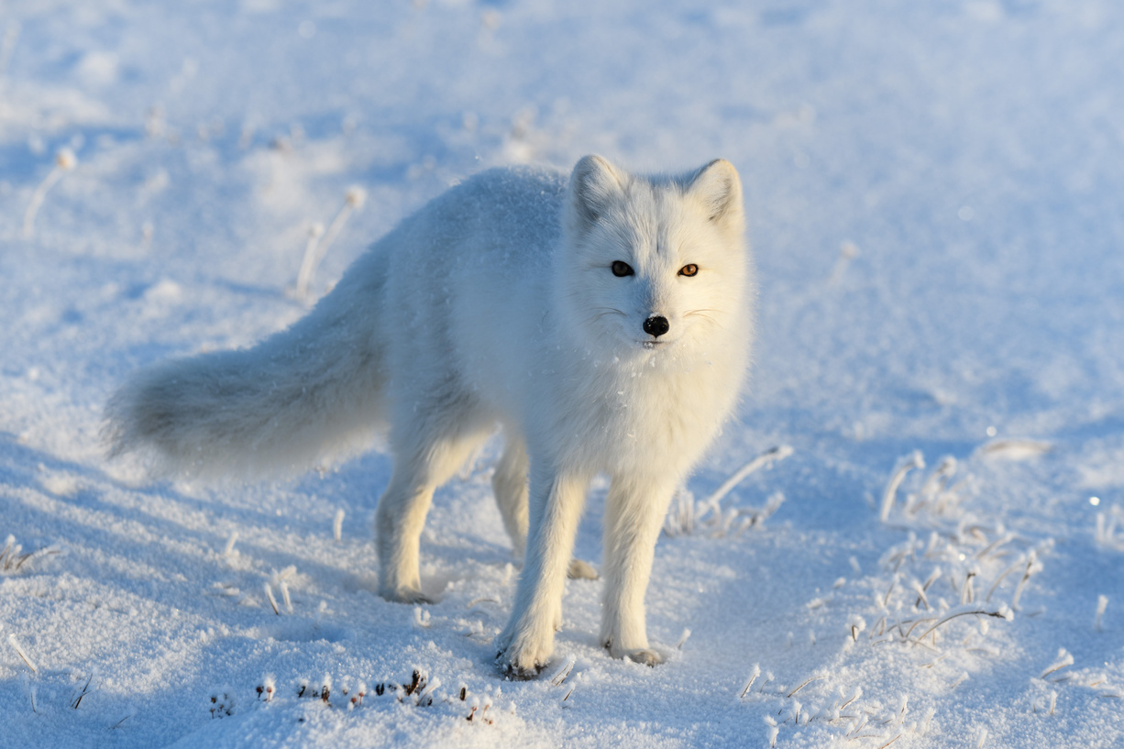
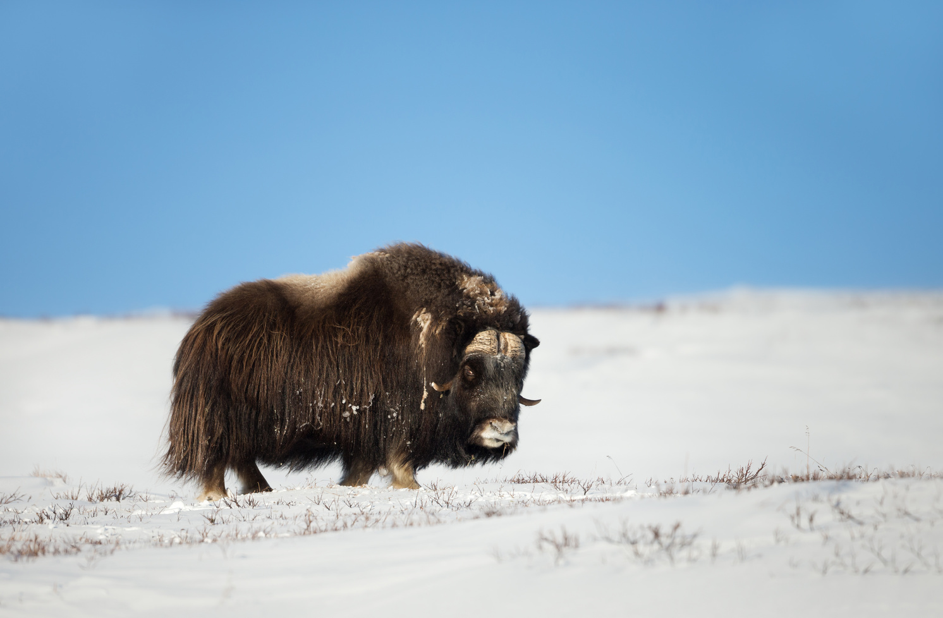
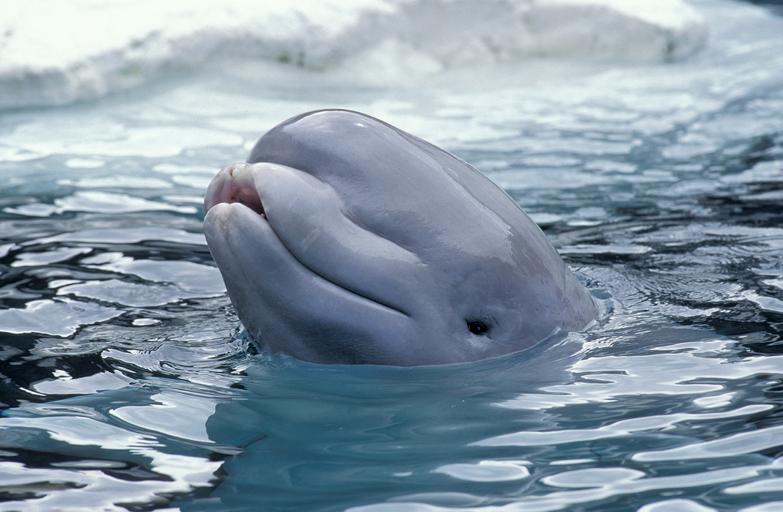
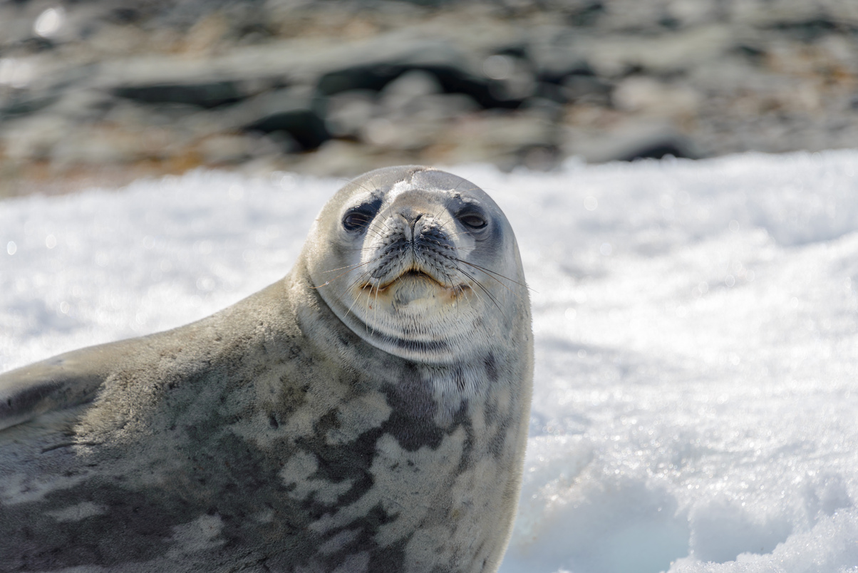
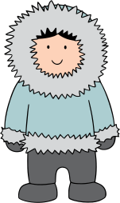
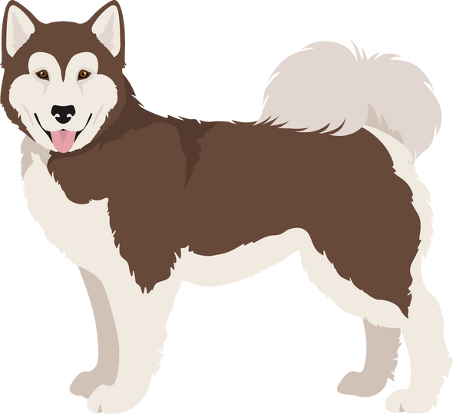
ᑕᒪᐃᓐᓂ ᐆᒪᔪᐃᑦ ᐊᐃᑦᑐᖅᑕᐅᔪᓐᓇᖅᑐᖅ ᓯᖏᖅᑕᐅᓗᑎᑦ
ᐆᒪᔪᐃᑦ ᐊᐅᓖᑦ ᑎᓴᐃᖓᔪᒥᒃ ᑎᖕᒥᐊᖑᙱᓚᑦ ᐅᖃᐅᑕᐅᔪᑦ.
ᑕᒪᓐᓇ ᑐᑭᓕᒃ ᐃᕝᕕᑦ ᐊᒻᒪᓗ ᕿᒻᒦᑦ ᑕᐃᒪᐃᒍᓐᓇᖅᑐᑦ. ᐊᐃᑦᑐᖅᑕᐅᓯᒪᔪᑦ ᓯᖏᖅᑕᐅᓯᒪᒍᓐᓇᖅᑐᑎᑦ!

Slide 9
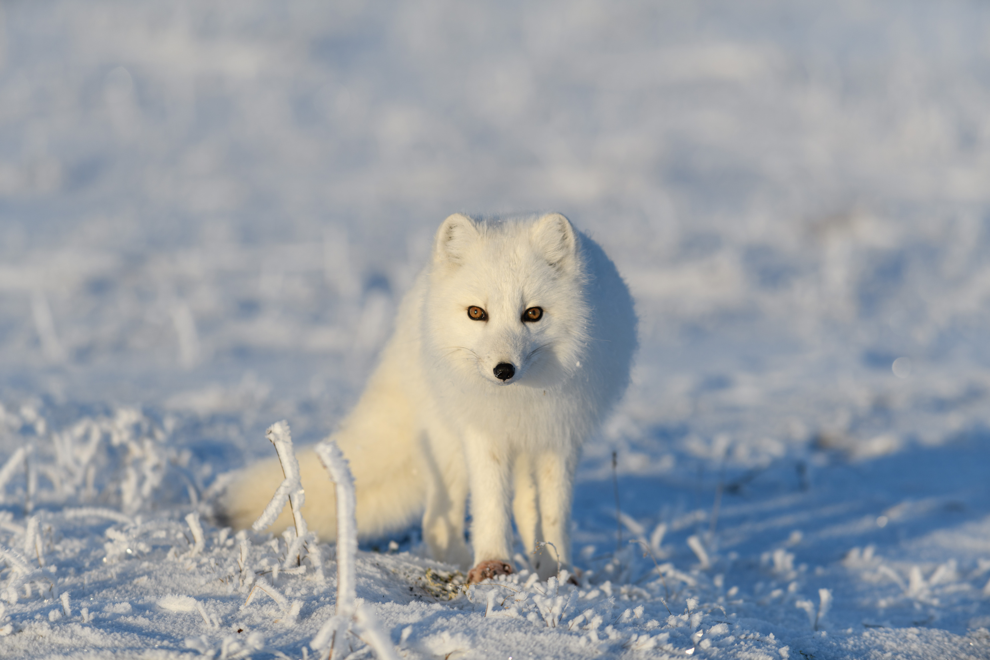
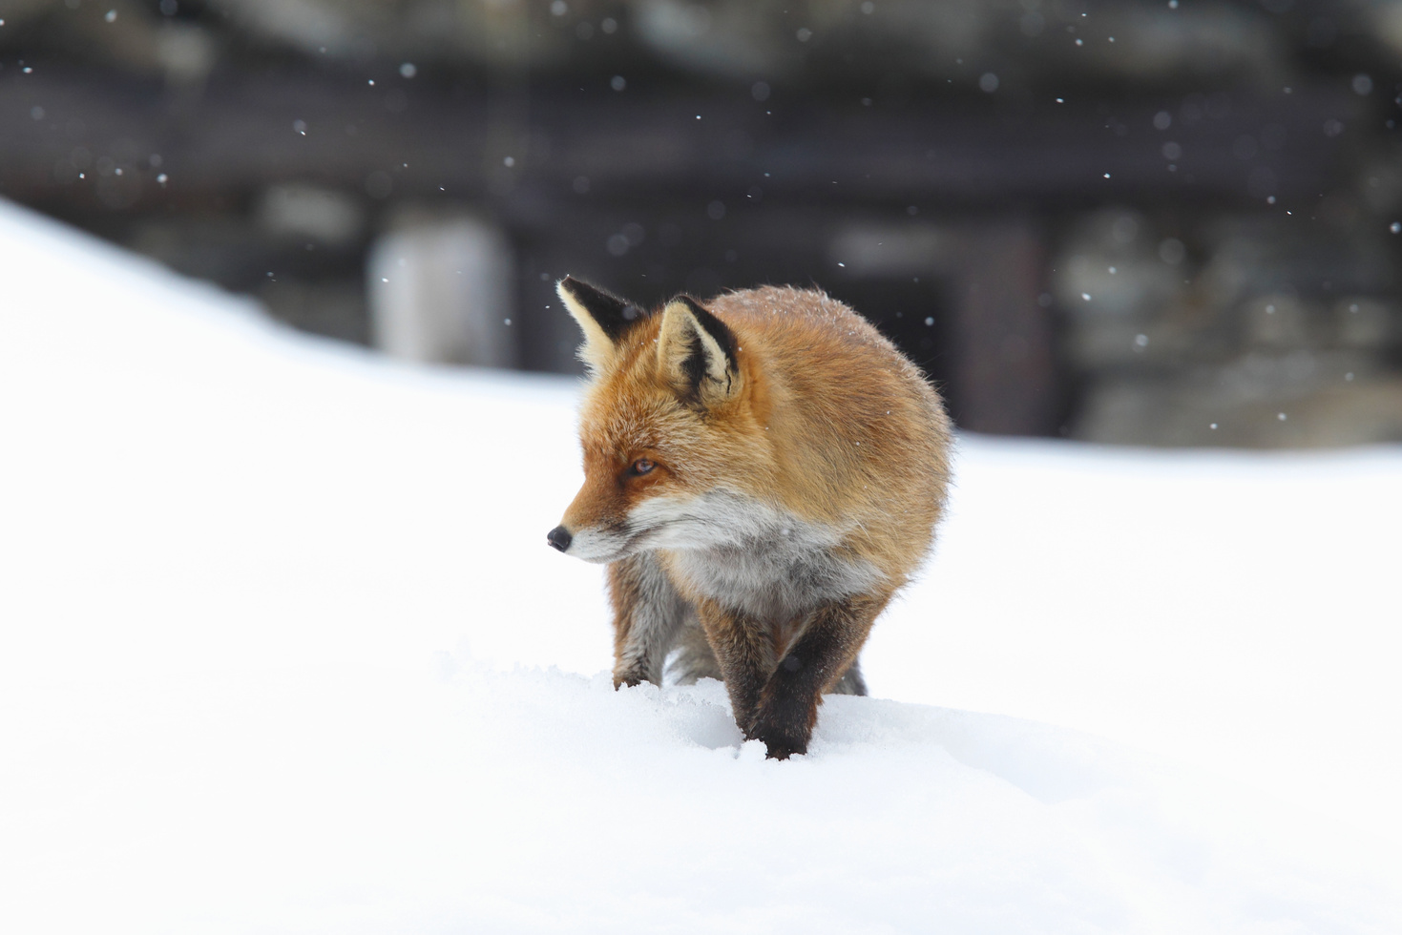
ᓇᑭᙶᖓᓗᐊᓲᖑᓂᖏᑦ
ᓯᖏᖅᑕᐅᓯᒪᓗᐊᓲᑦ ᓄᓇᕗᒻᒥ ᐅᑯᐊᖑᕗᑦ ᑎᕆᒐᓂᐊᕐᔪᑦ ᐊᒻᒪᓗ ᐊᐅᐱᓚᒃᑕᑦ ᑎᕆᒐᓂᐊᑦ
ᑕᐃᒪᐃᒍᓐᓇᕋᓗᐊᕆᓪᓗᑎᑦ, ᑕᐃᒪᐃᓗᐊᖅᐸᙱᑦᑑᒐᓗᐊᖅ ᐊᓯᖏᑦ ᓄᓇᕗᒻᒥ ᐆᒪᔪᐃᑦ ᓯᖏᖅᑕᐅᓯᒪᓗᑎᑦ
ᓯᖏᖅᑕᐅᓯᒪᔪᑦ ᑎᕆᒐᓂᐊᑦ ᐊᕕᑦᑐᖅᓯᒪᔪᒥ ᐆᒪᔪᑦ ᐊᐃᑦᑐᖅᑕᐅᓯᒪᓲᑦ , ᑐᑭᓕᒃ ᐊᑦᑐᐃᓂᖃᓗᐊᓲᖑᓪᓗᓂ ᑎᕆᒐᓂᐊᕐᓂ

Slide 10
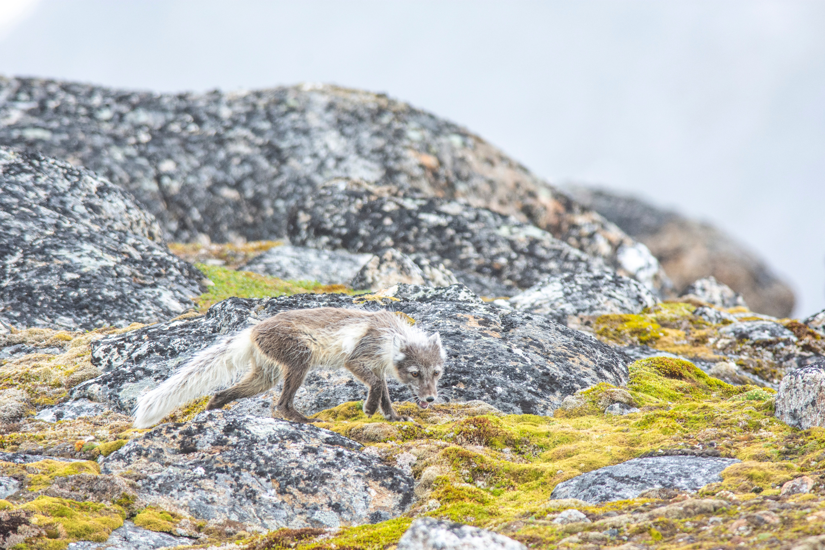

ᐅᖃᐅᓯᕆᔭᐅᓂᖏᑦ
ᑕᑯᓚᐅᖅᓯᒪᕖᑦ ᑎᕆᒐᓂᐊᕐᓂ ᑕᐃᑲᓂ ᖃᓂᒋᔭᖓᓂᓘᓐᓃᑦ ᓄᓇᓕᑉᐱᑦ?

Slide 11


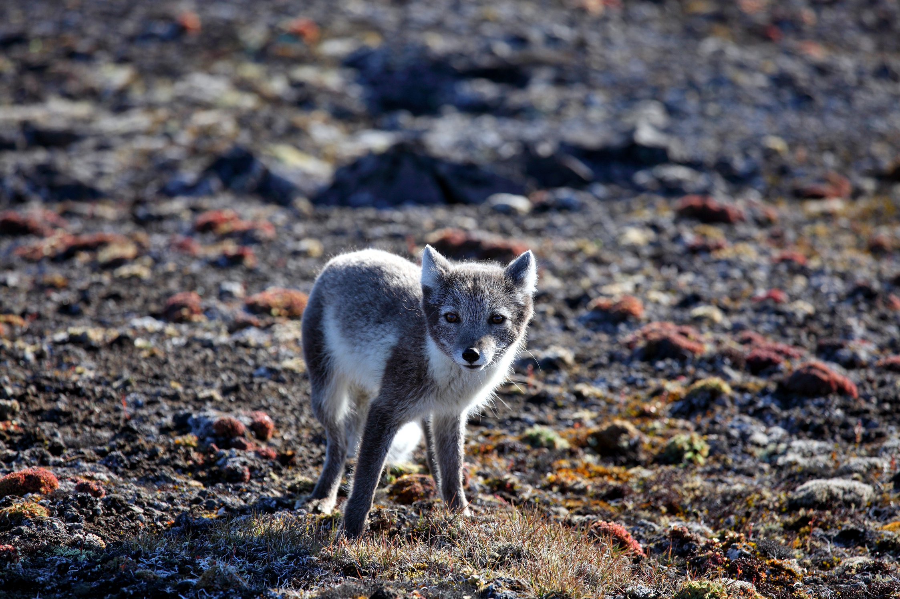
ᖃᓄᖅ ᖃᐅᔨᒪᒐᔭᖅᐱᑦ ᑎᕆᒐᓂᐊᖅ ᓯᖏᖅᑕᐅᓯᒪᔪᒥᓂᐅᒍᓂ?

Slide 12

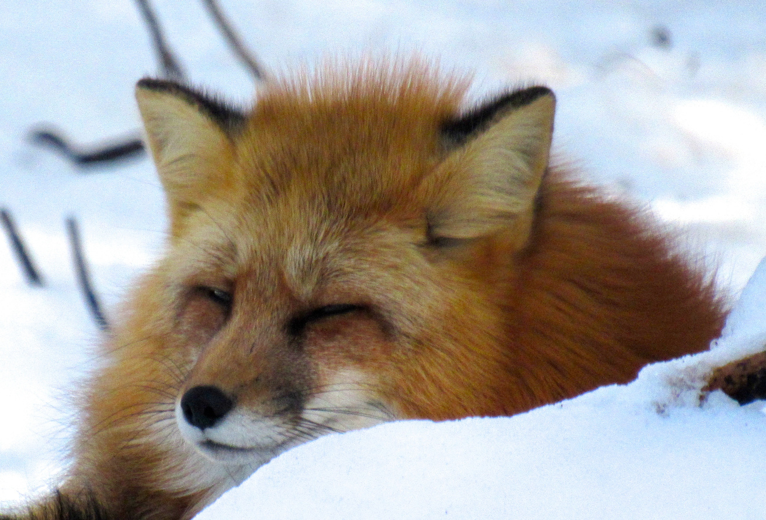

ᓇᓗᓇᐃᒃᑯᑕᖏᑦ ᐊᒻᒪᓗ ᖃᓄᐃᓲᖑᓂᖏᑦ
ᑎᕆᒐᓂᐊᑦ ᓯᖏᖅᑕᐅᓯᒪᔪᑦ ᐃᓕᖅᑯᓯᖅᓱᑦᑎᐊᙲᓐᓇᕈᓐᓇᕐᒪᑕ
ᑭᓯᐊᓂᓕ, ᐃᓚᖏᑦ ᑎᕆᒐᓂᐊᑦ ᓯᖏᖅᑕᐅᓯᒪᔪᑦ ᐃᓕᖅᑯᓯᖅᓱᑦᑎᐊᓲᖑᒋᕗᑦ. ᖃᐅᔨᒪᓪᓚᕆᒃᑲᔭᒐᔭᖅᑐᒍᑦ ᑭᓯᐊᓂ ᑎᕆᒐᓂᐊᖅ ᓯᖏᖅᑕᐅᓯᒪᓐᓂᕈᓂ ᑐᖁᓗᒍ ᐊᒻᒪᓗ ᖃᕋᓴᖓ ᐊᐅᓪᓚᖅᑎᓪᒍ ᖃᐅᔨᓴᖅᑕᐅᒐᔭᕐᒪᑦ
ᓇᓗᓇᐃᒃᑯᑕᖏᑦ ᐊᒻᒪᓗ ᖃᓄᐃᓲᖑᓂᖏᑦ ᓯᖏᖅᑕᐅᓯᒪᔪᑦ ᓴᖅᑭᓲᑦ ᒪᕐᕈᓗᐊᒃᑯᑎᒍᑦ: “ᓂᙵᐅᒪᔪᑦ” ᓯᖏᖅᑕᐅᓯᒪᓪᓗᑎᑦ ᐅᕝᕙᓘᓐᓃᑦ “ᖃᓄᐃᓗᐊᖅᑑᔮᙱᑦᑐᑦ” ᓯᖏᖅᑕᐅᓯᒪᔪᑦ

Slide 13
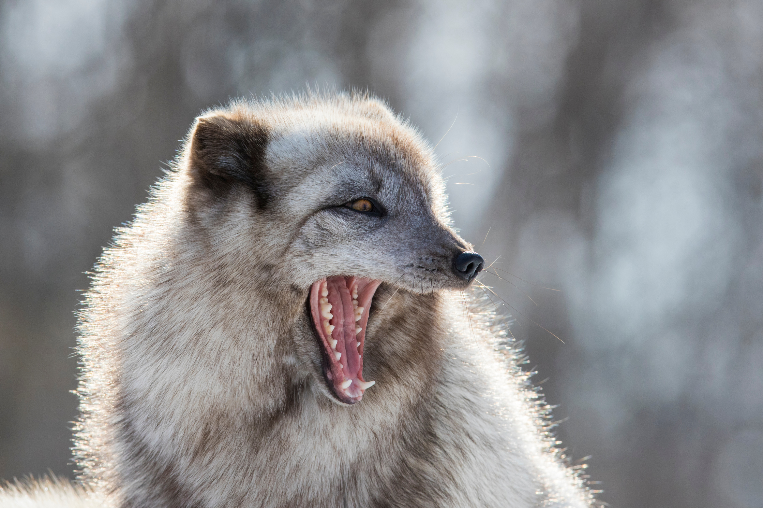

“ᓂᙵᐅᒪᔪᑦ” ᓯᖏᖅᑕᐅᓯᒪᓪᓗᑎᑦ
  “ᖃᓄᐃᓗᐊᖅᑑᔮᙱᑦᑐᑦ” ᓯᖏᖅᑕᐅᓯᒪᔪᑦ
  ᐊᓯᖏᖕᓂᒃ ᐆᒪᔪᕐᓂᑦ ᑭᓱᑐᐃᓐᓇᕐᓂᓪᓗ ᐱᒋᐊᖅᓯᓇᓱᒃᑐᑦ ᐃᖅᓯᒐᑎᑦ ᐱᔾᔪᑎᖃᙱᑦᑐᑎᓪᓘᓐᓃᑦ
  ᑮᓯᓲᑦ ᑕᒧᐊᒐᓱᓲᑦ ᓂᐅᒥᓂᒃ

Slide 14
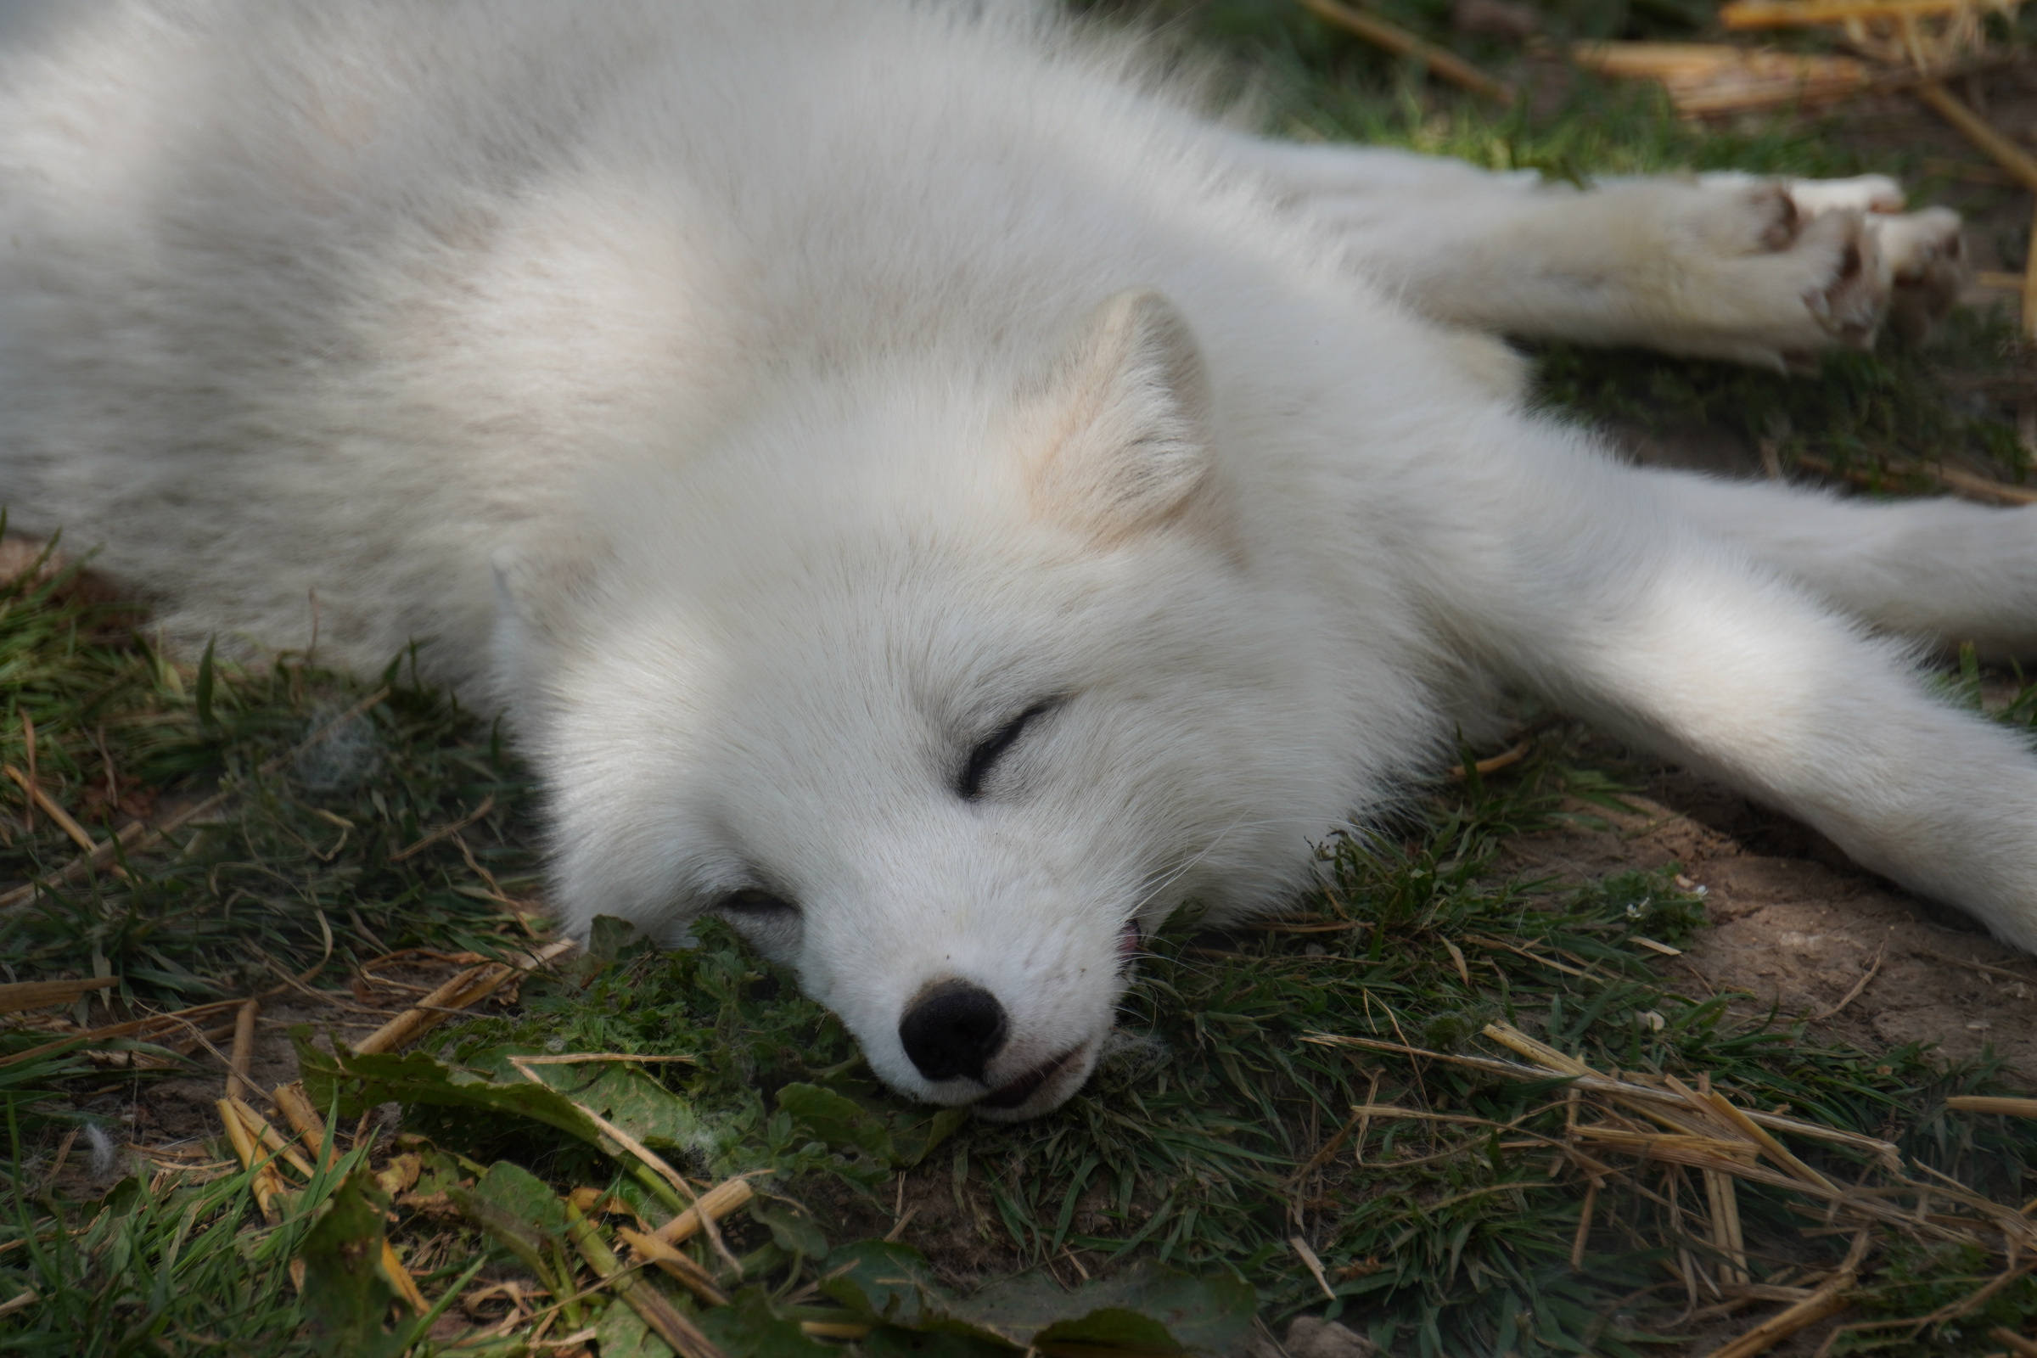
“ᖃᓄᐃᓗᐊᖅᑑᔮᙱᑦᑐᑦ” ᓯᖏᖅᑕᐅᓯᒪᔪᑦ
  ᓇᓗᔪᕐᔫᔮᖅᑐᑎᑦ−ᐅᐃᕐᖓᓗᐊᖅᑑᔮᖅᑐᑎᑦ ᐊᒻᒪᓗ ᓱᒃᑲᐃᑦᑐᑎᑦ ᖃᓄᐃᓕᓯᒋᐊᕐᓗᑎᑦ
  ᐱᓱᒡᒐᖅᑐᑦ
  ᓄᕚᕿᔪᑦ ᖃᐳᐊᖅᑐᓪᓘᓐᓃᑦ ᓄᕙᖏᑦ ᖃᓂᕐᒥᓂᒃ
  ᐃᖅᓯᒍᓐᓃᖅᑐᑎᑦ ᐃᓄᓐᓂᒃ ᐊᒻᒪᓗ ᑐᙵᓇᖅᑑᔮᖅᑐᑎᑦ ᑕᐃᒪᐃᑉᐸᙱᒃᑲᓗᐊᖅᑐᑎᑦ

Slide 15
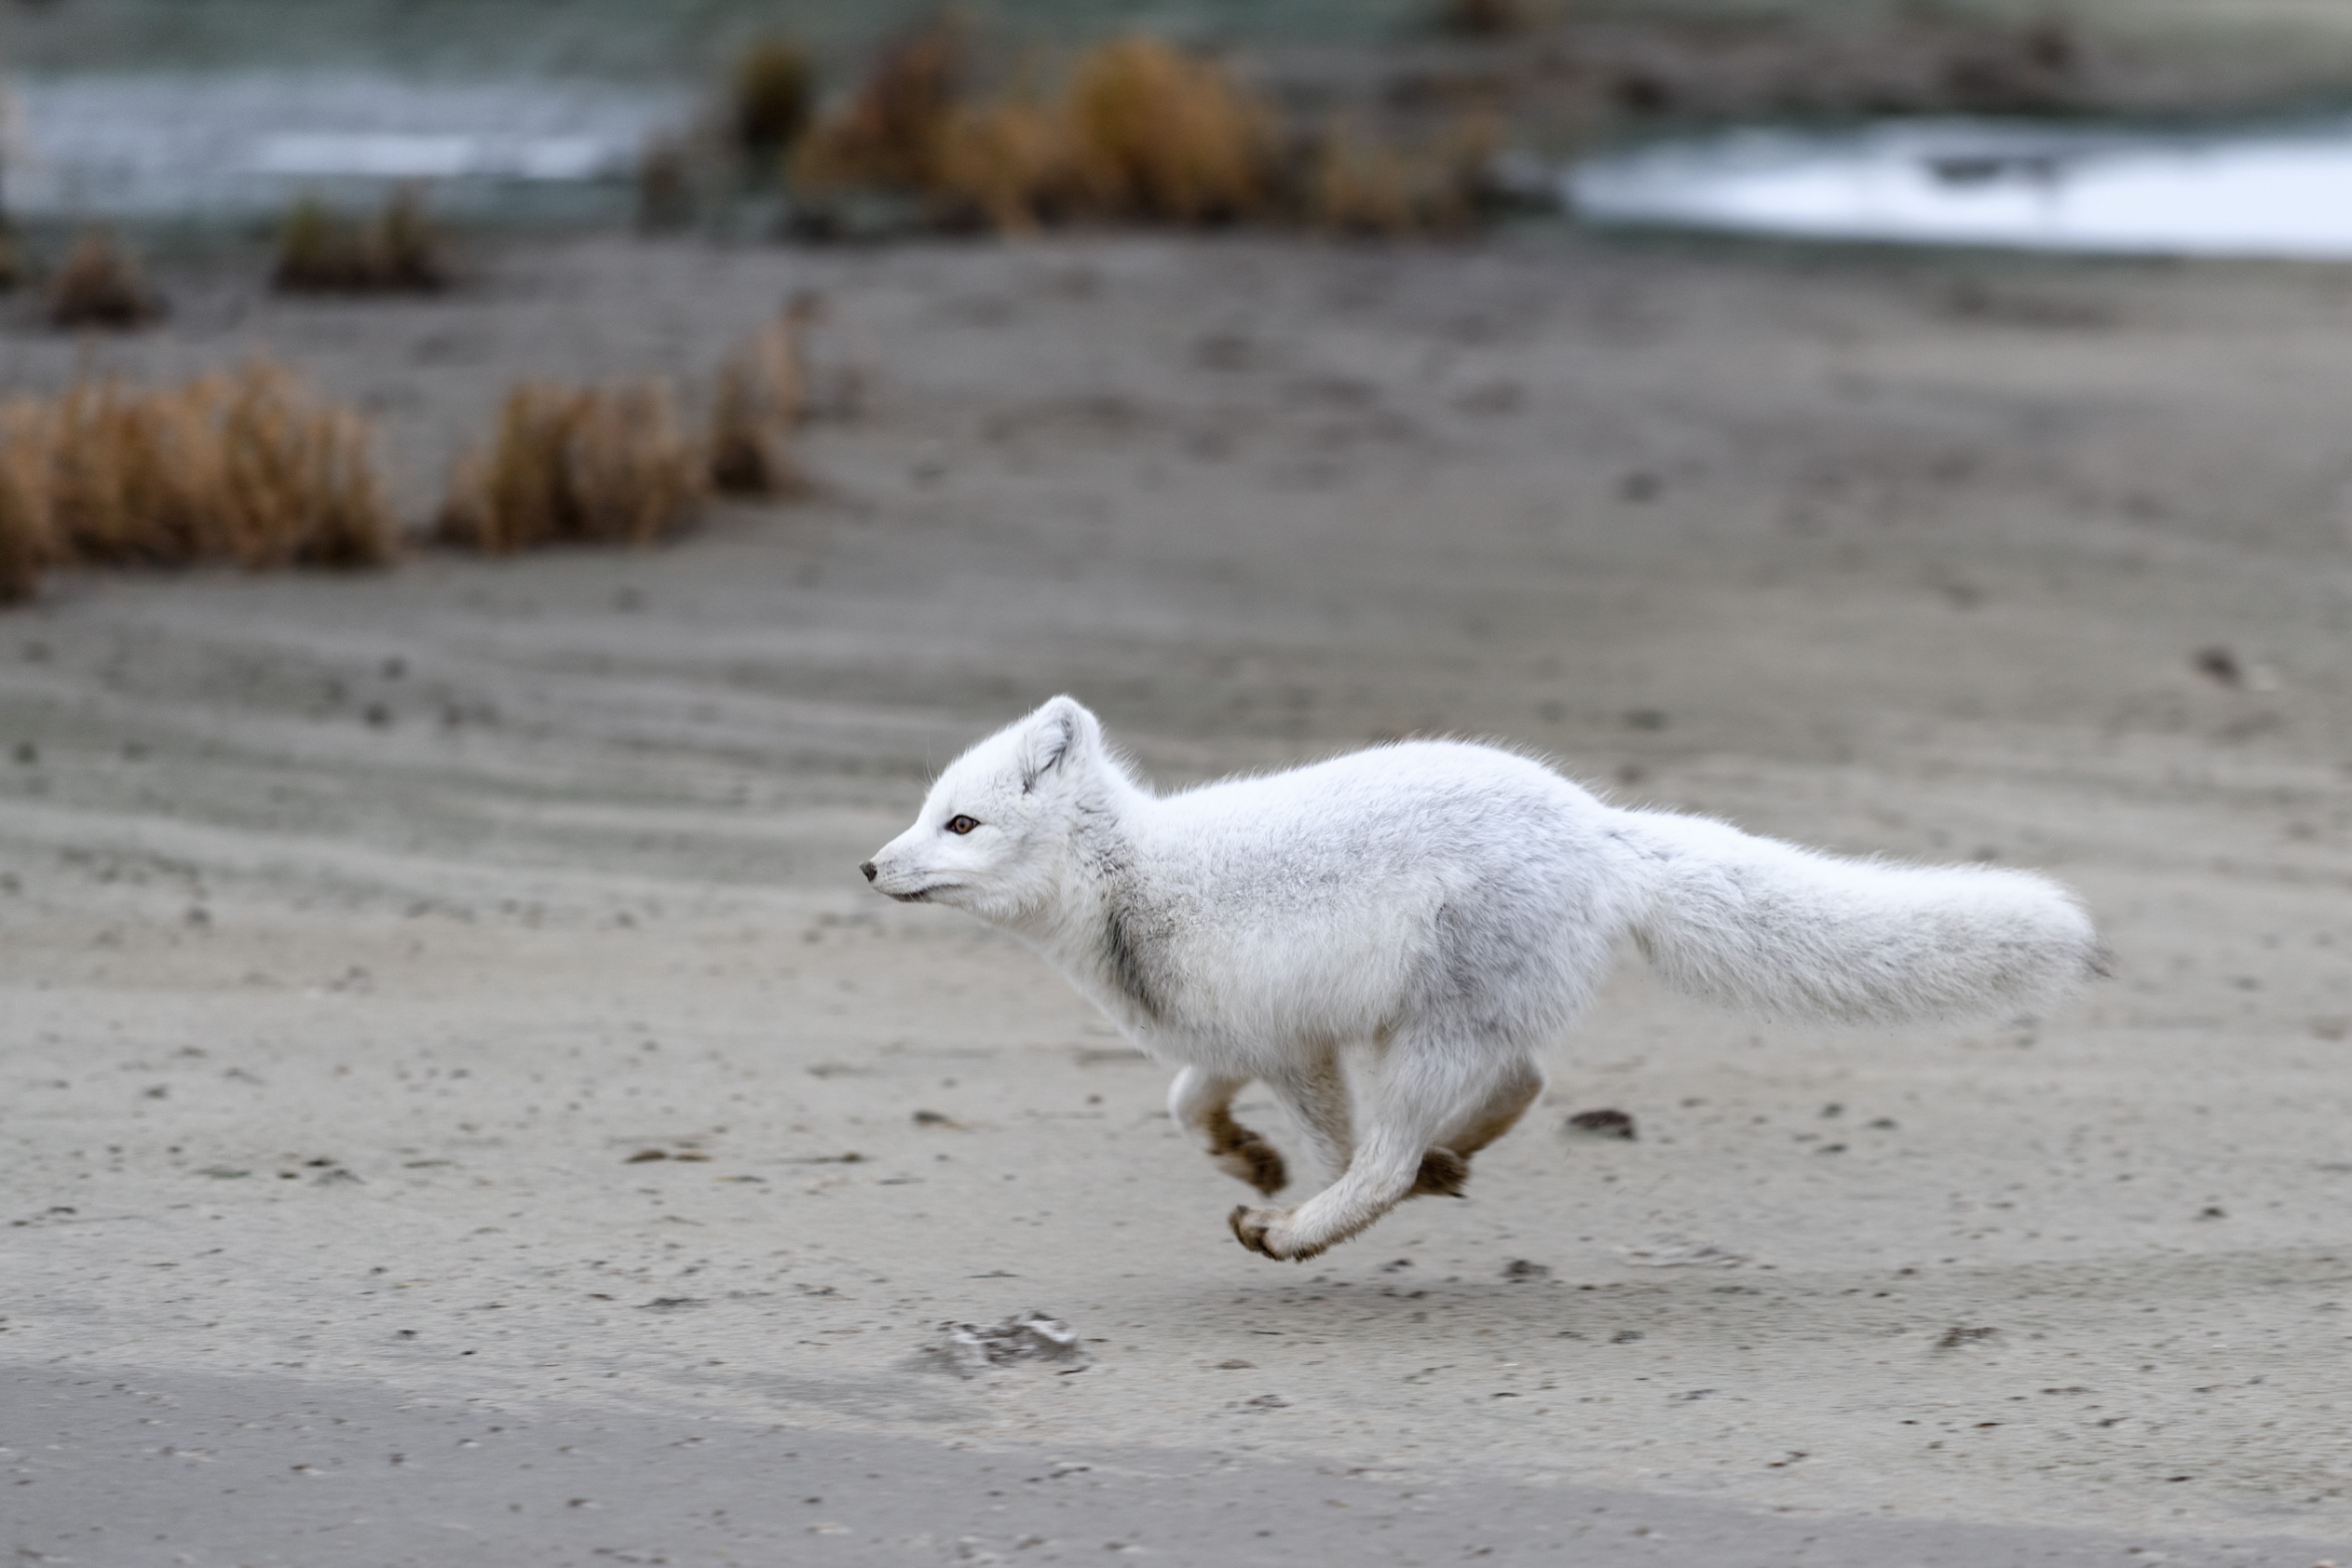
ᓅᒍᓐᓇᕐᓂᖏᑦ

Slide 16
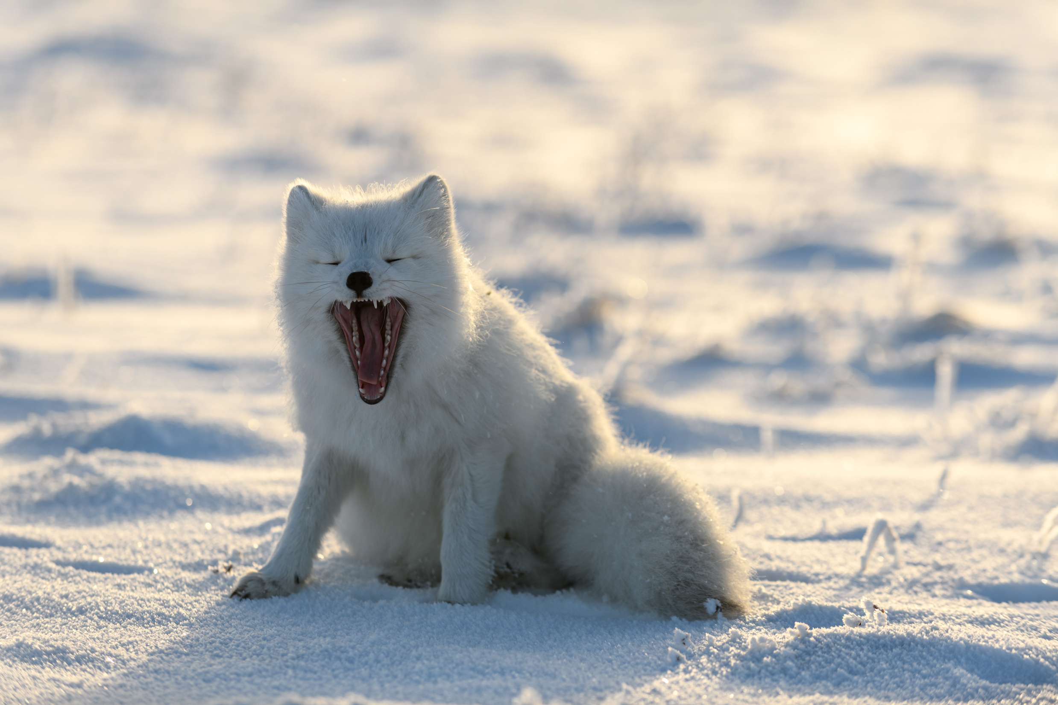
ᐊᑦᑕᕐᓇᖅᑕᐃᓕᒪᓂᖅ
ᑕᑯᒍᕕᑦ ᑎᕆᒐᓂᐊᕐᒥᒃ ᓄᓇᓕᖕᓂ ᐅᕝᕙᓘᓐᓃᑦ ᑎᕆᒐᓂᐊᕐᒥ ᓄᓇᒥ ᐃᓕᖅᑯᓯᖅᓱᑦᑎᐊᙱᑦᑐᒥ, ᐱᐅᒻᒪᕆᐅᕗᖅ ᐃᒪᐃᒃᑯᕕᑦ:
ᐅᖓᓯᑦᑐᒦᓪᓗᑎᑦ /ᐅᐸᙱᓪᓗᒍ
ᓱᒃᑲᐃᓪᓗᑎᑦ ᐱᓱᓪᓗᑎᑦ ᕿᒪᓪᓗᒍ/ ᐅᓪᓚᙱᓪᓗᑎᑦ
ᐃᓐᓇᕐᒥᒃ ᐅᖃᐅᔾᔨᓗᑎᑦ ᐅᕝᕙᓘᓐᓃᑦ ᓄᓇᓕᓐᓂ ᒪᓕᒐᕋᓛᓕᕆᔨᒥᒃ

Slide 17
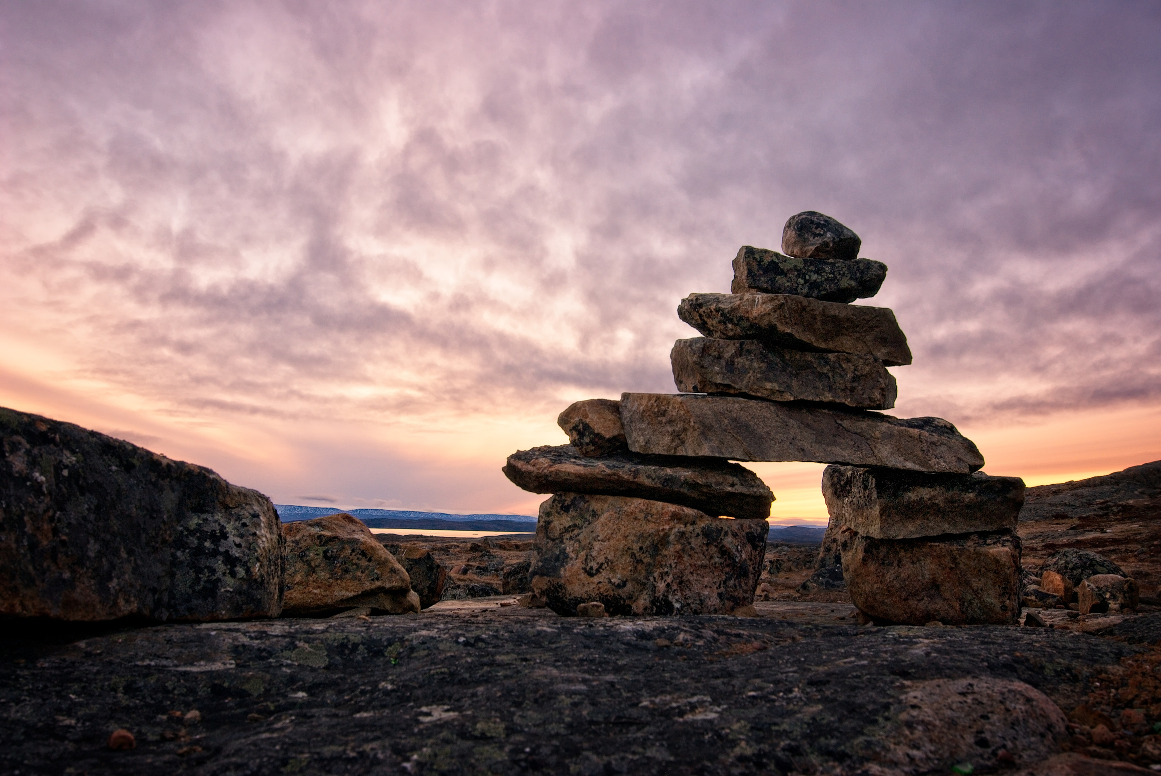
ᐆᑦᑐᕋᓚᐅᖅᑕ!

