Slide 1
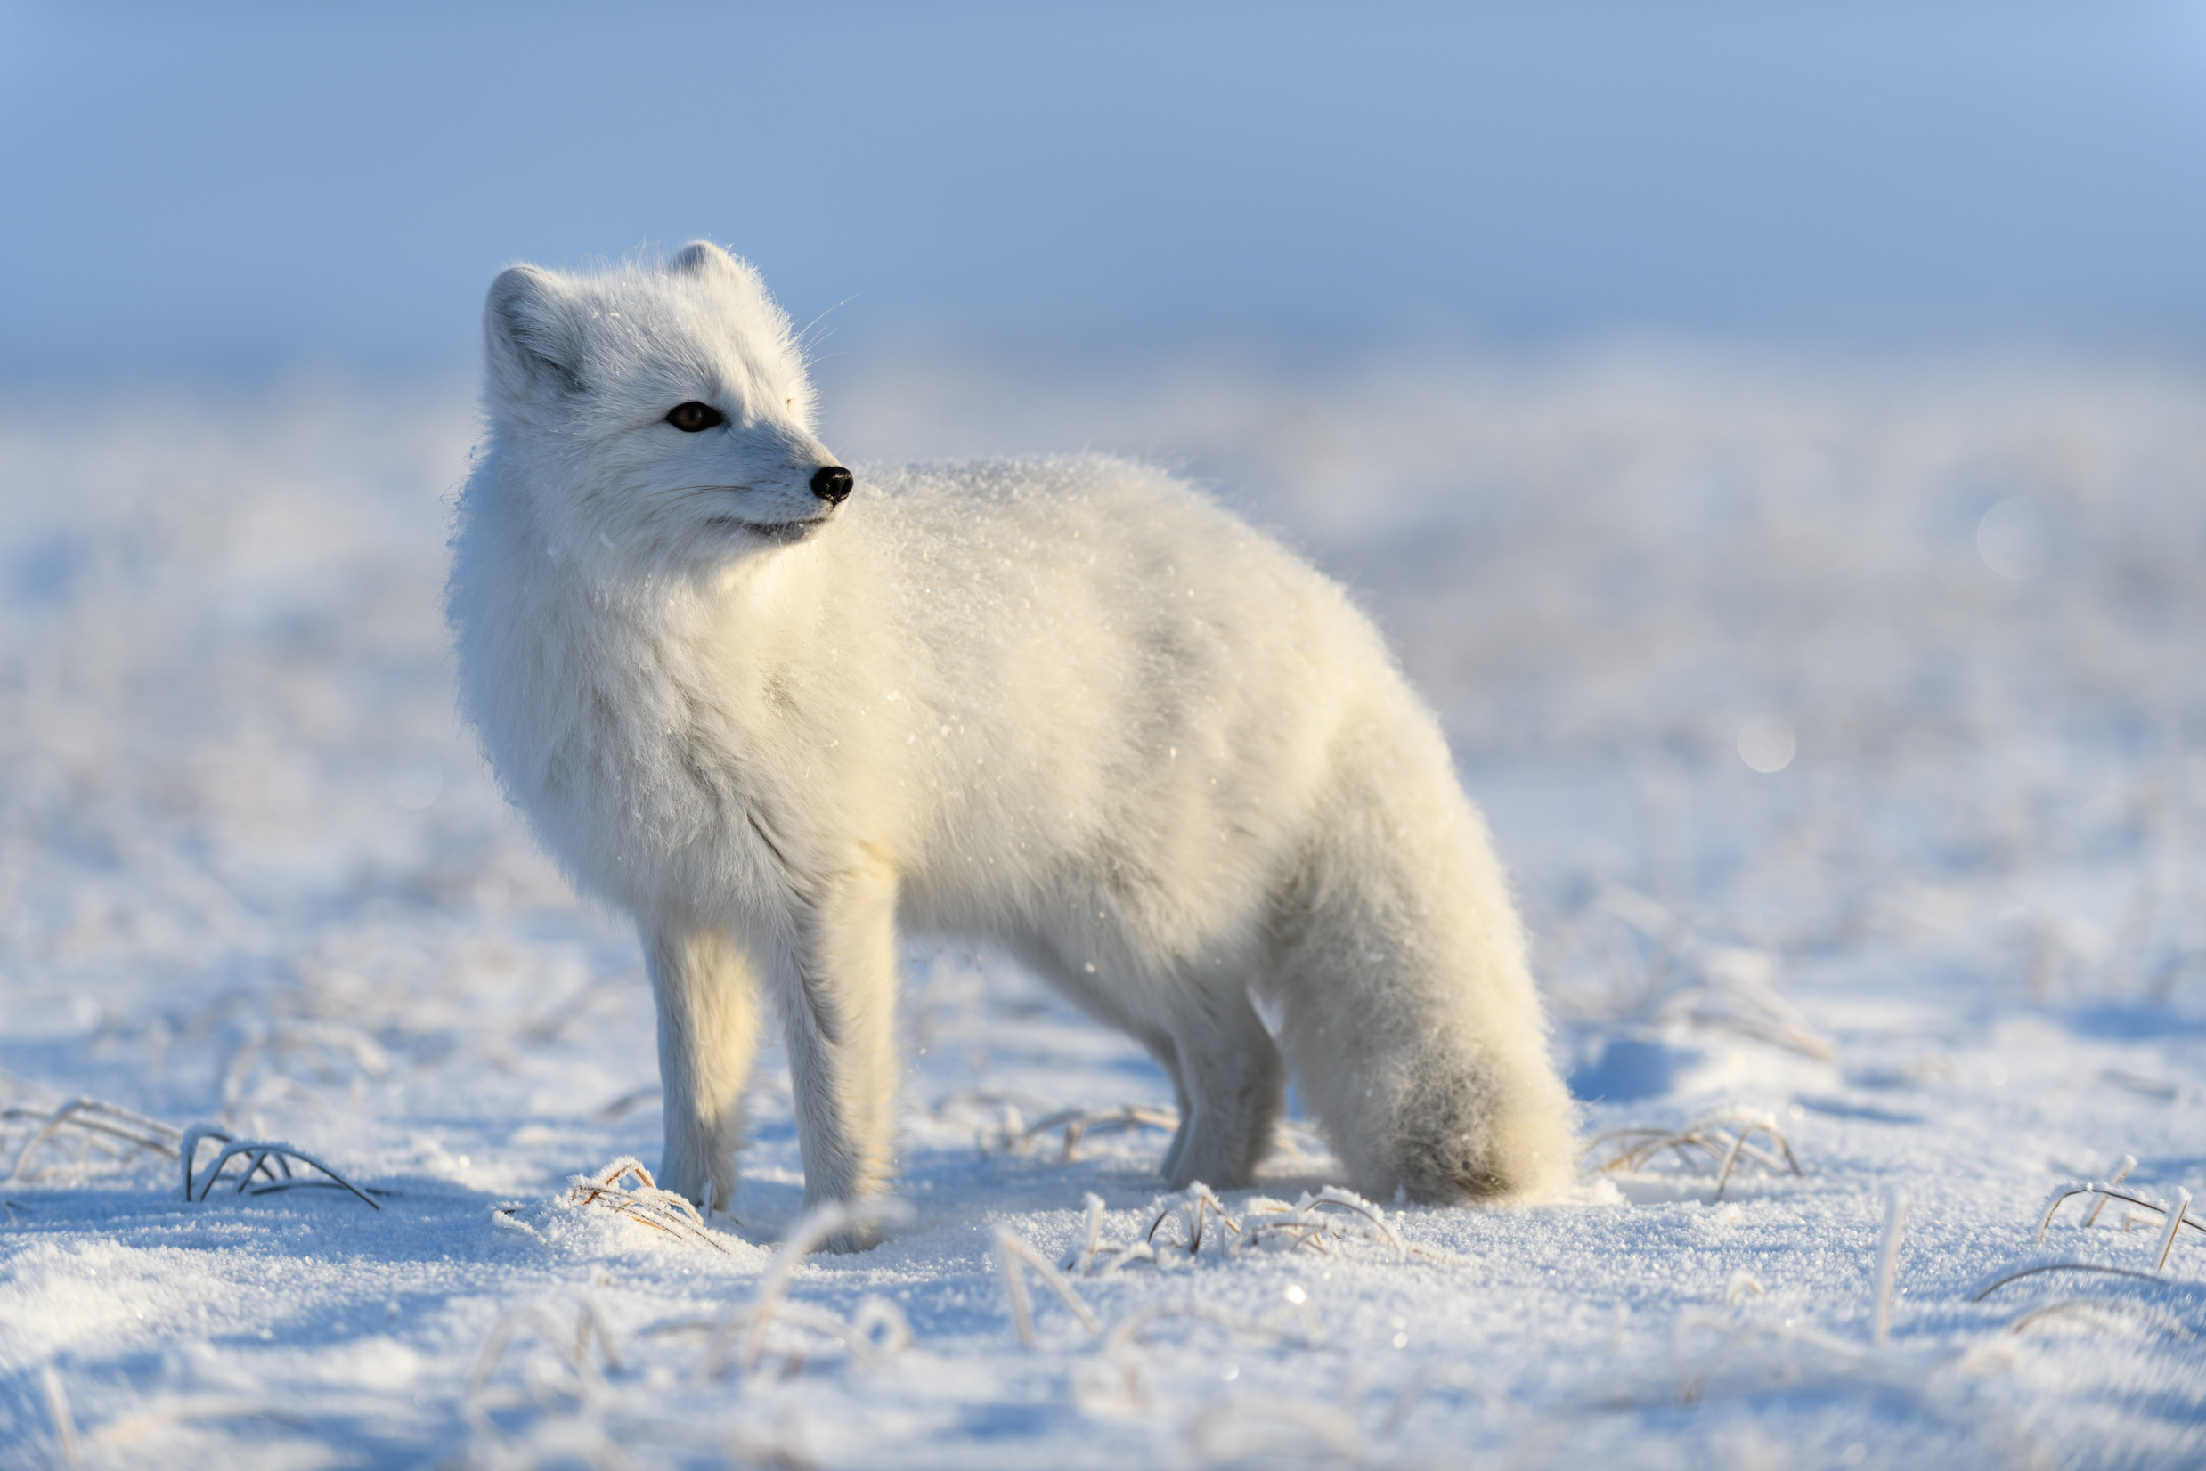

Nunavunmi Nakimayunik Qauhimaniqmut Atuqtailiniqmullu Ilihautighat
Ilihautik 1: Nakimayut Anngutighallu

Slide 2
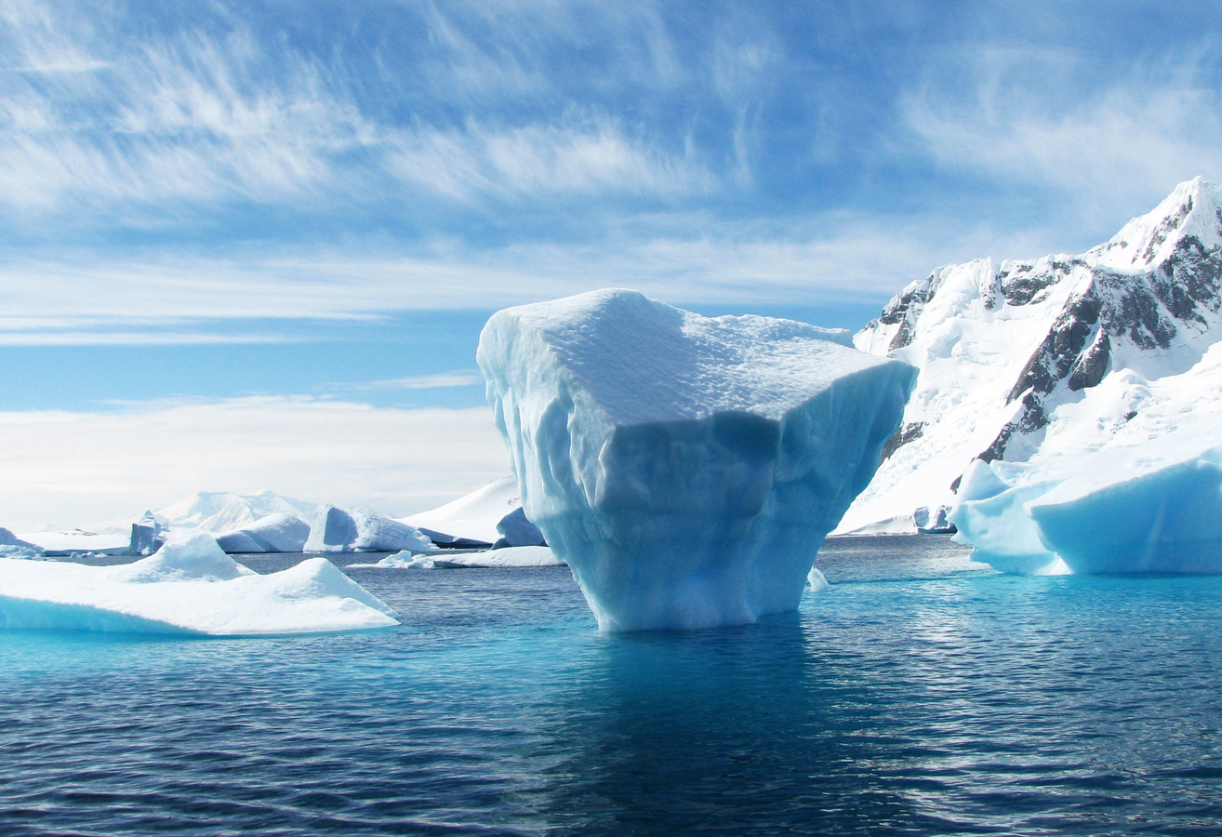
Ayuiqhaiyut iniqtaghanik
Iniqvighaanit hapkua ilihaqtitauyut, taimailiunginnarialingniaqtunga:
Naunaiqhitilutik hunauyaaghat nakimayut
Naunaiqhitilugit ilittuqhitiuyut naunaitkutauyullu nakimayunik tirigannianit?
Naunaiqhilutik qanuq amirnaiqhimayaamik anngutighat avatiinit

Slide 3
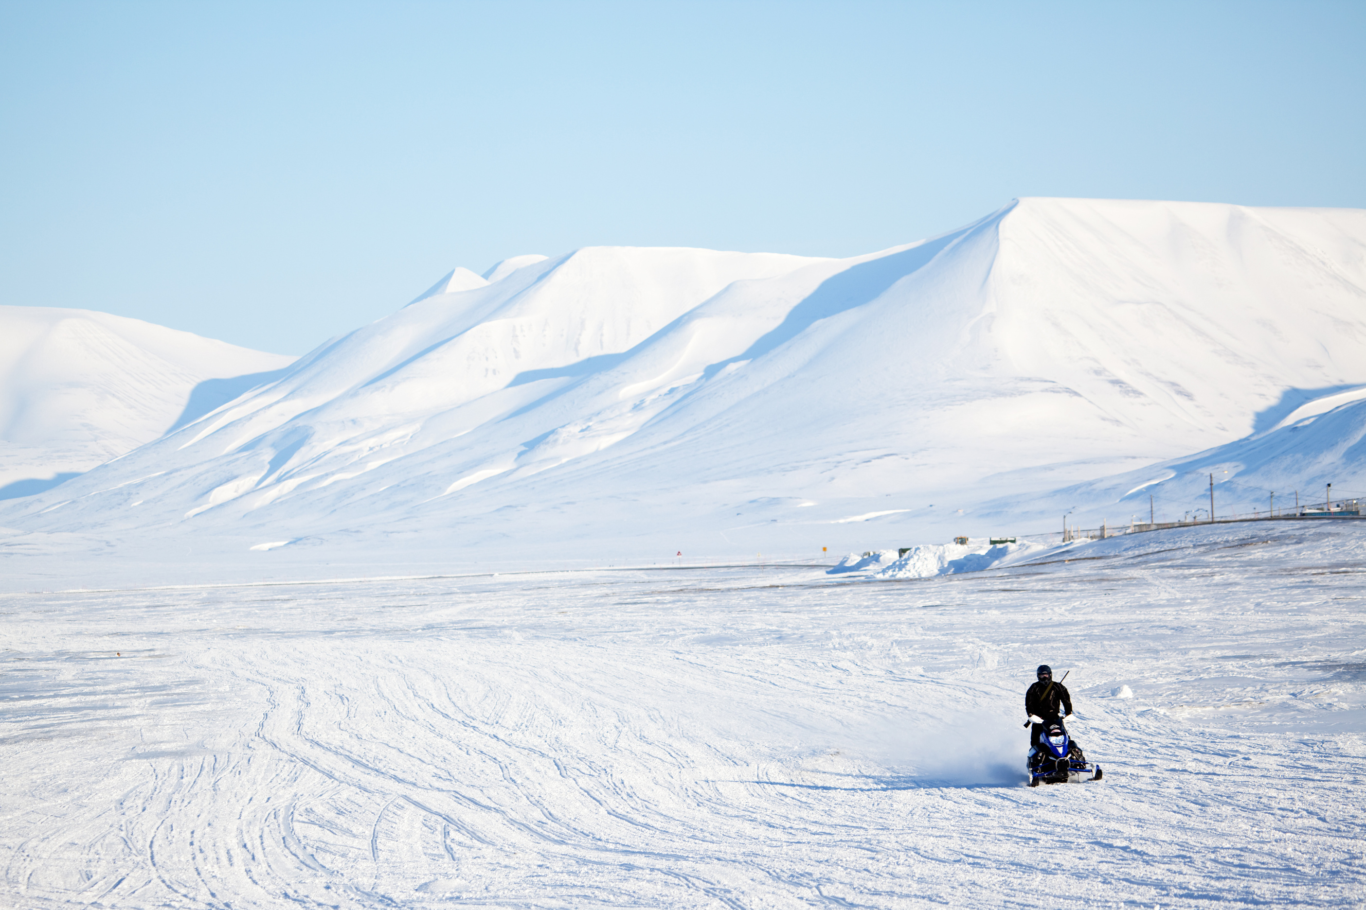
Humik ilihimavit nakimayunik?
Humik ilvit ilihimavit??
Humik ilvit nalu huirumavit?

Slide 4


naki﻿mayunik
Nakimayut tuqunnaqtuq aanniarutik aanniarnaqtuq hangutaqtumik.
Hangutaqtut halumailruuyut mikiyunnuit takunnaittuq.
  Kitut aallat hangutaqtut ilihimavigit?
2. Qanuq qauhimannaqqa tuqunnaqtuq?

Slide 5
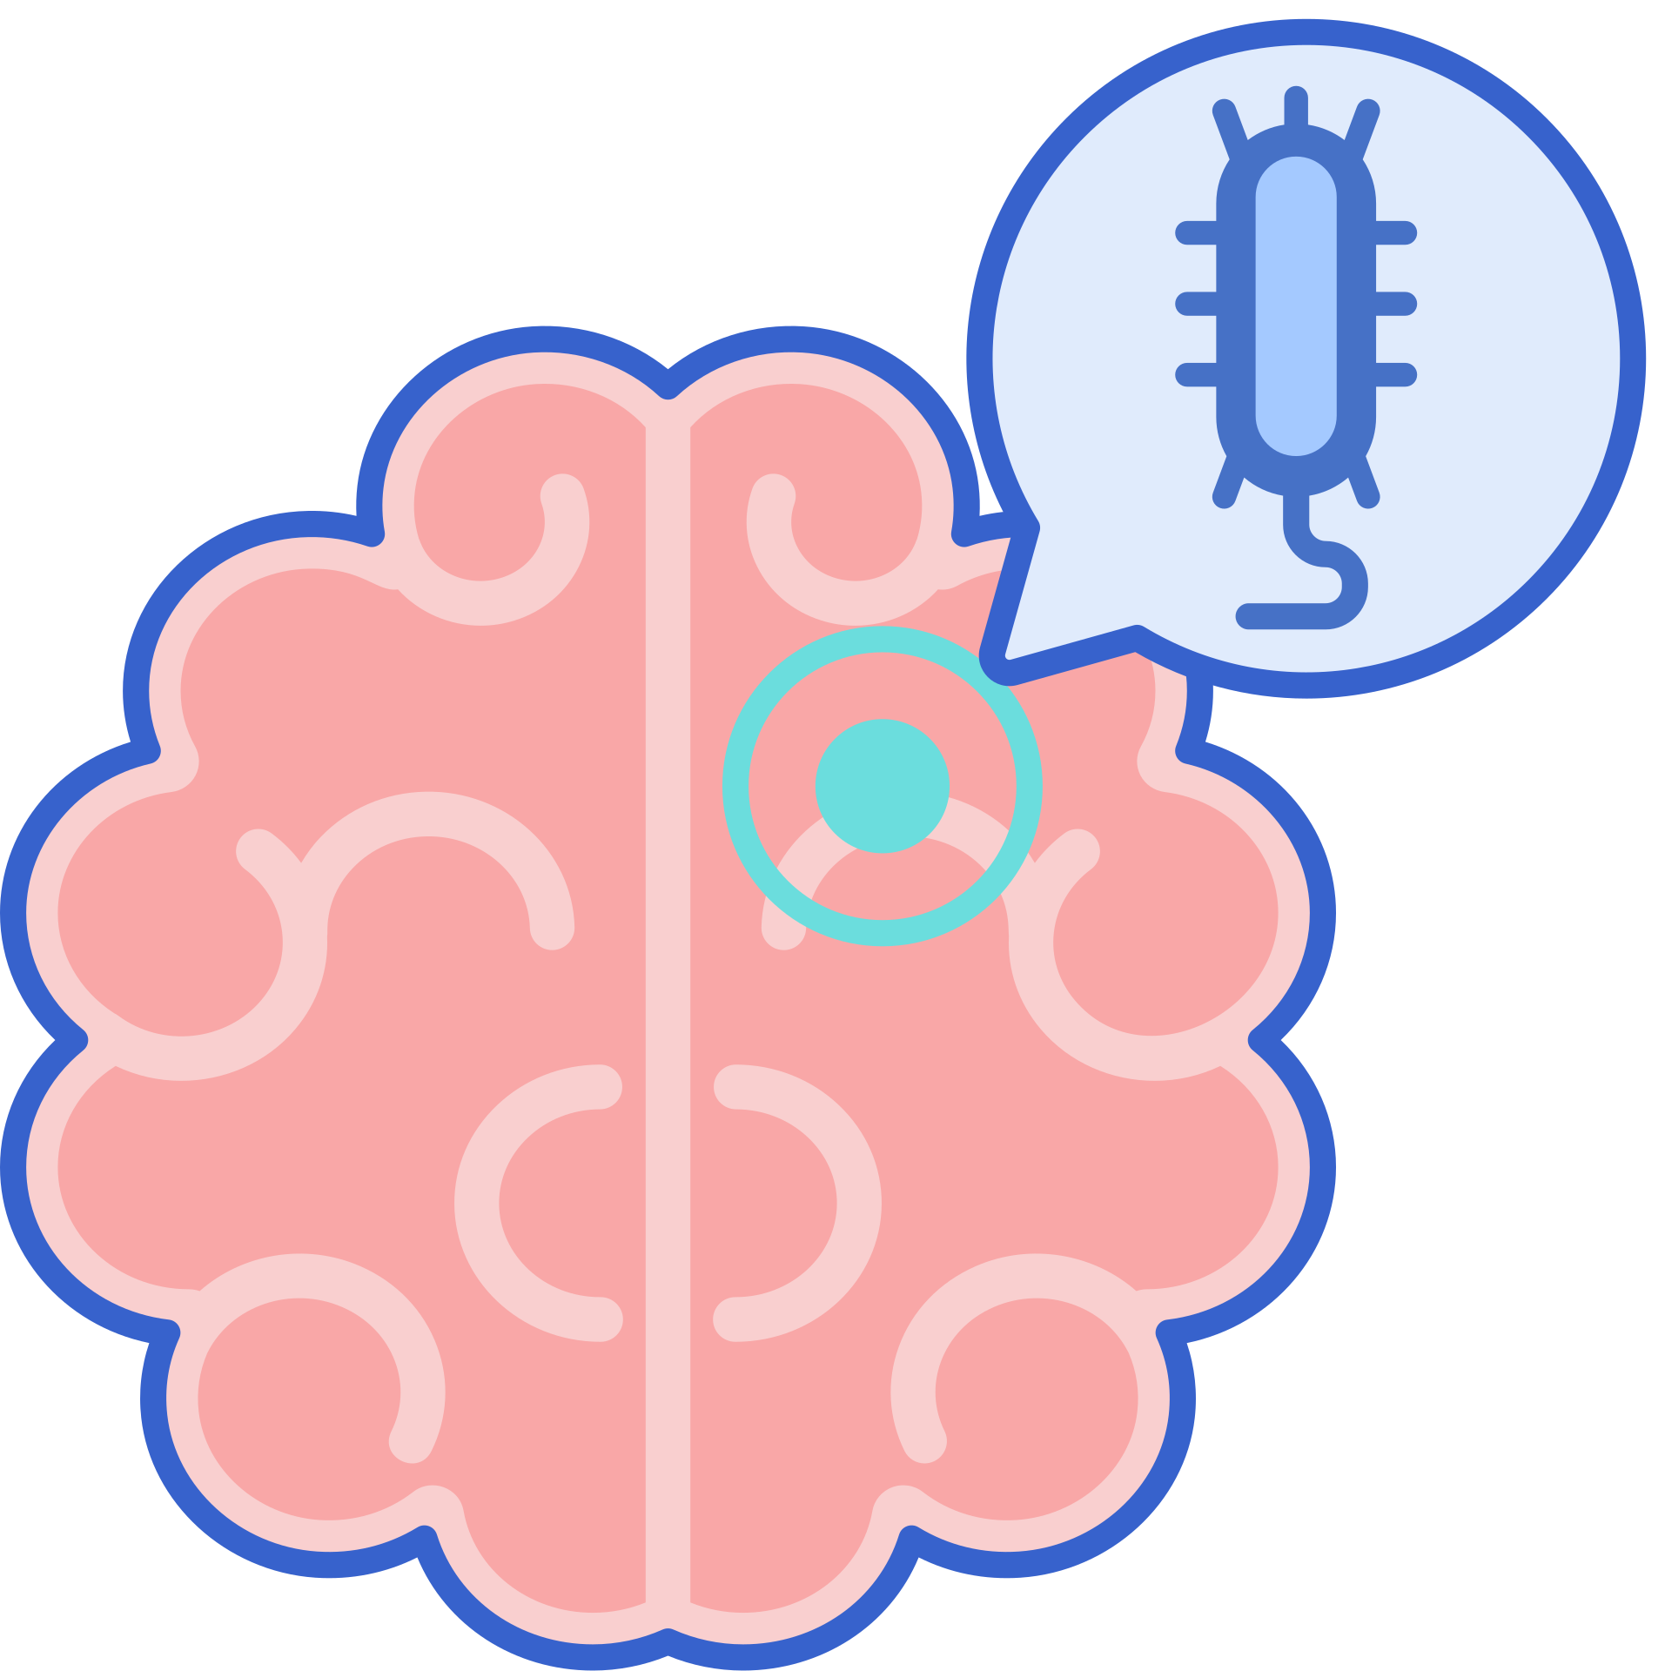
Anngutighat aanniarutilgit nakimaplutik
Nakimayunit hangutaqtuq anngutighanut aanniaqpiarnaqtuq
Taimainnaqtuq immaqtiliqpaktait qaritainik (qaritait puvitpaktut angiklivaghutik).
Aanniarutilgit anngutighat nakimayut tuquinnaliqpaktut.

Slide 6
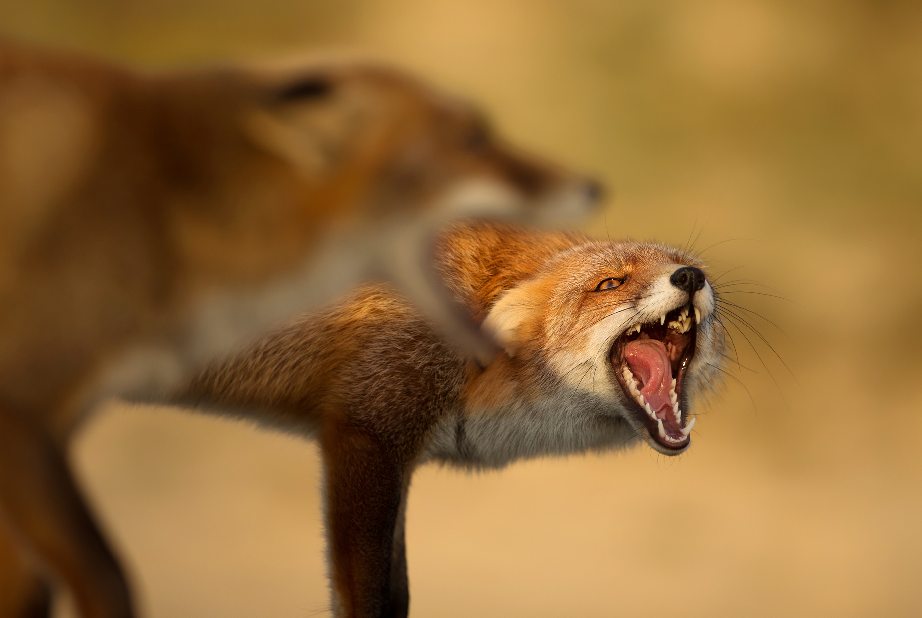
Nakimayunit hiamitittut
Nakimayunit hangutaqtuq paqitaunnaqtuq nuvangmit aanniarutilgit anngutighat.
Aanniarutiqaraangat anngutighat kiihigumik aannianngittumik anngutighamik, aanniarutaittuq anngutighaq nakimalaaqtuqlu.
Aanniarutilgit anngutighat hangutitailiqpaktut ahinut anngutighanut tuqutinnatik

Slide 7
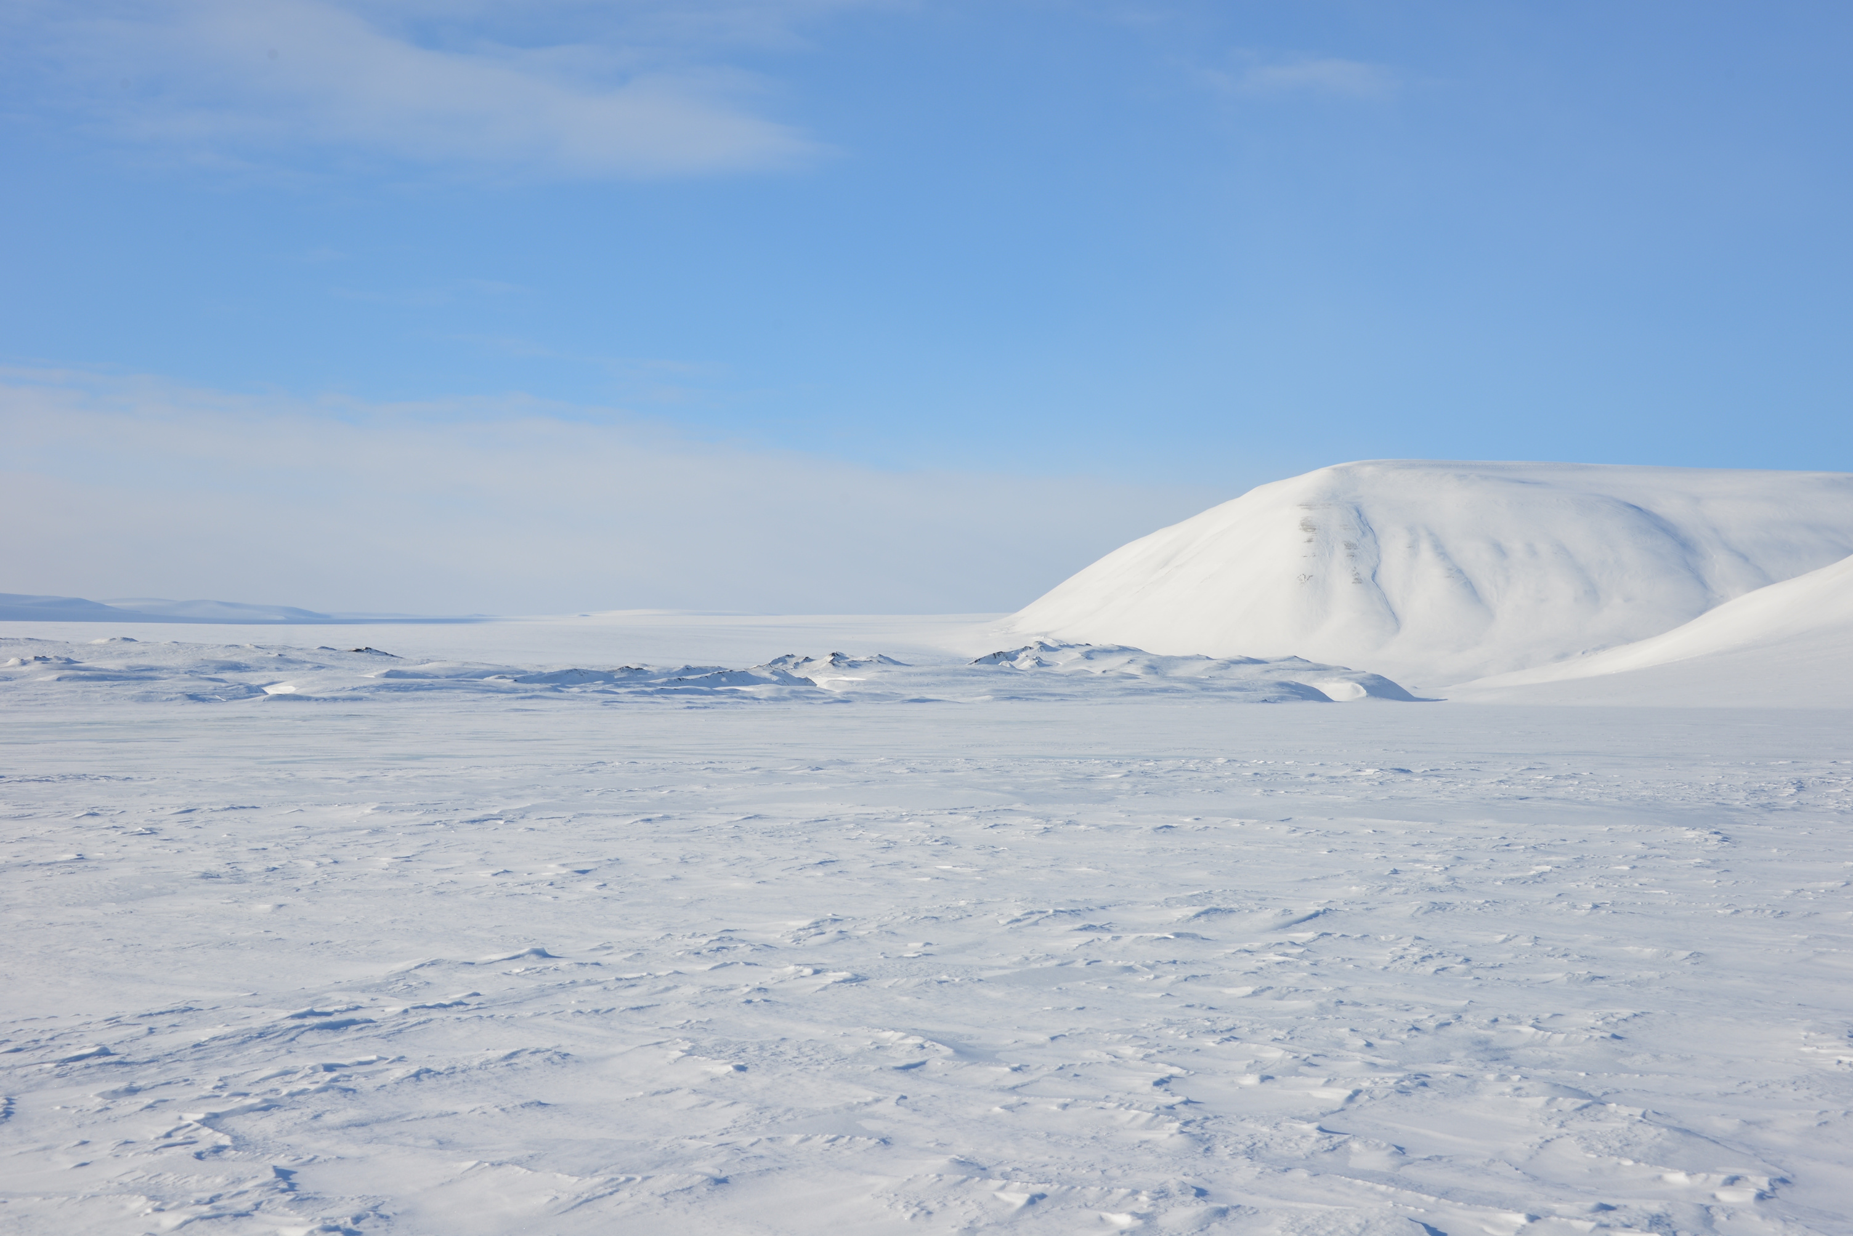
Kitut ukiuqtaqtumiutat anngutighat nakimaliqpakpat?
Qanuq ilvit ihumavit?

Slide 8
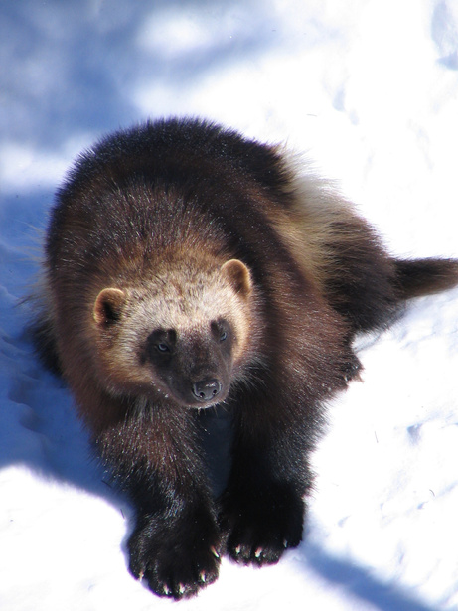
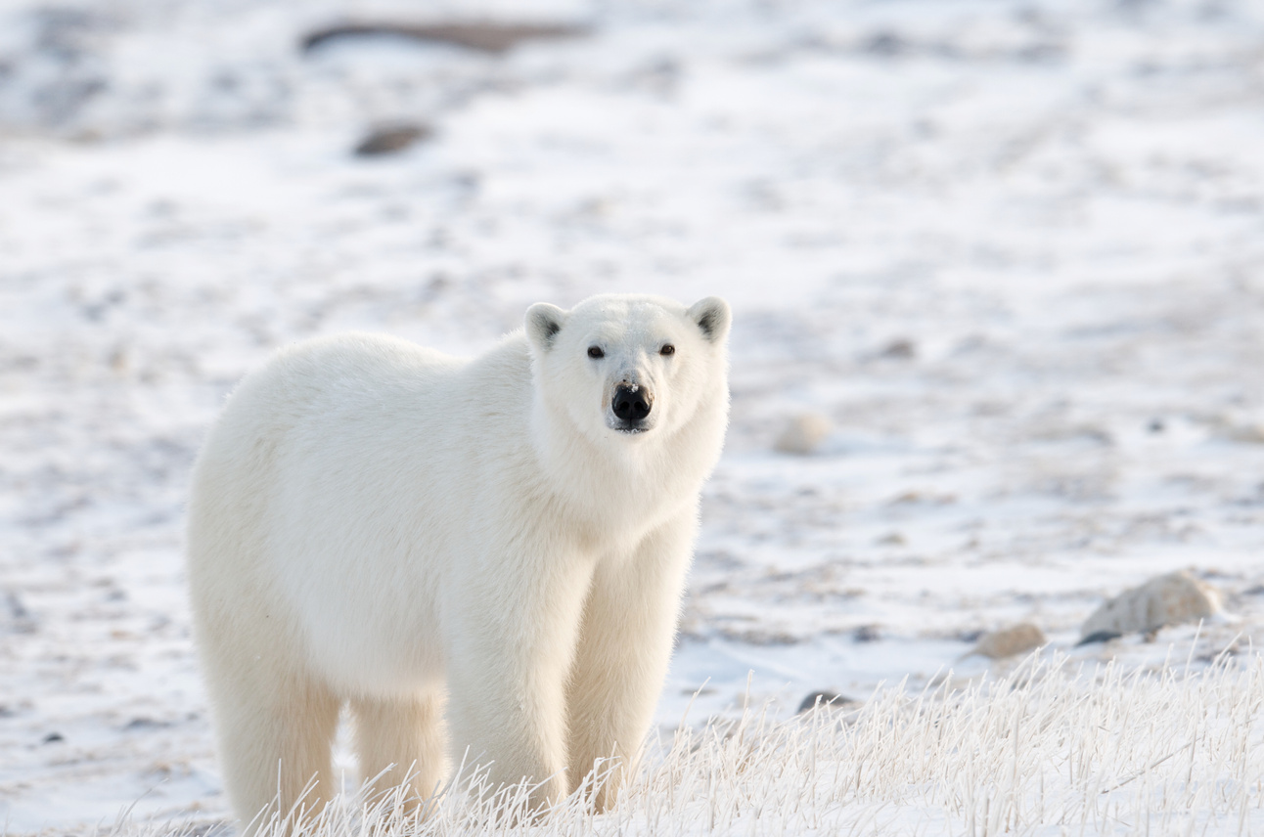
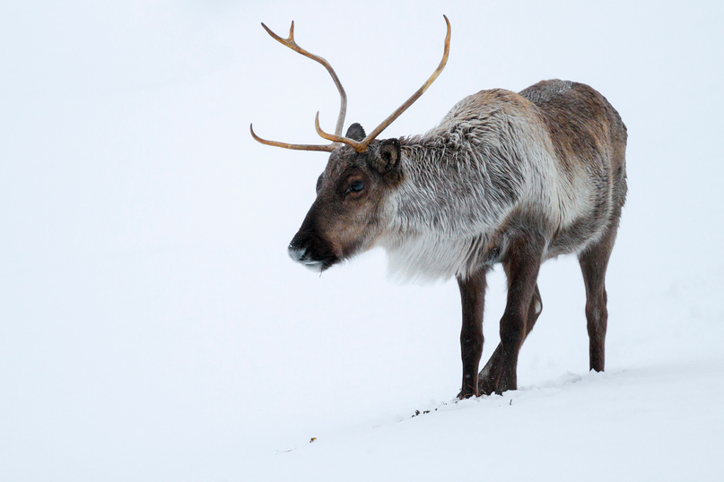
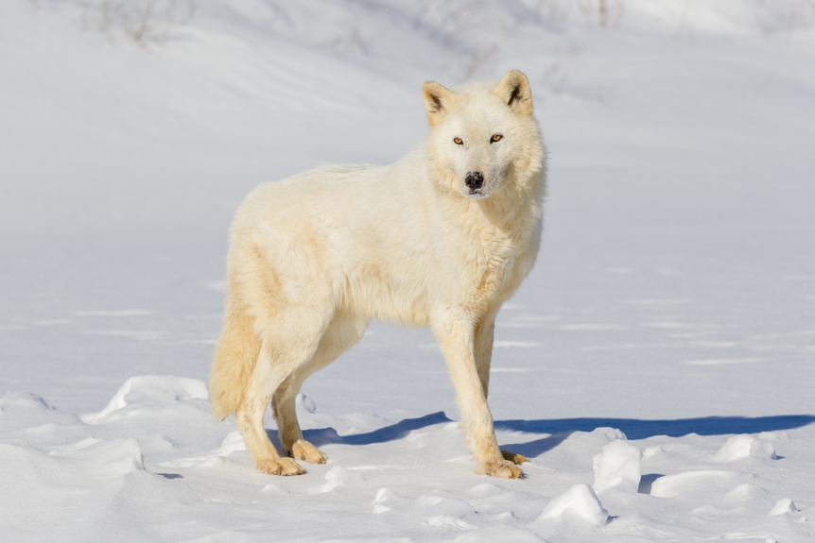
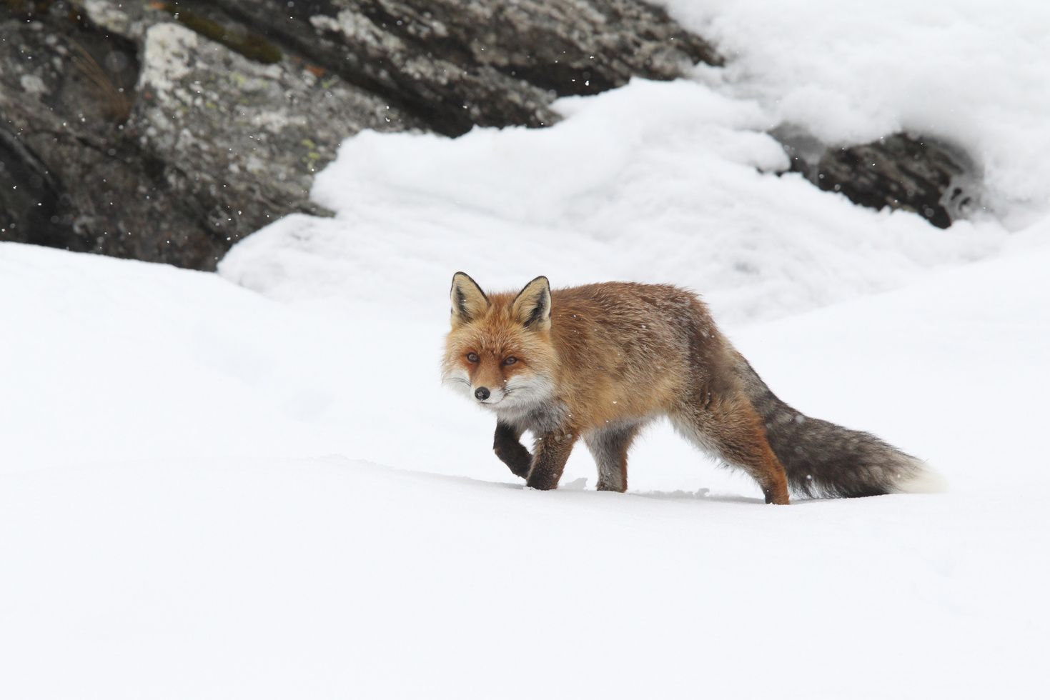
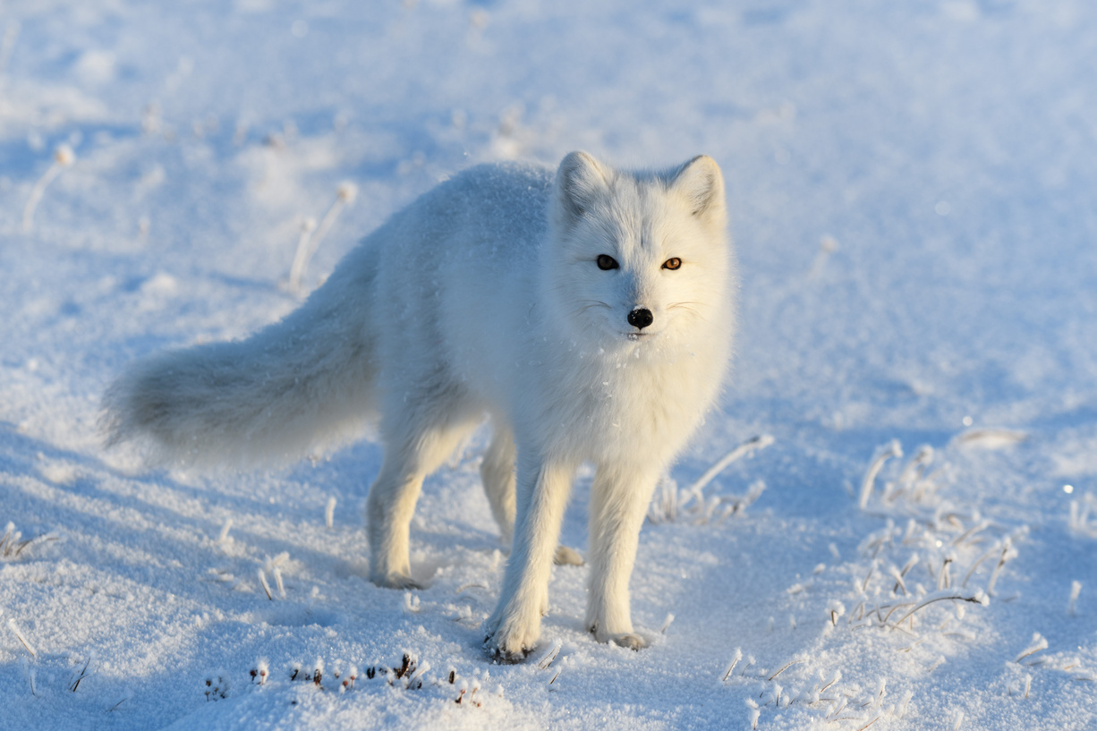
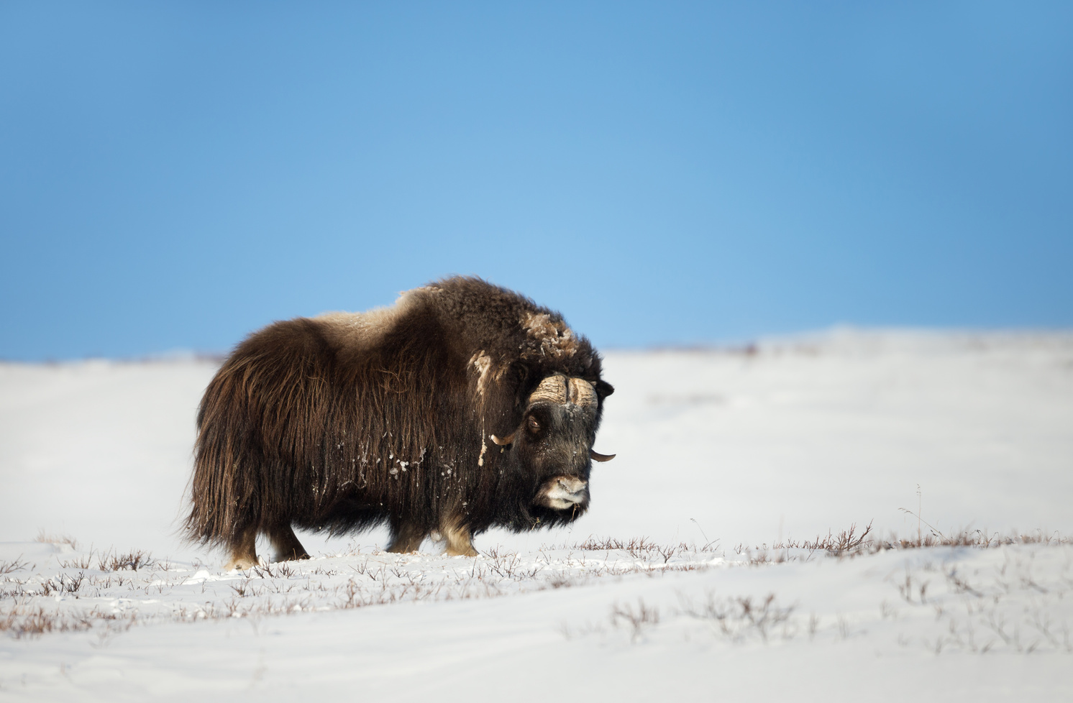
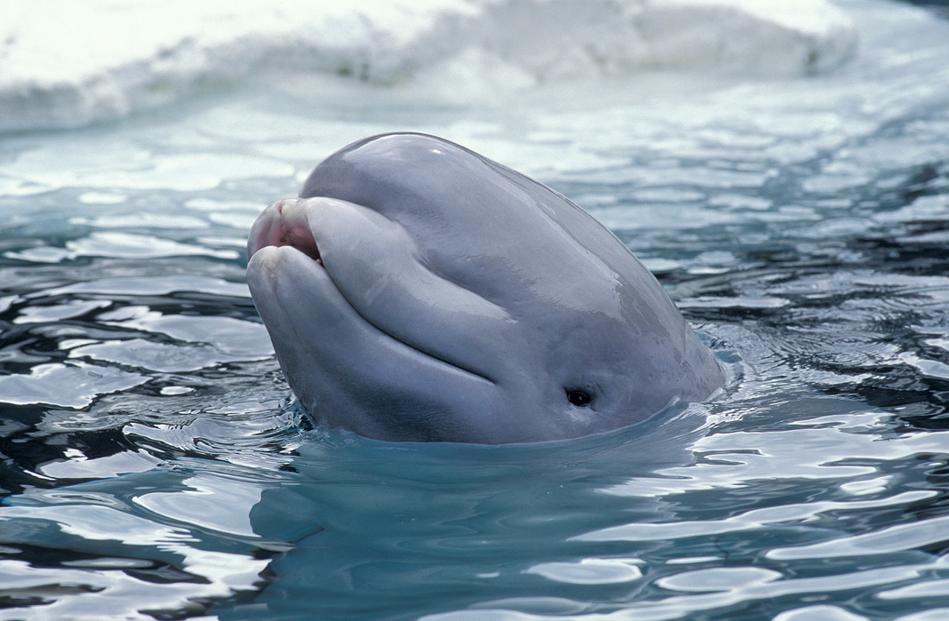
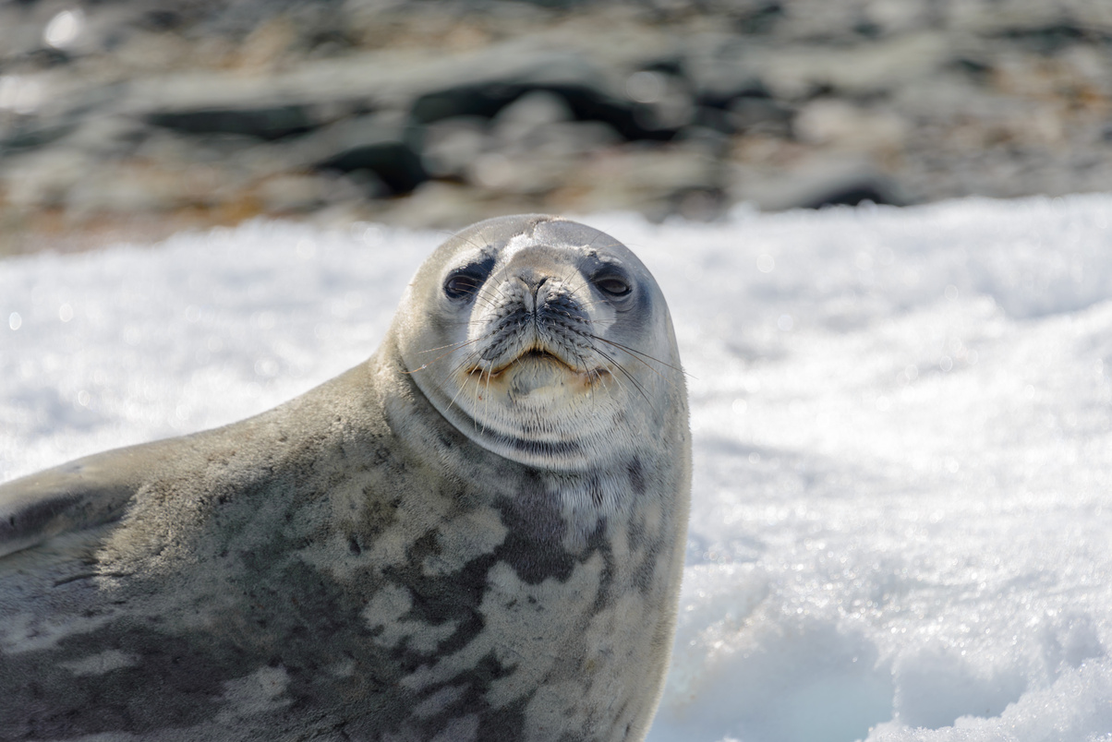
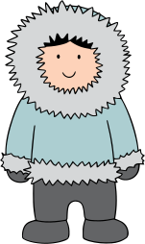
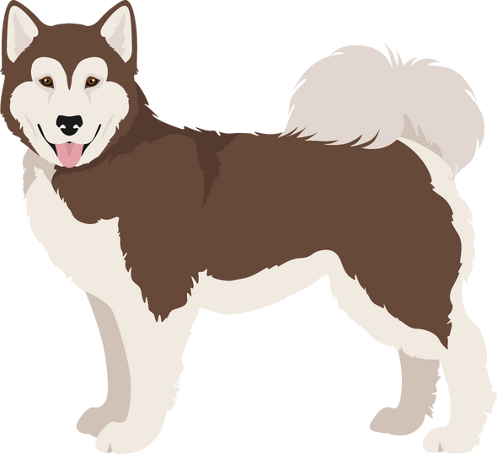
Tamangnik anngutighat aanniarutiqalaat nakimayunit
Anngutighat aumayumik-aulgit anngutighauyut huraangunngittut.
Talvuuna ilvit qinmiillu aktuqtauhimalaaqtuk. Aanniarutiqaqlutik nakimayunit!

Slide 9
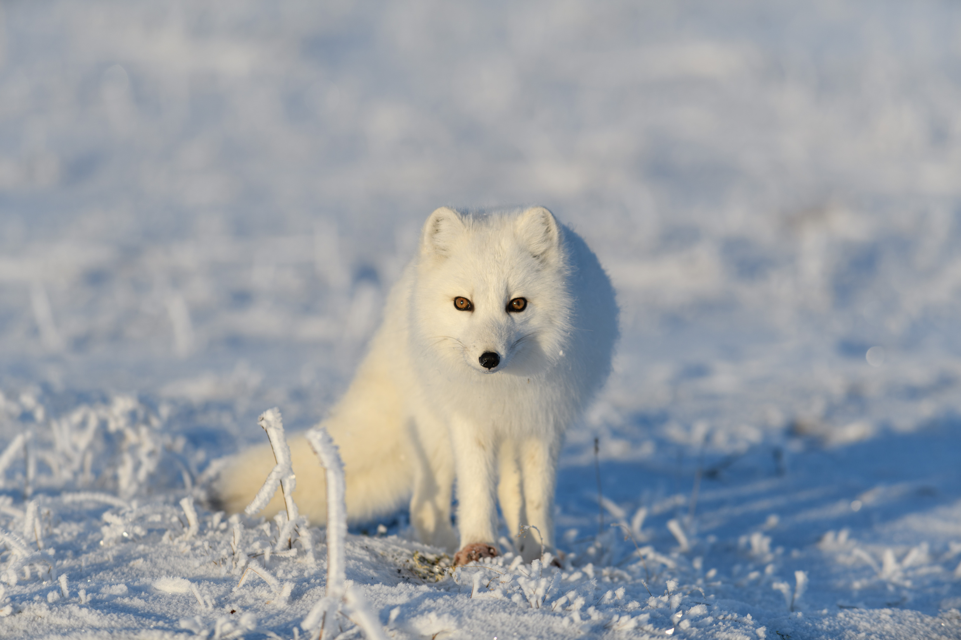
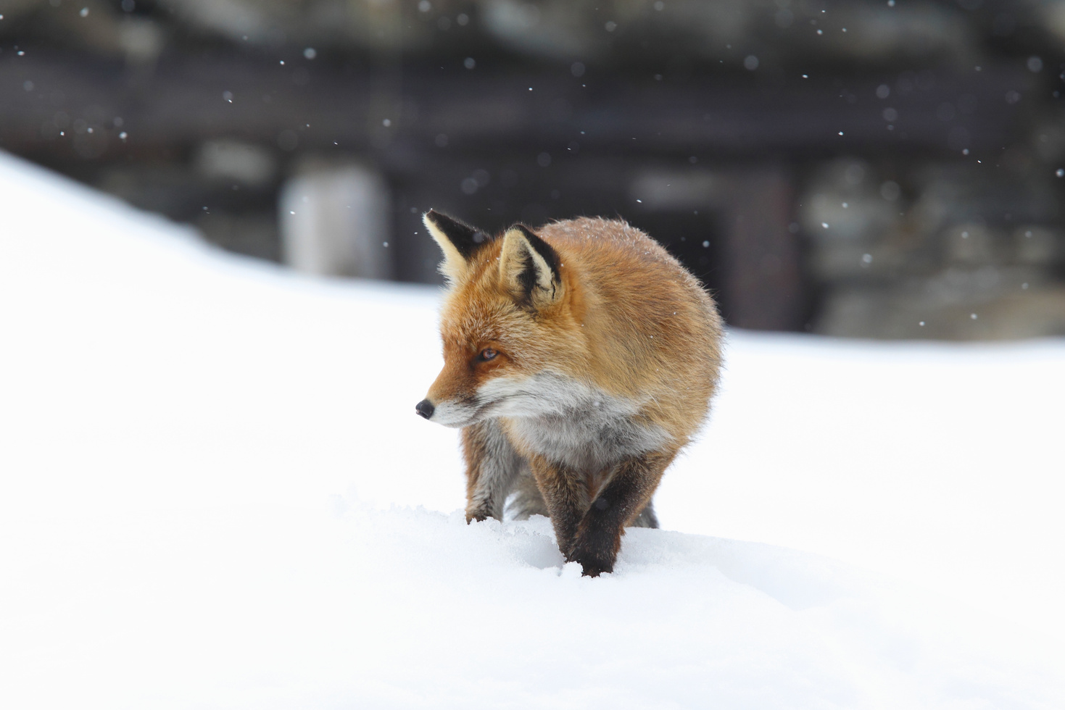
Hivulliit hangutitaiyut
Hivulliit aanniarutiqaqpaktut nakimayunit Nunavunmi taapkuanguyut Tiriganniat taapkualu kayuqtuit
Amiriyaghauplutik, pilgaqhuqpallaa yuittut aallat Nunavunmiutat anngutighat nakimayunit
Nakimayaamik tirigannianit pitquhiuliqpaktuq , taimaa pilgaqhuutauliqpaktuq tirigannianit

Slide 10
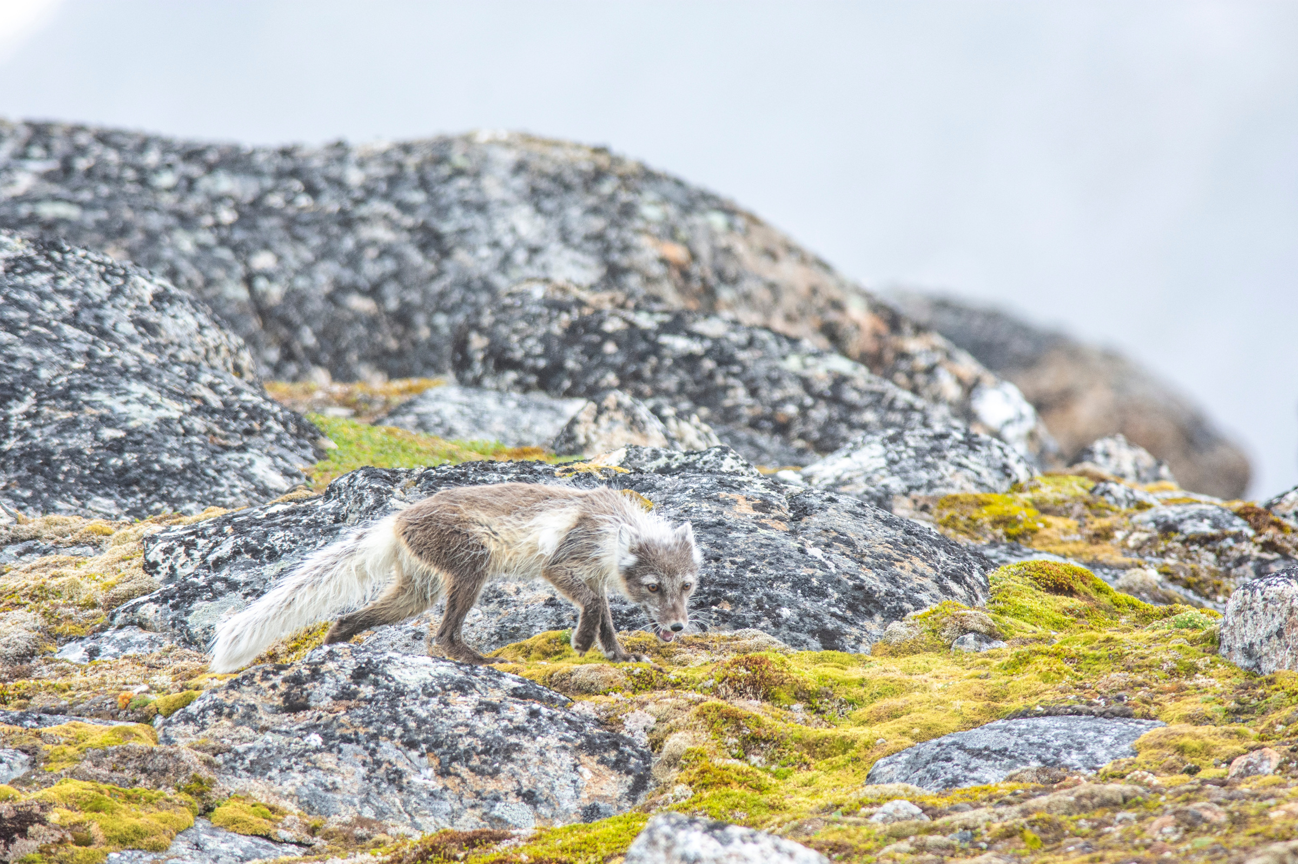

Unipkaat
Takuhimavit tirigannianik talvani qanilruaniluuniit nunallaat?

Slide 11

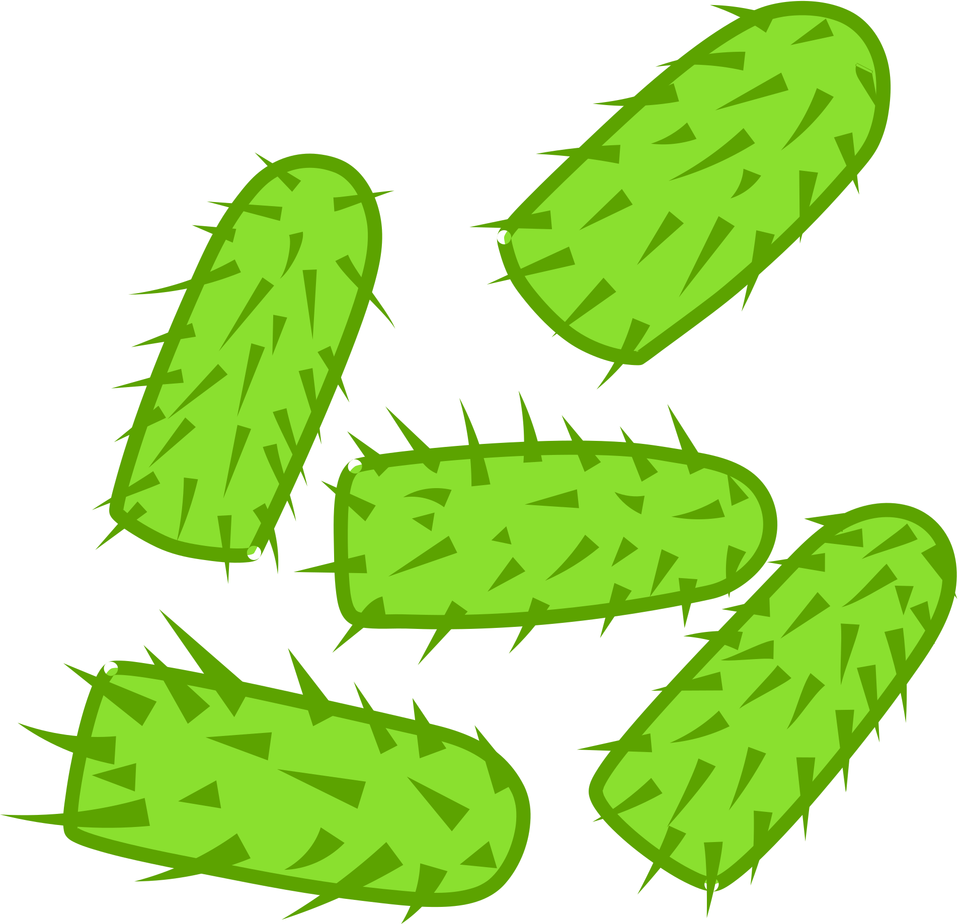
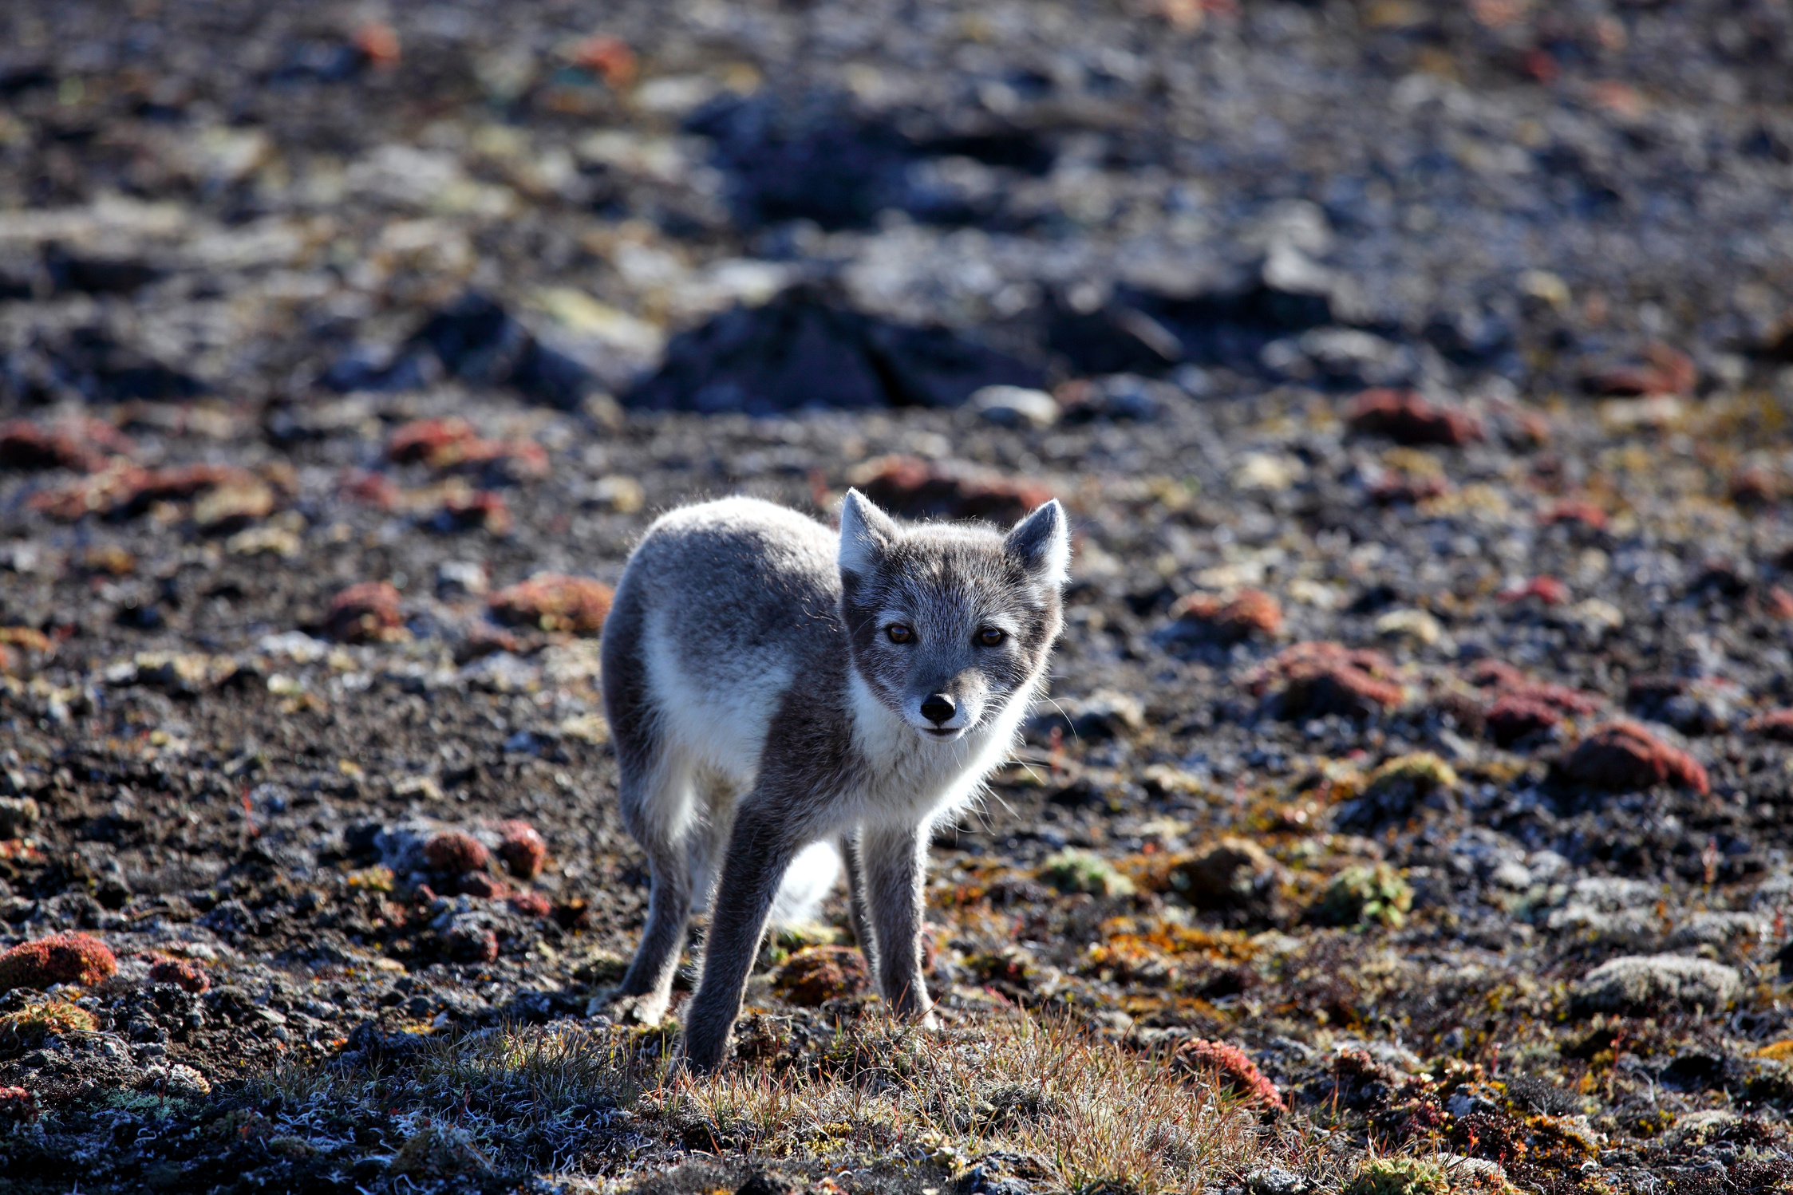
Qanuq qauhimaniaqqit tiriganniaq aanniarutiqariamik nakimayunit?

Slide 12

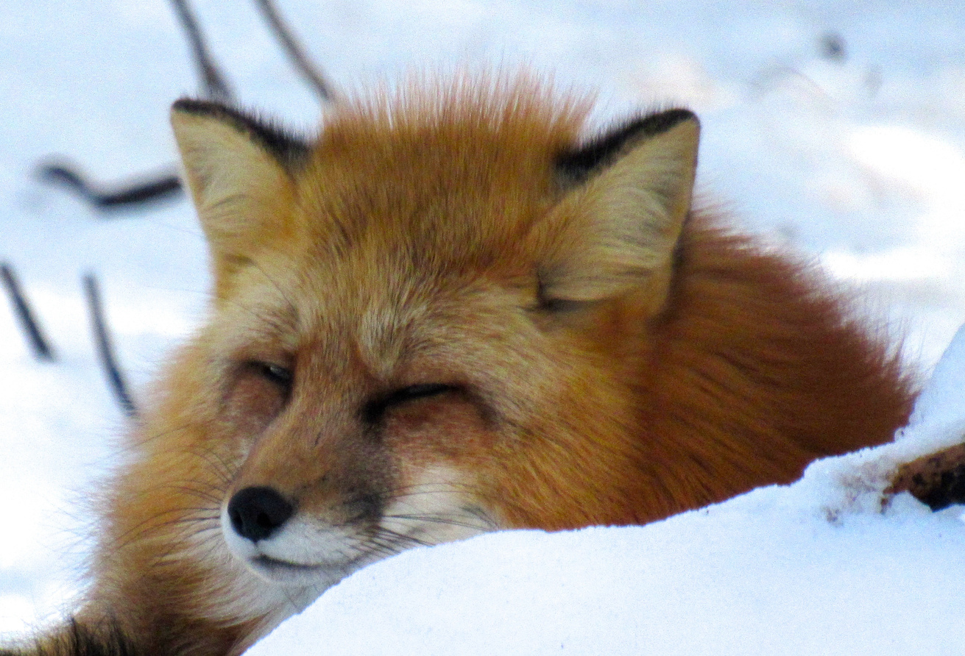
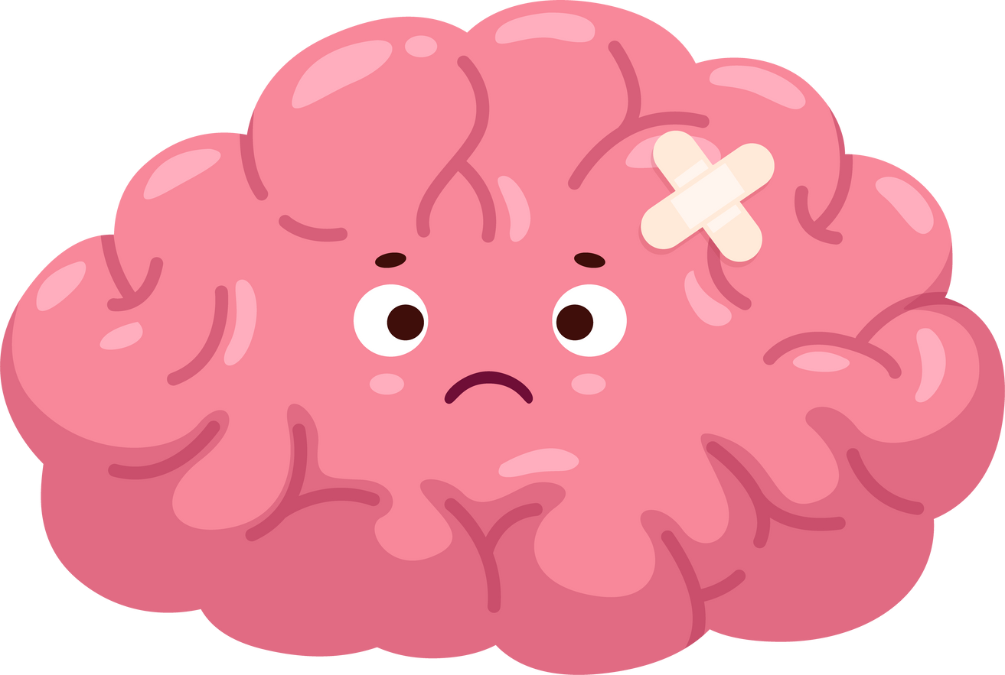
Ilittuqhitiuyut naunaiqhitillu
Tiriganniat nakimayut pitquhiqaliqpaktut aallanngayumik
Kihimi, ilangi tiriganniat nakimayut naammainnaqquuliqpaktut. Naunaittiariamik tiriganniaq nakimayaaghainik taimaa tuqutiqlugu qaritaalu aullaqtillugu qauyihaqtauyaamik.
Naunaiqhitit ilittuqhitillu takunnaqhivaktut malrukkut: “mamiahuktutut” nakimayut taimaaluuniit “nipaittumik” nakimayut

Slide 13
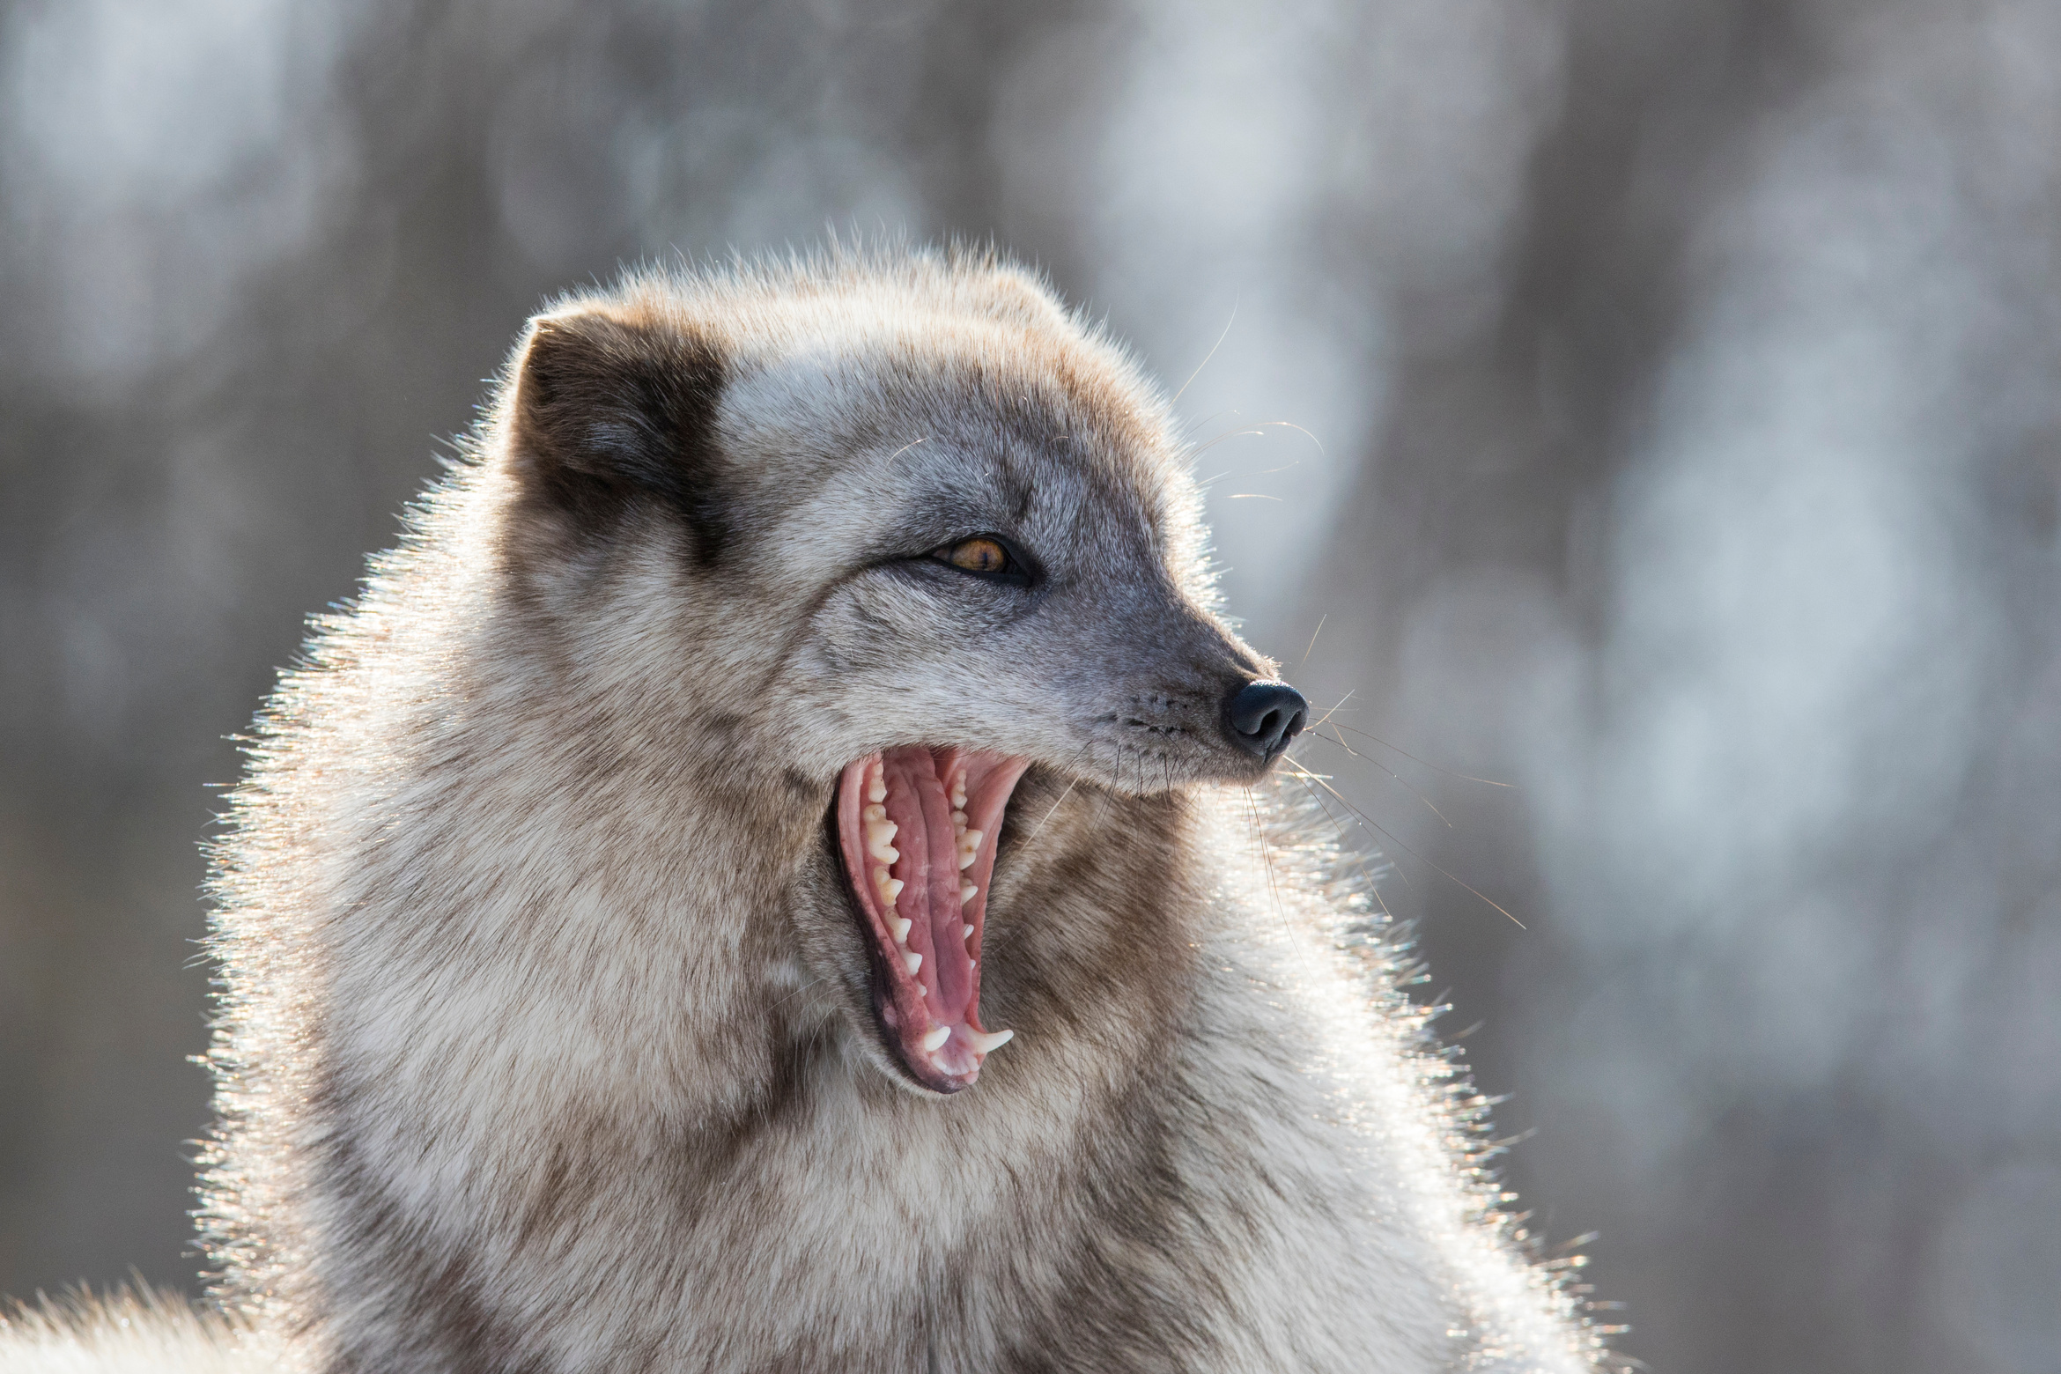

“mamiahuktutut” nakimayut
  Quviattaqtutut mamiahuktuttullu
  Ugiarahuaqpaktut ahinik anngutighanik hunaqutinikluuniit iqhiittumik huliyauhimaittumiklu
  Kiihivaktut kingmaqpaghugillu kanaangit

Slide 14
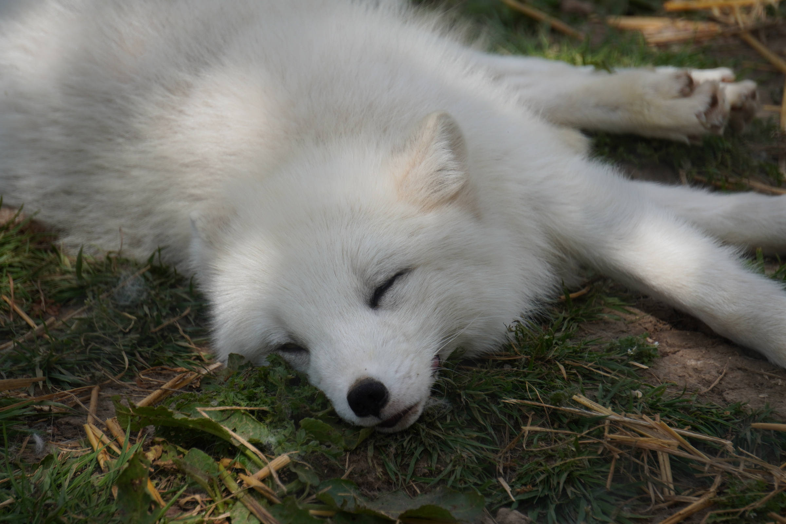
“nipaittumik” nakimayut
  Naluhiliqpaktut – uinngaqquuyuktut kayumiiqpaghutiklu
  Pihugiamik ayuqhaliqpaktut
  Nuvviqivaktut qakuqhivaghutiklu qaniigut
  Iqhigihuiliqpagait inuit inugikpaghutik

Slide 15
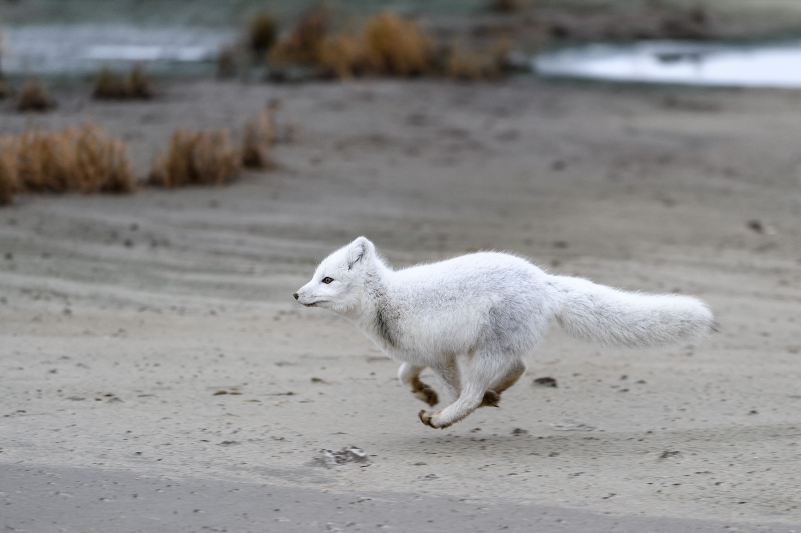
Ingutalukaaqtut nutqallaghutik

Slide 16
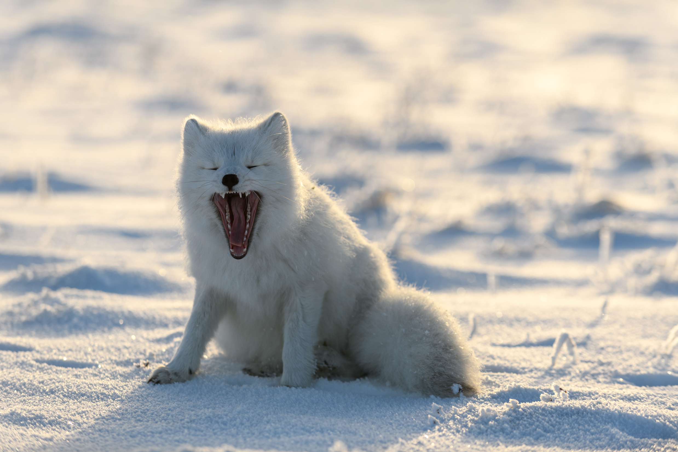
Staying Safe
If you see a fox in your community or a fox on the land acting strangely, it is important that you:
Stay away / don’t approach
Walk away slowly/ don’t run
Tell an adult or bylaw officer

Slide 17
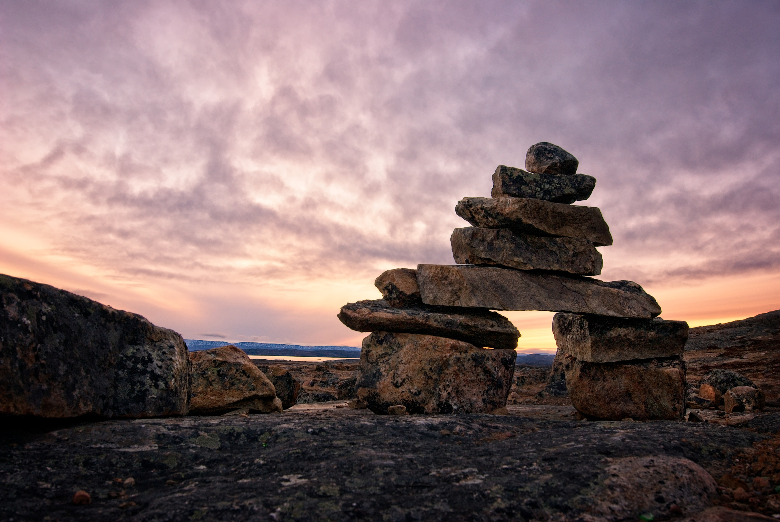
Let’s practice!

