Slide 1
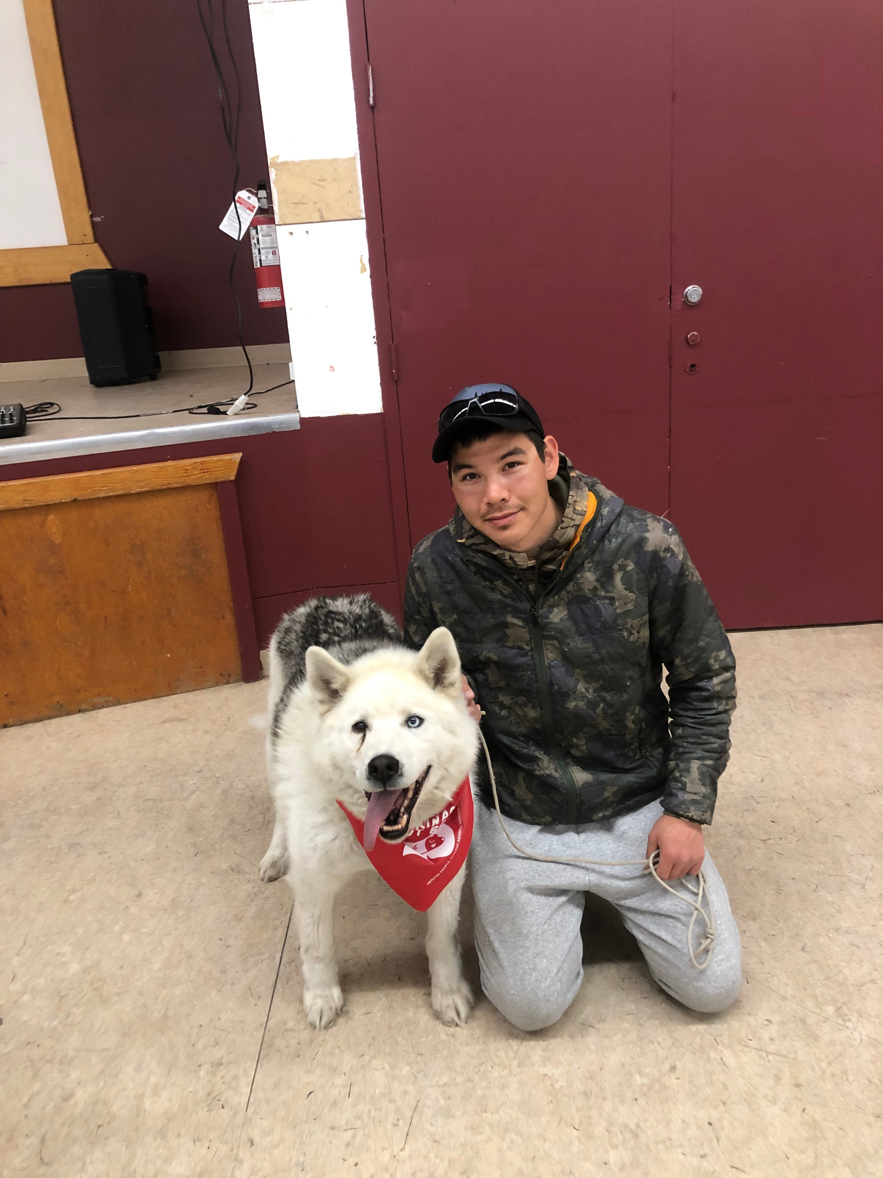

Nunavut Rabies
Awareness & PREVention education Program
Lesson 4: Humans and Dogs

Slide 2

Learning Goals
By the end of this lesson I will be able to:
Describe safe behaviour around dogs.
Use dog body language to identify how dogs are feeling.

Slide 3

Have you been bitten or hurt by a dog before?

Slide 4
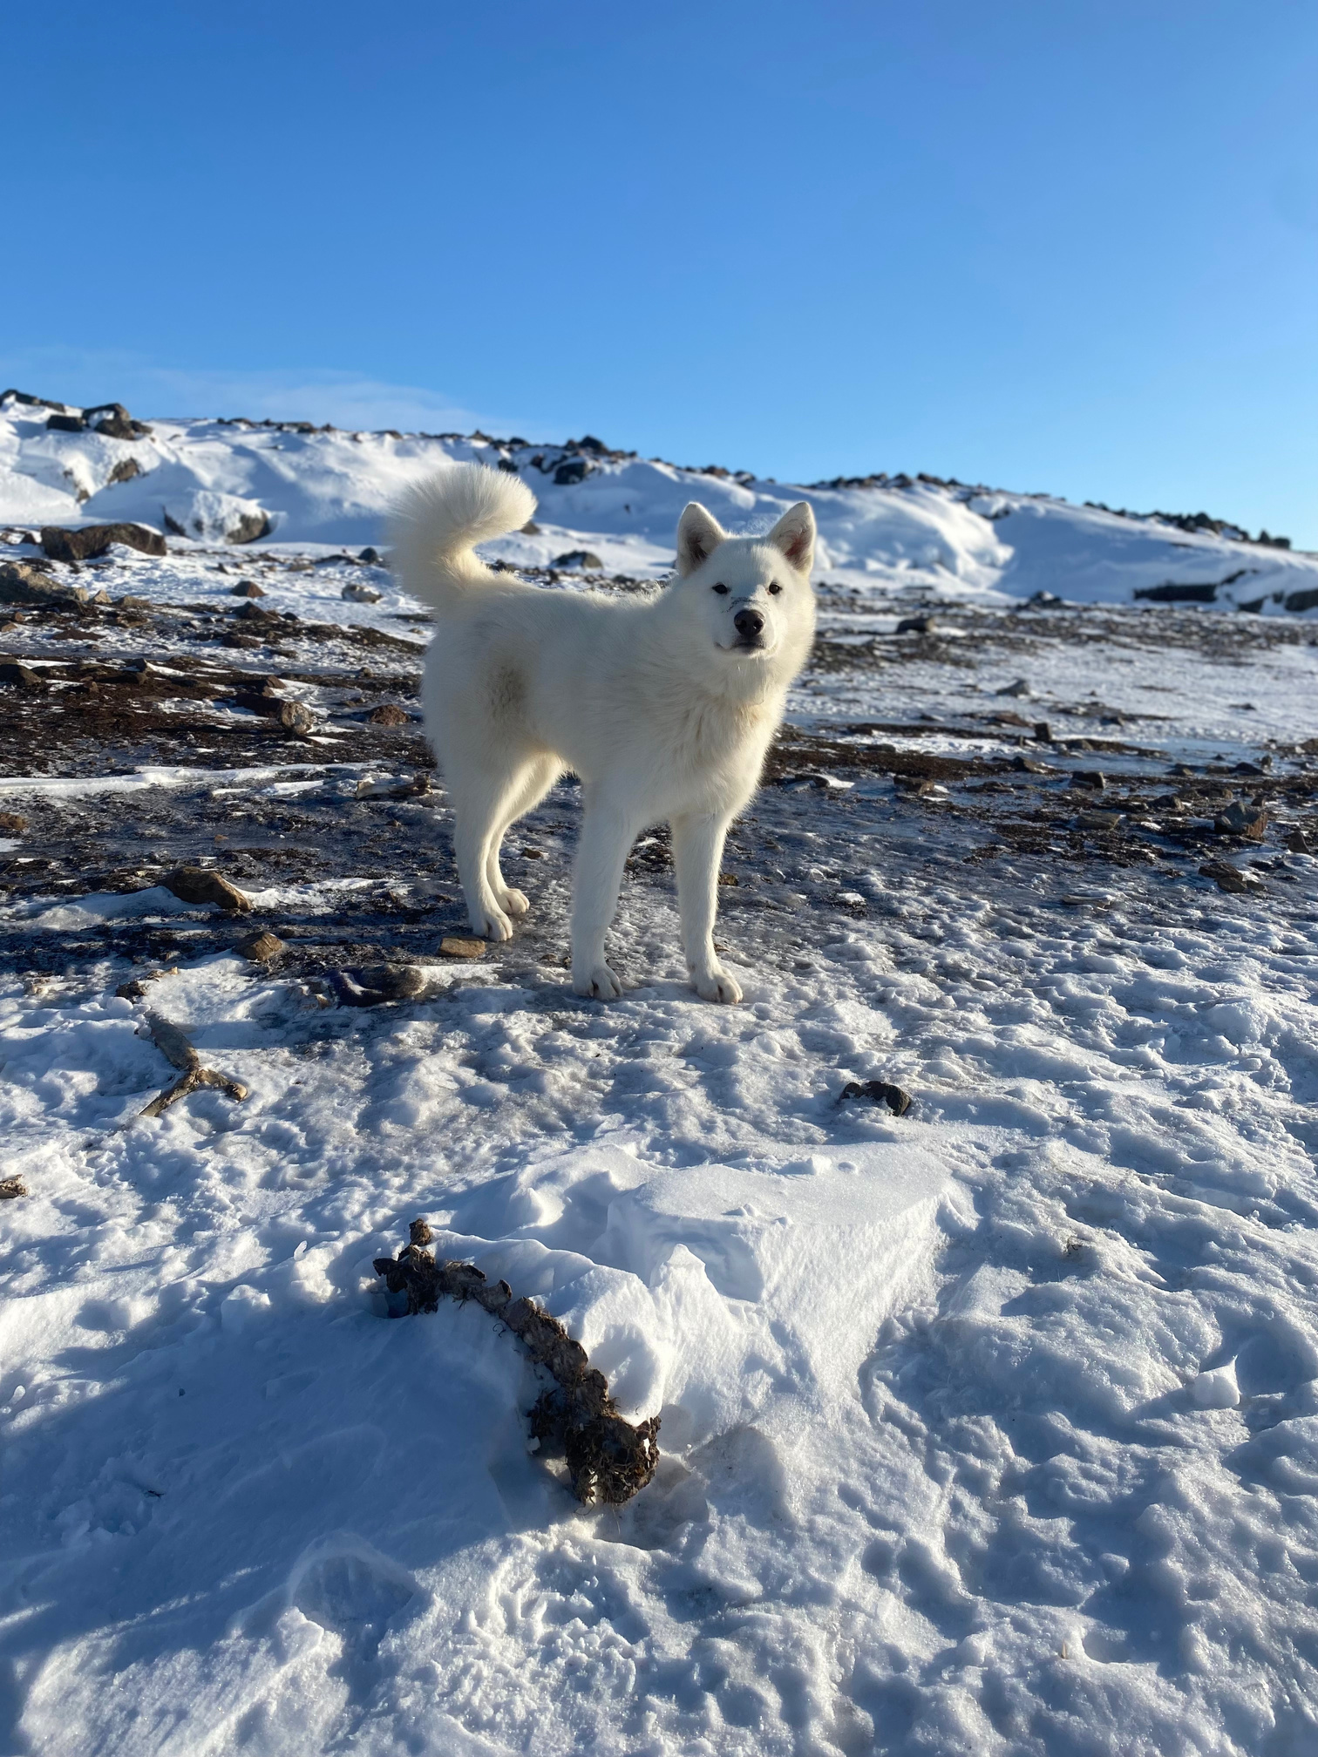
Dog bites
Dog bites are unfortunately quite common. Every bite comes with the risk of transmitting the rabies virus to a human.
There are many reasons that a dog may bite a person.
Can you think of any?

Slide 5
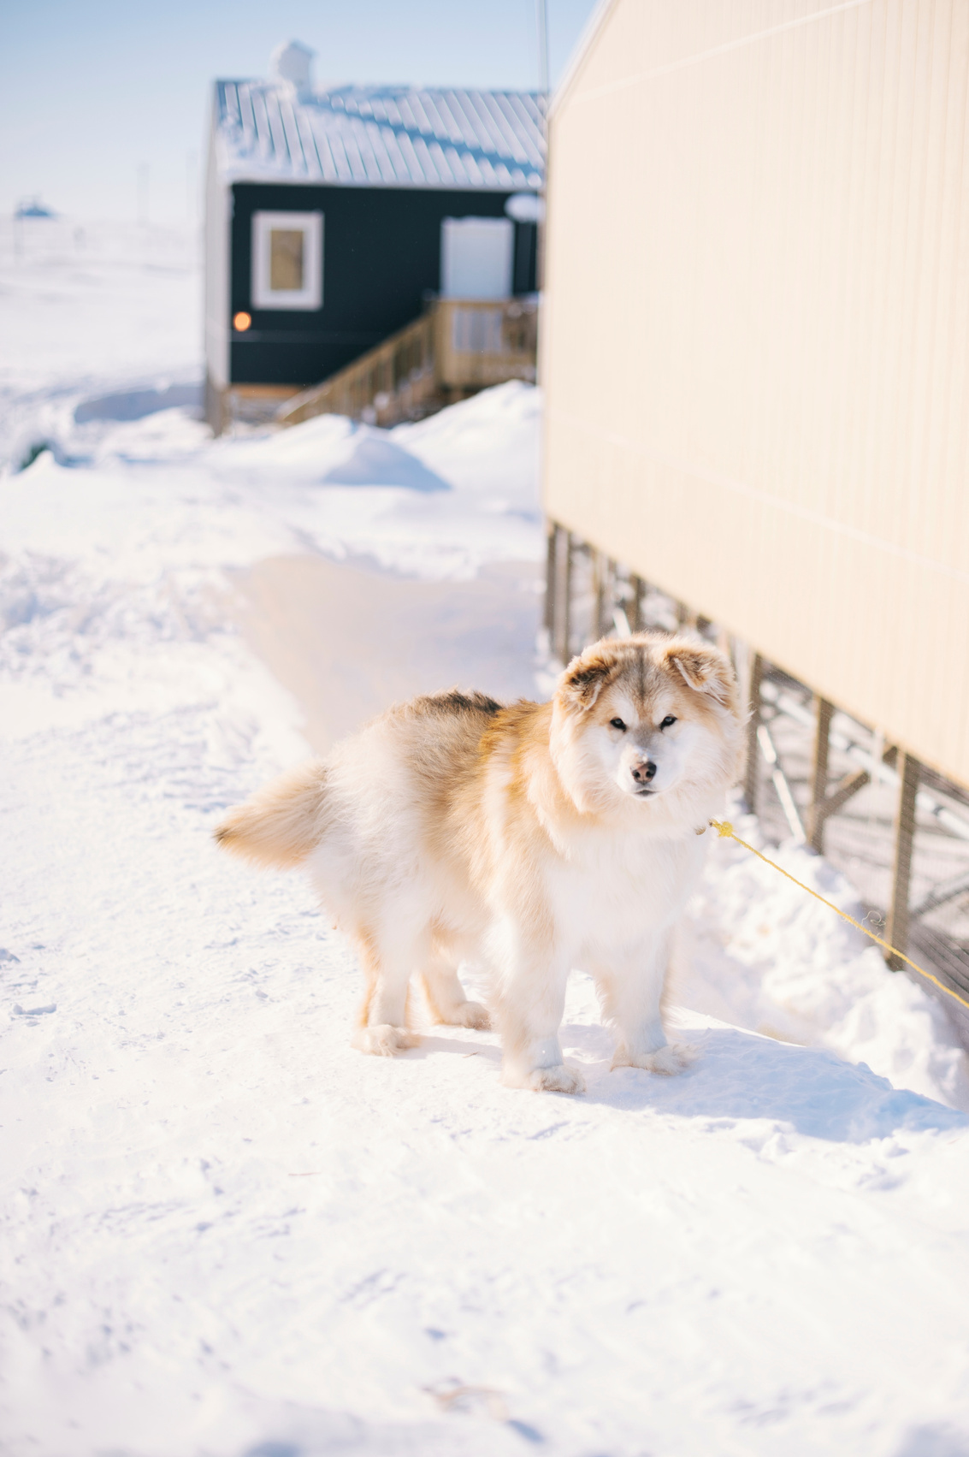

why dogs bite
Dogs may bite for many different reasons, including:
They are protecting themselves or their property
They may be in pain
They may feel trapped
They may have been surprised by your actions
They may be very excited

Slide 6
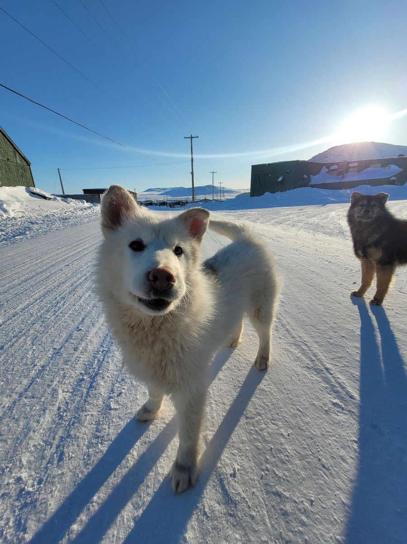
Safe behaviour around dogs
Rarely do dogs attack humans for no reason. In most cases, the way we act and behave around dogs makes a big difference in whether we are bitten or not.
Let’s consider some scenarios and decide if they are safe or unsafe.

Slide 7
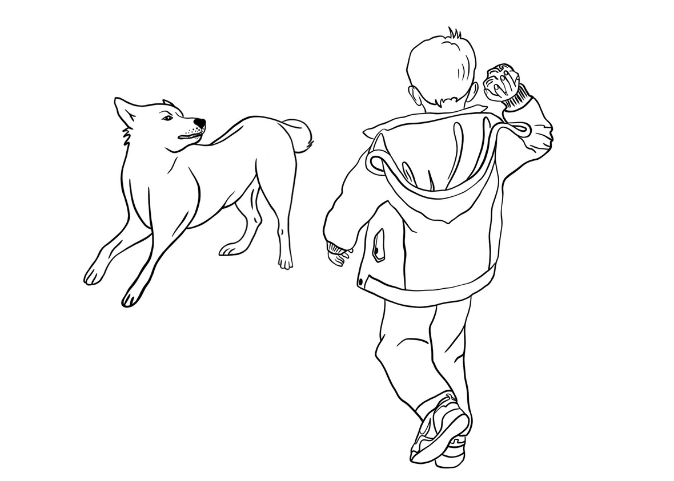
Is this behaviour safe or unsafe?
Throwing rocks at dogs

Slide 8


Unsafe!

Slide 9
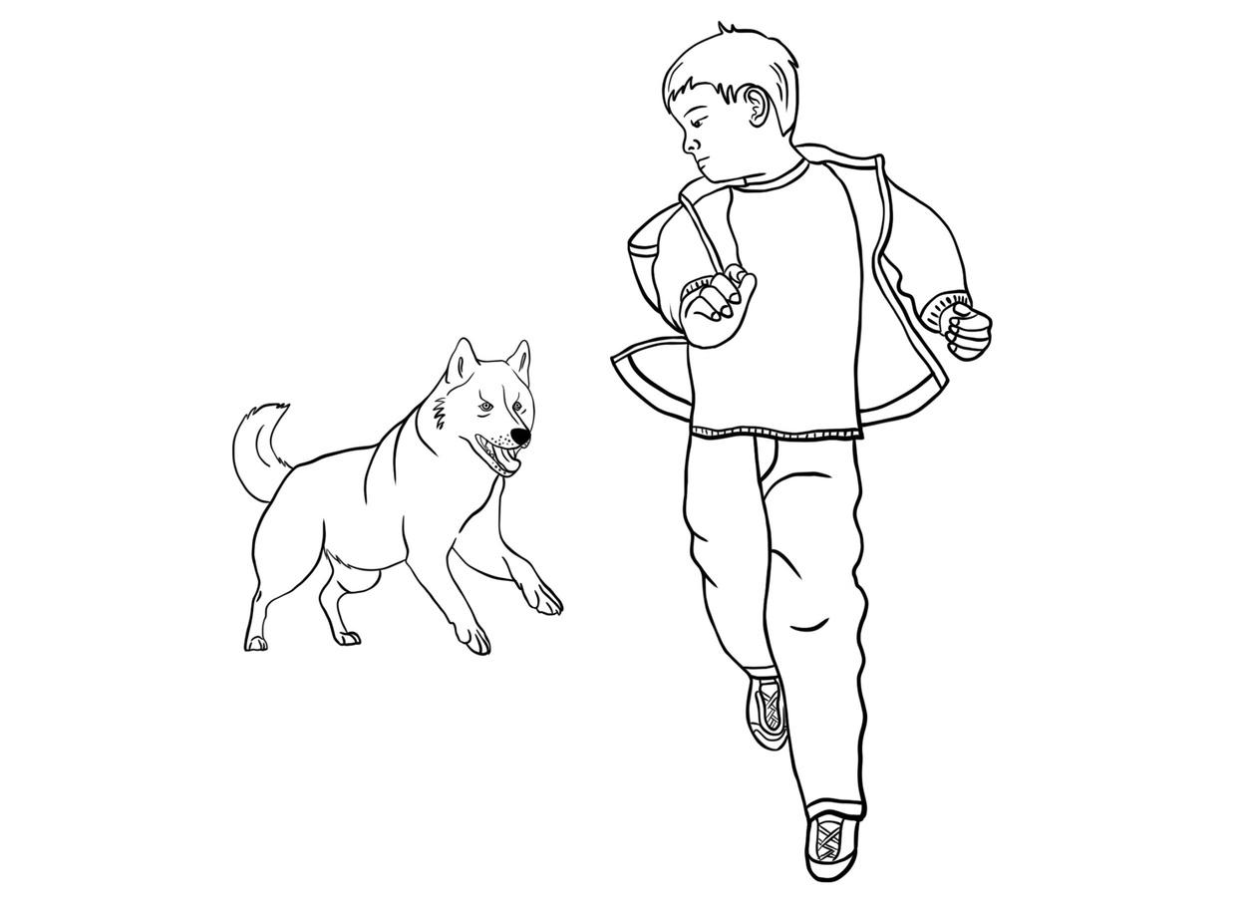
Is this behaviour safe or unsafe?
Running away from dogs

Slide 10
Unsafe!

Slide 11
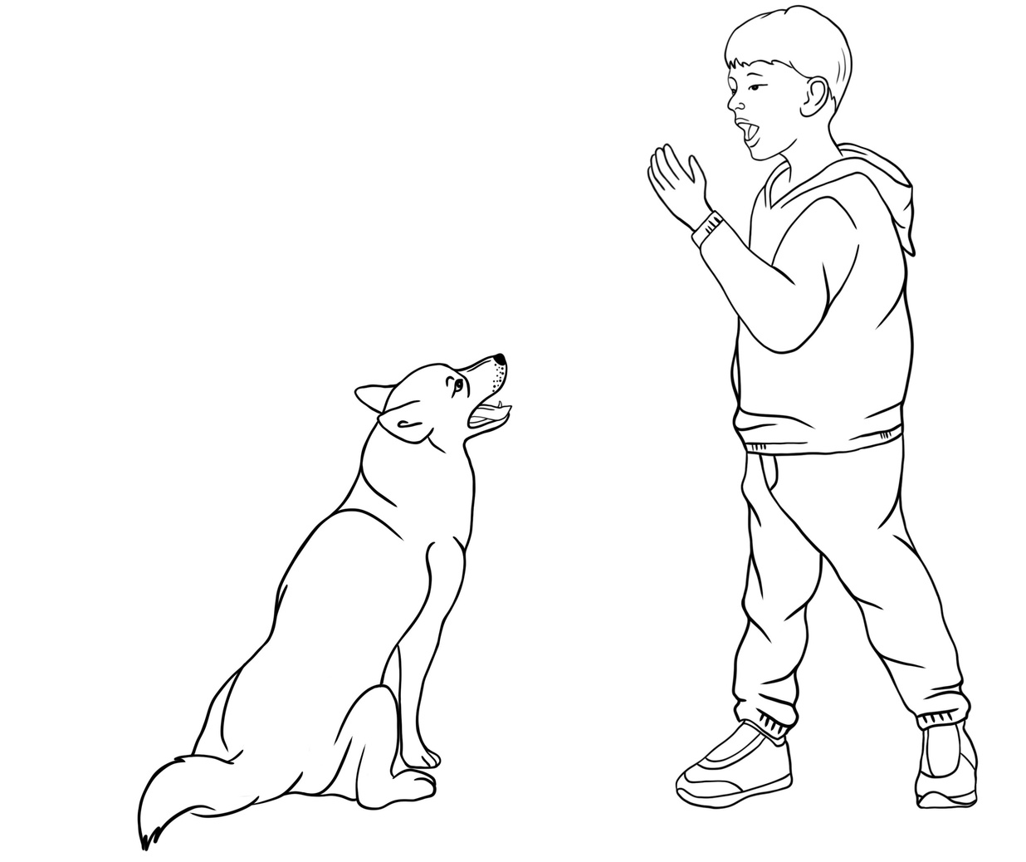
Is this behaviour safe or unsafe?
Screaming or yelling at a dog

Slide 12
Unsafe!

Slide 13
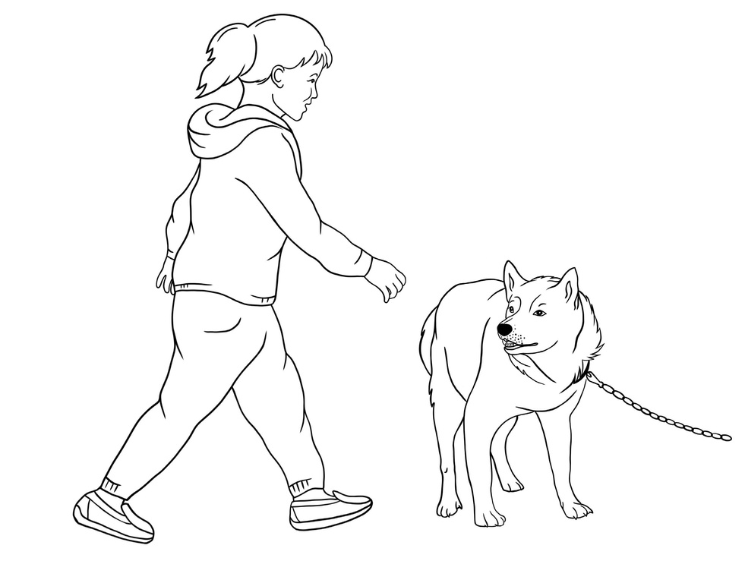
Is this behaviour safe or unsafe?
Going up to a dog that is tied up or cornered (and who doesn’t know who you are)

Slide 14
Unsafe!

Slide 15
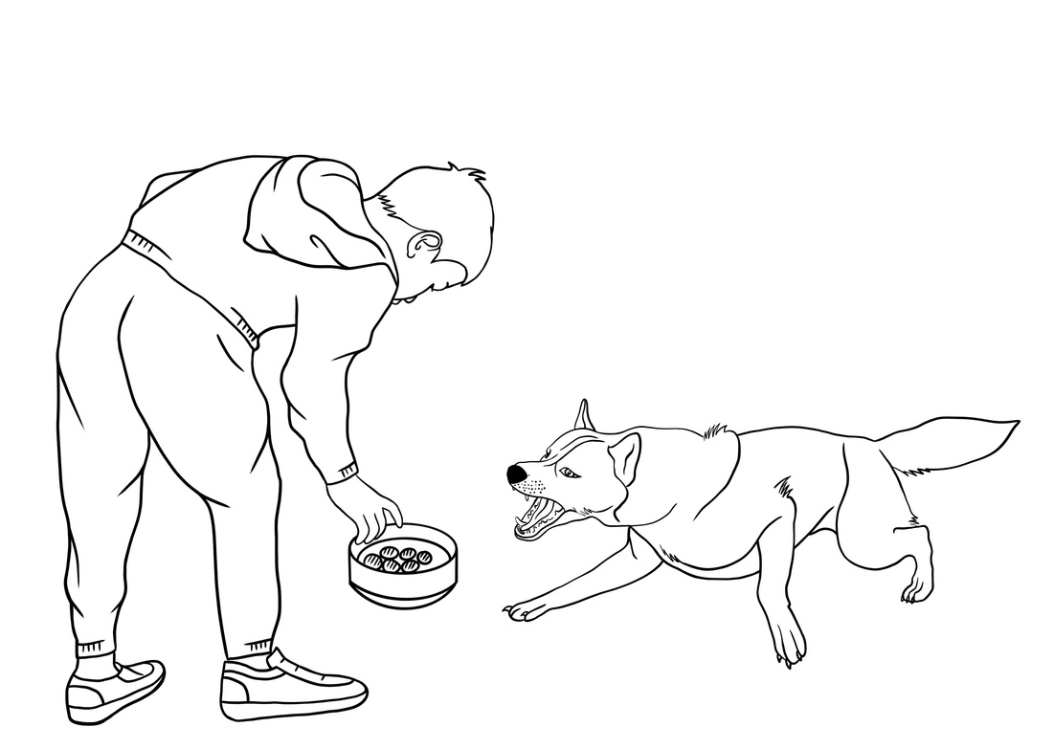
Is this behaviour safe or unsafe?
Taking away a dog’s food or toy

Slide 16
Unsafe!

Slide 17
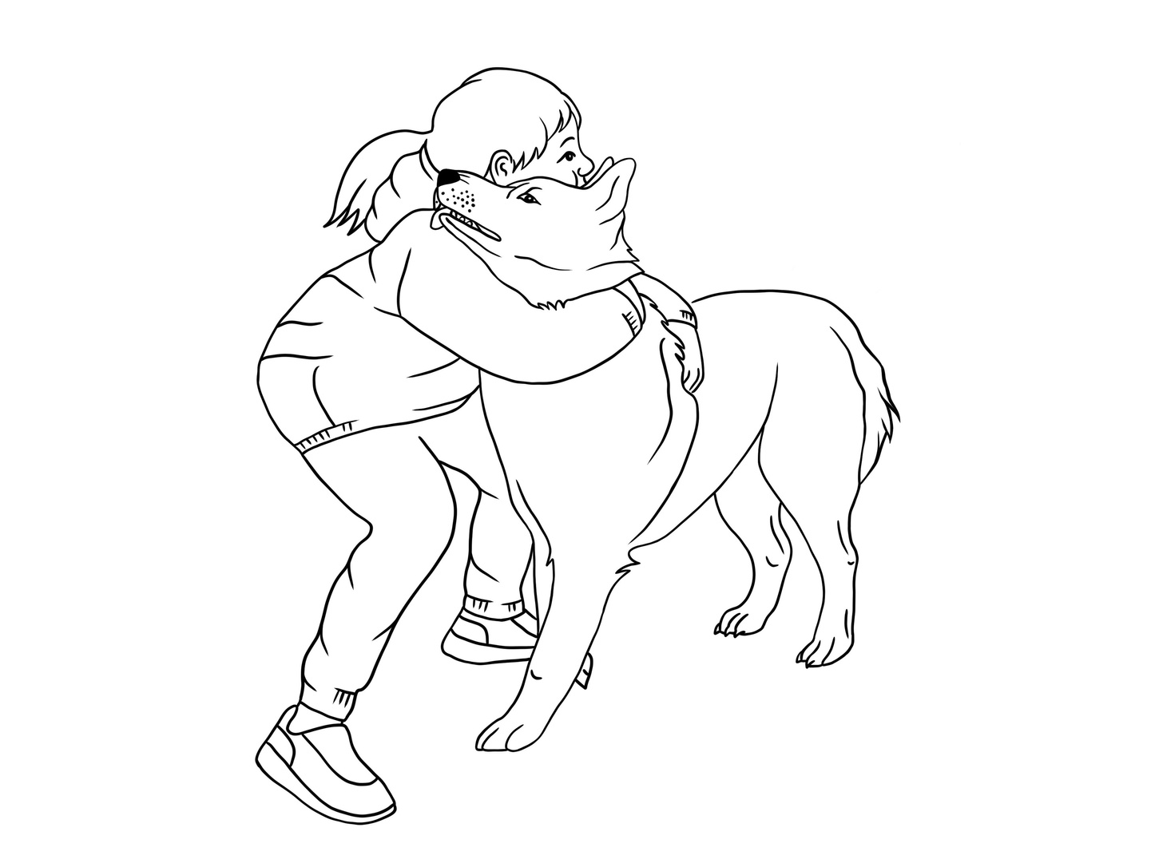
Is this behaviour safe or unsafe?
Tightly hugging a dog

Slide 18
Unsafe!

Slide 19
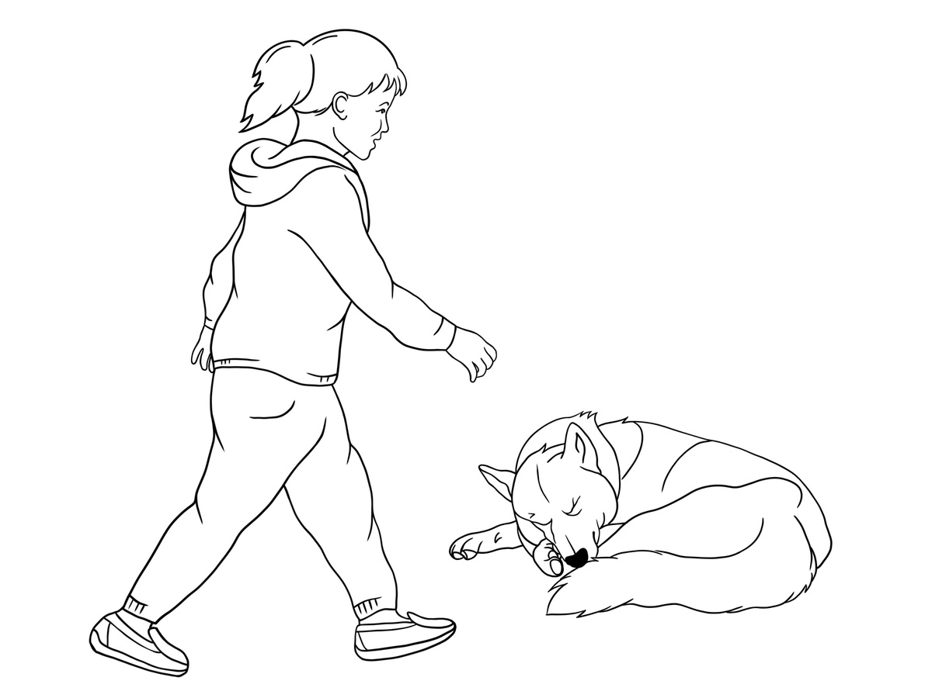
Is this behaviour safe or unsafe?
Going up to a sleeping dog

Slide 20
Unsafe!

Slide 21
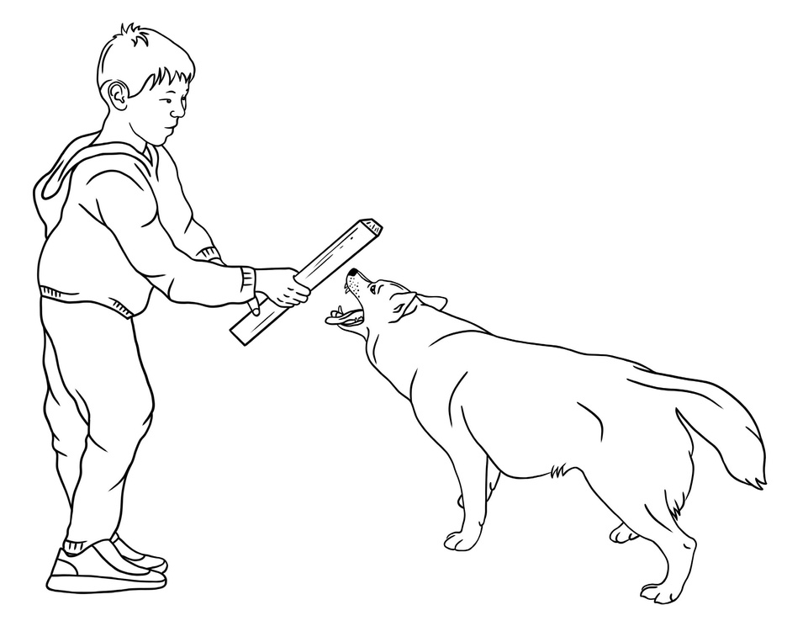
Is this behaviour safe or unsafe?
Teasing a dog

Slide 22
Unsafe!

Slide 23
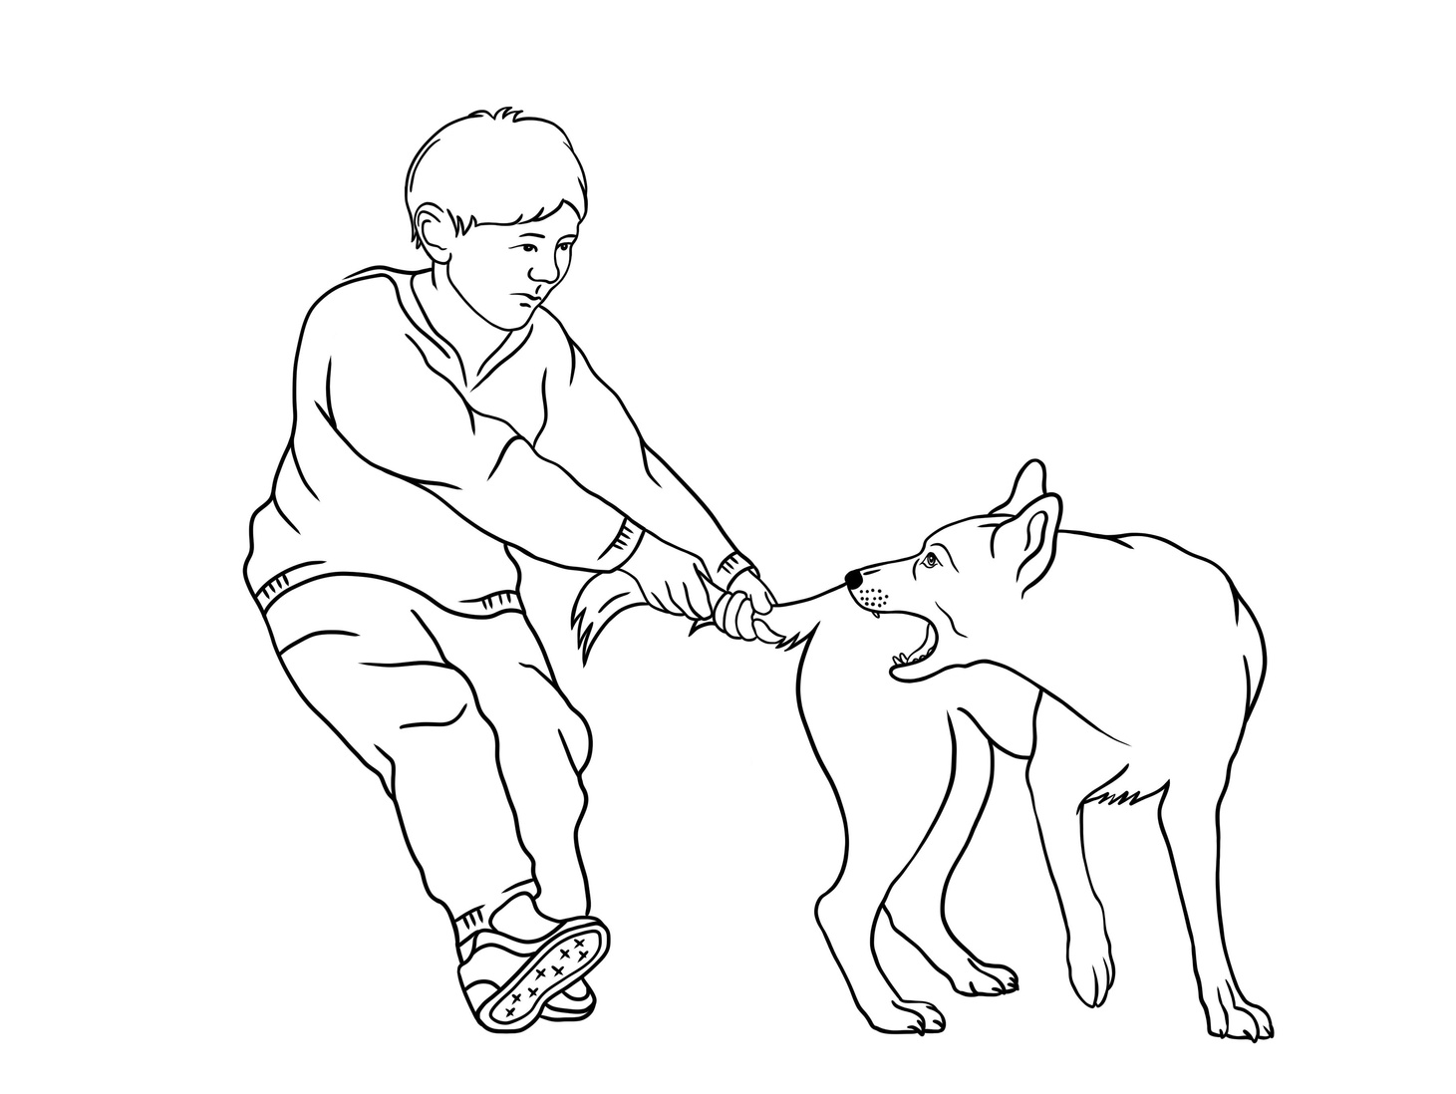
Is this behaviour safe or unsafe?
Pulling a dog’s tail

Slide 24
Unsafe!

Slide 25
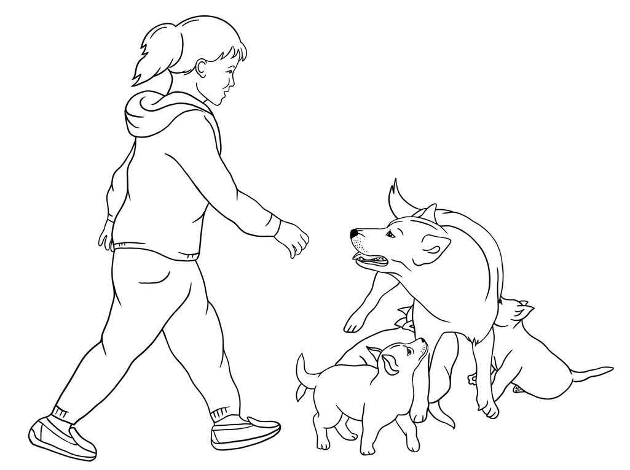
Is this behaviour safe or unsafe?
Taking puppies away from a mother dog

Slide 26
Unsafe!

Slide 27
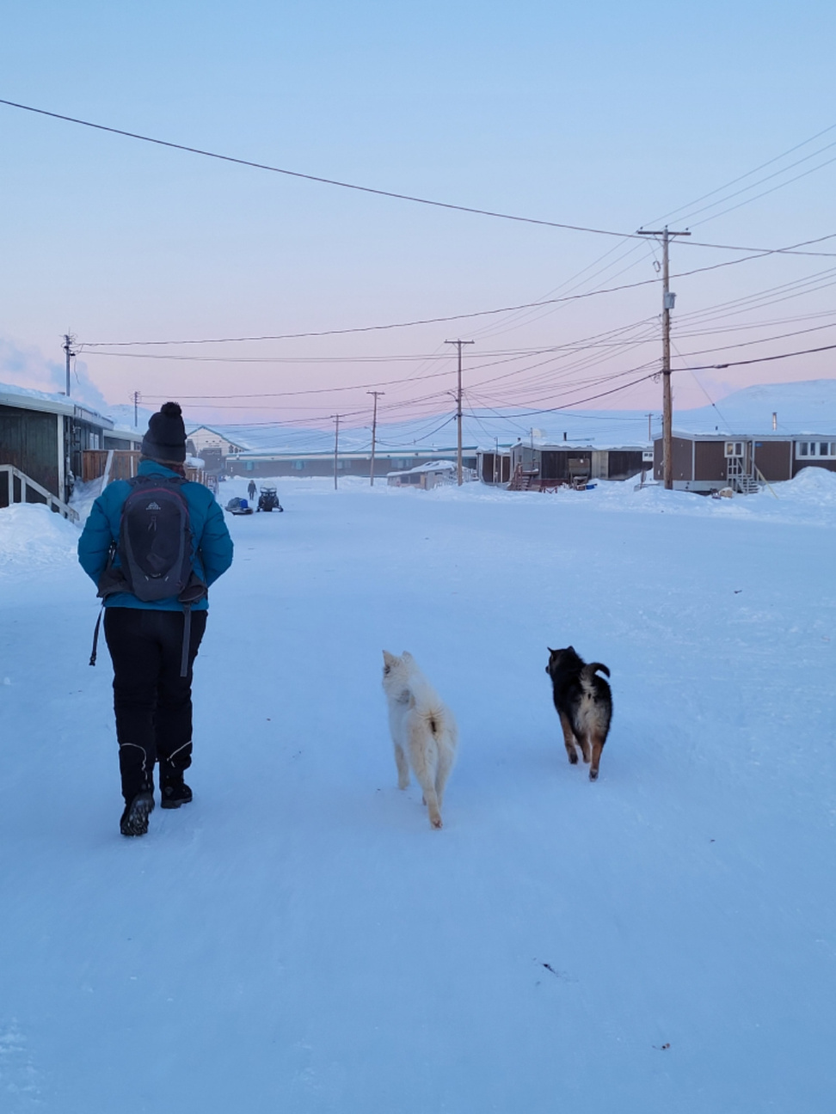

As you found out, all of the scenarios were unsafe!
How many of you have done one or more of those things?
So, how should you act around dogs instead? (Especially dogs that are roaming free around you community).

Slide 28
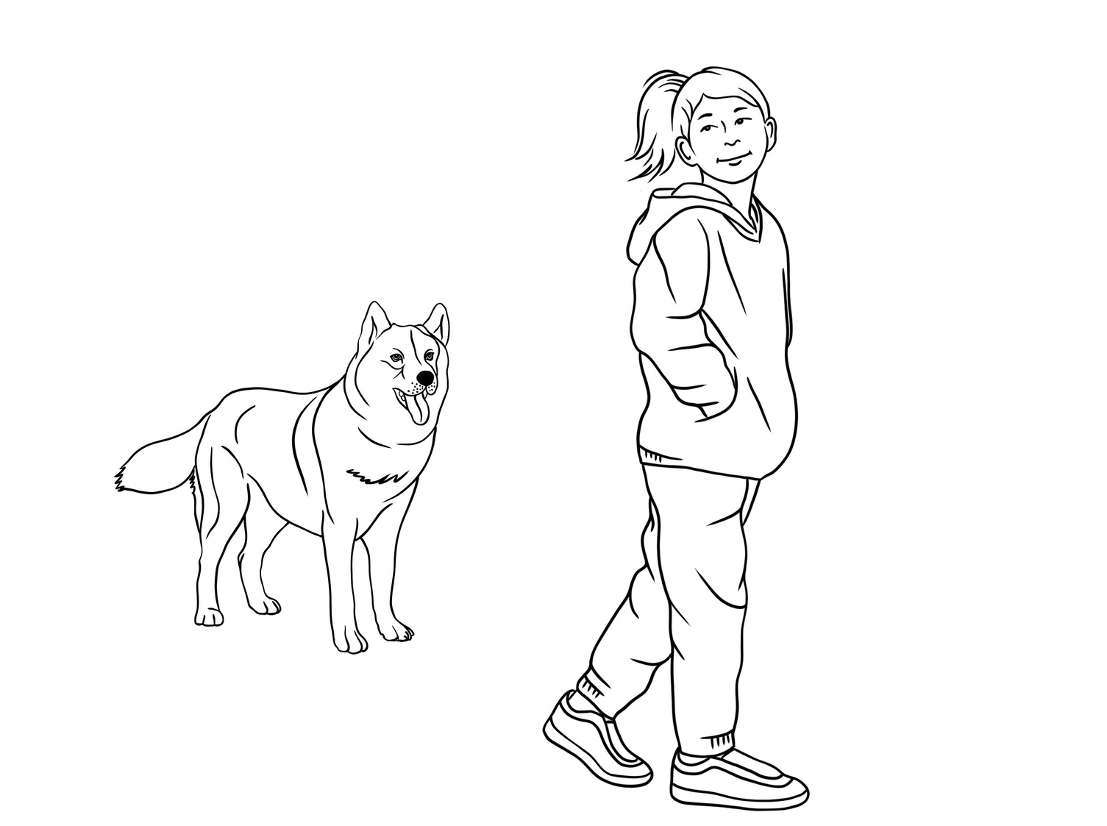
safe behaviour around dogs
It is best to try and stay a safe distance away from dogs that are roaming loose in your community.
Often if you ignore them by not making eye contact and walking by slowly, they will not bother you.

Slide 29
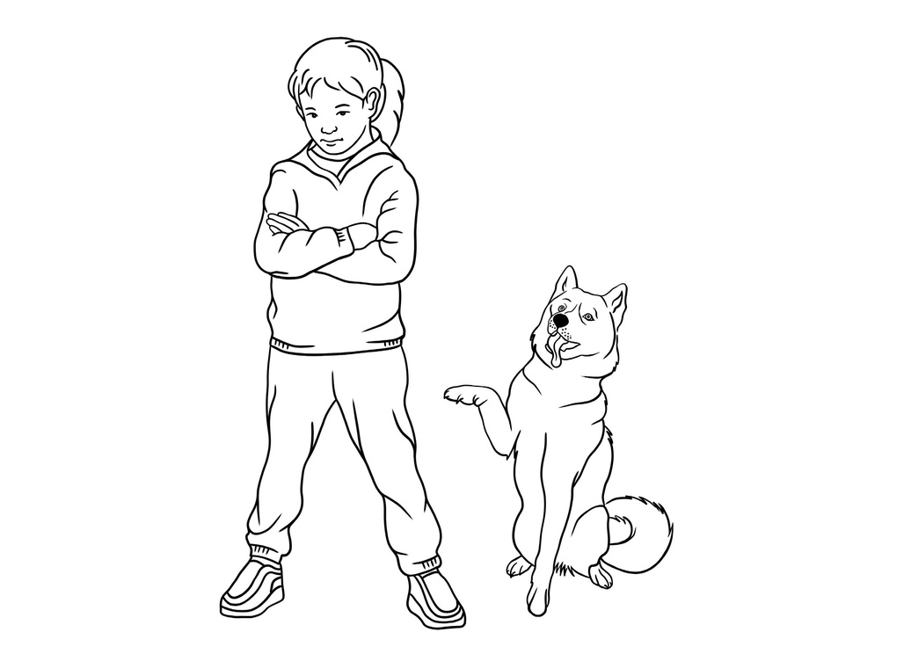
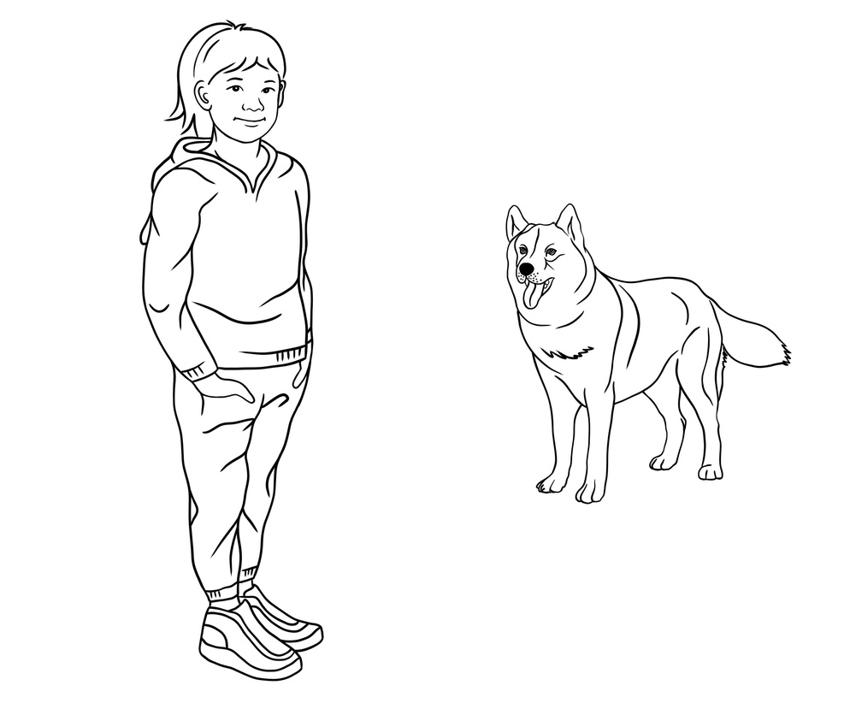

If a dog is being overly curious and comes up to you, try this strategy:
Stand still with your arms at your sides or crossed
Face away from them
Look down
Usually the dog will get bored and will walk off.
Never run away or scream at a dog that is coming too close. This will often make them excited or aggressive and they may chase and/or bite you.

Slide 30
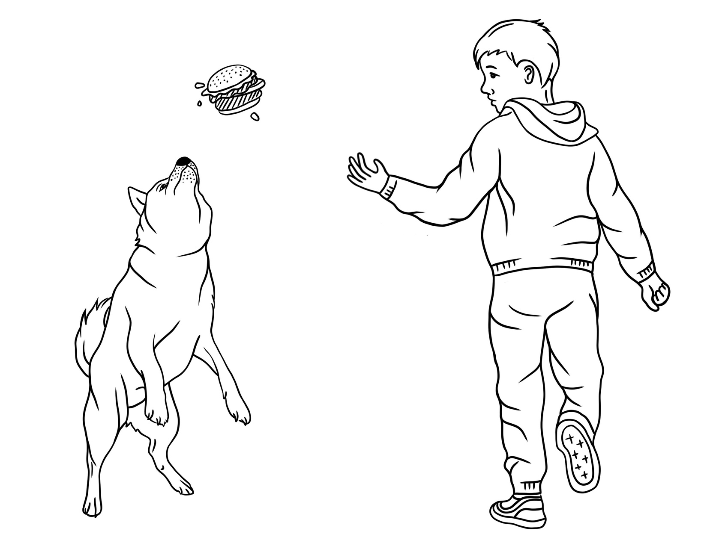
If you are carrying something like food or toys that a dog is overly interested in, throw it away from you.
That will often distract the dog and allow you to walk away slowly without them noticing or caring.

Slide 31
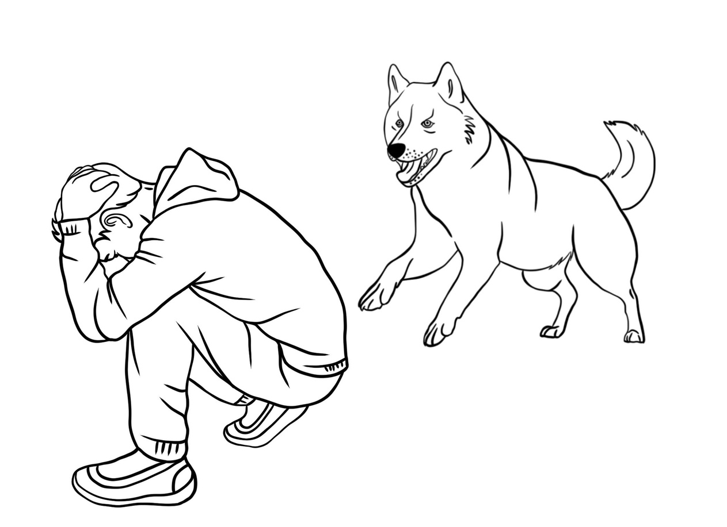
If a dog is really not leaving you alone, try this:
Get on the ground in a curled up brace position, with your arms covering your face and head.
This is a non-threatening position for a dog and they may decide to leave you alone.
Also, the brace position protects your important body parts if the dog does bite you.

Slide 32

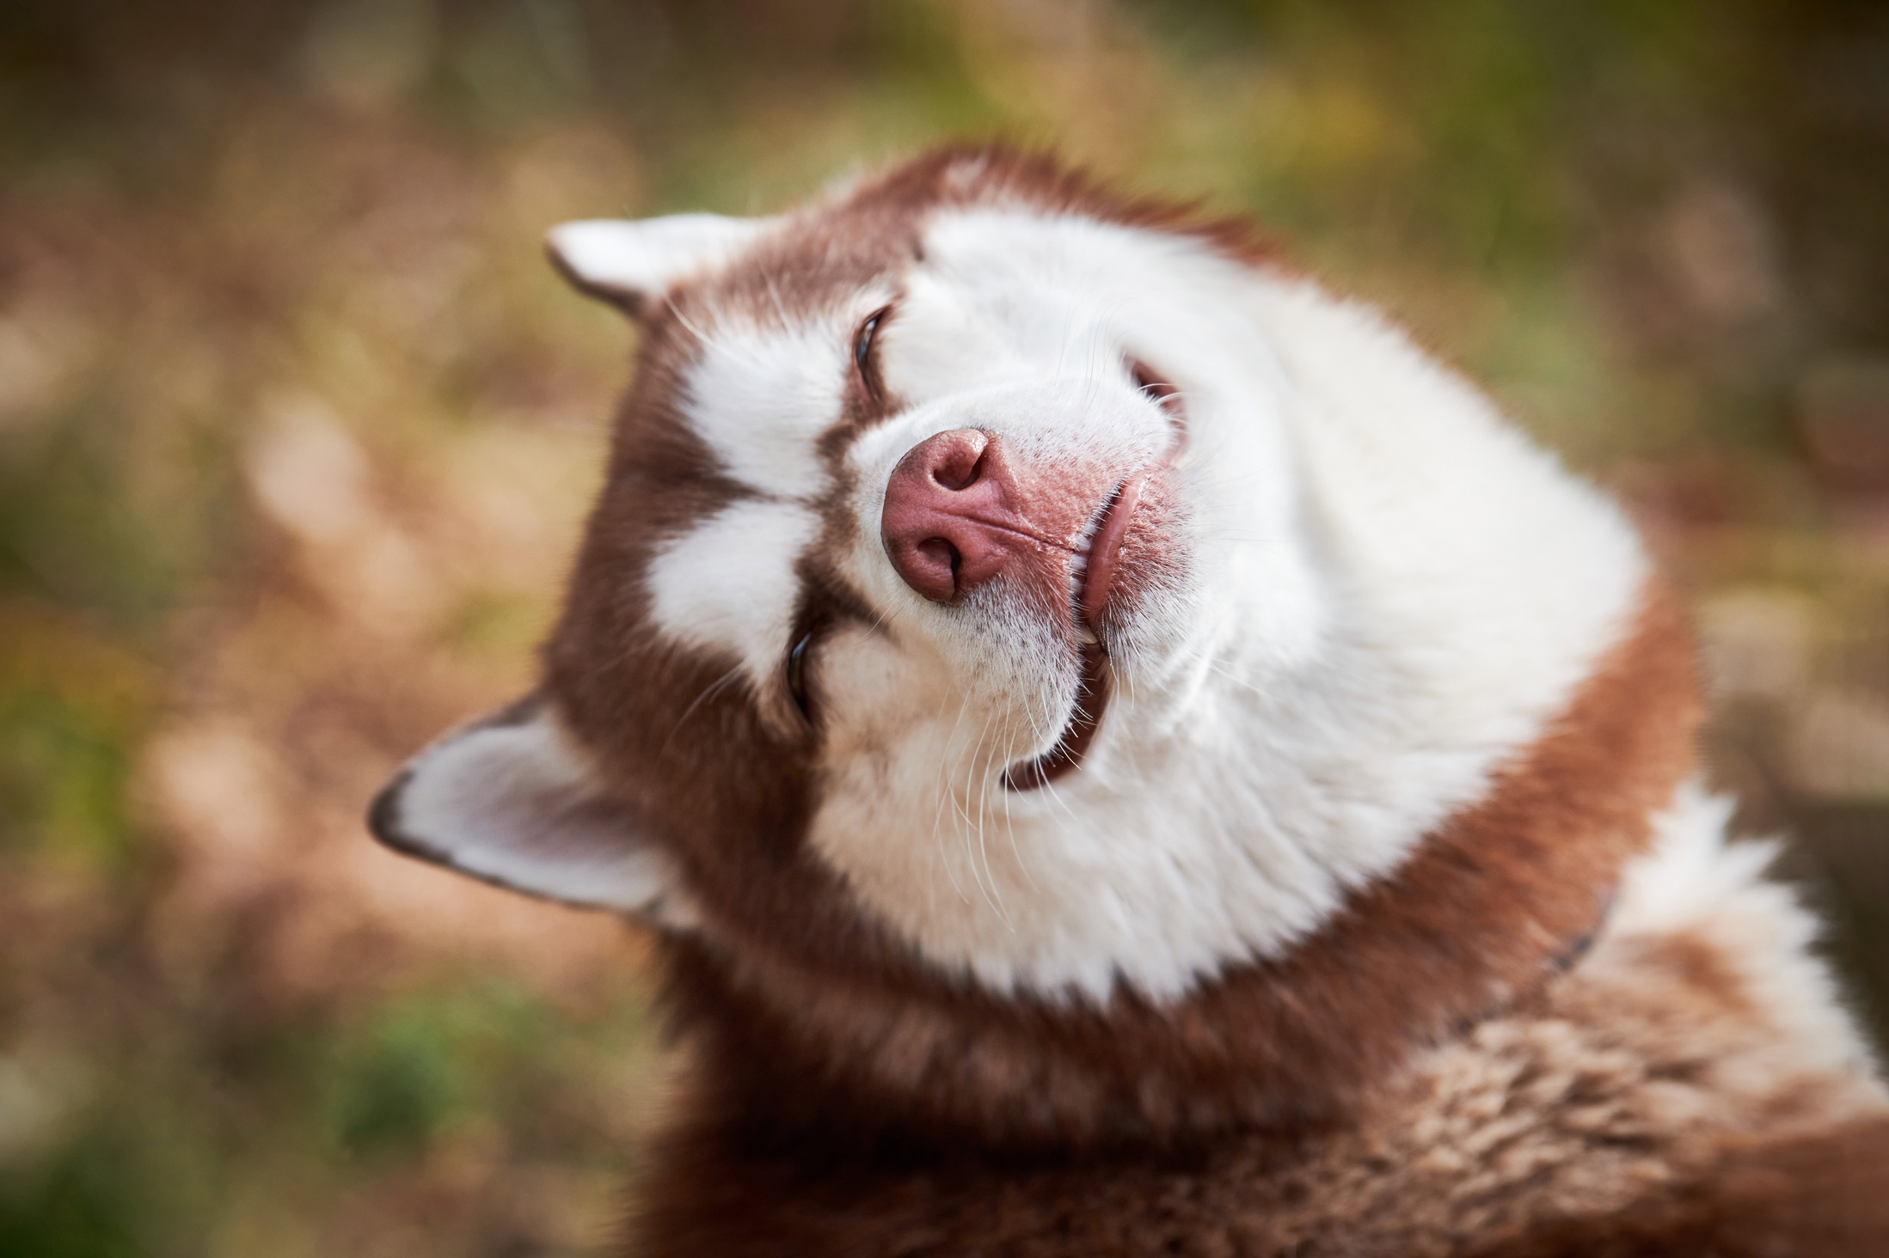
Role Play

Slide 33
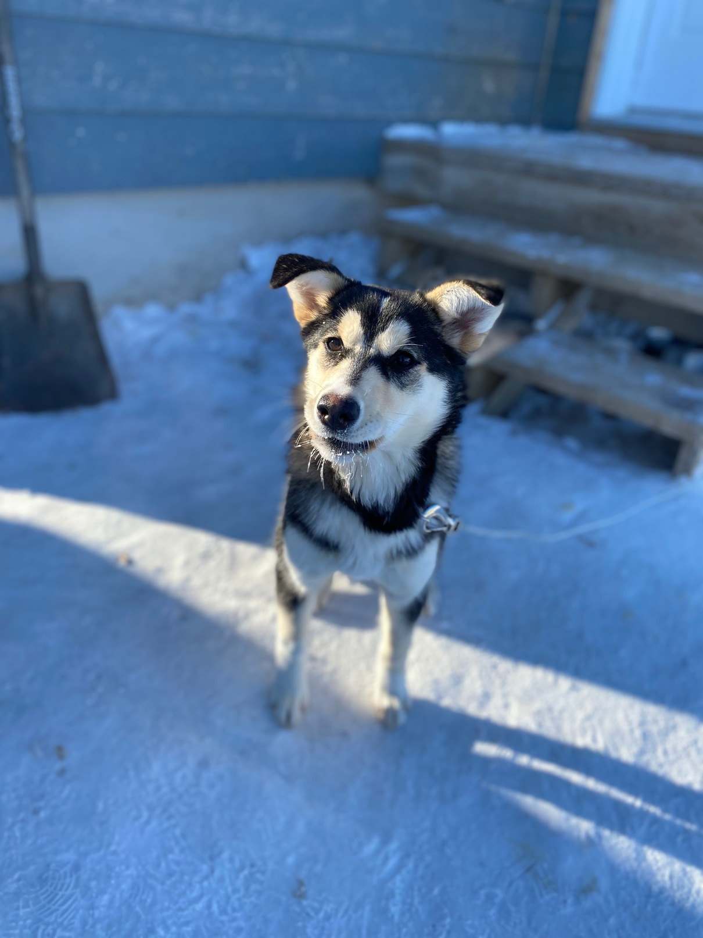
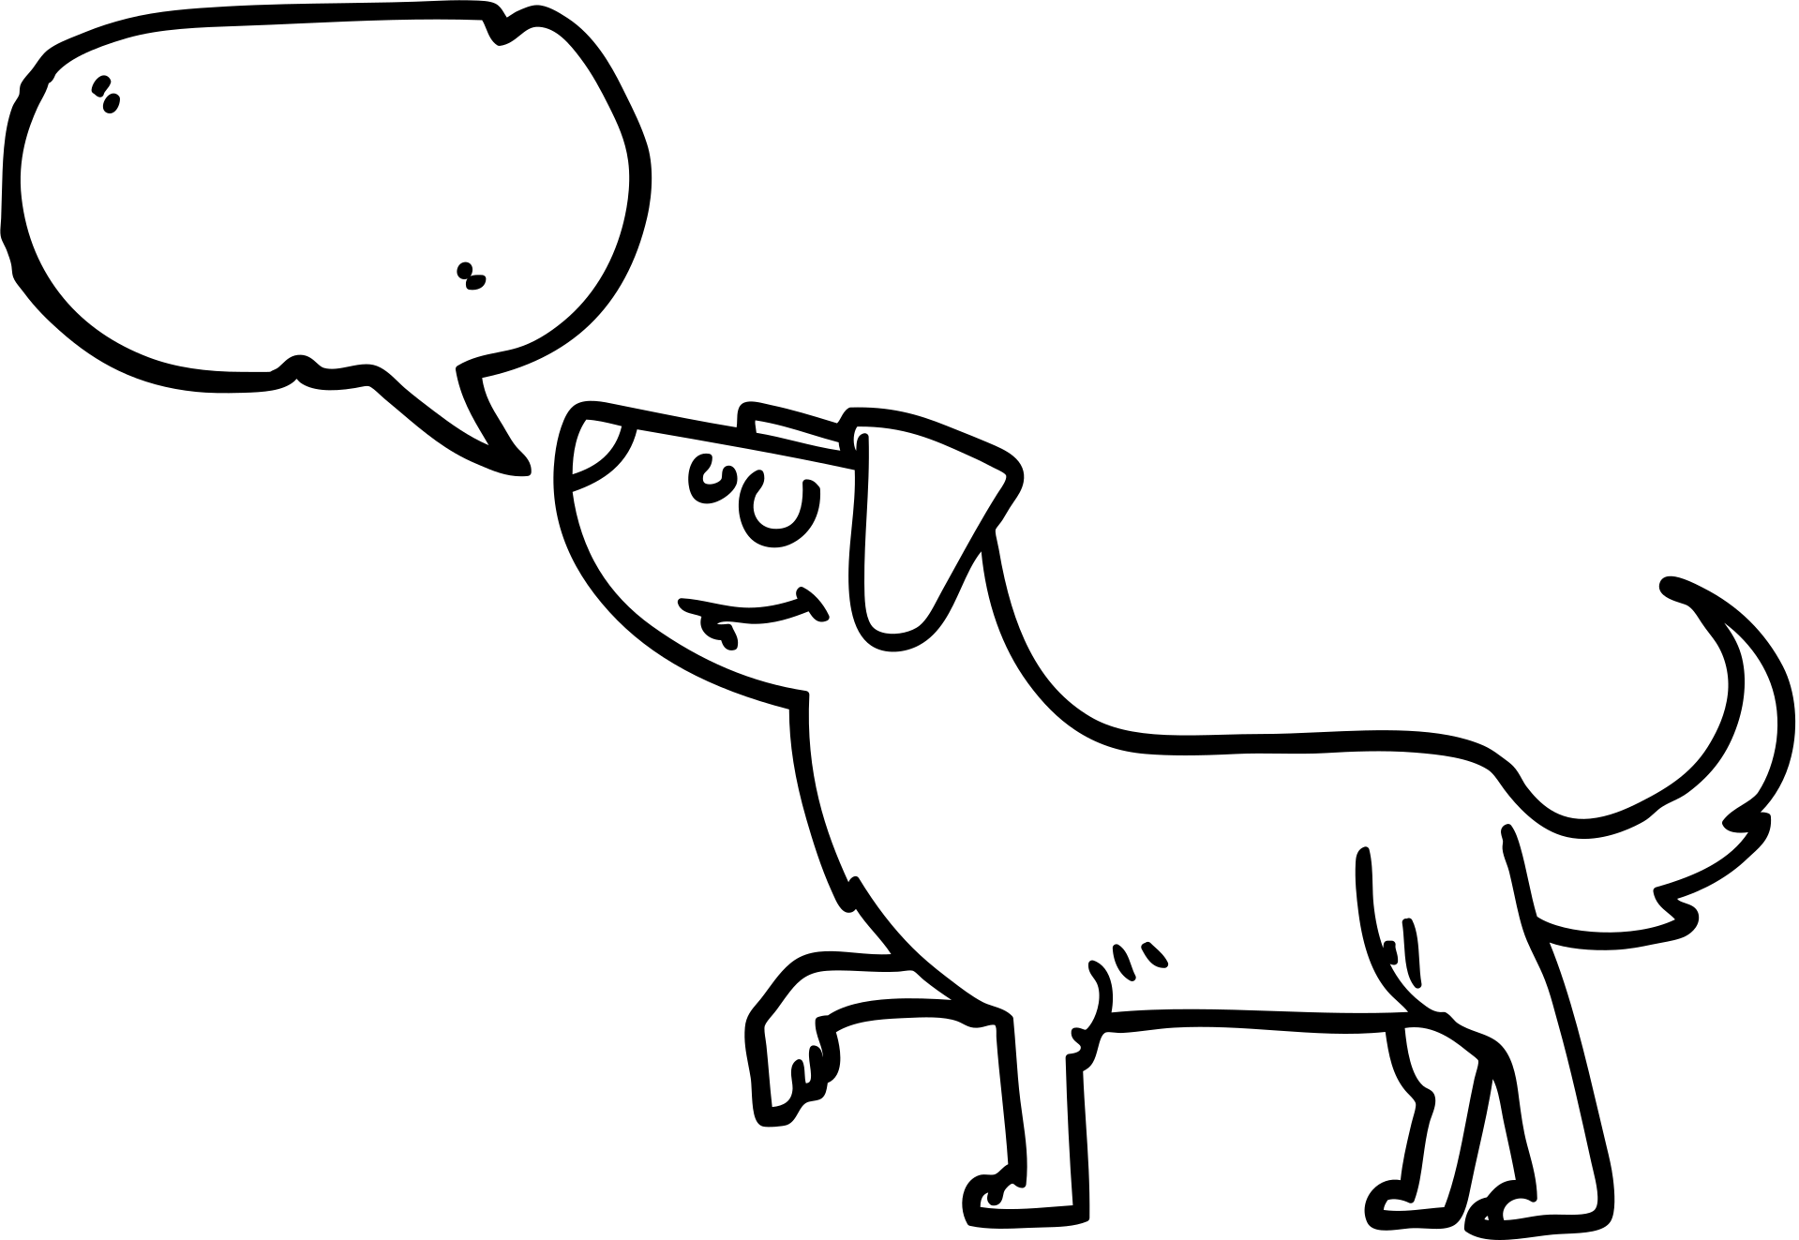
Dog Communication
Although dogs don’t speak Inuktitut, English or French, they do communicate with us.
The main way that dogs communicate is through body language.
Understanding dog body language can help us be safe around dogs.

Slide 34
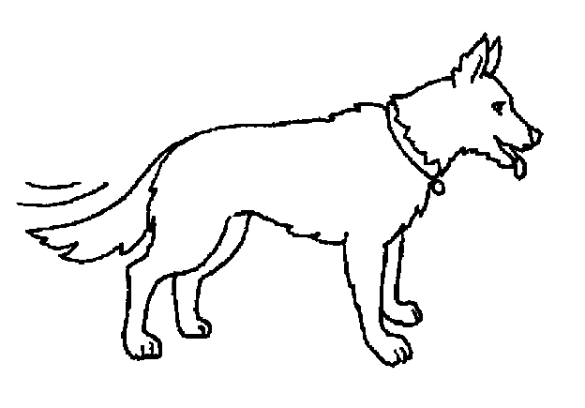
Dog Body langauge
Dogs show us how they are feeling with their whole bodies!
Look closely at this dog’s ears, mouth and tail for clues.
How do you think they are feeling?

Slide 35
Happy

Slide 36
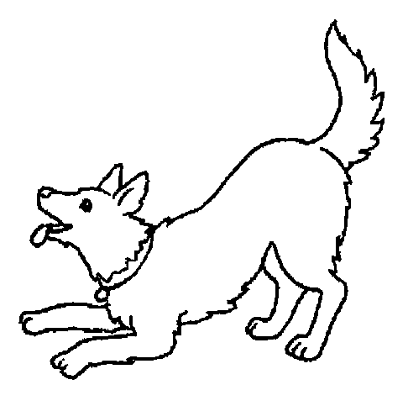
How is this dog feeling?

Slide 37
Playful

Slide 38
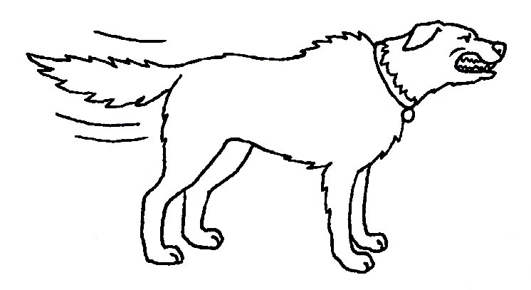
How is this dog feeling?

Slide 39
Angry

Slide 40
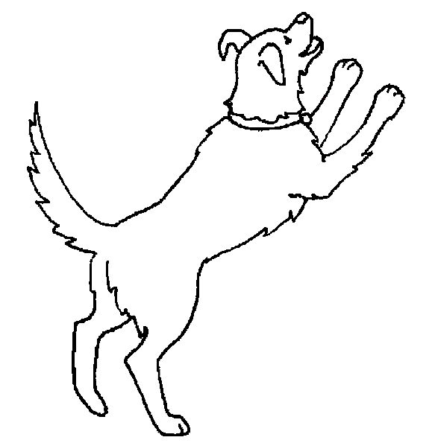
How is this dog feeling?

Slide 41
Excited

Slide 42
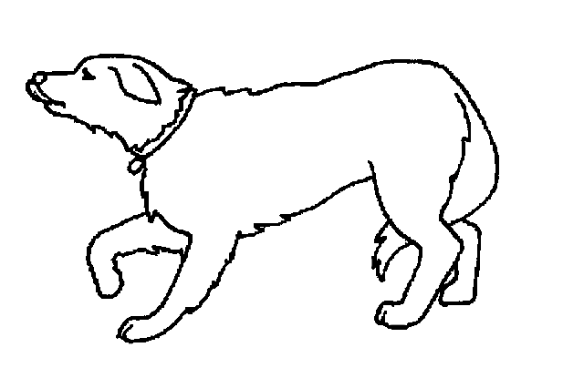
How is this dog feeling?

Slide 43
Scared

Slide 44
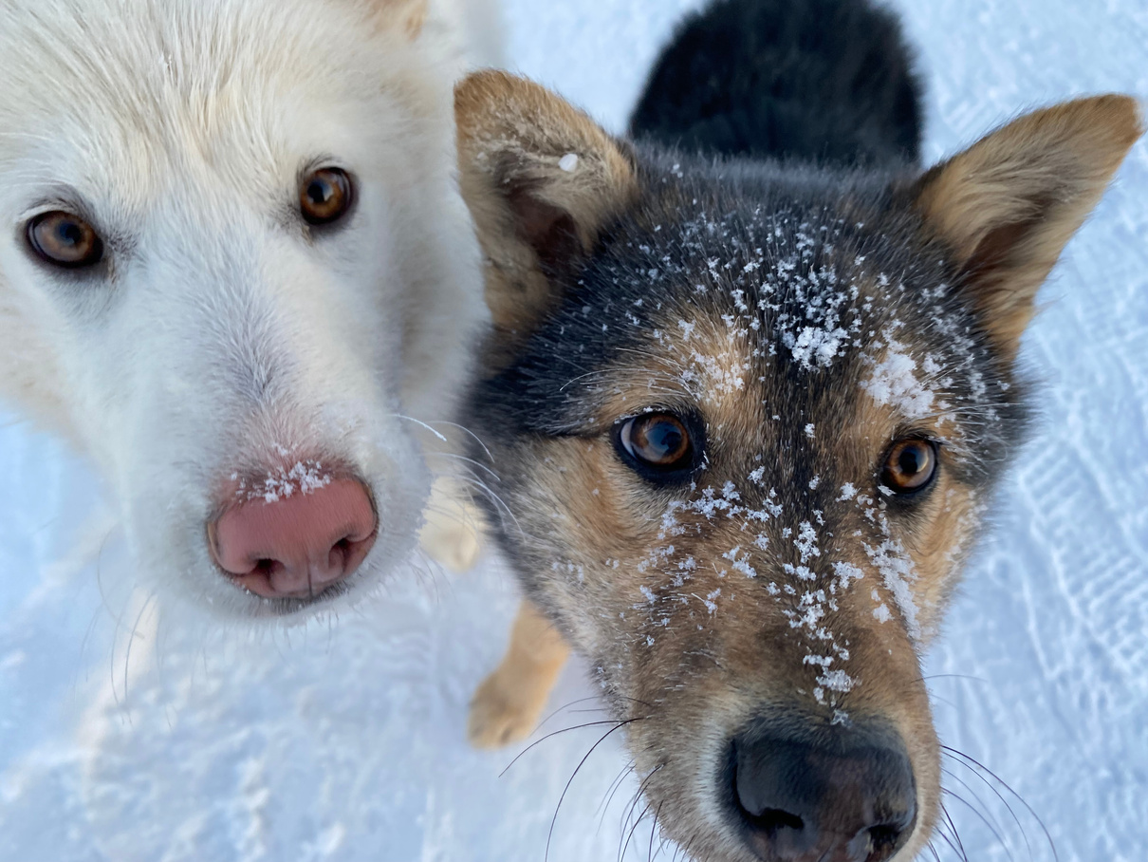
Dog safety
You should never approach dogs that looks scared or angry. This may put you at risk of being bitten.
You should also be careful around dogs who are playful and excited, as they may bite you too.
The safest dogs to be around are dogs that know you well, who feel safe with you, and are feeling happy.

Slide 45
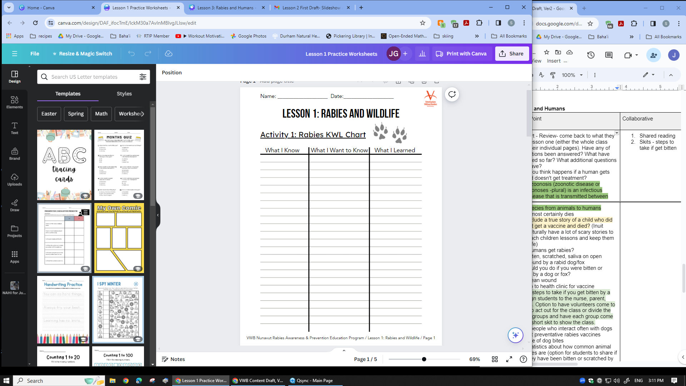

What have you learned?
Go back to the KWL Chart that you started in Lesson 1. It’s time to fill out the last collumn- “What I Learned”!
Think about:
What have you learned about rabies in this program that you didn’t know before?
What will you remember 1 month from now or 1 year from now?

Slide 46

Let’s practice!

