Slide 1
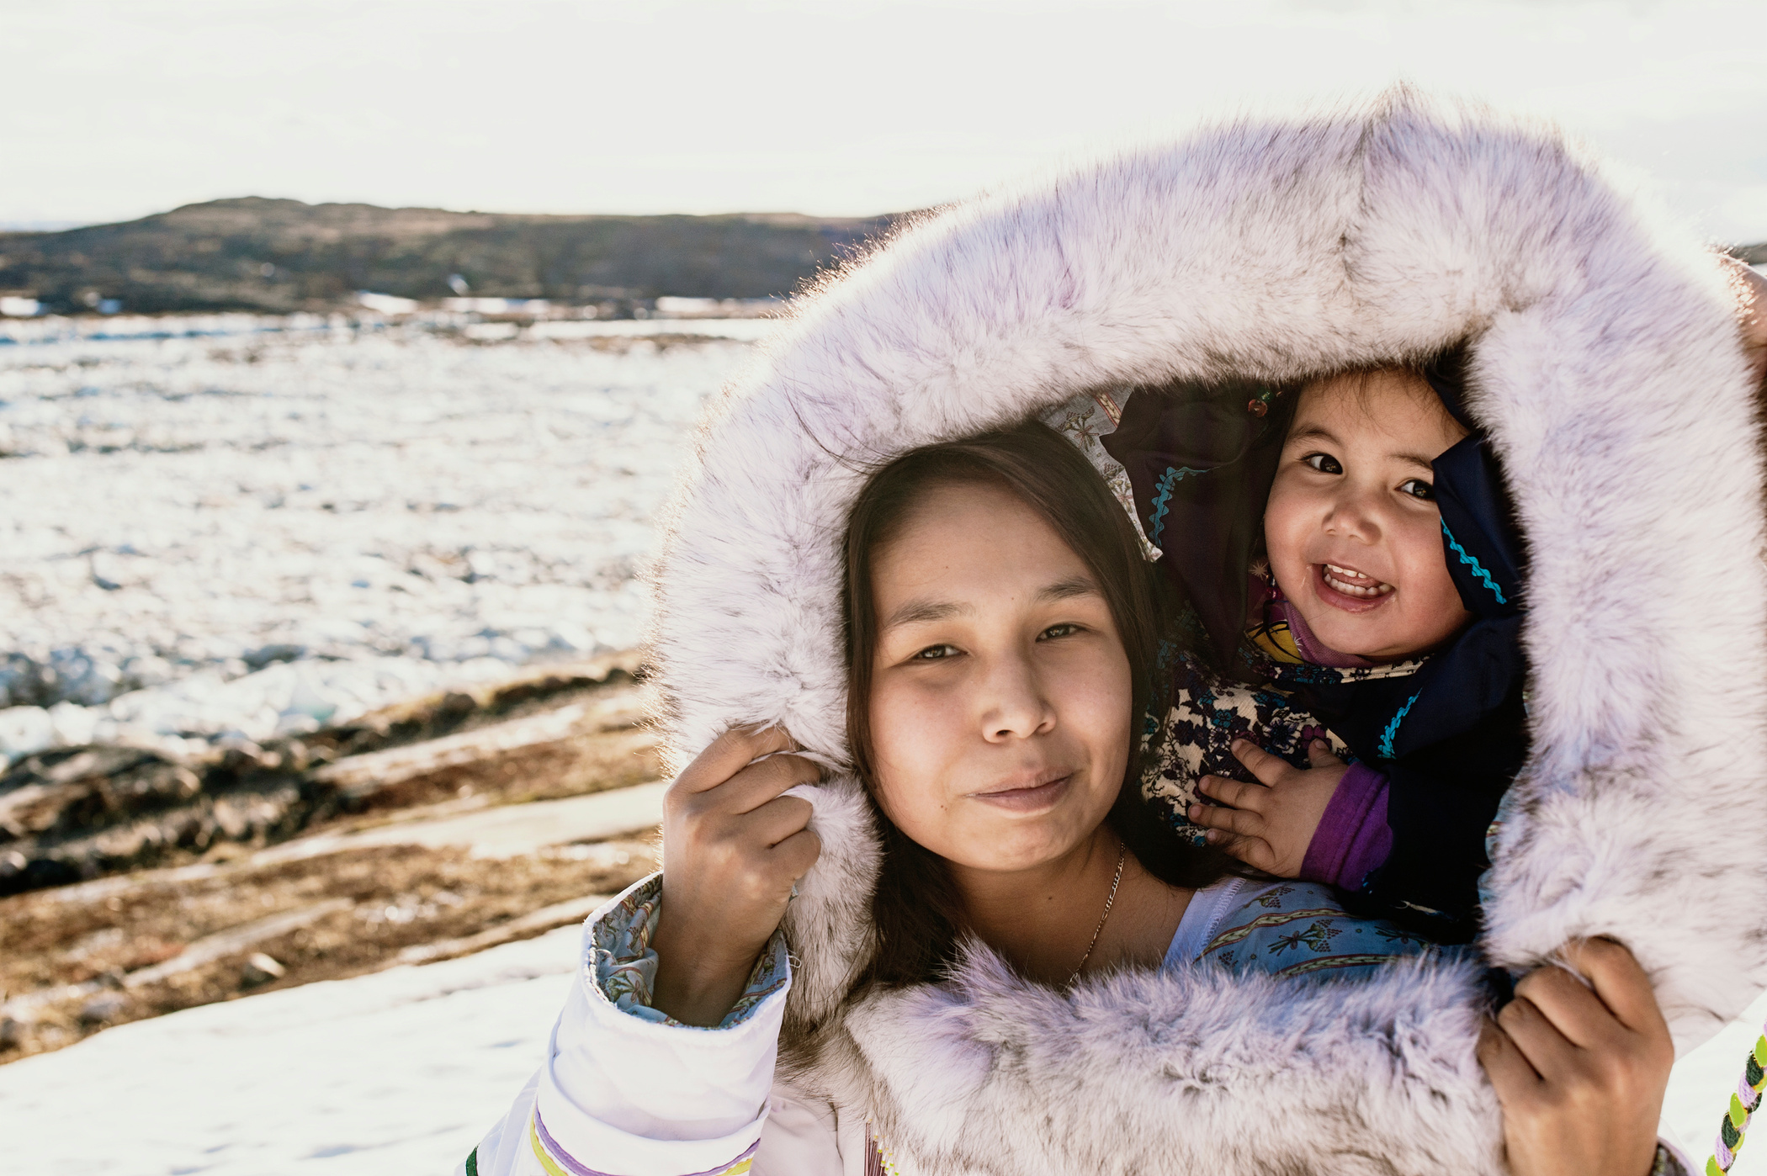

Nunavut Rabies
Awareness & PREVention education Program
Lesson 3: Rabies and Humans

Slide 2

Learning Goals
By the end of this lesson I will be able to:
Describe how a person may become infected with the rabies virus.
Describe the steps to follow if someone has been bitten or scratched by an animal or has come into contact with an animal that is suspected of having rabies.

Slide 3
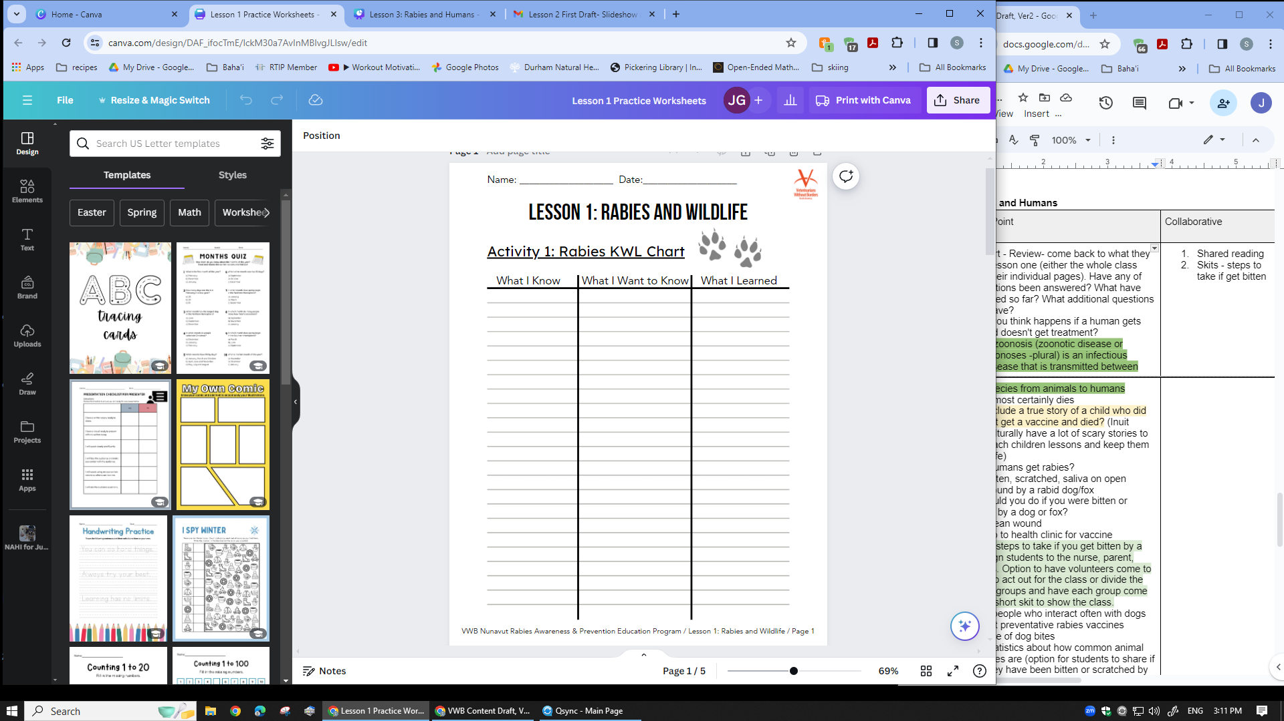

KWL Chart Review
Revisit your KWL chart from Lesson 1.
Have any of your questions been answered?
What have you learned so far?
Do you have any new questions to add to the list?

Slide 4
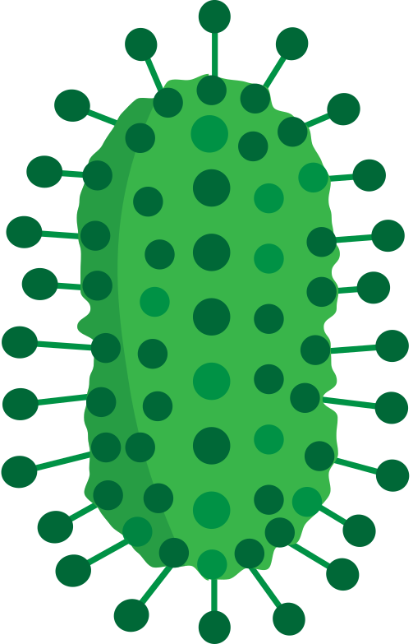
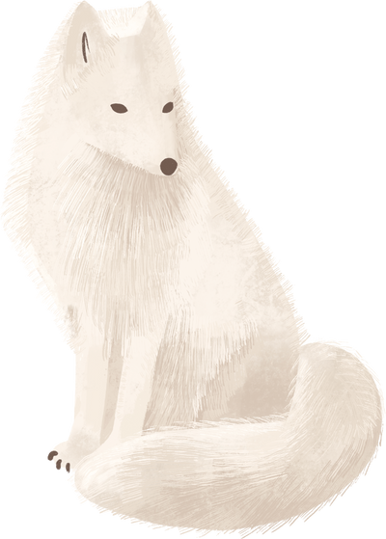
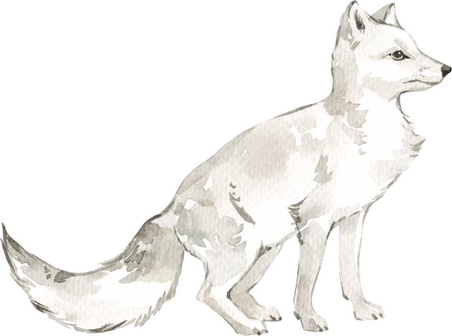

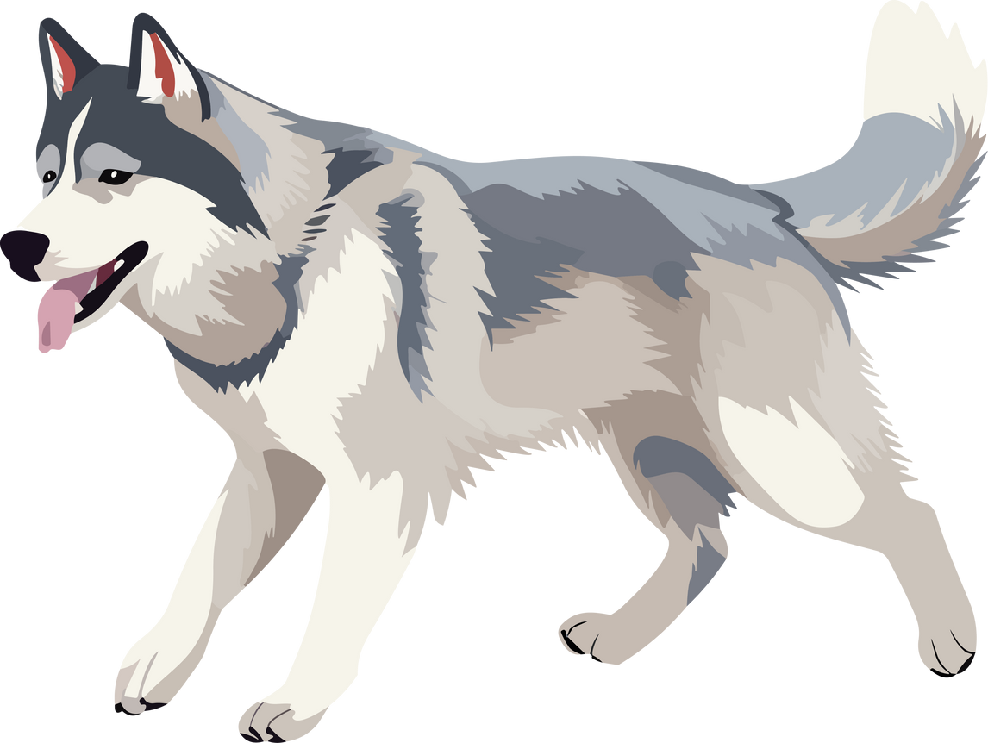
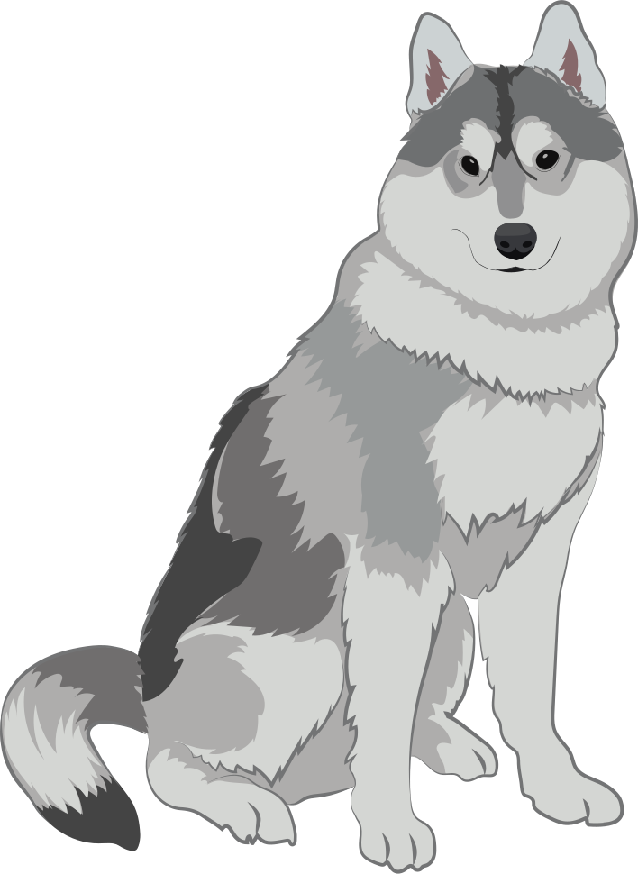
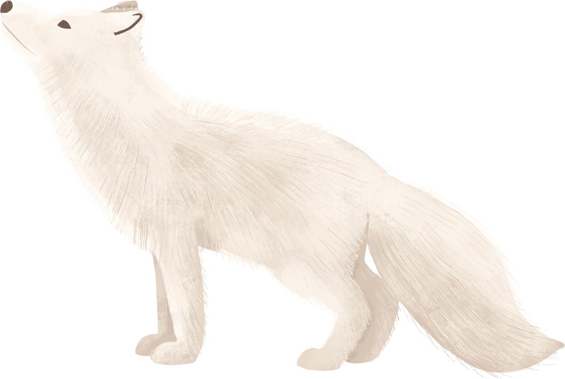

Infected with Rabies
We know that foxes usually get rabies by interacting with infected foxes.
We also know that dogs normally get rabies from interacting with infected foxes or dogs. But what about humans?
Can humans become infected with rabies?

Slide 5
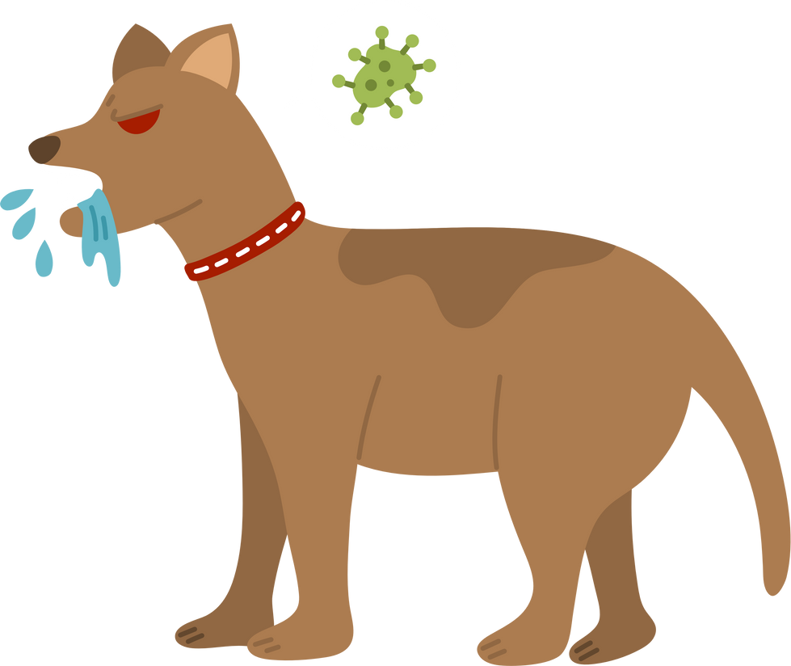
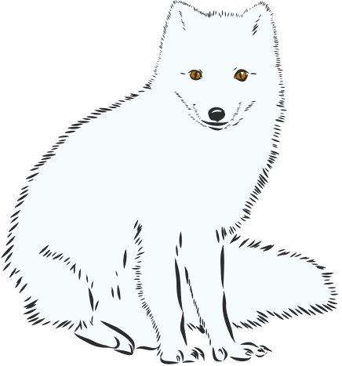
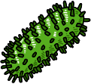
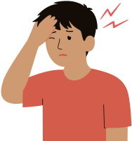
Rabies and humans
Yes they can!
Rabies is a zoonotic disease. That means that the virus can be transmitted from animals to humans.
Humans become infected with the rabies virus from interacting with a rabid animal, often a dog. It is less common for humans to get rabies from foxes or other wild animals.

Slide 6

How do you think a person is infected with rabies from a dog or other animal?

Slide 7
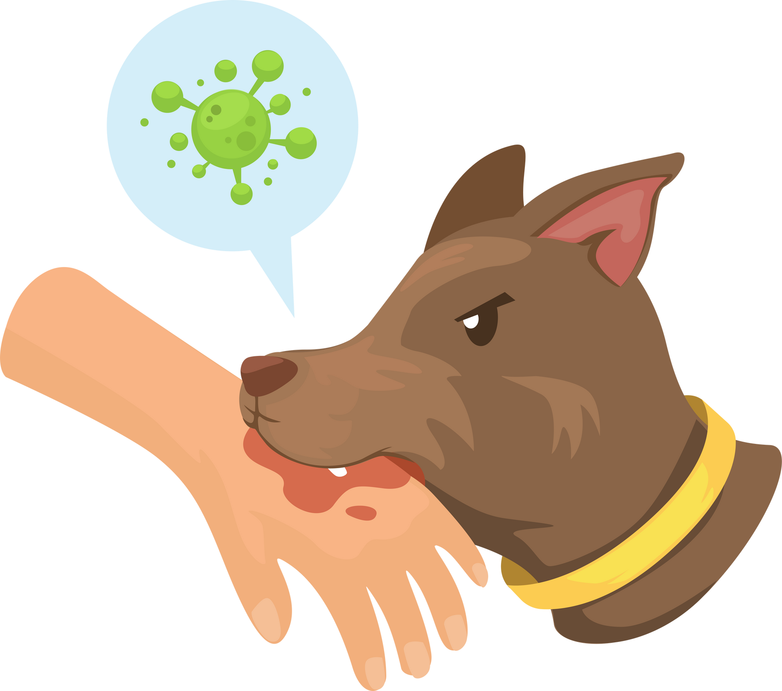
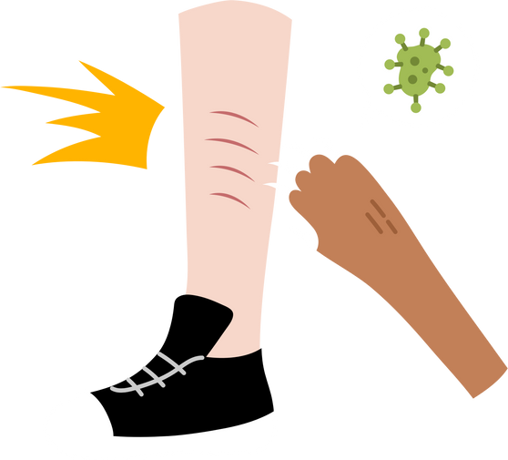

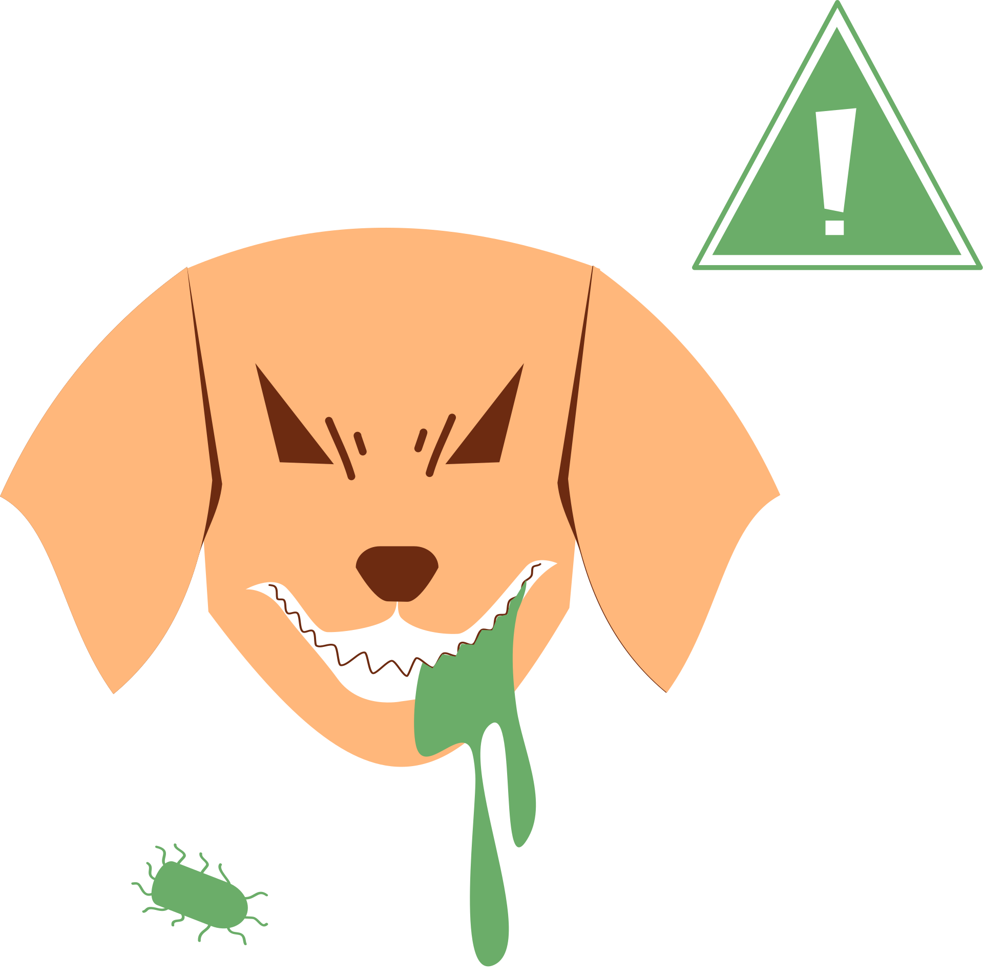



How people get rabies
Humans usually become infected with the rabies virus from a bite or a scratch from a rabid animal, such as a dog.
It is also possible for humans to be infected with rabies if the saliva of a rabid animal enters an open wound or a person’s eyes, mouth or nose.

Slide 8
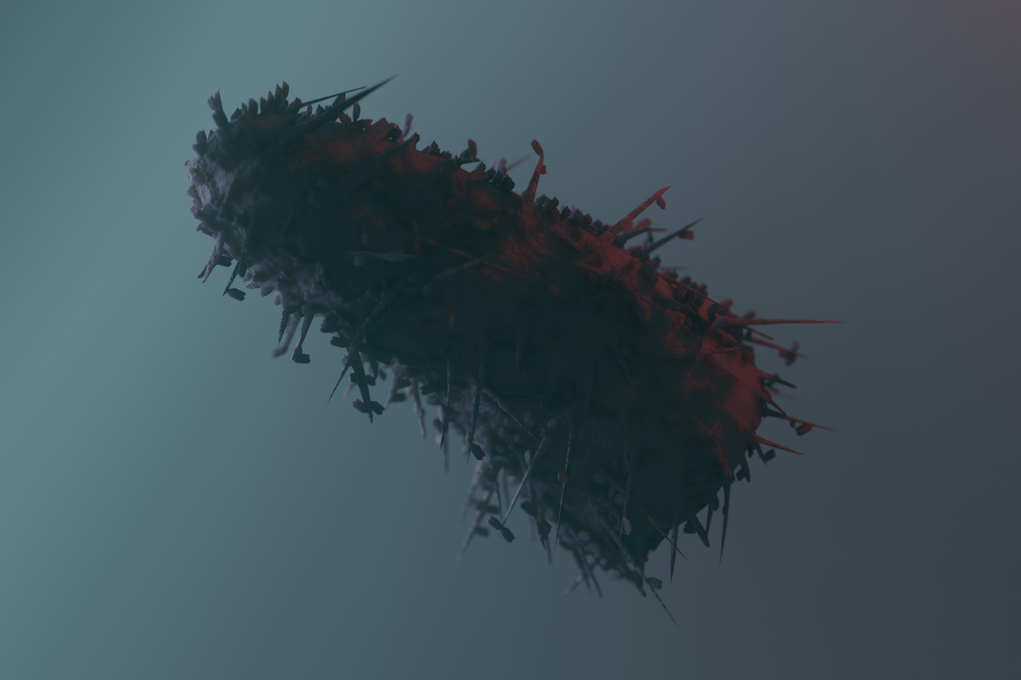
Rabies and Humans Facts
Rabies is a deadly disease that should be taken seriously.
According to the World Health Organization, Rabies causes about 59,000 human deaths every year around the world. Over half of these deaths are children.
For context, the population of Nunavut in the 2021 Statistics Canada census was 36,858.

Slide 9
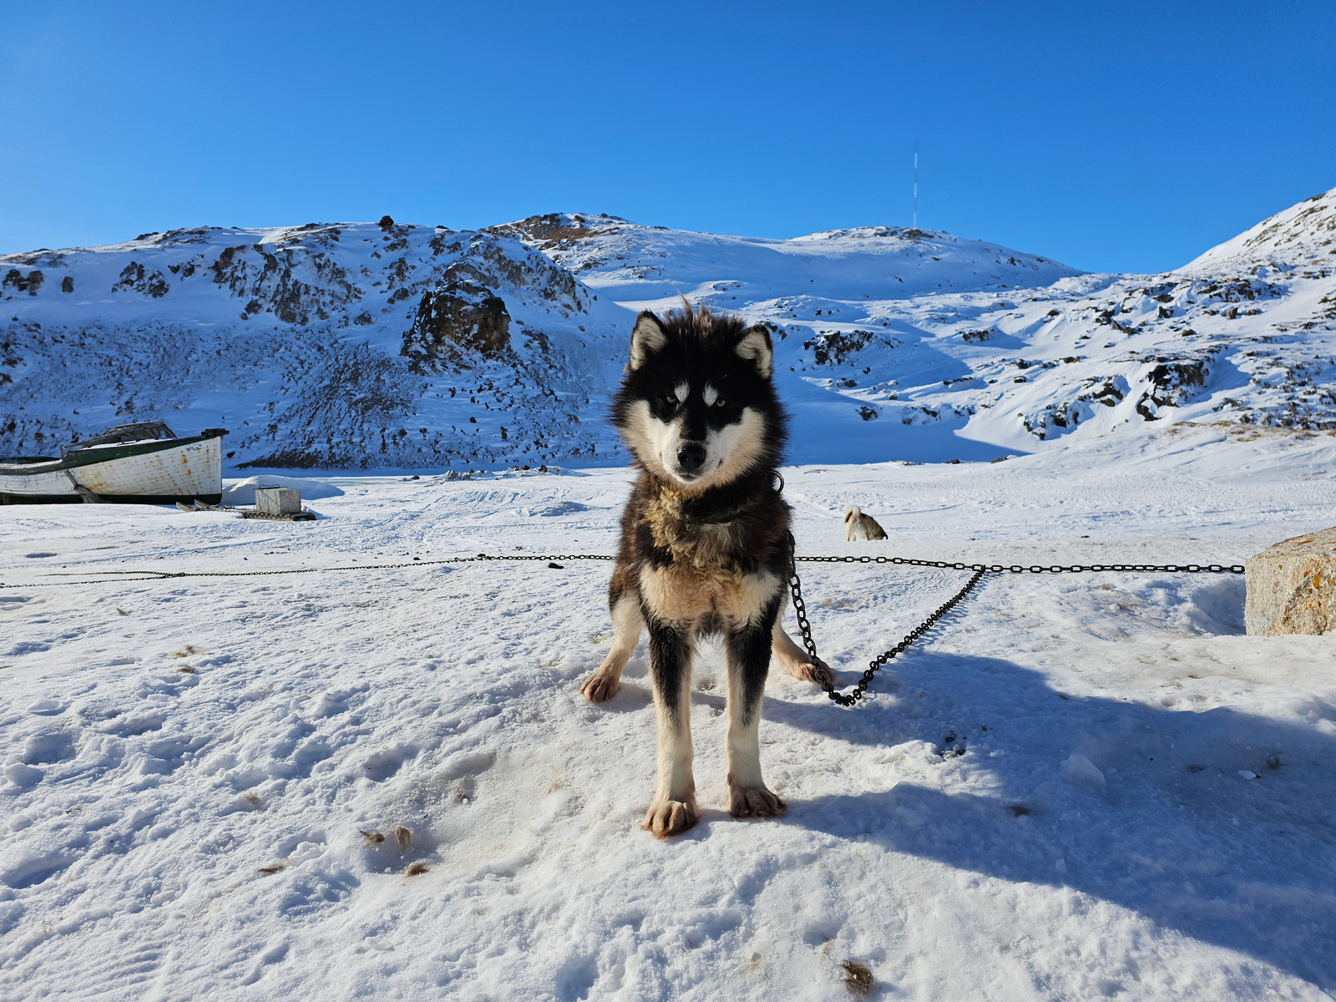
What do you think you should do if you’ve been bitten, scratched by an animal or have come into contact with an animal that’s acting strangely?

Slide 10

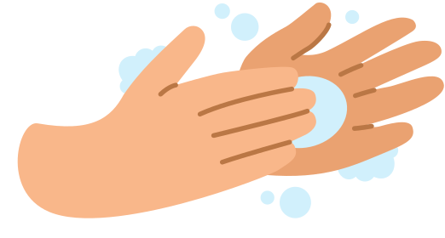
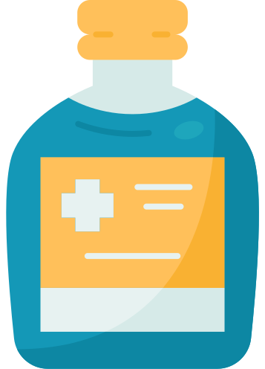

Steps to take
Take these steps if you’ve been bitten or scratched by an animal (like a dog or a fox) OR have come into contact with an animal that is know or suspected to have rabies.
Tell an adult what happened.
If you have been bitten or scratched, wash the wound right away with soap and warm water.
Disinfect the wound with alcohol or an iodine solution.
Immediately go to the health center.

Slide 11

Going to the health center
It is essential that you go to the health center within 24 hours of being bitten or scratched by an animal OR having come into contact with an animal that might have rabies.
At the health center, the nurse or doctor will treat your wound and decide if you need to have a rabies vaccine.

Slide 12
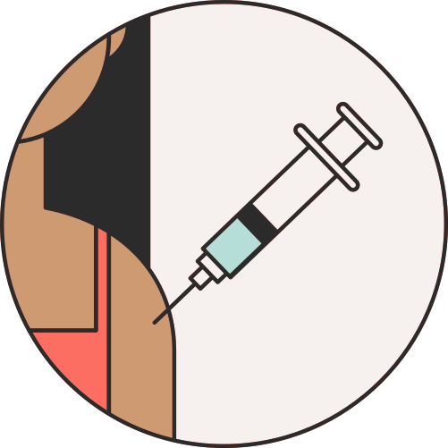


The Rabies Vaccine
If you are infected with rabies and you DON’T get a rabies vaccine in time...
... you have an almost 100% chance of dying.
If you are infected with rabies and you DO get a rabies vaccine in time...
... you have an almost 100% chance of surviving.
The rabies vaccine could save your life.

Slide 13


Role Play

Slide 14
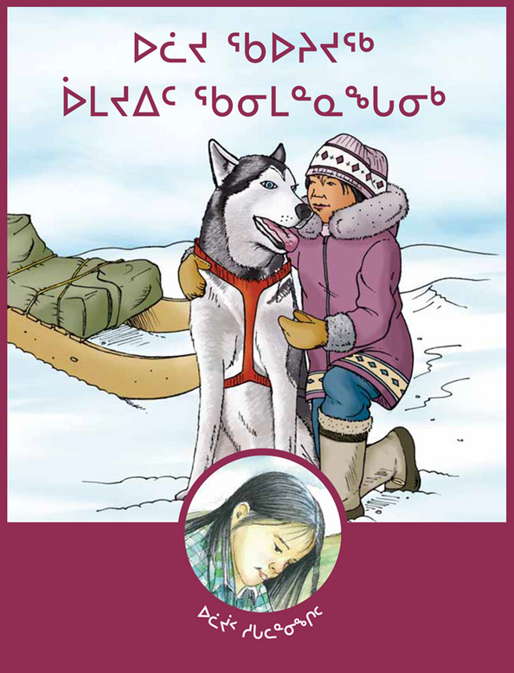
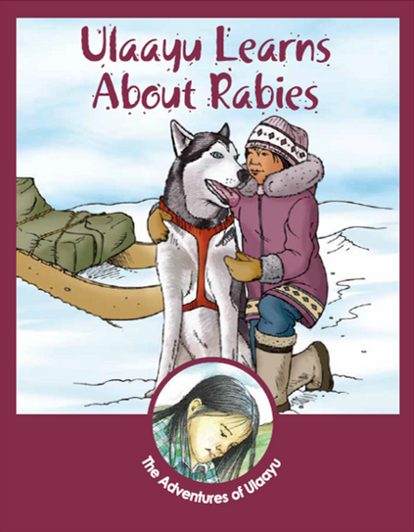
ulaayu learns about rabies
Ulayuu Learns About Rabies by Dr. Hugh Whitney tells the story of an Inuit girl who learns about rabies after her dogs encounter a fox in the wild.
Read it to find out more about rabies, how it is transmitted, and how to prevent infections in people and dogs.
Notes:
https://www.gov.nt.ca/ecc/sites/ecc/files/resources/rabies_story_book_inu.pdf
https://www.gov.nt.ca/ecc/sites/ecc/files/resources/rabies_story_book_en.pdf

Slide 15

Let’s practice!

