Slide 1
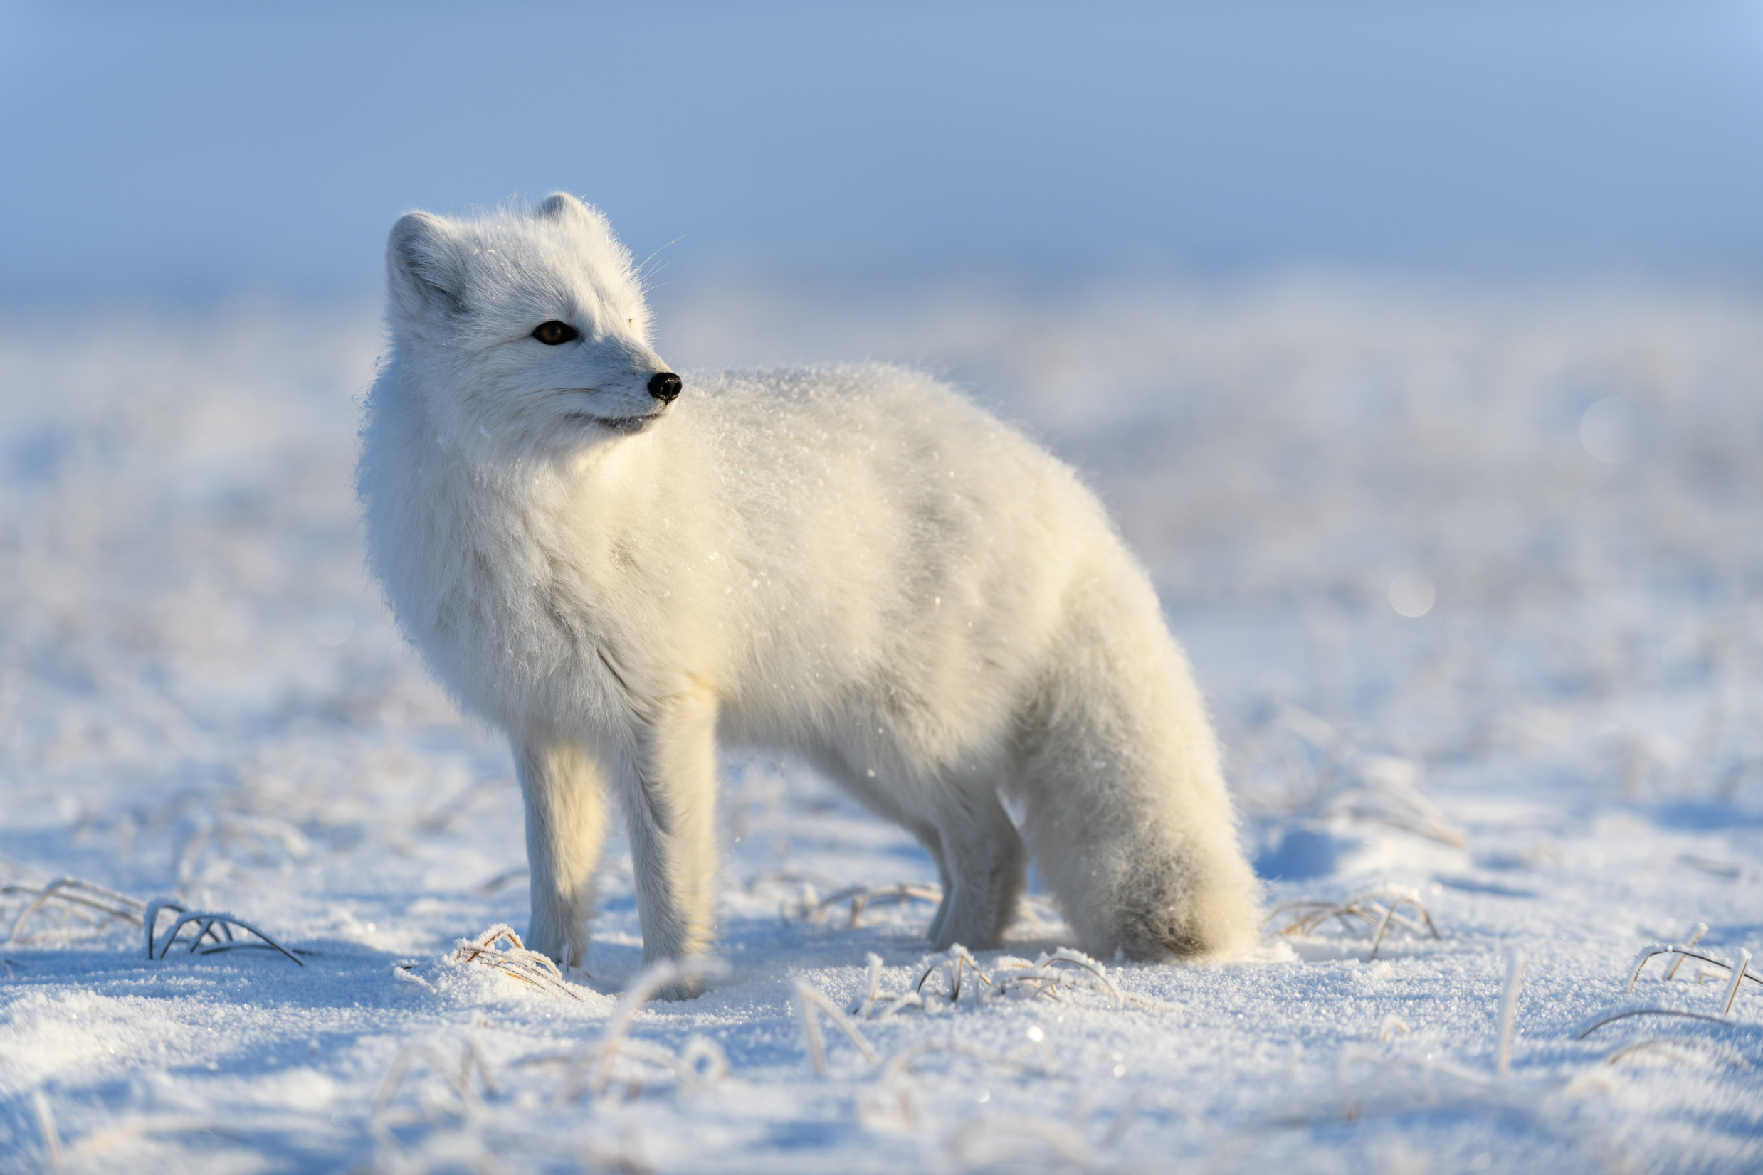

Nunavut Rabies
Awareness & PREVention education Program
Lesson 1: Rabies and Wildlife

Slide 2

Learning Goals
By the end of this lesson I will be able to:
Describe what rabies is.
Describe the signs of rabies in foxes.
Identify how to be safe around wildlife.

Slide 3
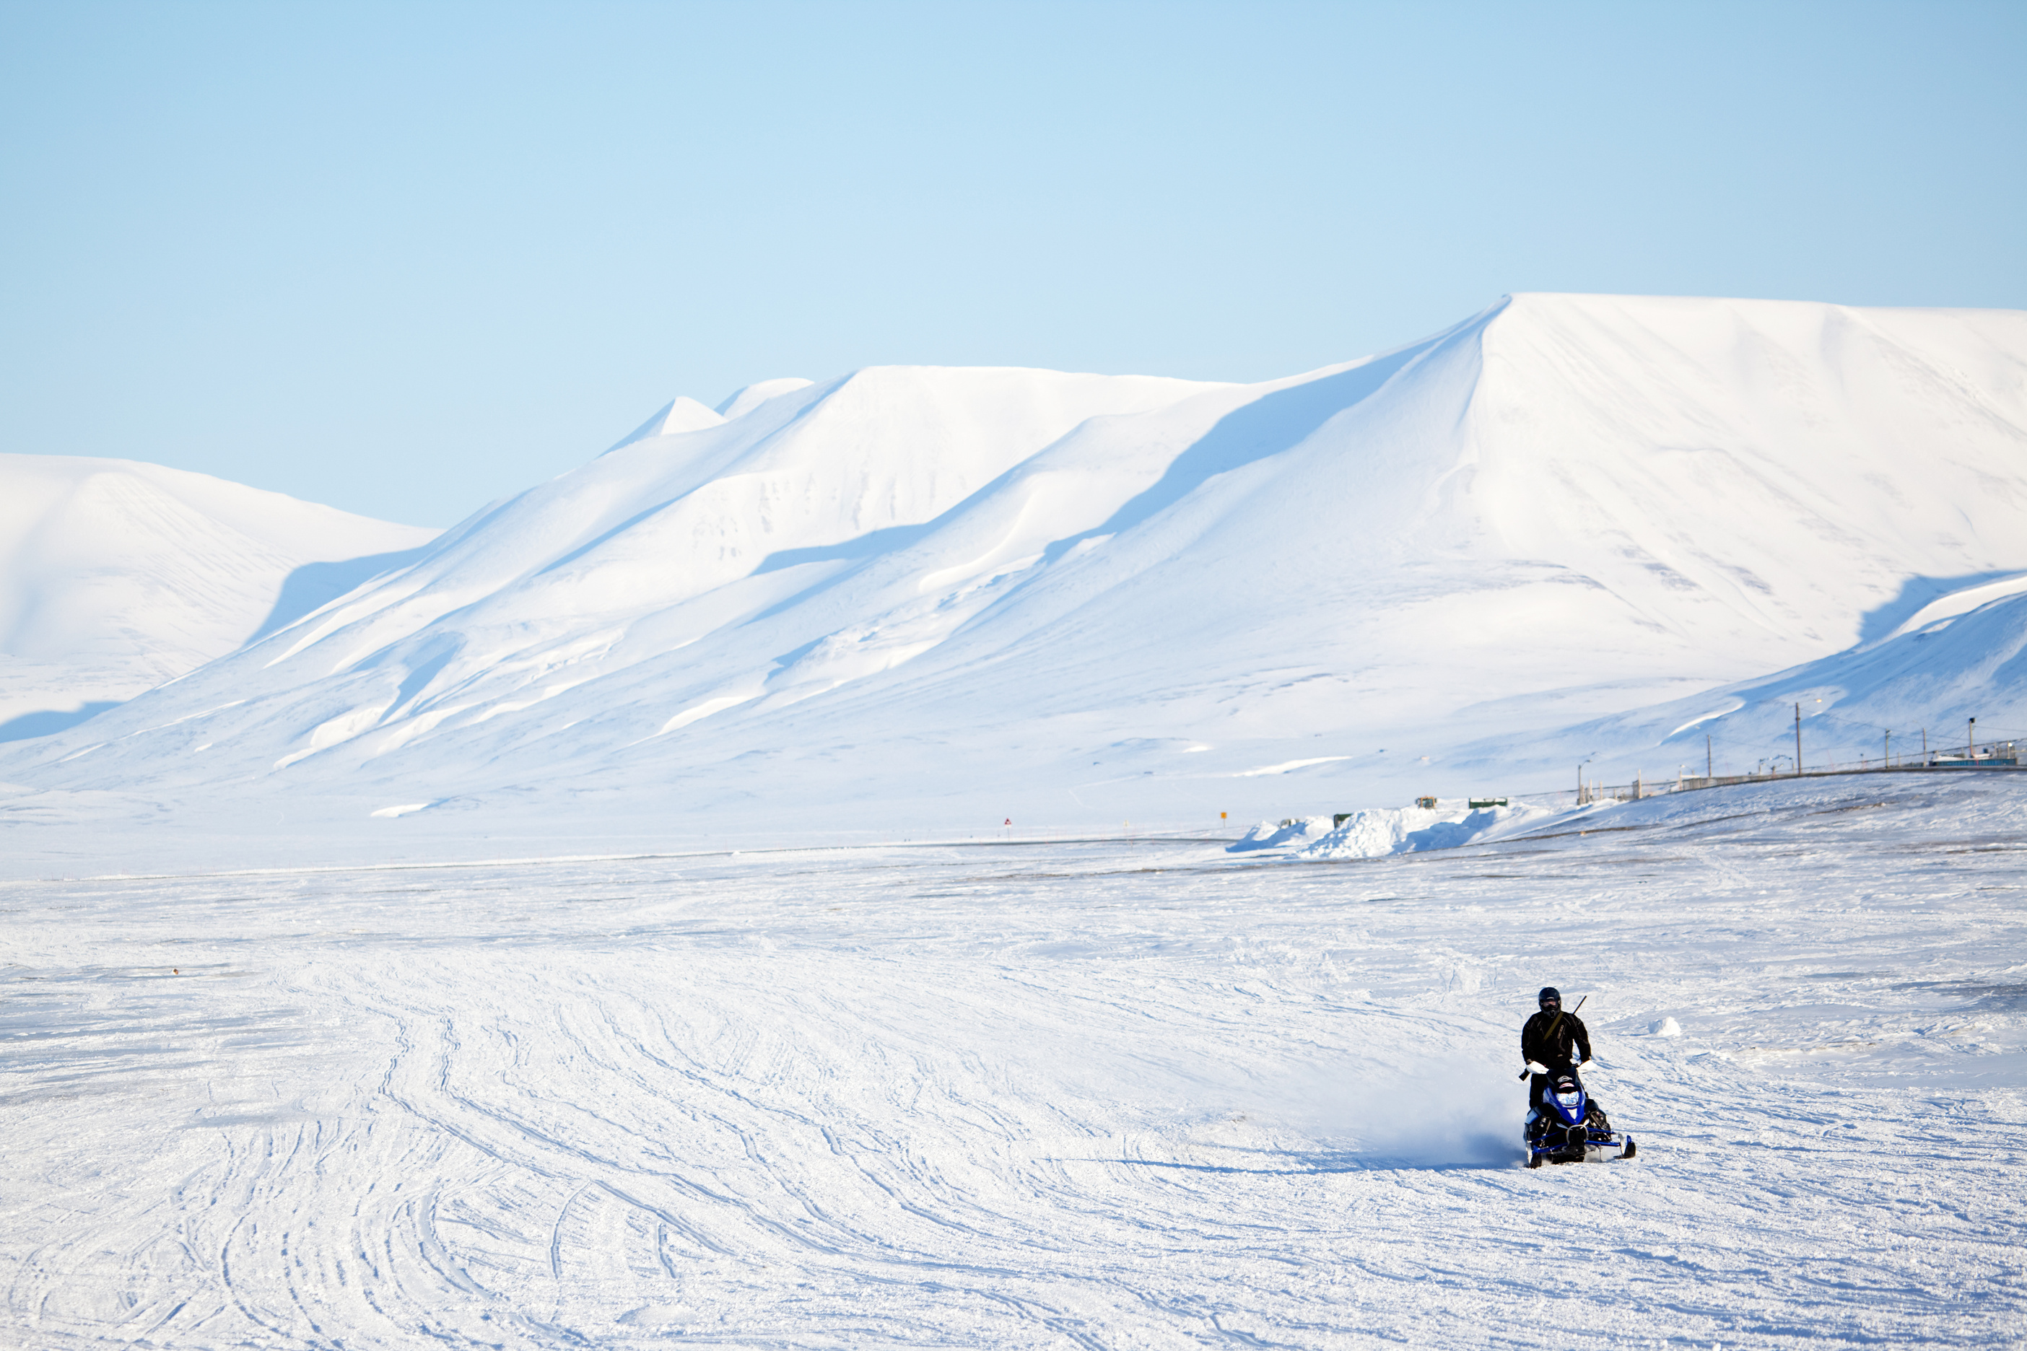
What do you know about Rabies?
What do you KNOW?
What do you WANT to know?

Slide 4
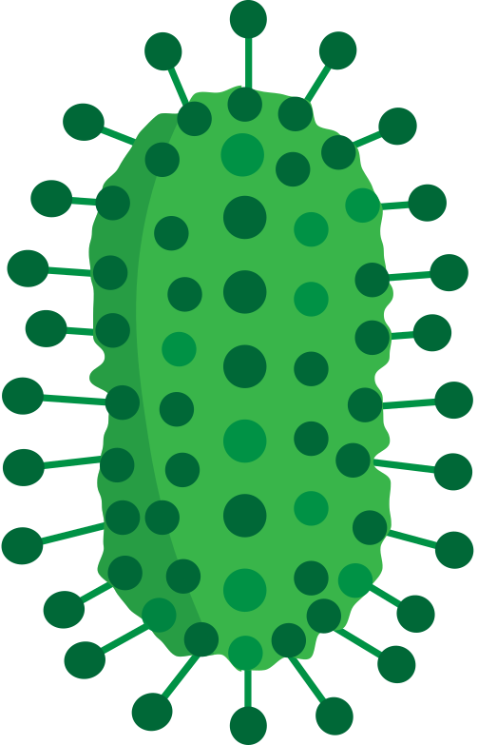

Rabies
Rabies is a deadly disease caused by a virus.
A virus is a germ so small that you can’t see it.
  What other viruses do you know of?
2. What does it mean that it’s deadly?

Slide 5
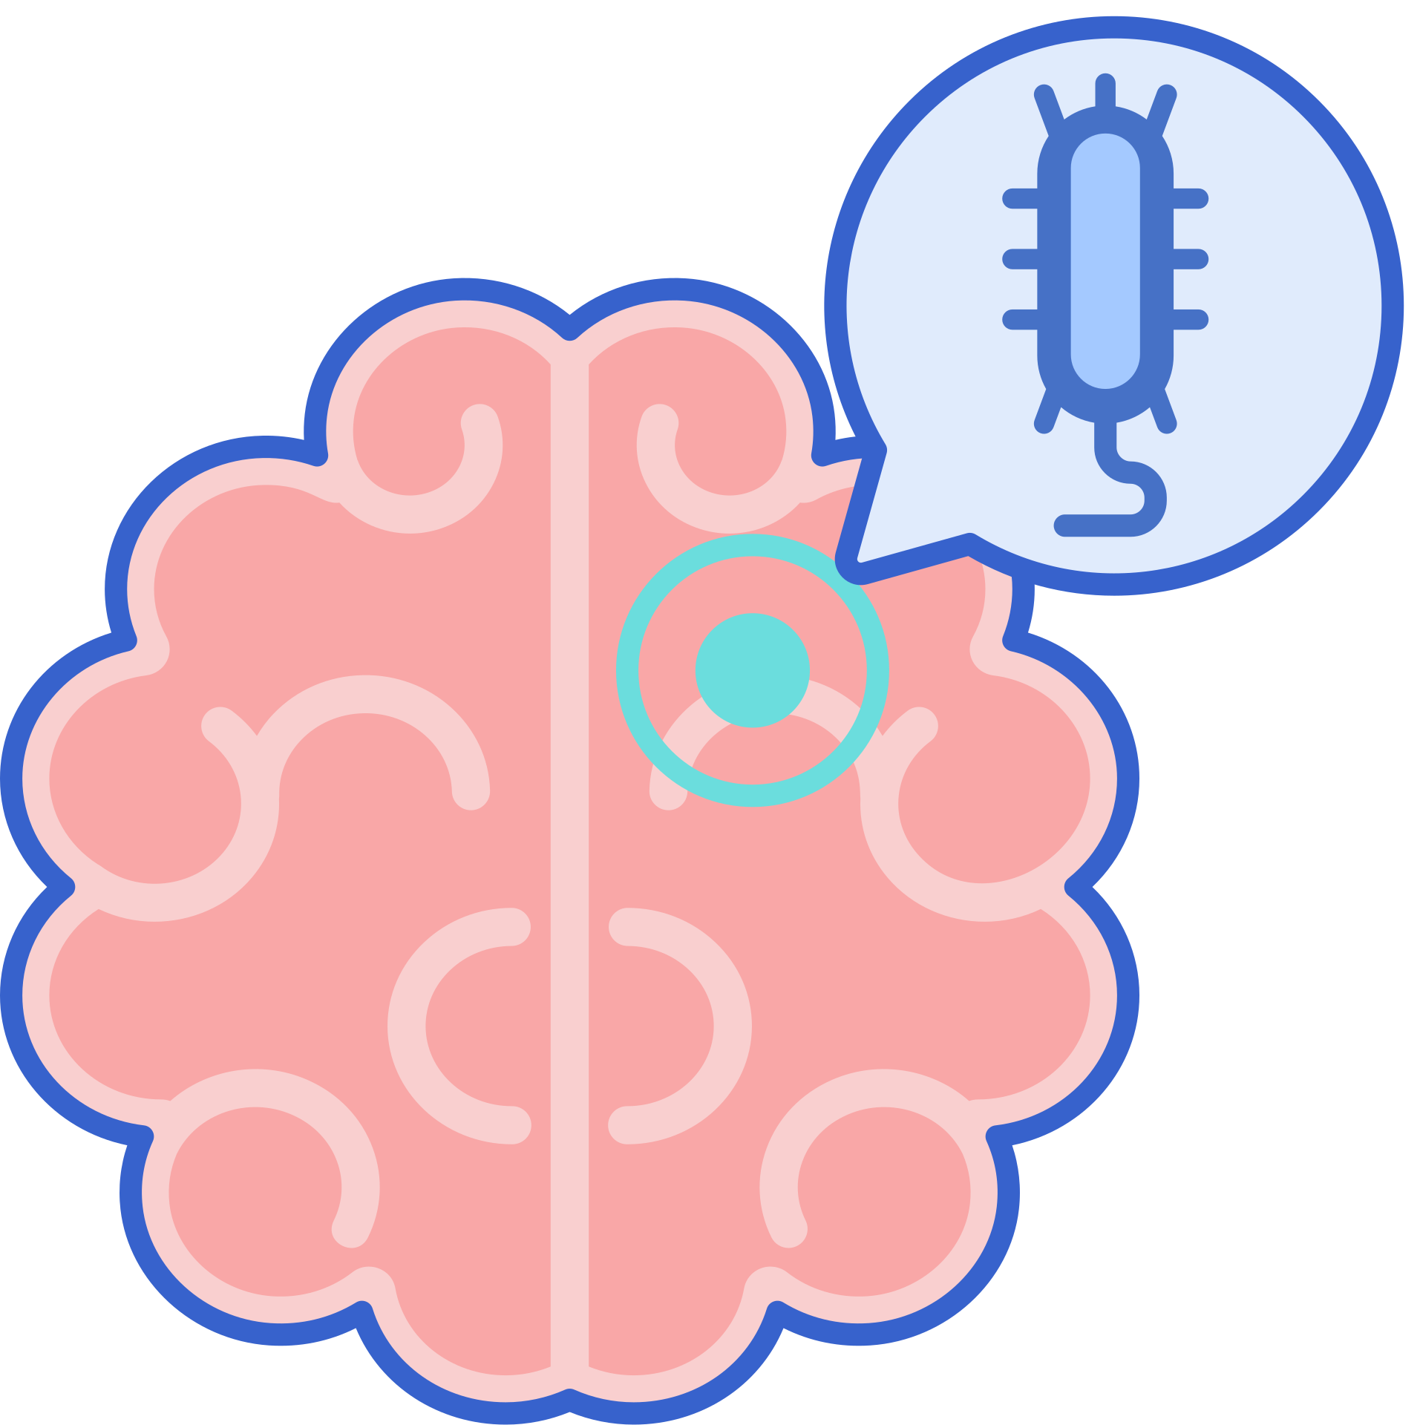
Animals infected with rabies
The rabies virus makes animals very sick.
It causes inflammation of their brains (their brains swell and become big).
Infected animals with the rabies virus almost always die.

Slide 6
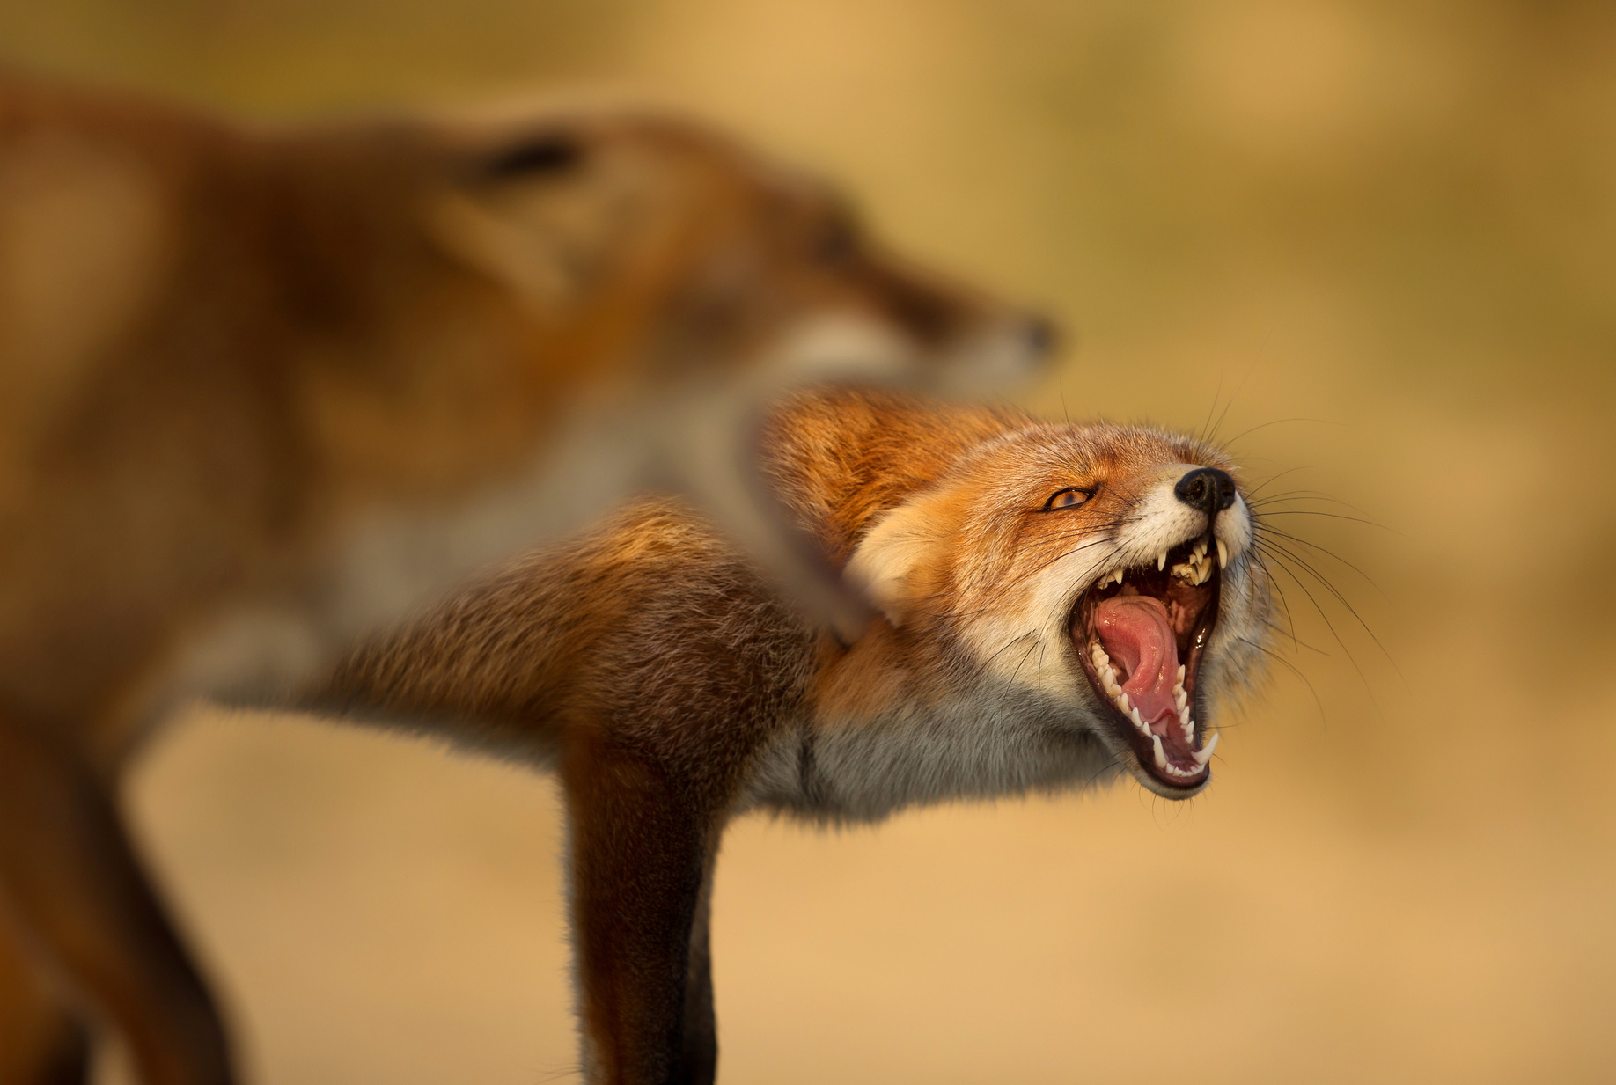
Rabies Spread
The rabies virus is found in the saliva of infected animals.
When an infected animal bites a healthy animal, the healthy animal may get rabies too.
Infected animals often pass the virus on to other animals before they die.

Slide 7
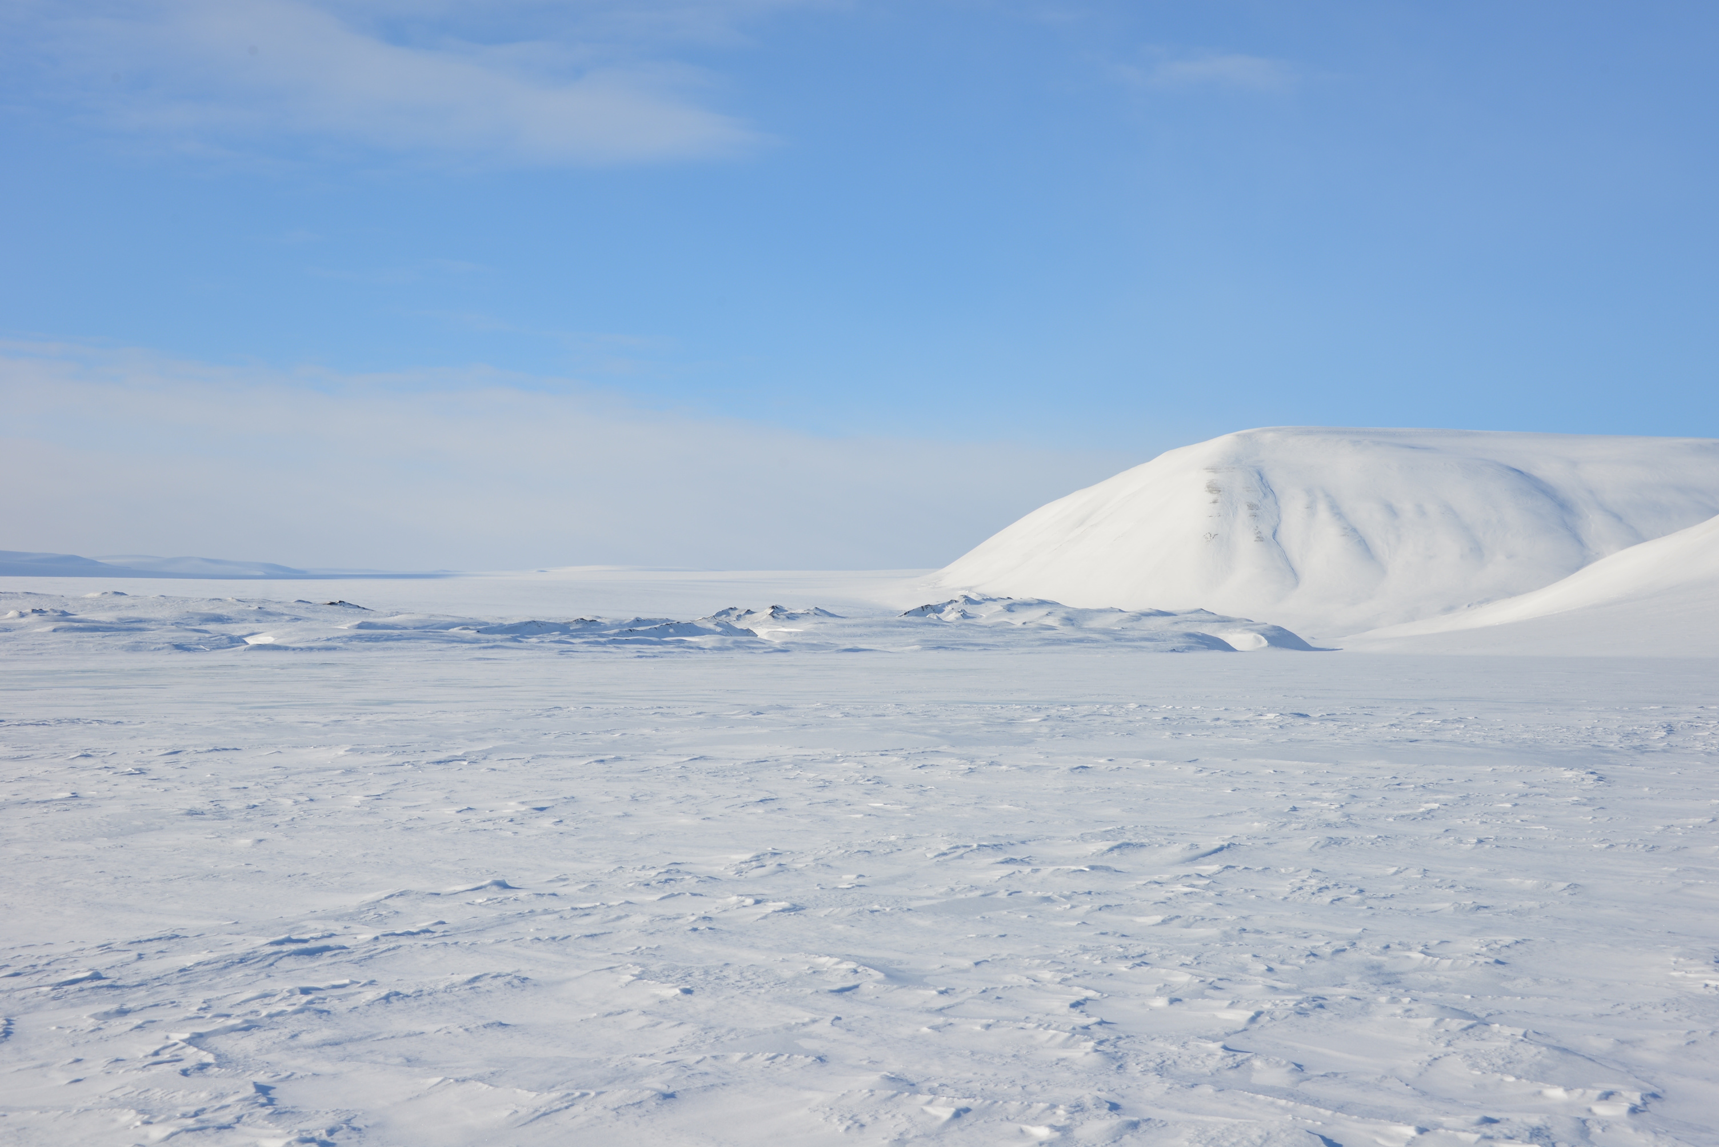
Which Arctic wildlife can have rabies?
What do you think?

Slide 8
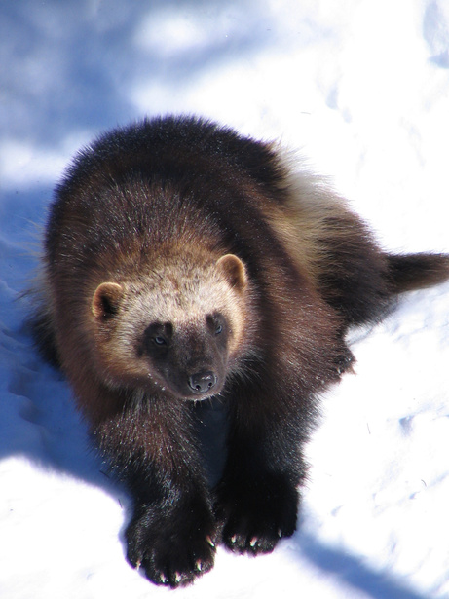
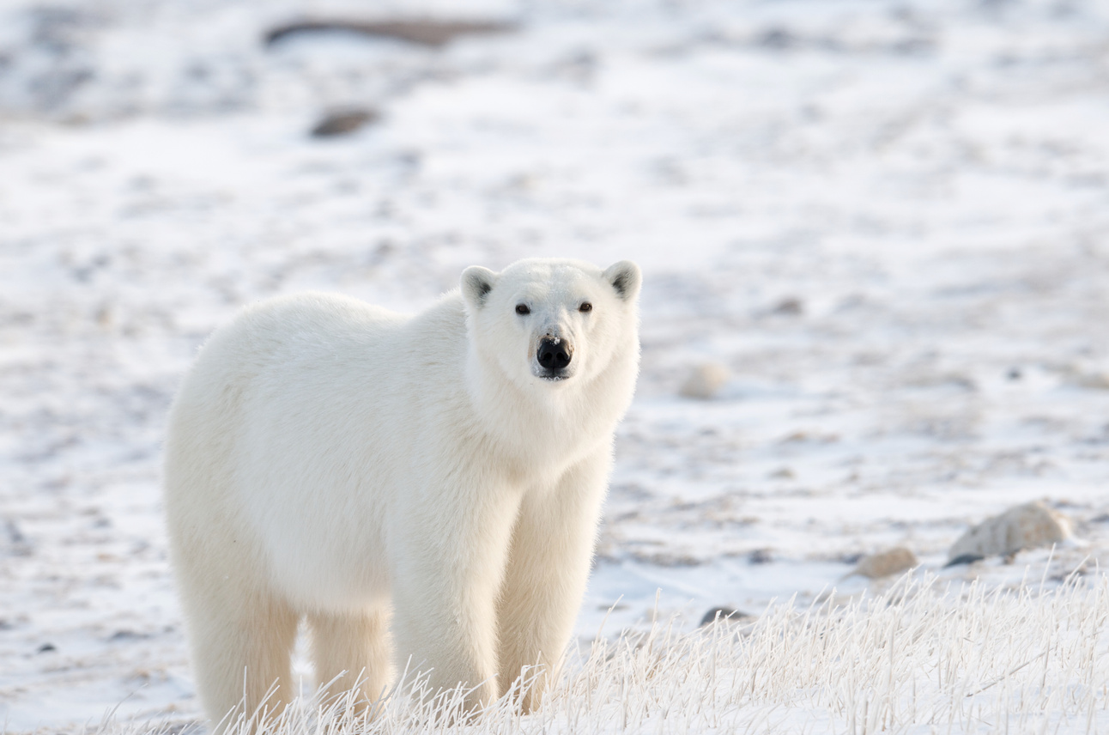
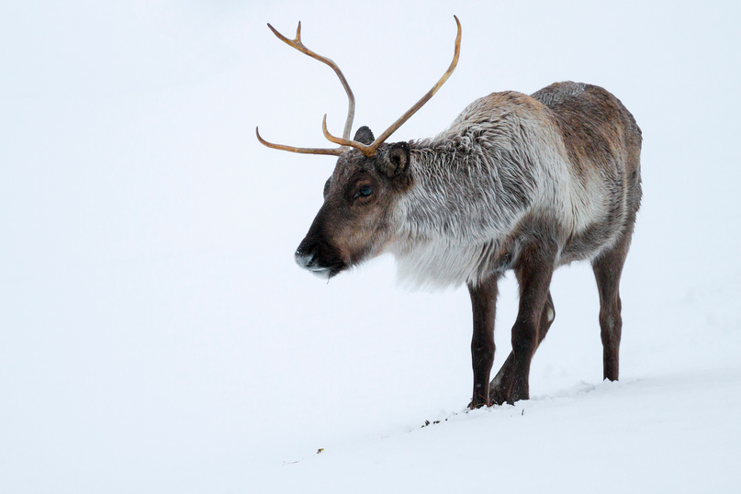
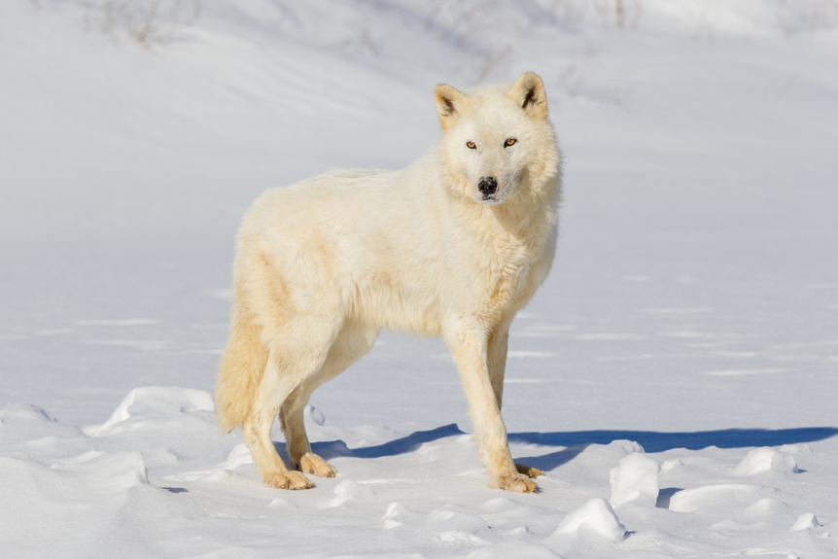
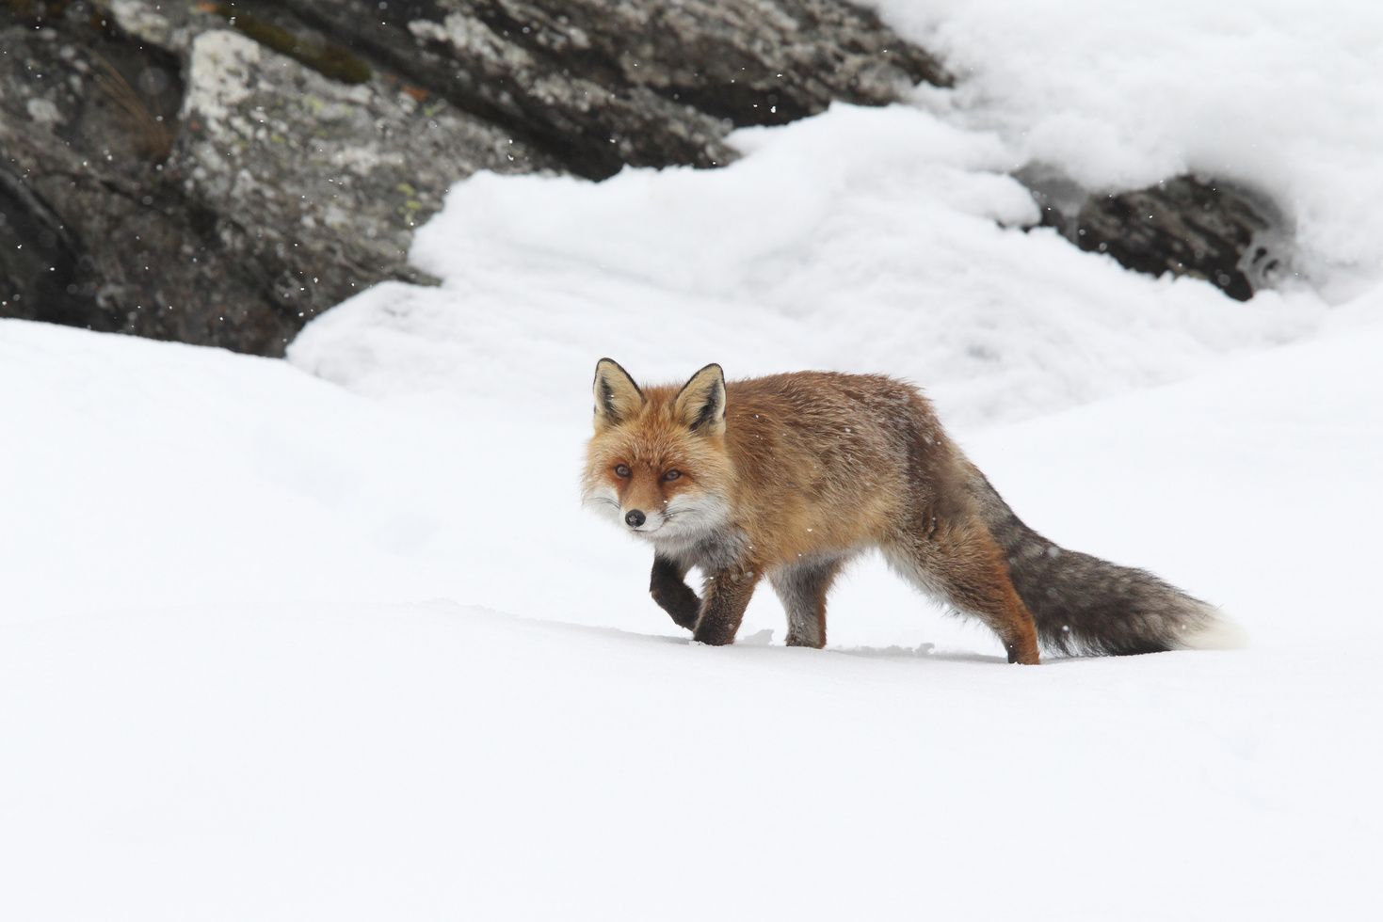
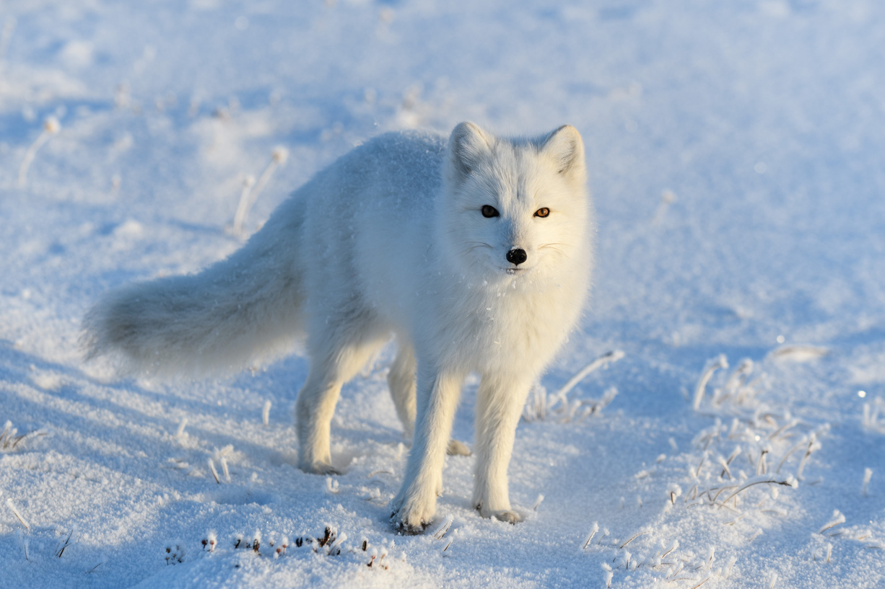
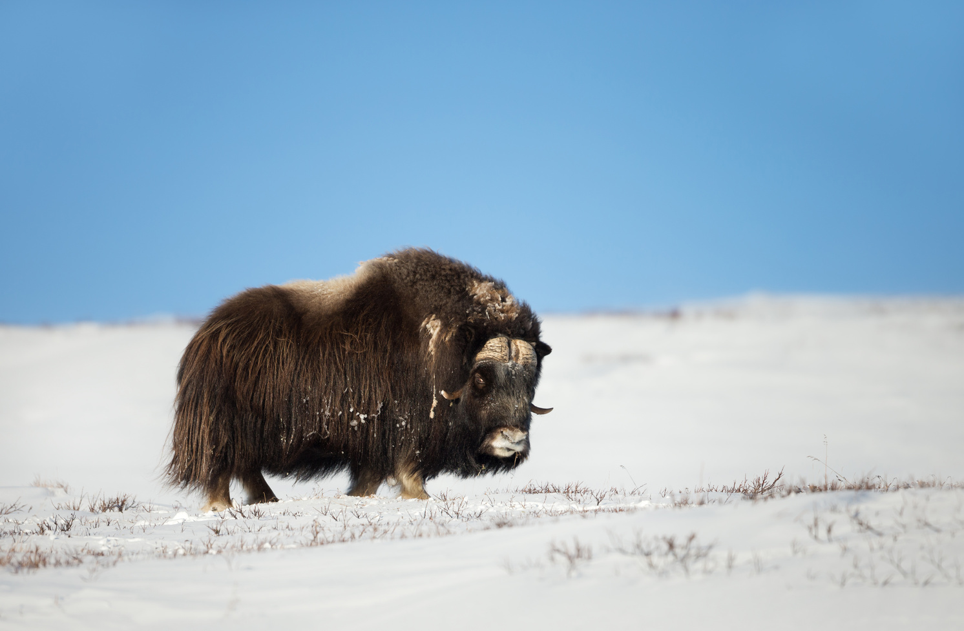
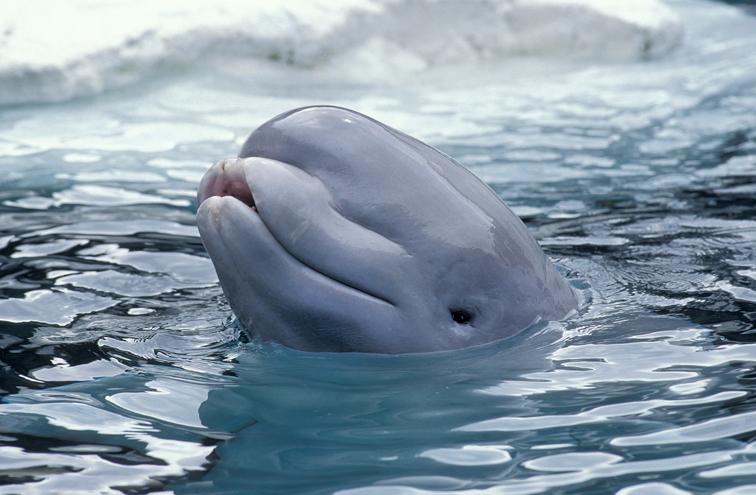
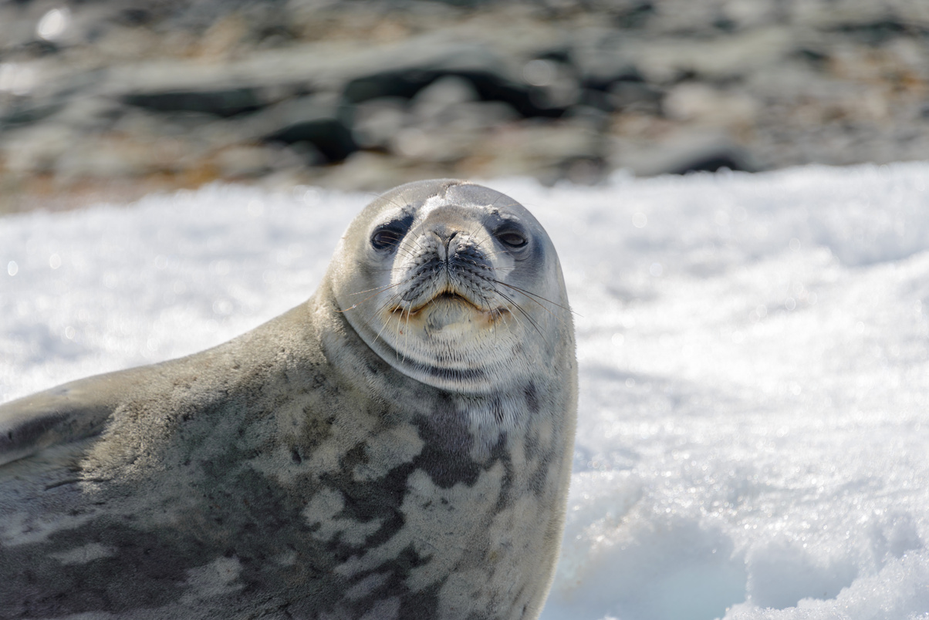
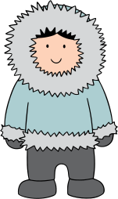
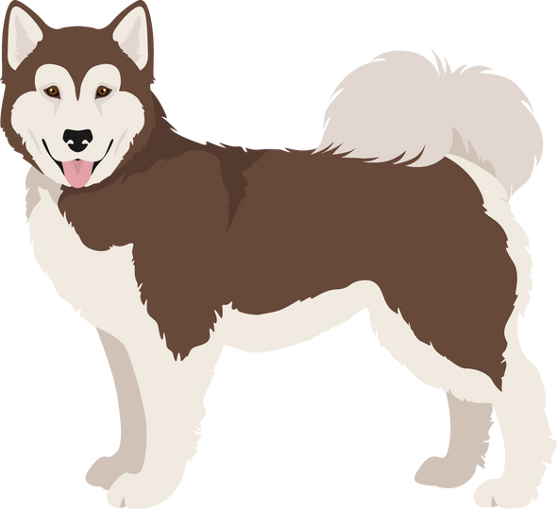
All mammals are able to be infected with rabies.
Mammals are warm-blooded animals that are not birds.
That means that you and your dog can be infected with rabies too!

Slide 9
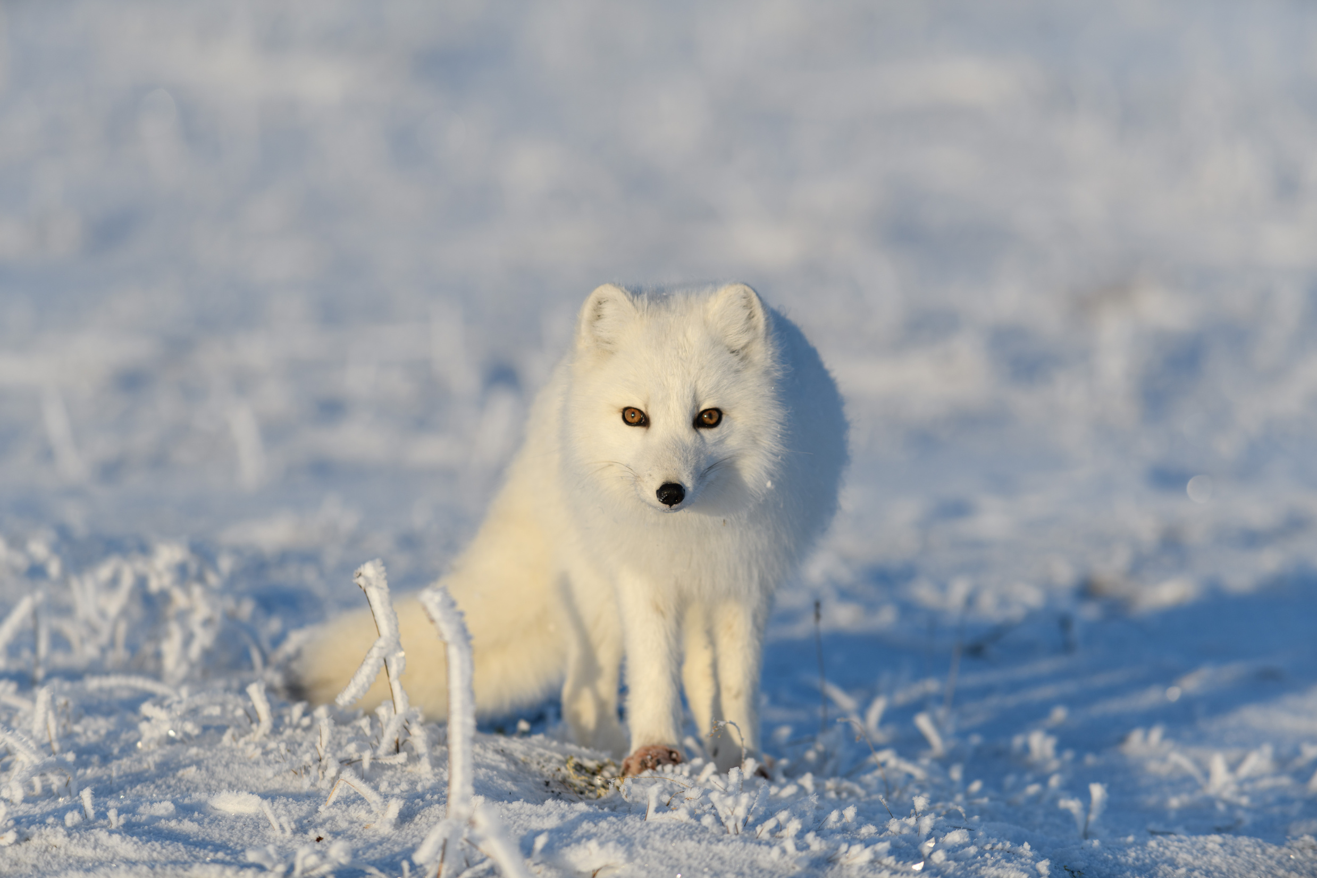
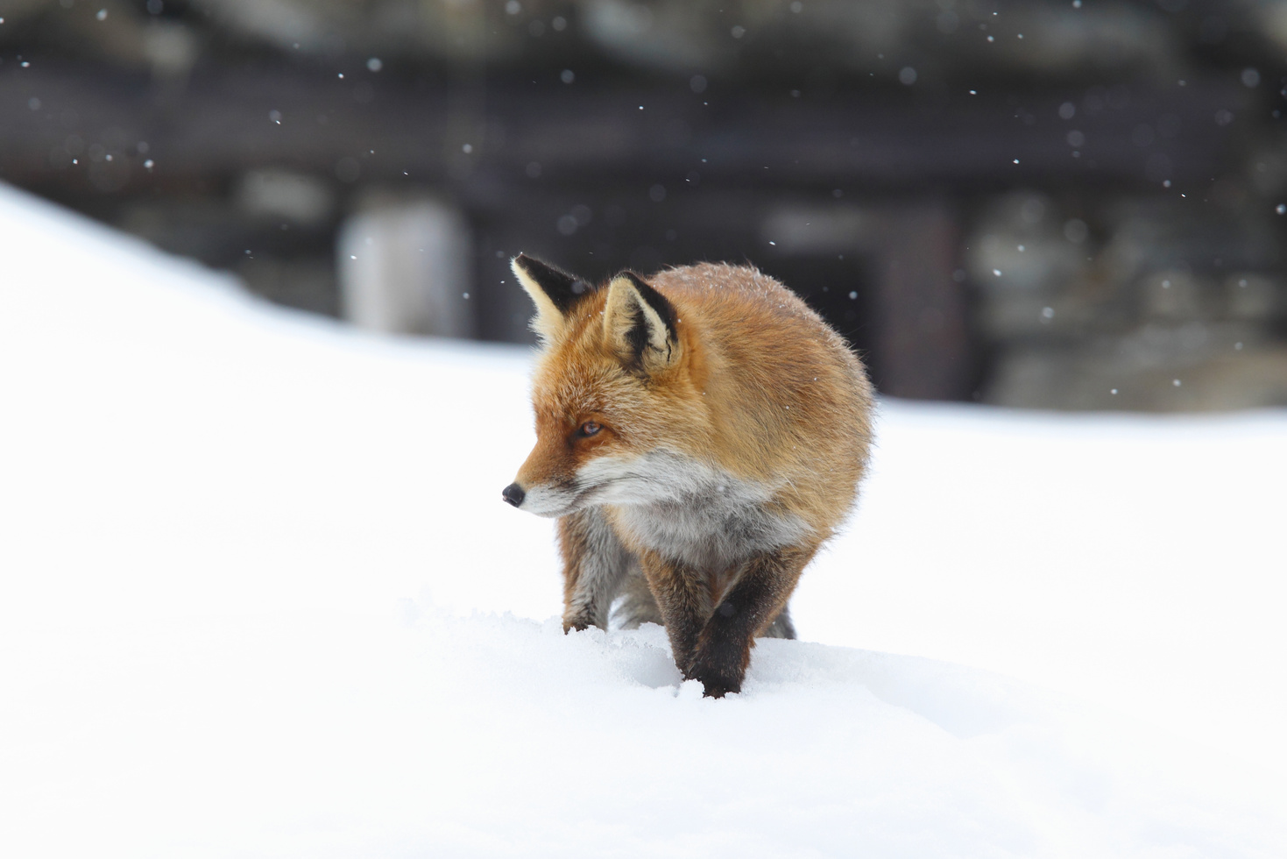
Primary Hosts
The primary carriers of rabies in Nunavut are Arctic foxe﻿s and red foxes.
Although possible, it is rare for other Nunavut mammals to have rabies.
Rabies in foxes is enzootic, which means that it regularly affects the fox populations.

Slide 10
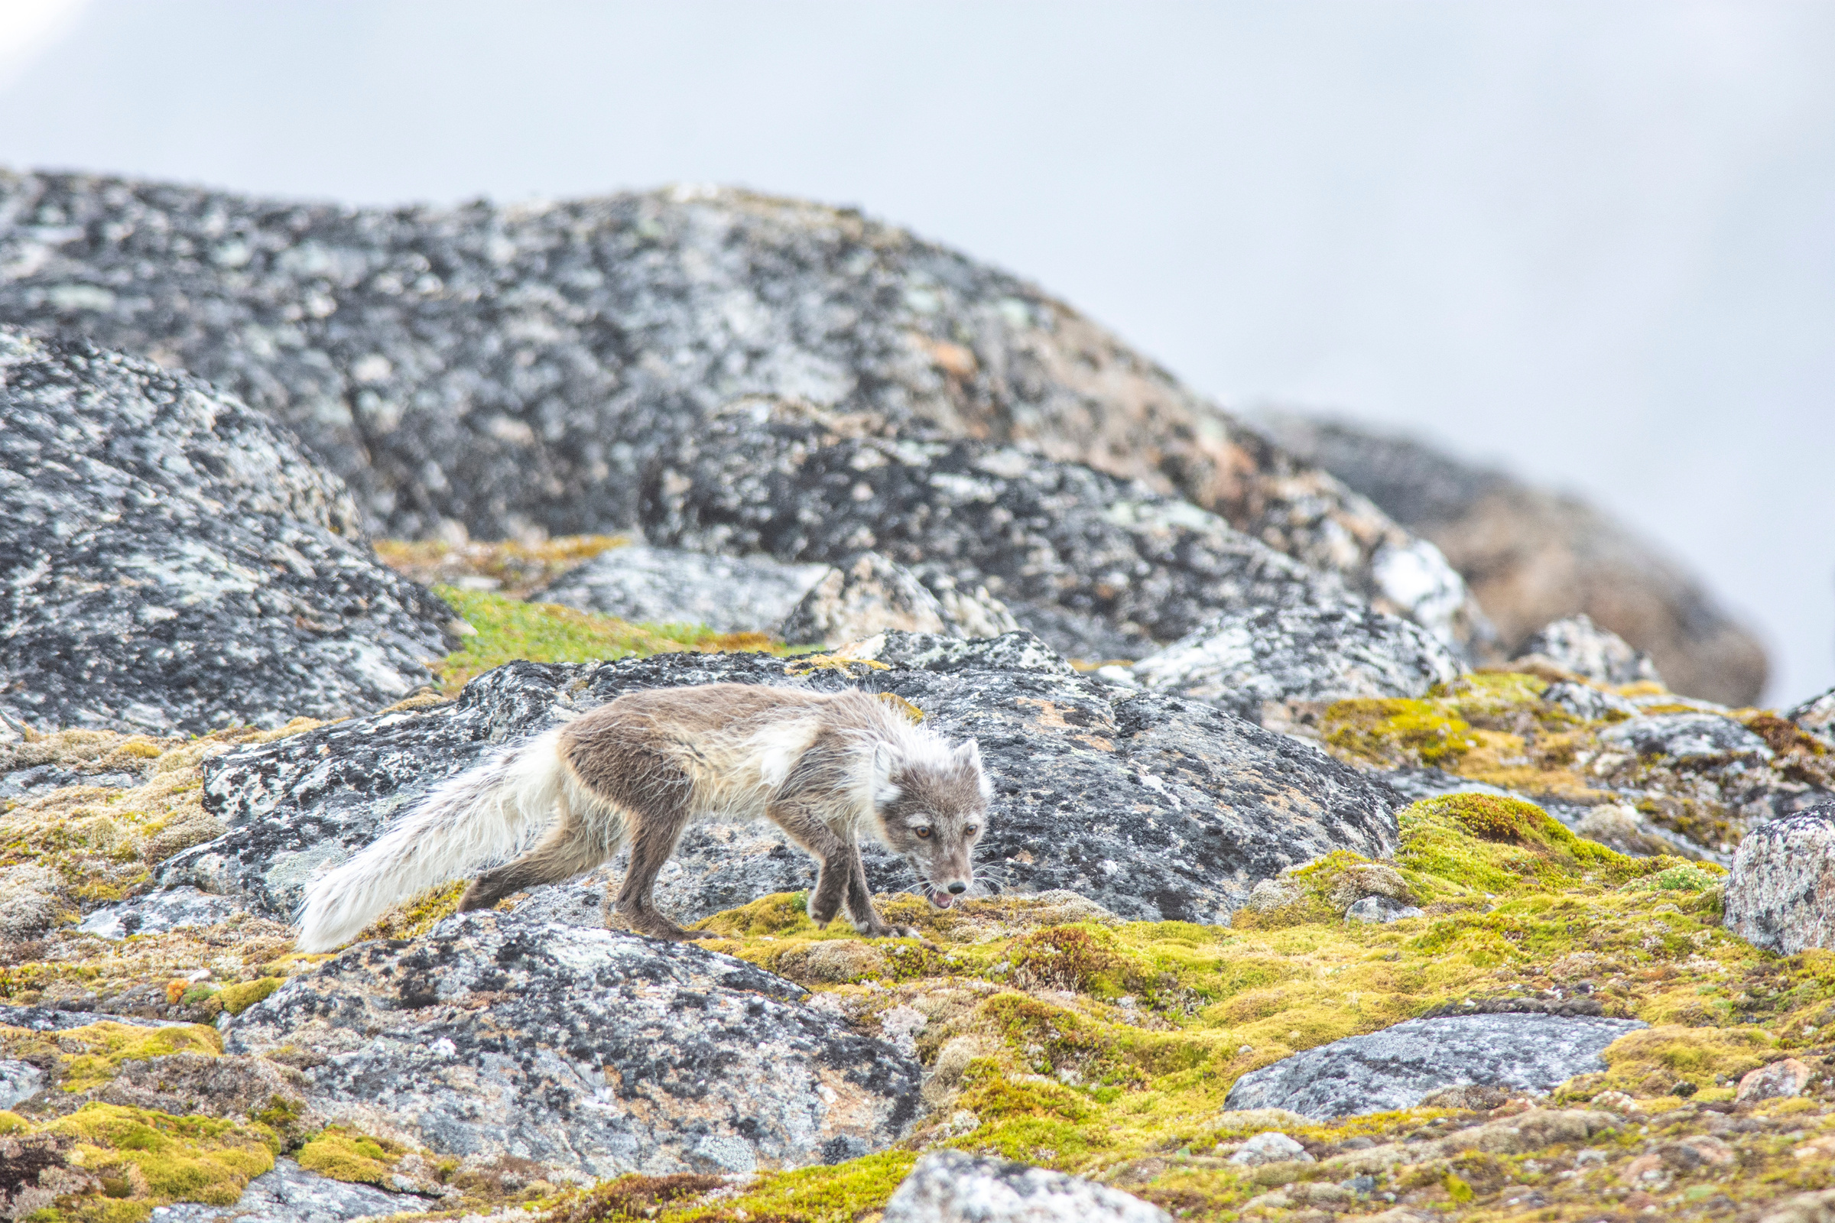

Discussion
Have you seen any foxes in or close to your community?

Slide 11


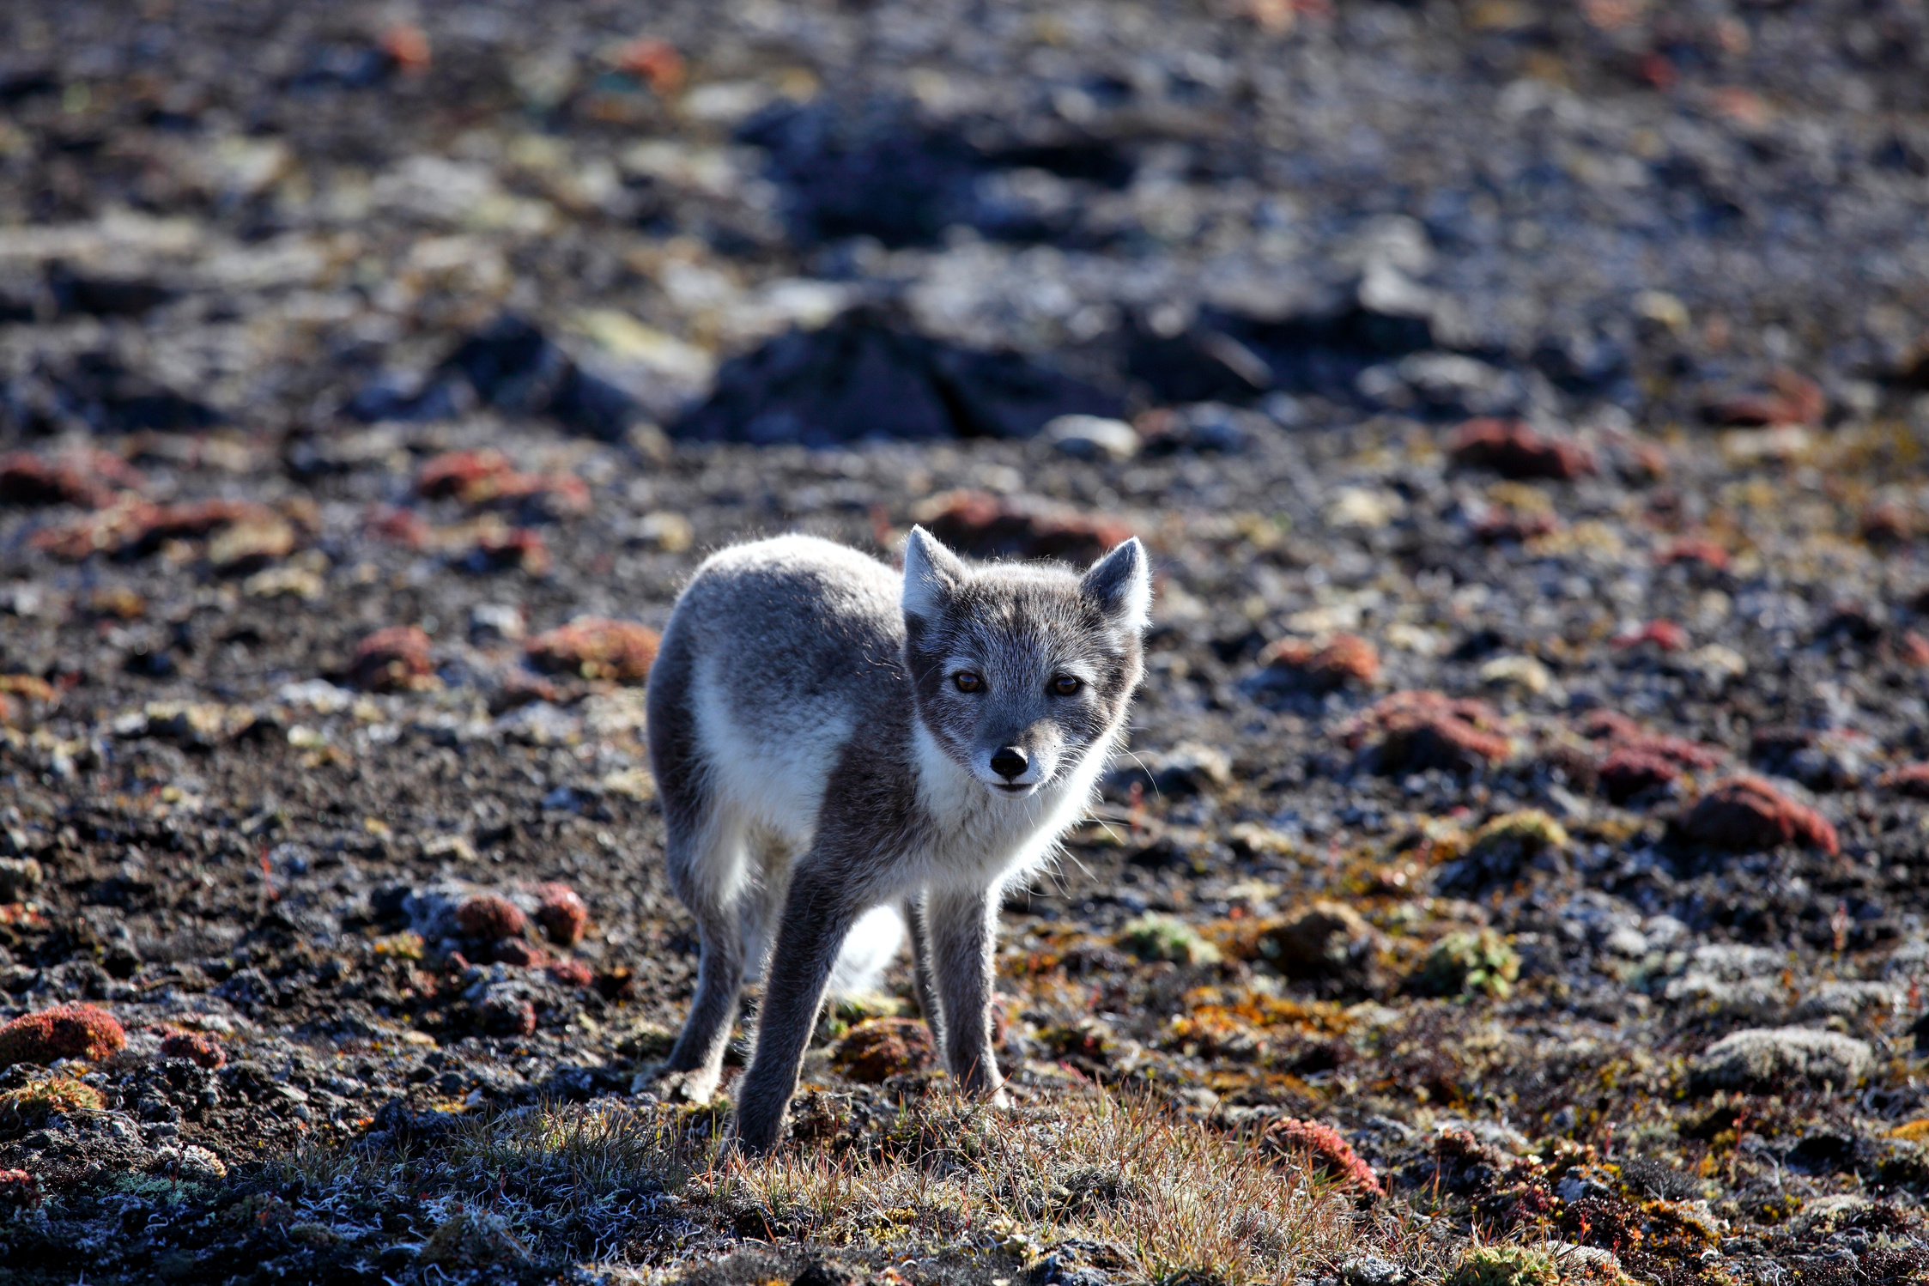
How would you know if a fox was infected with rabies?

Slide 12

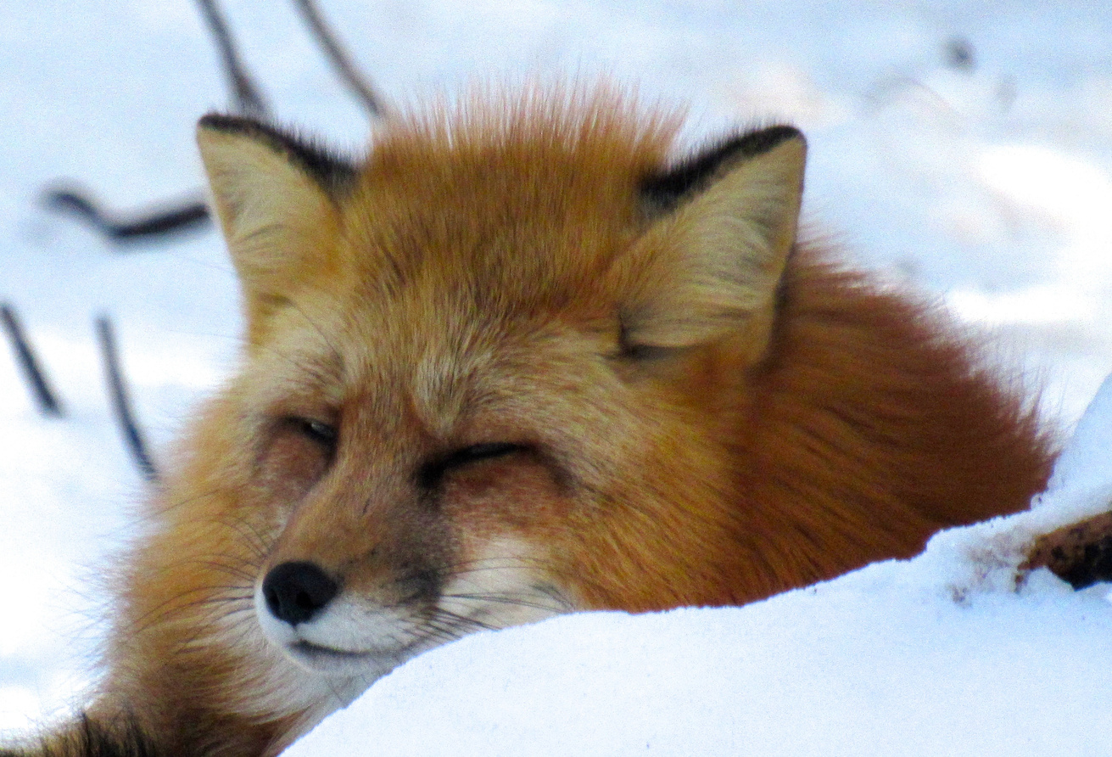
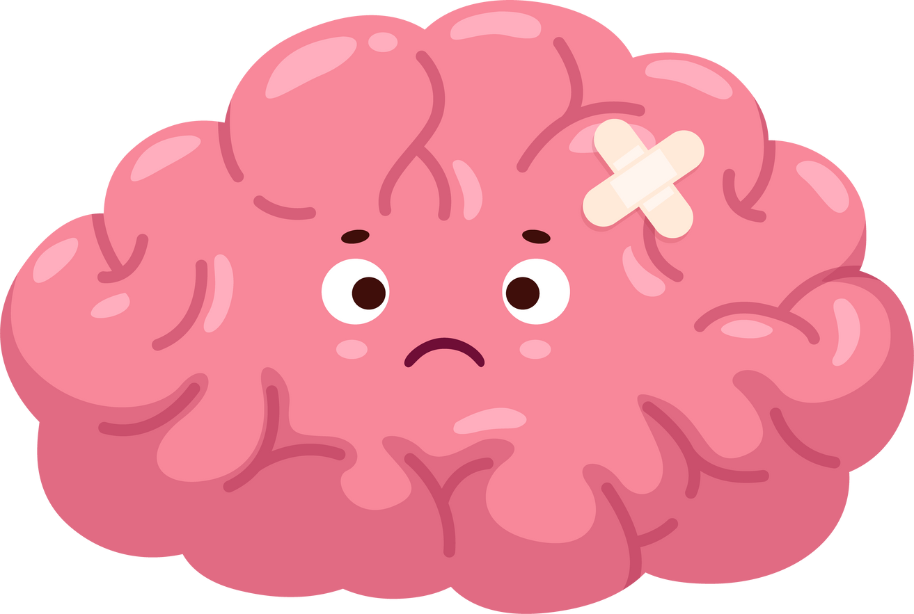
Signs of rabies
Foxes that have rabies may act differently than normal.
However, some foxes with rabies act normally. The only way to know for sure if a fox is infected with rabies is to kill it and send its brain for testing.
Signs of rabies show up in two main ways: “angry” rabies or “dumb” rabies.

Slide 13
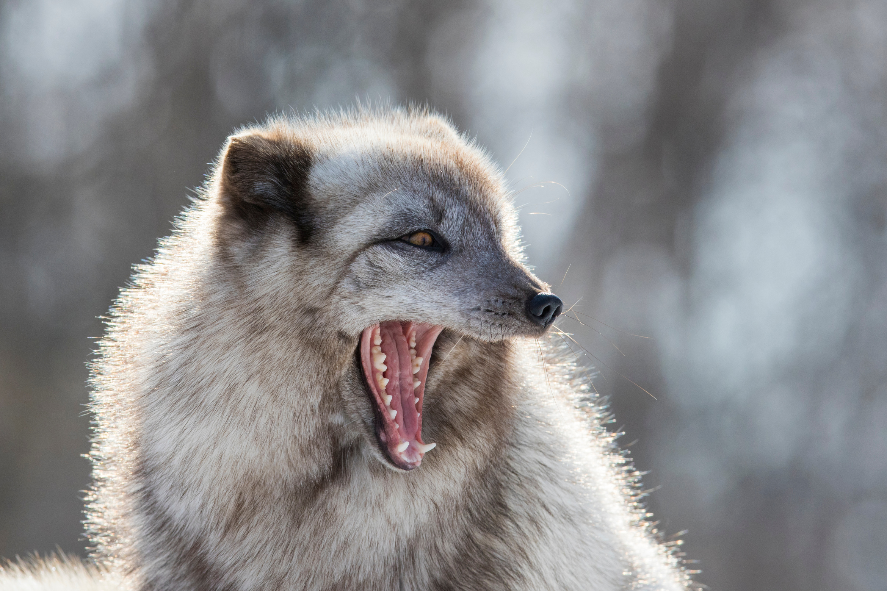

“Angry” Rabies
  act excited and aggressive
  attack other animals or objects without fear or reason
  bite or chew their own legs

Slide 14
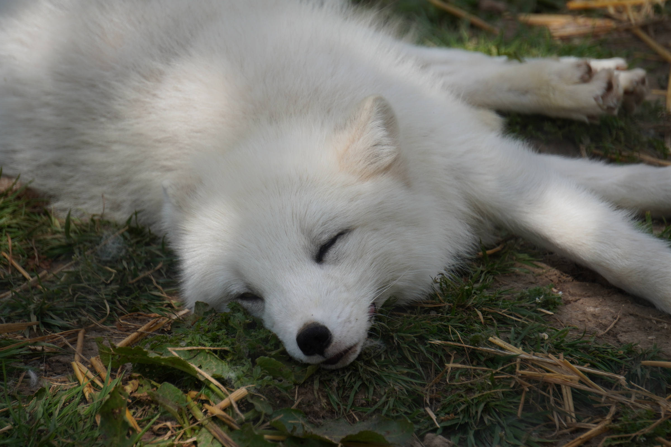
“Quiet” Rabies
  act confused, look groggy, and slow to react
  have difficulty walking
  drool or “foam” from their mouths
  lose their fear of humans and are unusually friendly

Slide 15
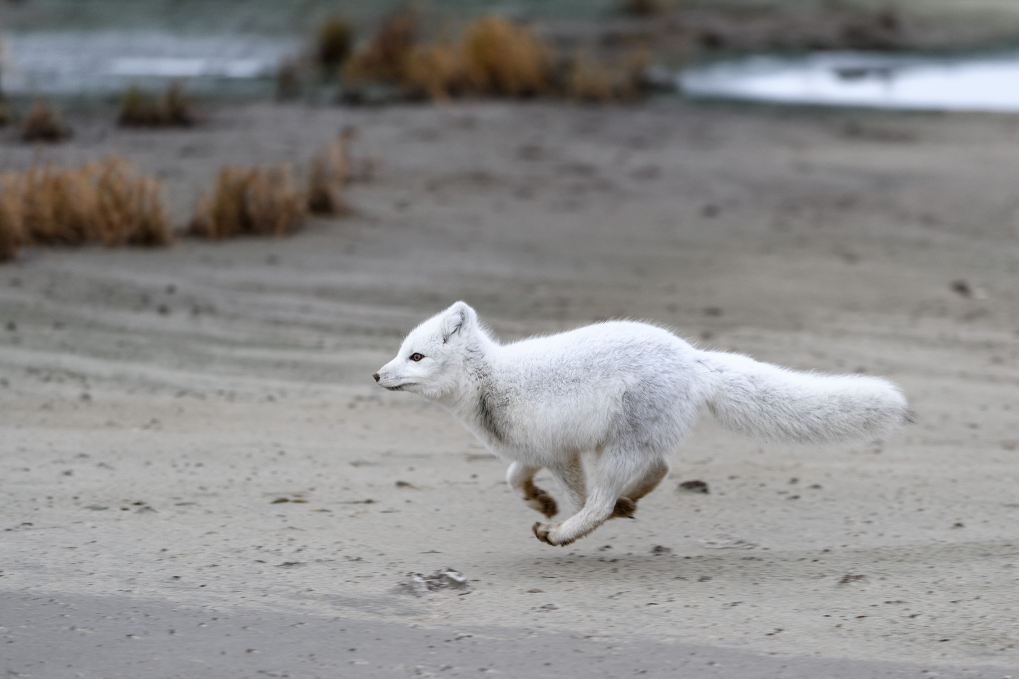
Movement Break

Slide 16
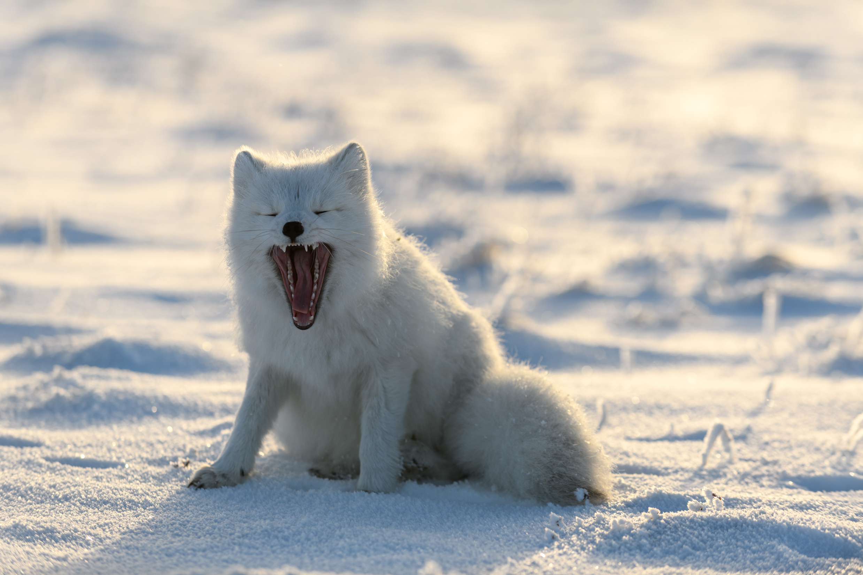
Staying Safe
If you see a fox in your community or a fox on the land acting strangely, it is important that you:
Stay away / don’t approach
Walk away slowly/ don’t run
Tell an adult or bylaw officer

Slide 17

Let’s practice!

